Slide 1

Qualitative Analysis of Spruce Budworm Outbreaks
by Ron Bassar

Slide 2
Fast Slow
Budworms Surface area of Predators Branches
Energy Reserve
Divide variables into fast and slow categories

Slide 3
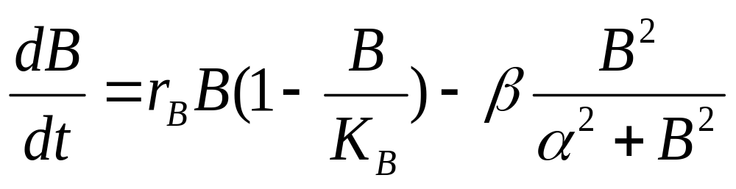
Budworm Growth Equation

Slide 4
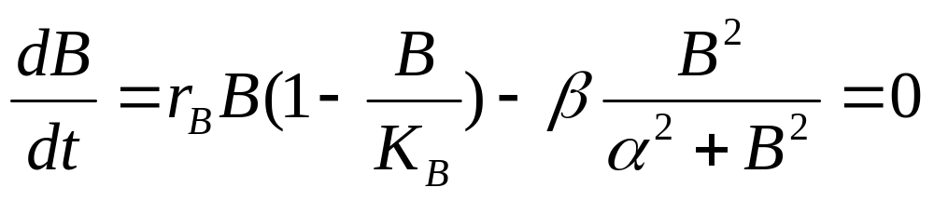
Finding Equilibrium Points

Slide 5
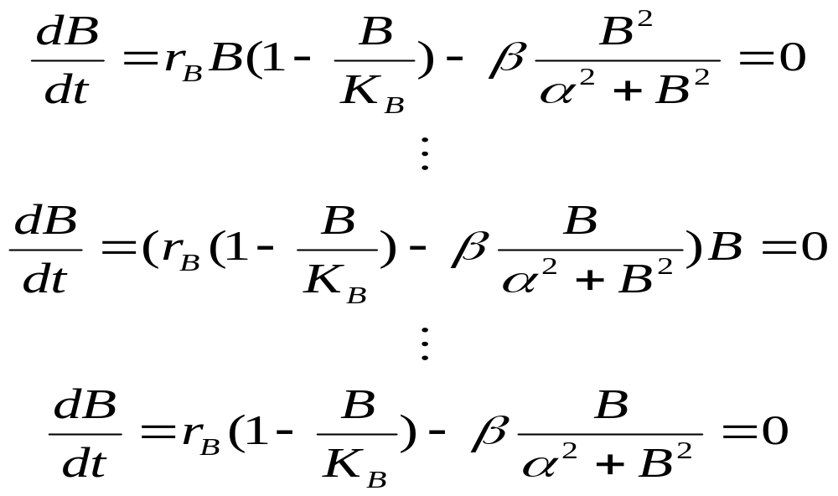
B=0 is an Equilibrium Point

Slide 6
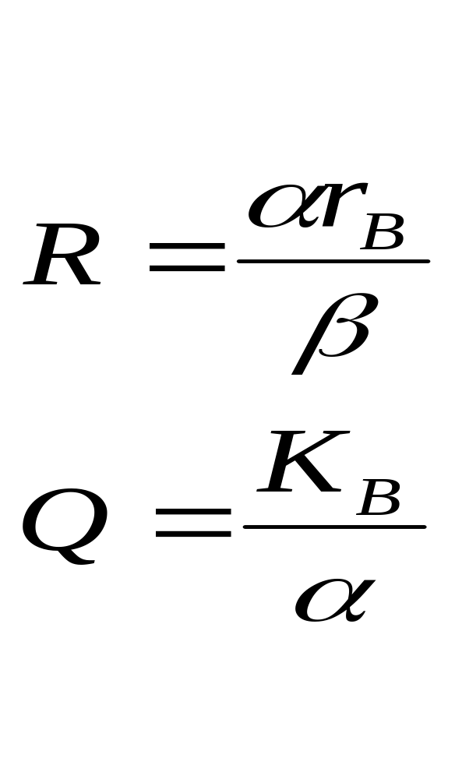
Dimensionless Parameters

Slide 7
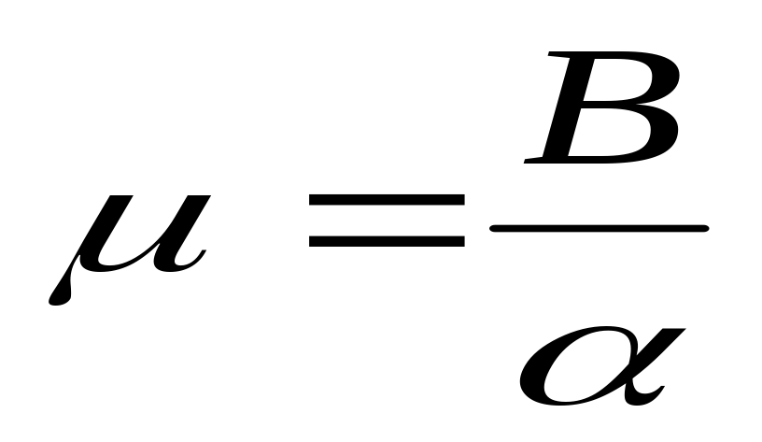
Dimensionless Variable

Slide 8
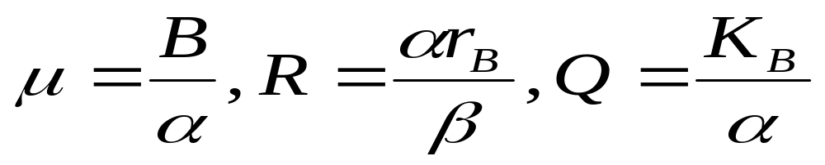
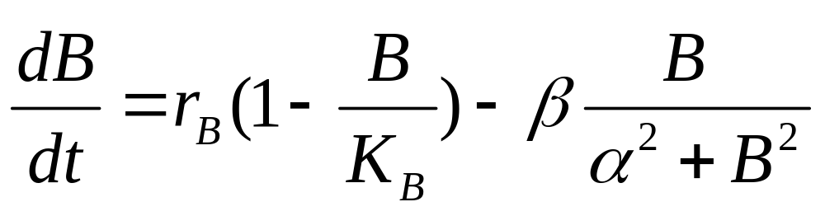
Dimensionless Means No Units

Slide 9
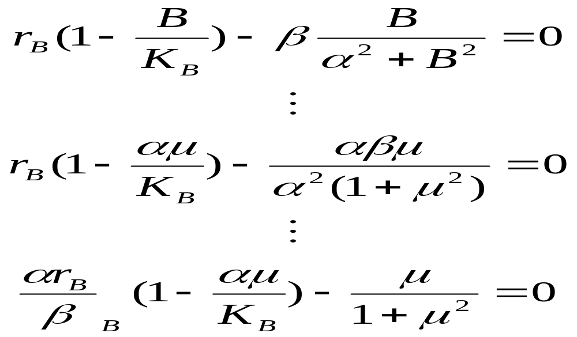
Grouping of Parameters in the Equation

Slide 10
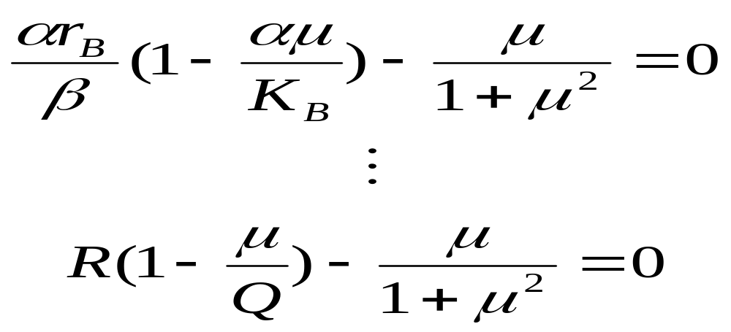
Sub in Dimensionless Parameters

Slide 11
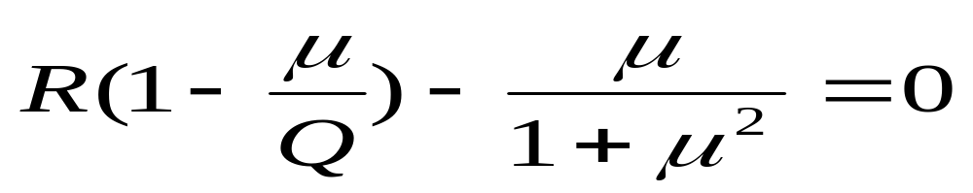
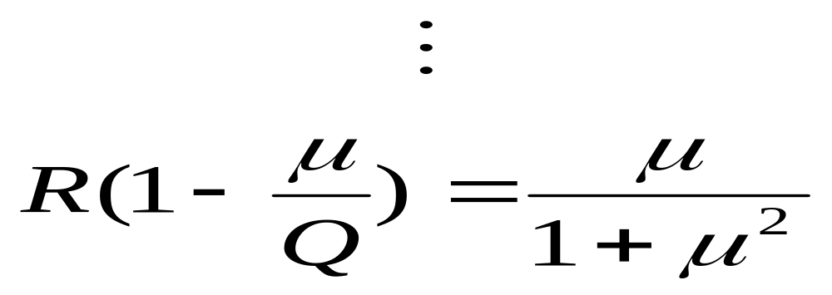
Per Capita Death and Growth Rates in Terms of the Dimensionless Variables

Slide 12
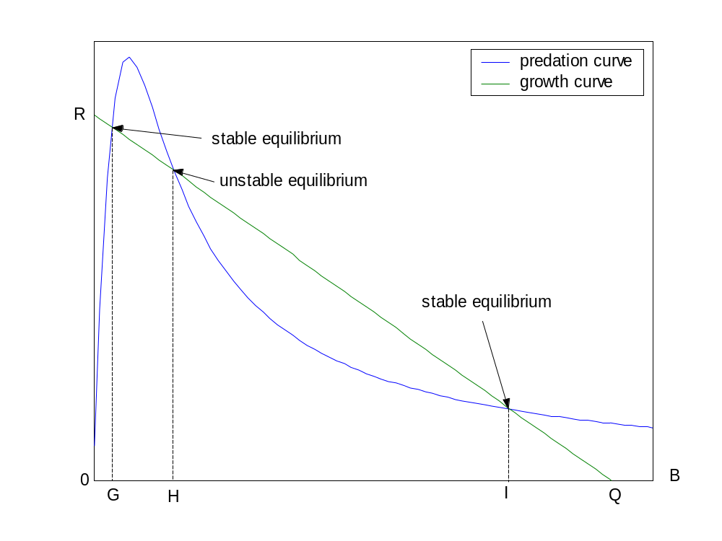
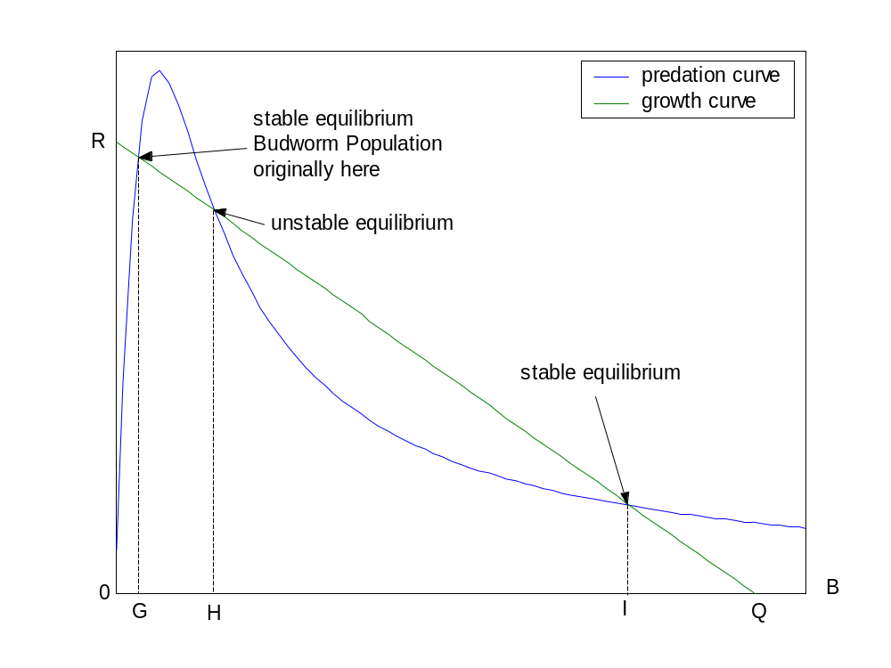
Predation and Growth Curves Plotted vs. Budworm Density

Slide 13
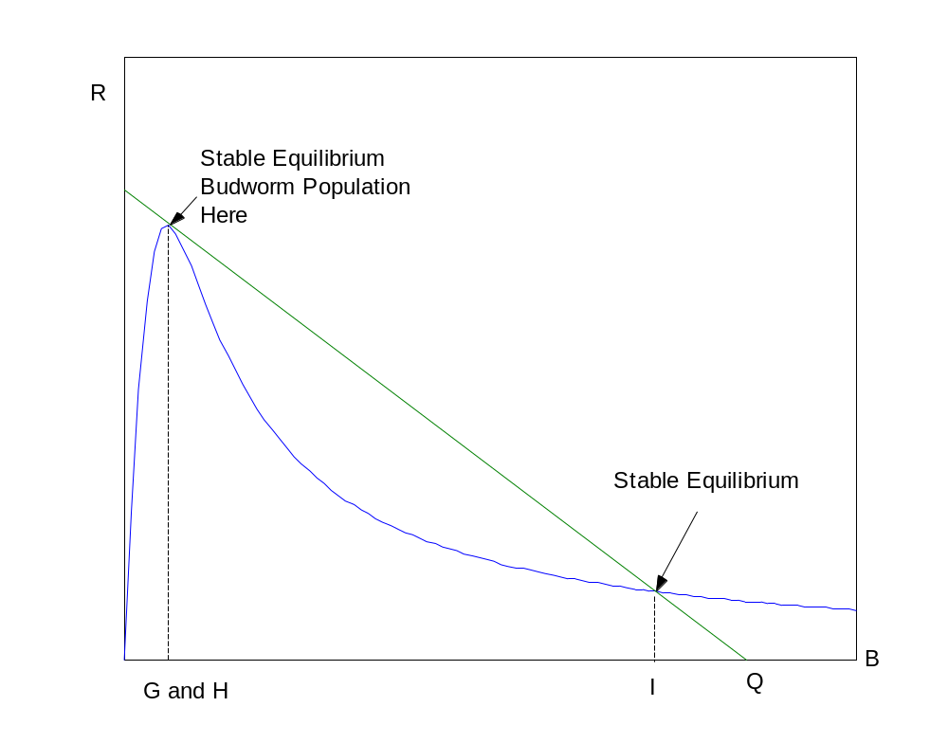
R Increases to Point Where G and H Coalesce

Slide 14
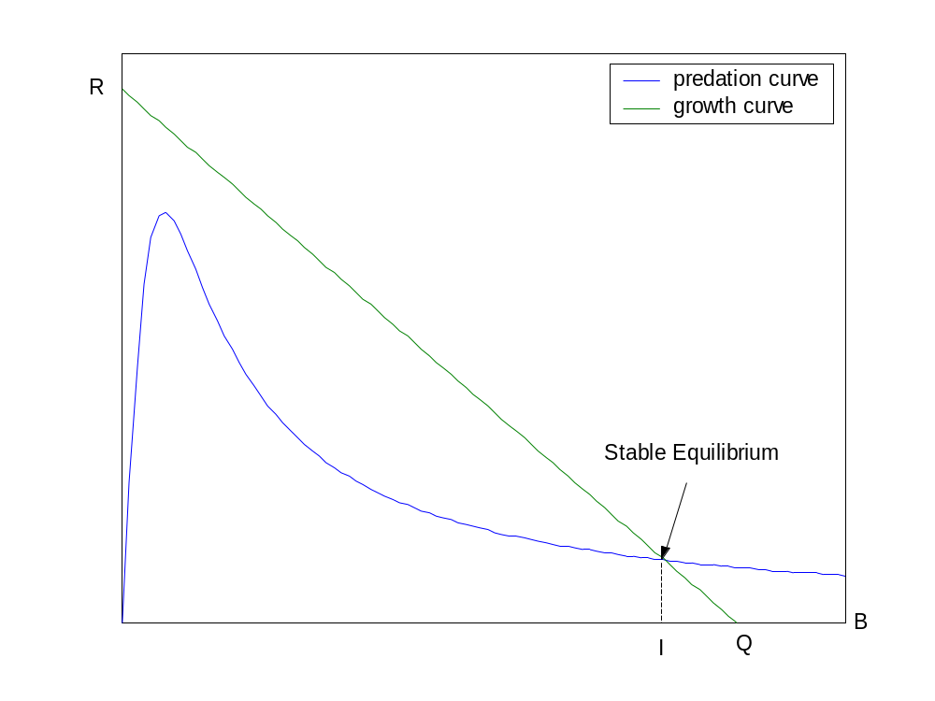
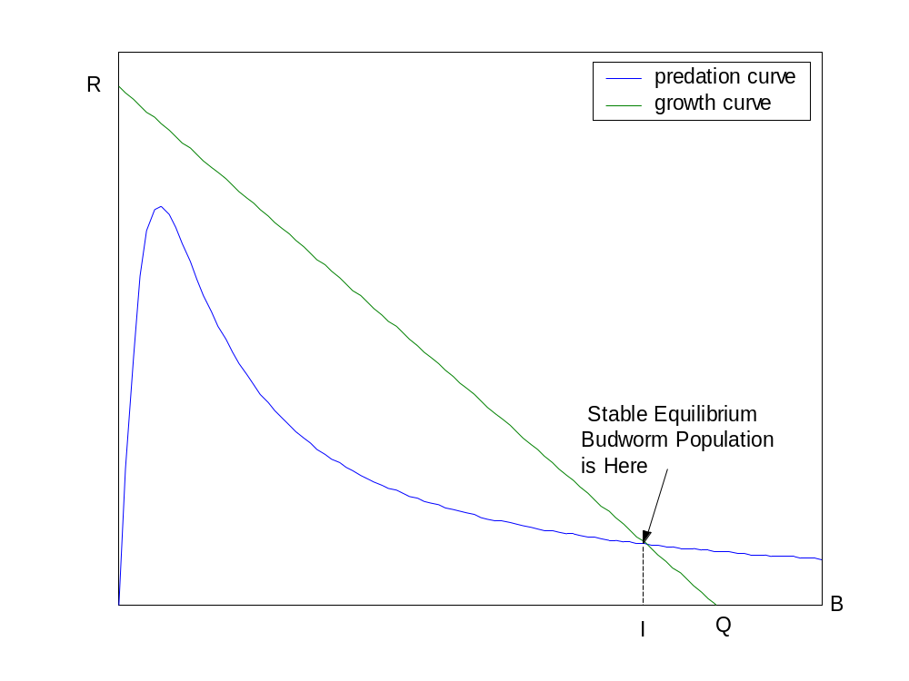
Equilibria disappear as R increases and Budworm Population jumps to I

Slide 15
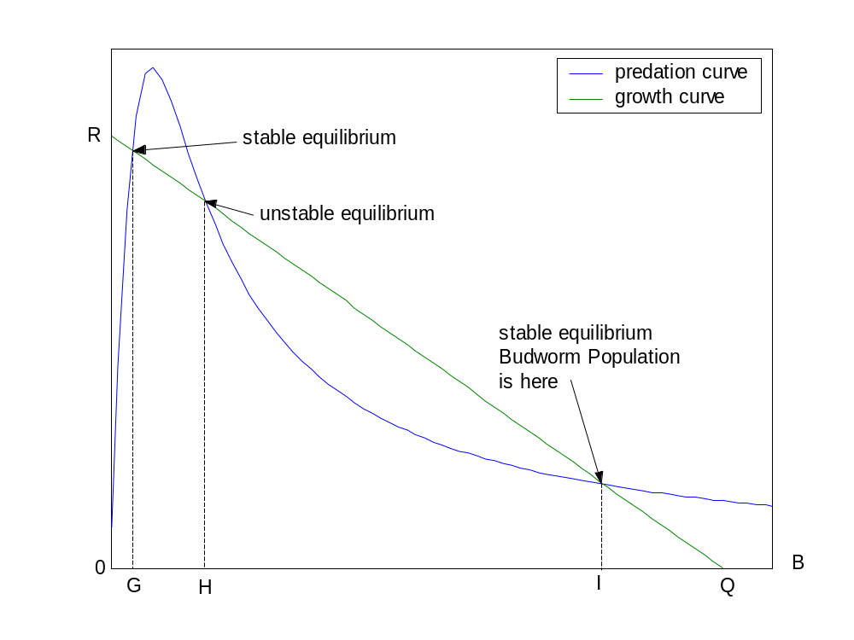
If R Decreases Population Remains at I

Slide 16
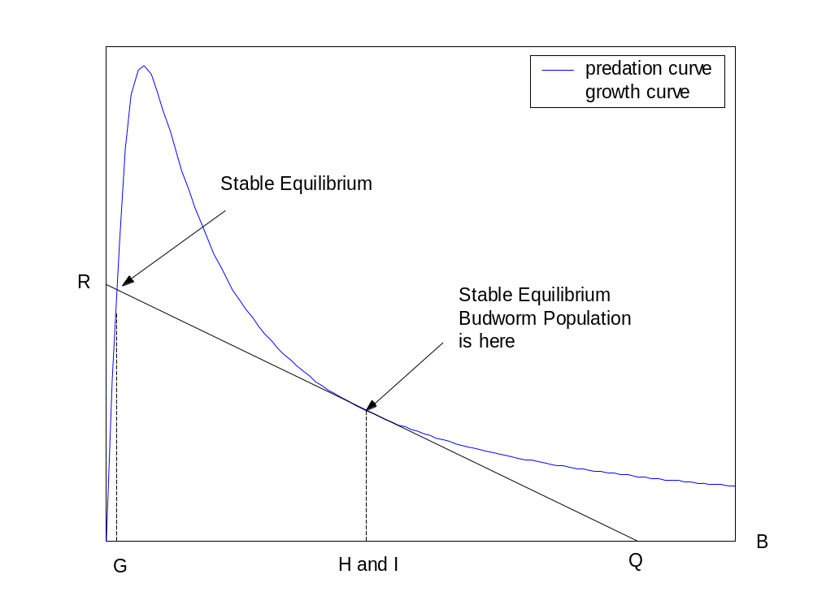
Still at I

Slide 17
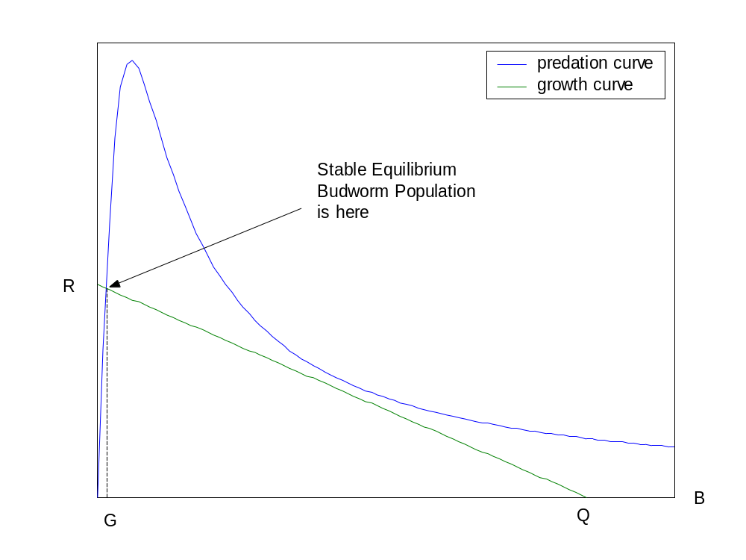
Population Jumps to G as R Continues to Decrease

Slide 18
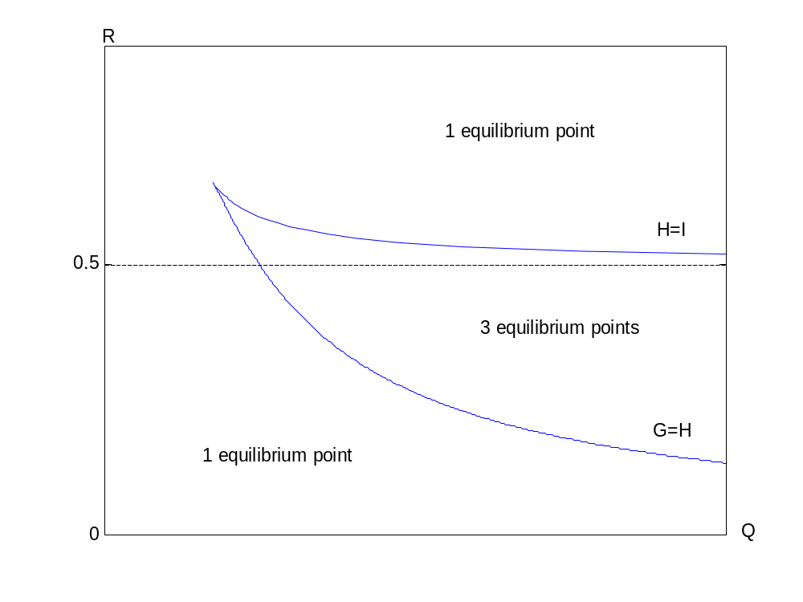
Bifurcation Curves

Slide 19
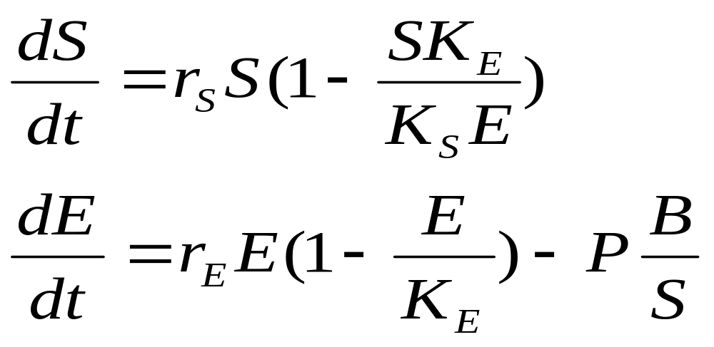
Equations of Branch Surface Area and Energy Reserve

Slide 20
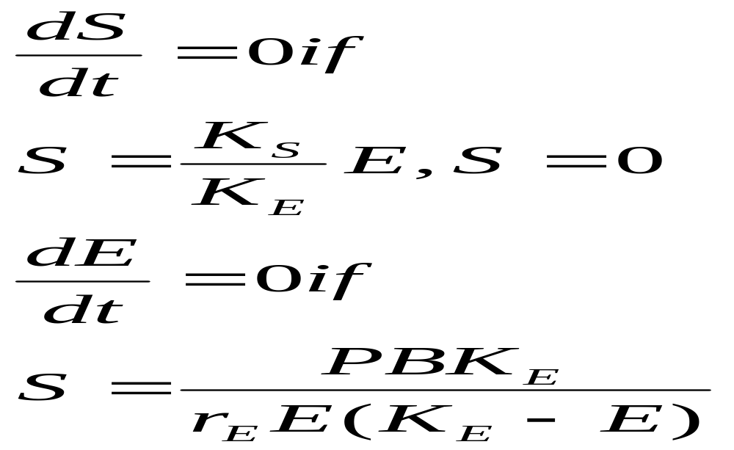
Equilibrium Points of S and E

Slide 21
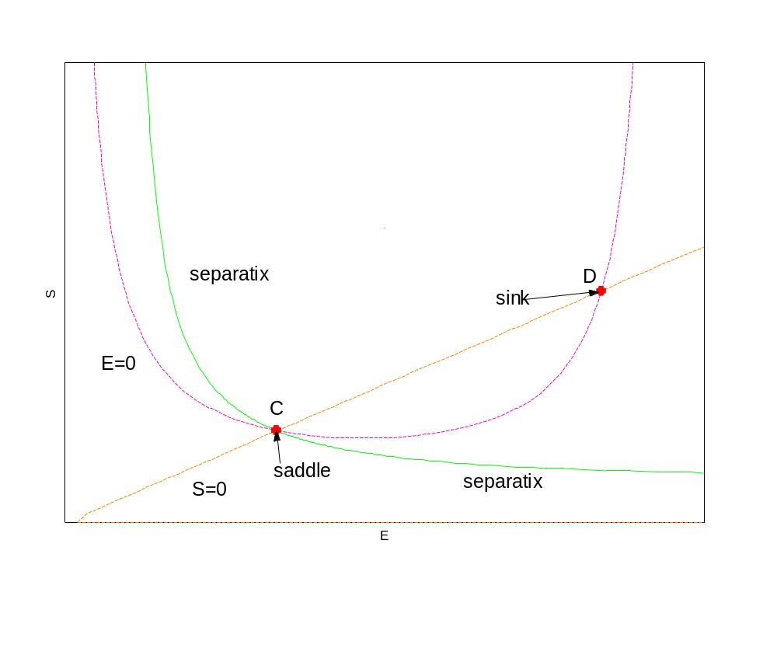
Analysis of Slow Variables

