Slide 1
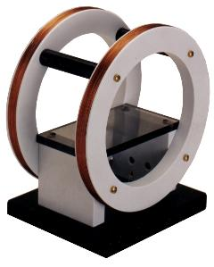

Forced Oscillations and Magnetic
Resonance

Slide 2

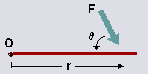

A Quick Lesson in Rotational Physics:
TORQUE is a measure of how much a force acting on an object
causes that object to rotate.
Moment of Inertia, I, is the rotational analogue to mass.
Angular acceleration, , is the second derivative of angular position.

Slide 3
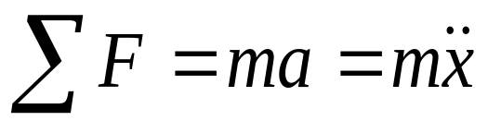
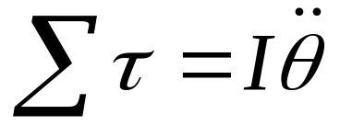
Newton’s Second Law of Motion:
Rotational Equivalent of Newton’s Second law:
Where: τ is the torque
I is the moment of inertia
is the angular acceleration

Slide 4
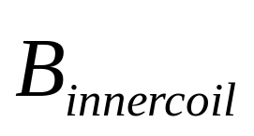
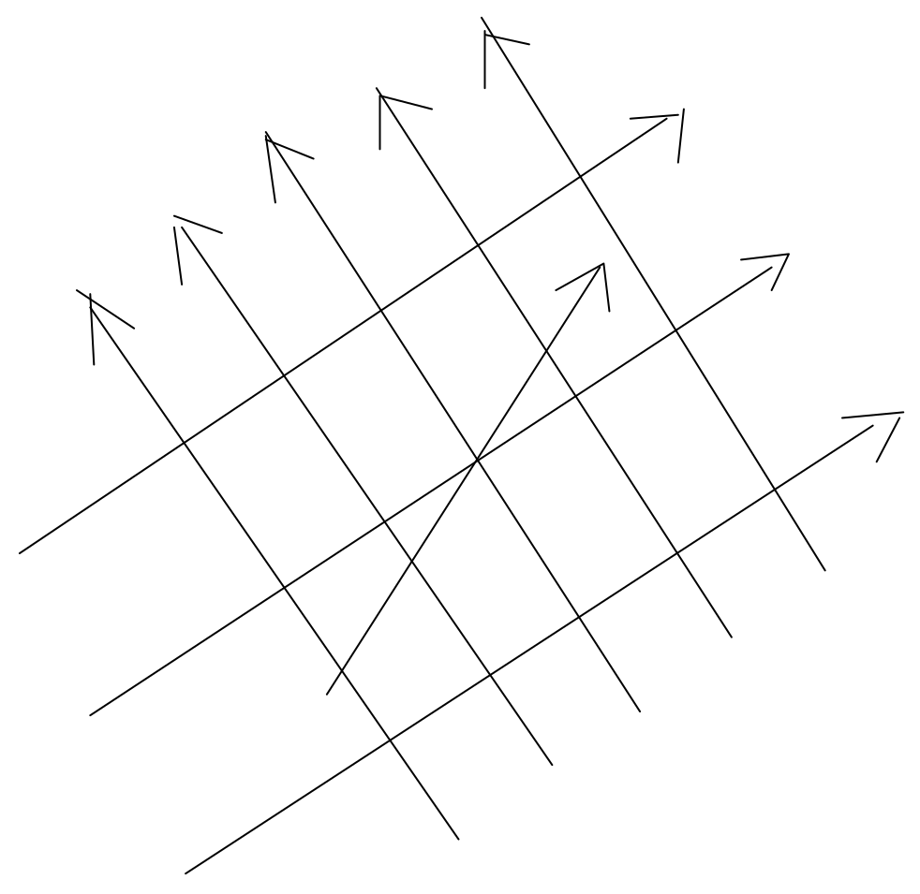
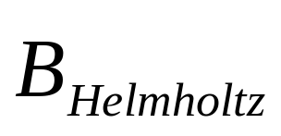

Diagram of the magnetic field due to both coils, along with the
angle associated with the angular displacement from equilibrium.

Slide 5
There are three forces acting on the compass
needle:
1) magnetic force due to Helmholtz coils
2) magnetic force due to inner coils
3) damping force due to friction between the
compass needle and the holding pin
Since we are dealing with rotational motion,
these forces are actually torques.

Slide 6
Constants and Variables
B = magnetic induction due to Helmholtz coils
β = damping constant
F = amplitude of the driving field
ω = the driving frequency
μ = dipole moment of the compass needle
I = rotational inertia of the compass needle
θ = angular displacement from equilibrium

Slide 7
Newton’s Second Law of Motion
(rotational)
τ_{net} = τ_{driving field} + τ_{restoring} + τ_{damping}

Slide 8
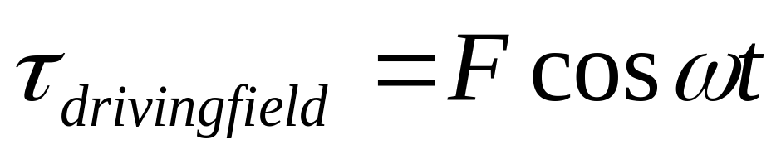
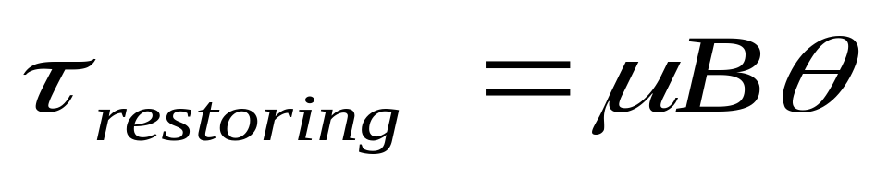
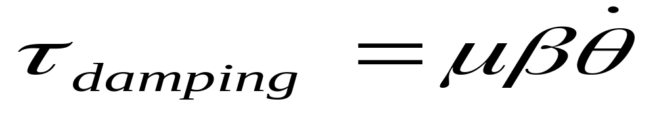
The torque due to the driving field is:
The torque due to the restoring field is:
The torque due to the damping force is:

Slide 9
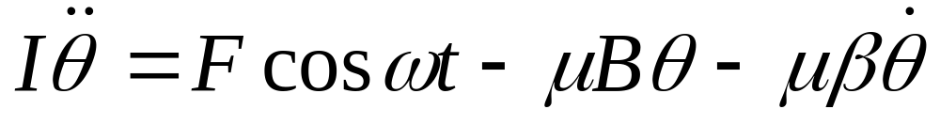
The Second Order Differential Equation
Which corresponds to Newton’s Second Law of Motion:
τ_{net} = τ_{driving field} + τ_{restoring} + τ_{damping}

Slide 10
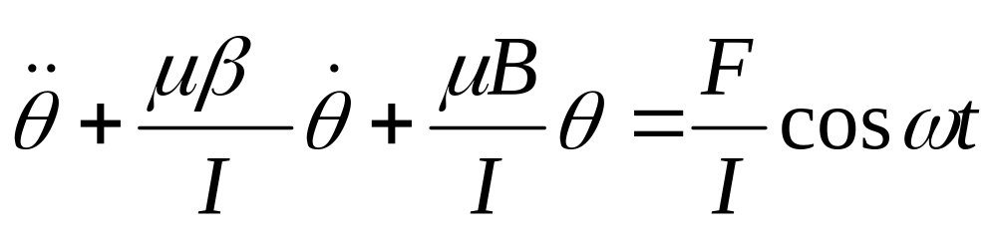
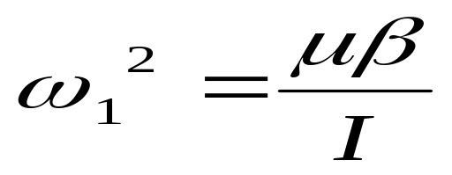
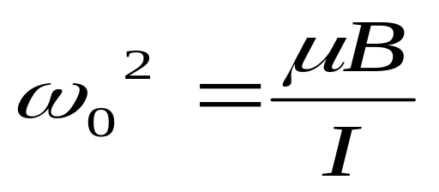
Dividing through by I, the rotational inertia, and rearranging
gives:
then we let...

Slide 11
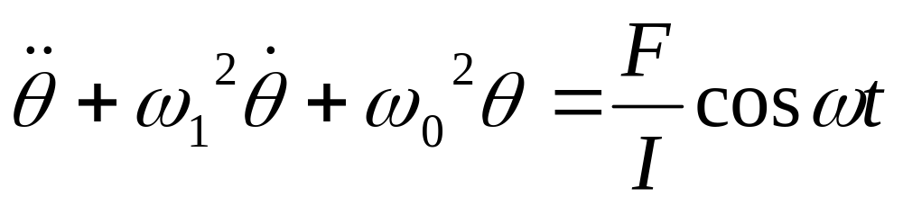
Substituting ω₀² and ω₁² into the differential equation yields:

Slide 12
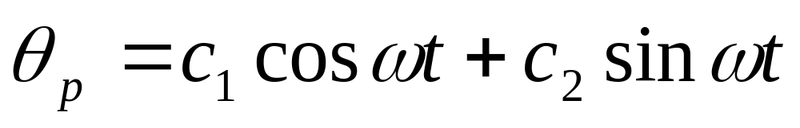
We assume a particular solution:
Since we are dealing with a oscillatory function it makes sense
to assume the most general oscillatory solution involving the
two oscillatory functions, sin and cos.

Slide 13
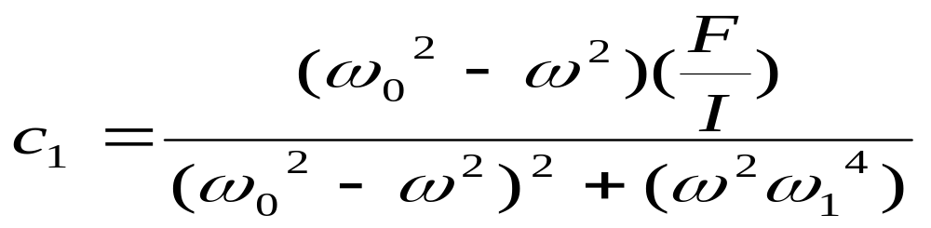
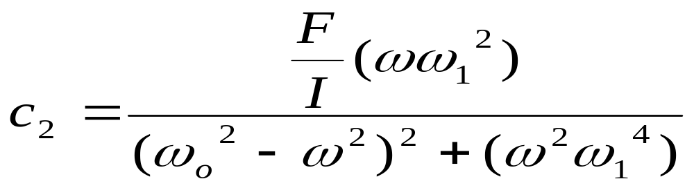
Solving for c₁ and c₂ we get:

Slide 14
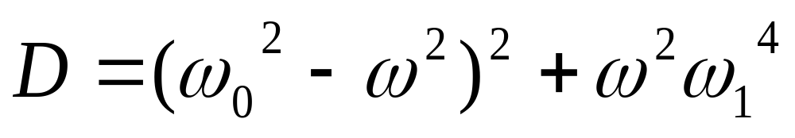
Letting:
This is the denominator of the c₁ and c₂ solutions

Slide 15
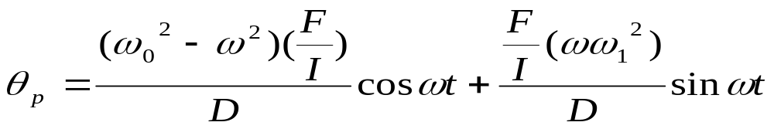
Further calculations lead us to the following equation:

Slide 16
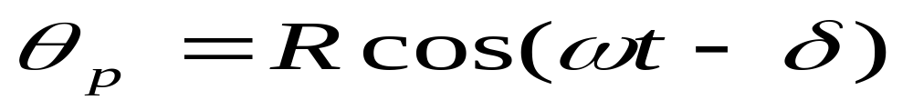
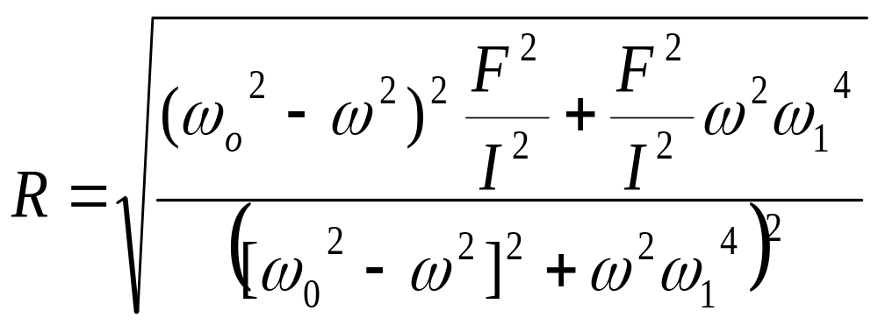
We can rewrite the particular equation, by
using some simple trigonometry:
where

Slide 17
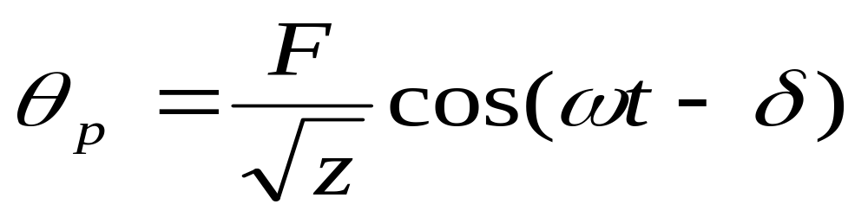
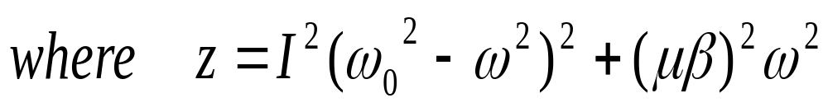
Through further calculations we can rewrite our
particular solution in terms of amplitude of the
driving field:
We want to do this, in order to use our experimental data
directly in the equation. The ratio in front of the cosine function
is the amplitude of the compass needle.

Slide 18
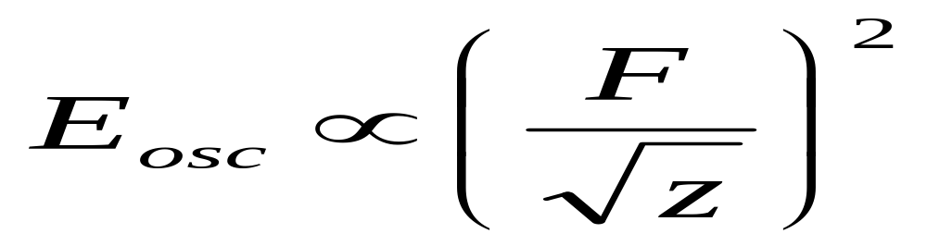
Let’s introduce a new relationship,
With any kind of wave motion the relationship of the oscillatory
energy is directly proportional to the square of the amplitude of
the motion.

Slide 19
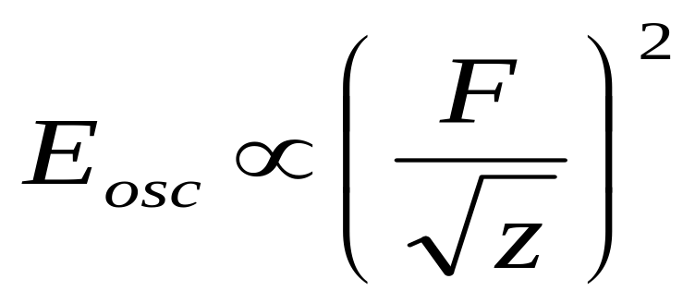
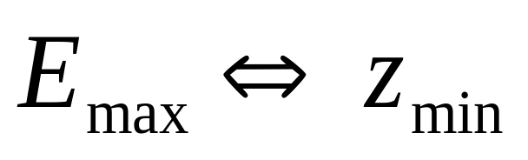
F which is the amplitude of the driving field, remains constant,
thus the relationship
can lead us to the conclusion:
In other words, when z is at a minimum, the oscillatory energy
of the compass needle is at a maximum

Slide 20
-When we take the derivative of z and set it equal to
zero, that is when z is at a minimum.
-When z is at a minimum, E, oscillatory energy, is at
a maximum.
-When E is at a maximum, the deflection of the
compass needle is at a maximum, and we get
resonance.

Slide 21
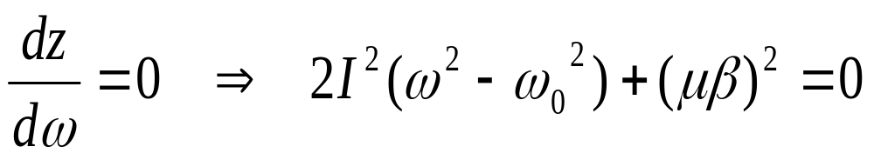
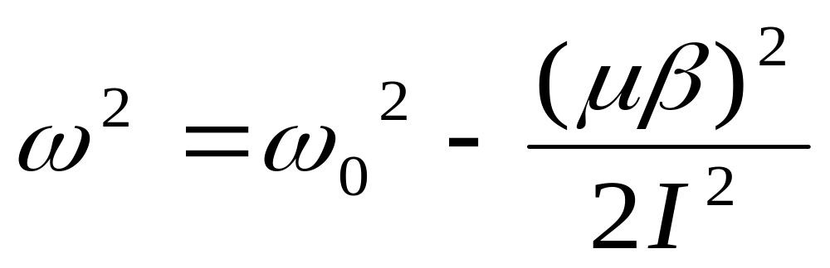
When solved for ω² will yield:

Slide 22
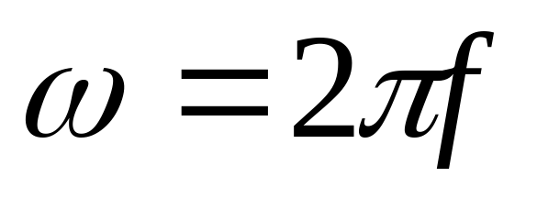
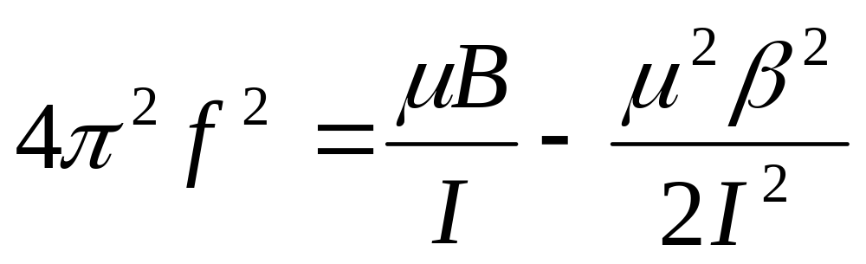
Using the fact that
We can make a substitution and come up with:

Slide 23
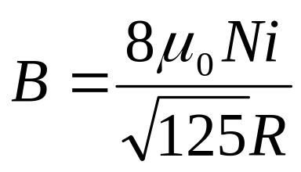
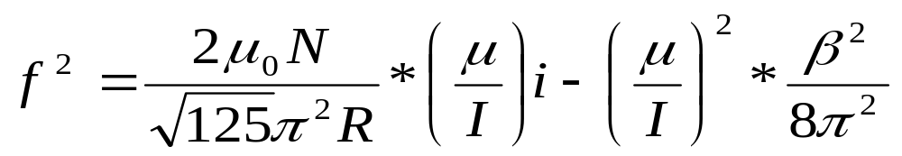
Rearranging and making the substitution
Gives us the final equation

Slide 24
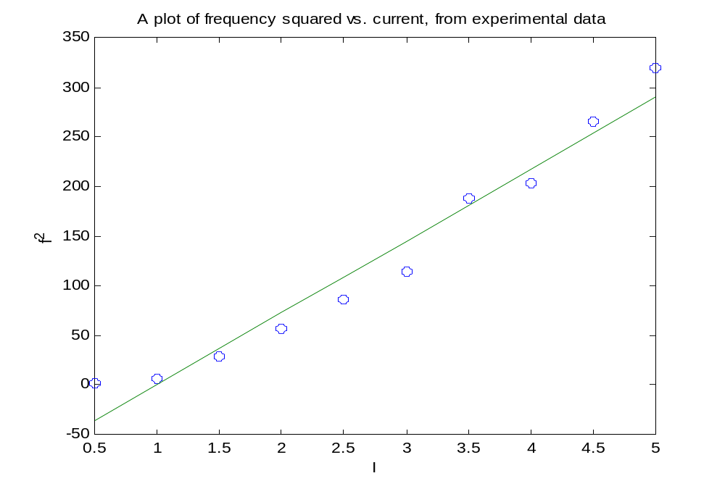
The following graph was generated from experimental data:

Slide 25
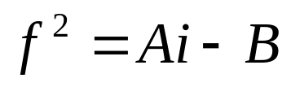


The graph is a line with the equation in the form of
Where f² is the frequency measured, i is the current measured,
A is the slope of the graph which is directly proportional to the
ratio , and B is the y-intercept which is directly proportional
to
Thus, we now can determine from our experimental data that the
magnetic dipole moment-rotational inertia ratio to be
3.66 * 10^6, and the damping constant 2.03 * 10^-5 .

Slide 26
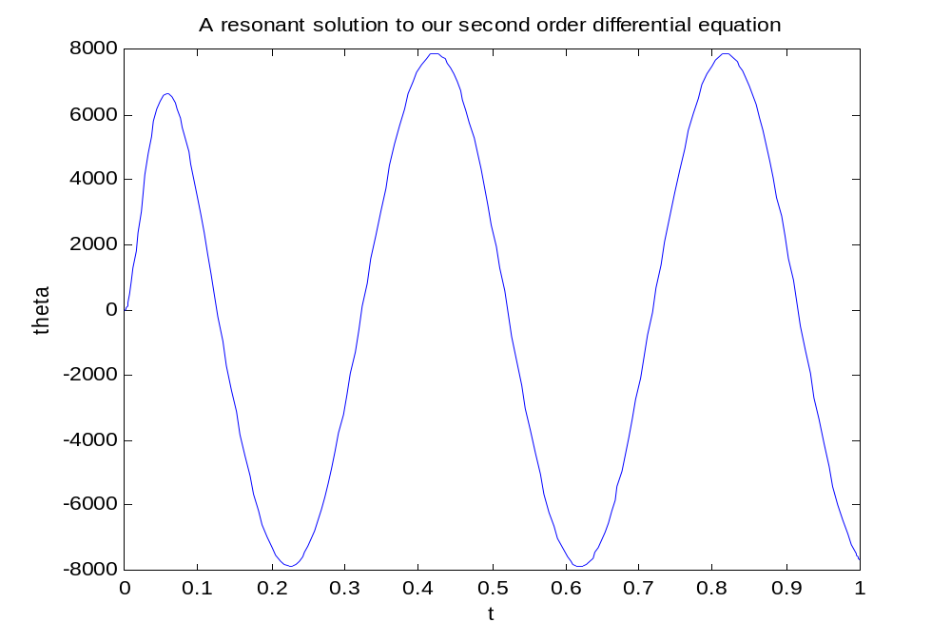
(Current used 1A)

Slide 27
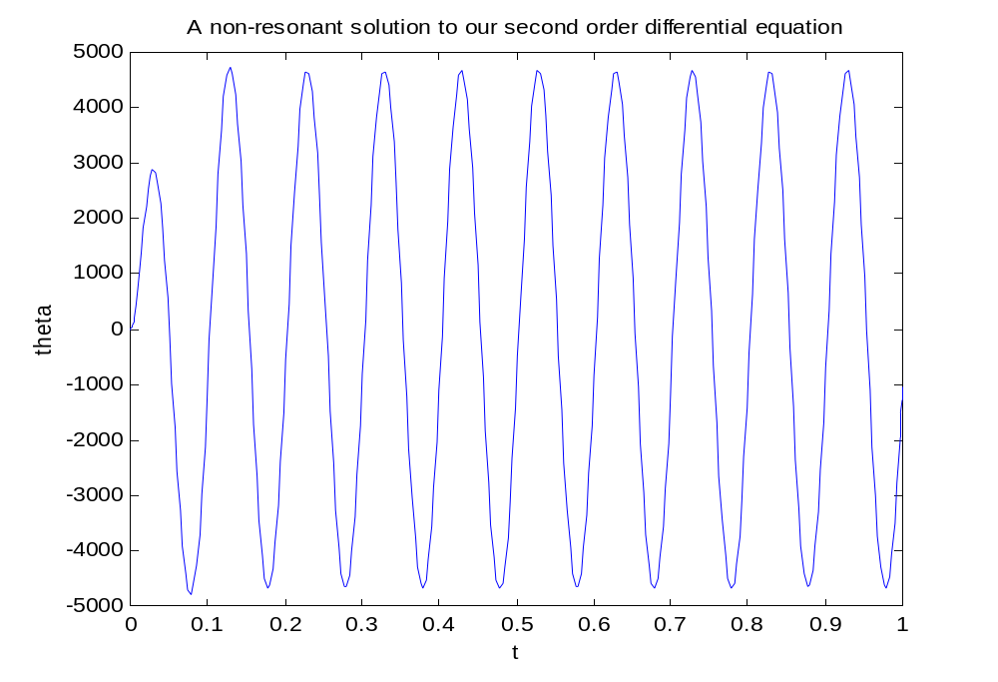
(Current used 1A)

Slide 28
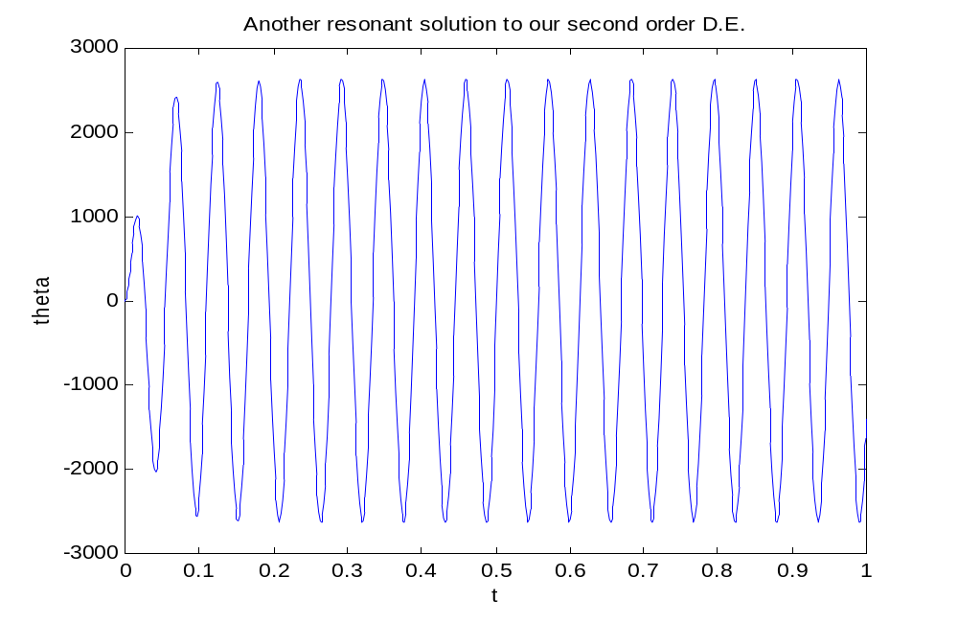
(Current used 5A)

Slide 29
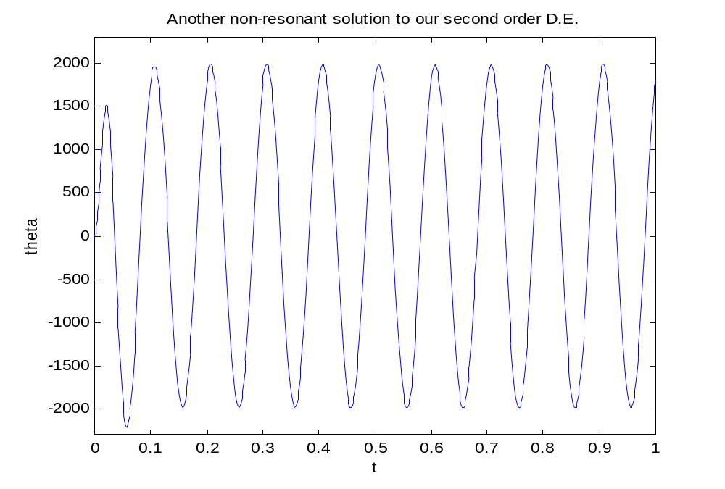
(Current used 5A)

Slide 30
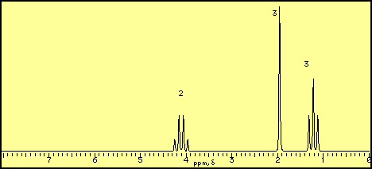
The NMR for ethyl acetate, C₄H₈O₂:

