Slide 1

The Spring Pendulum
By Nick Whitman

Slide 2
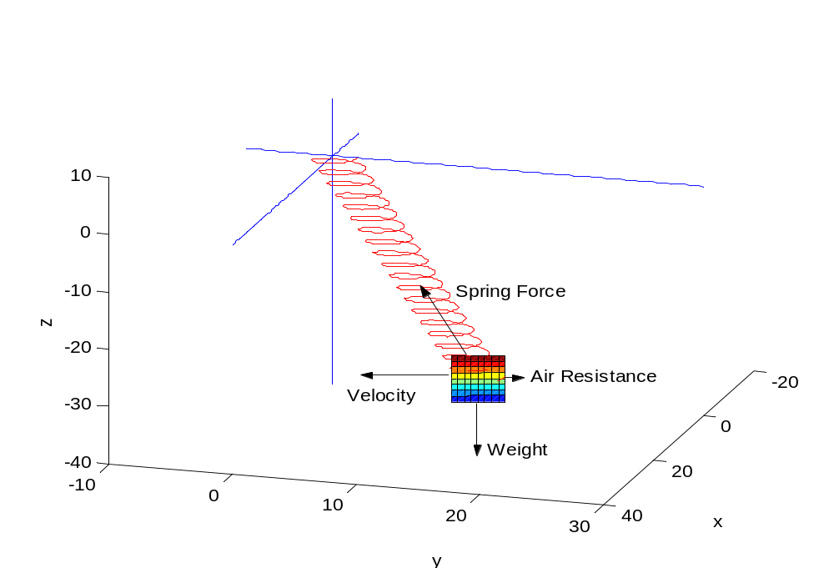
A Model of the Spring Pendulum

Slide 3
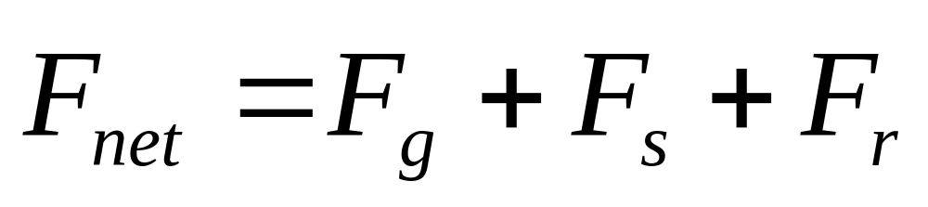
The Forces Acting on the Mass

Slide 4
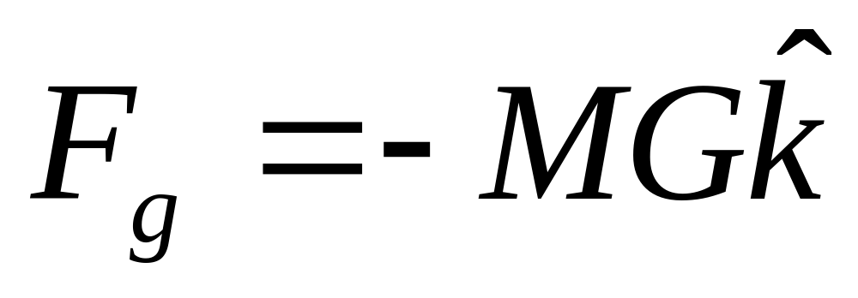
The Force Due to Gravity

Slide 5
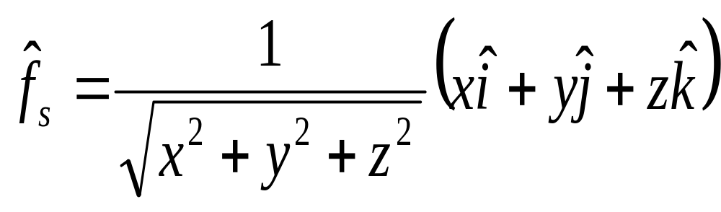
Unit Vector in the Direction of the Spring Force

Slide 6
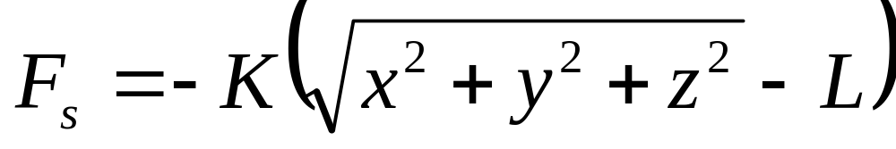
The Magnitude of the Spring Force

Slide 7
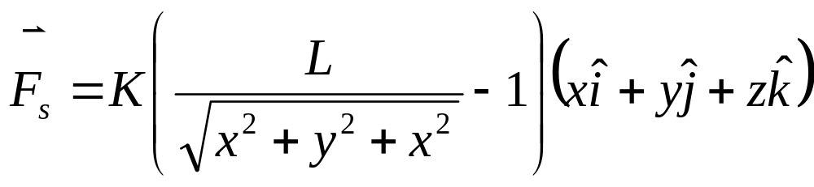
The Spring Force

Slide 8
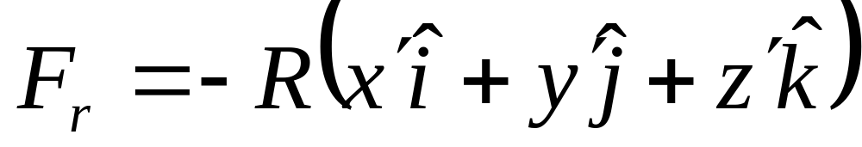
The Force Due to Air Resistance

Slide 9
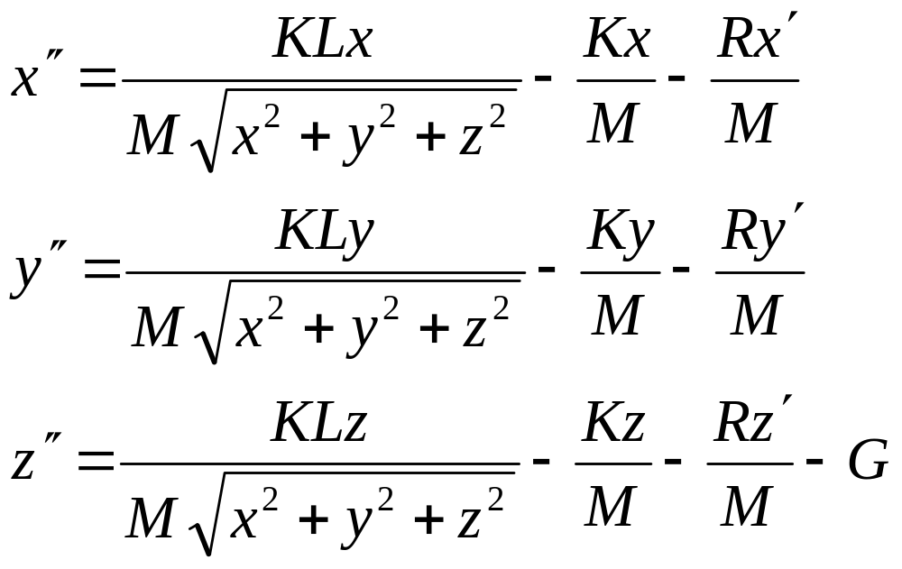
Adding the Forces, Separating into Forces on Each Axis, and Dividing by Mass

Slide 10
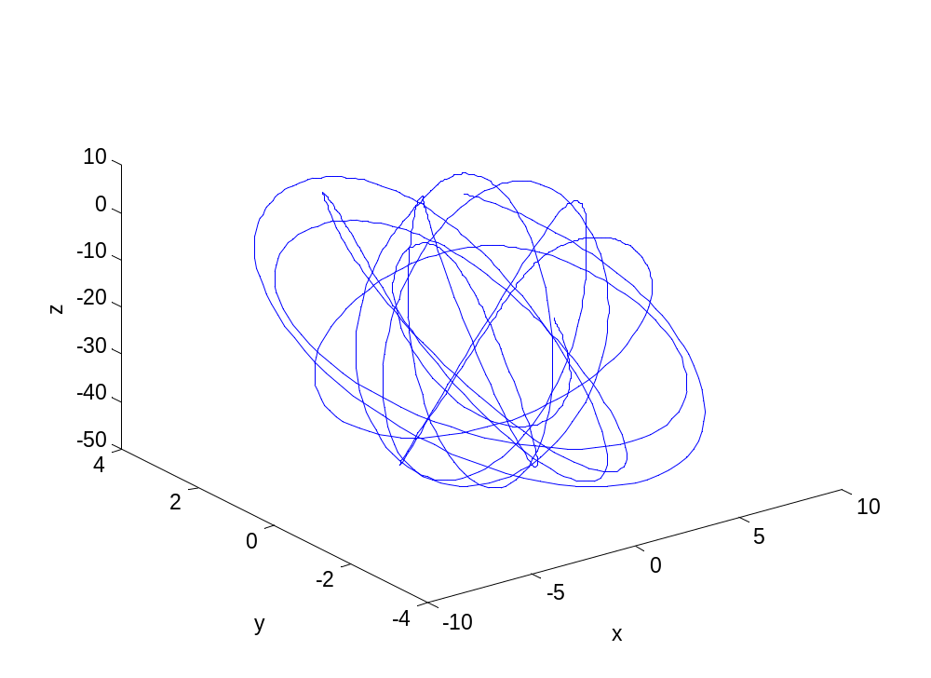
Example With No Damping

Slide 11
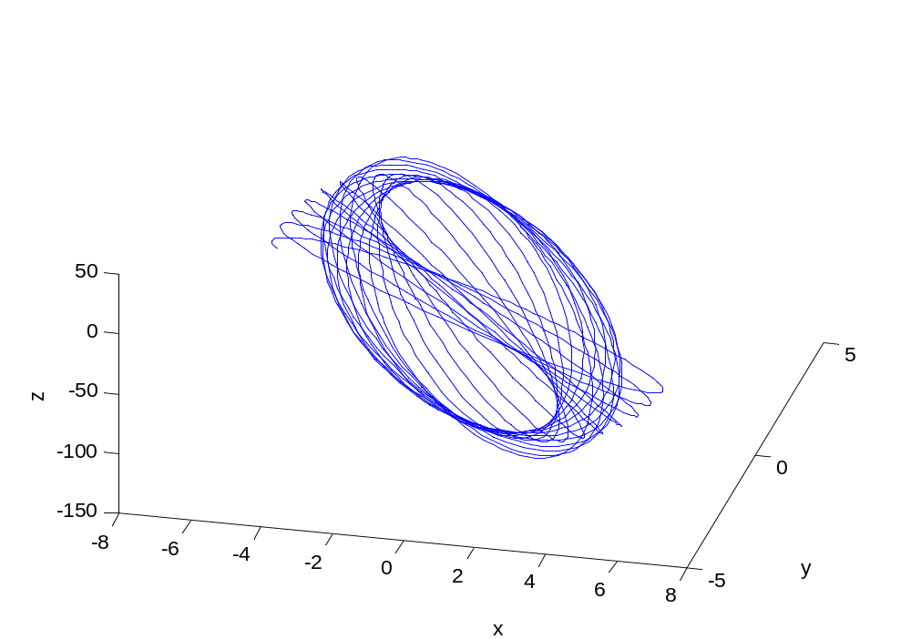
Another Without Damping

Slide 12
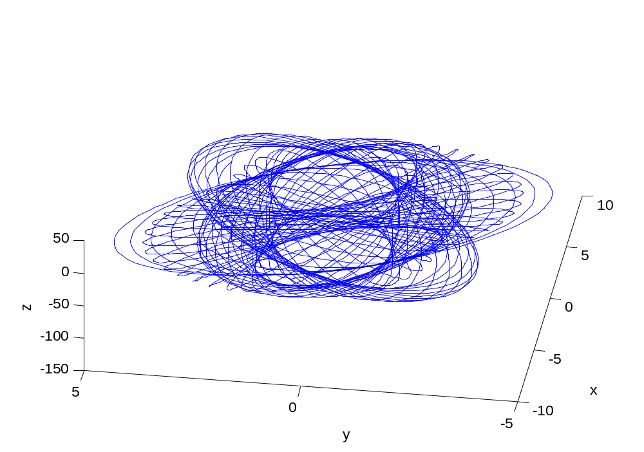
Same as Last Over a Longer Time

Slide 13
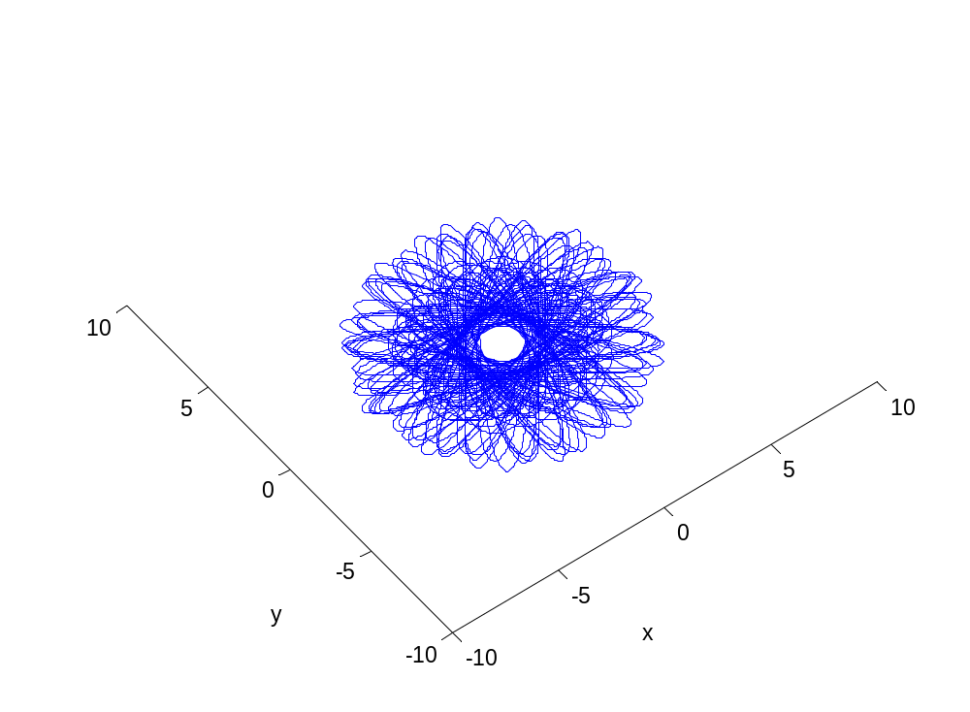
No Damping Over a Long Time From Above

Slide 14
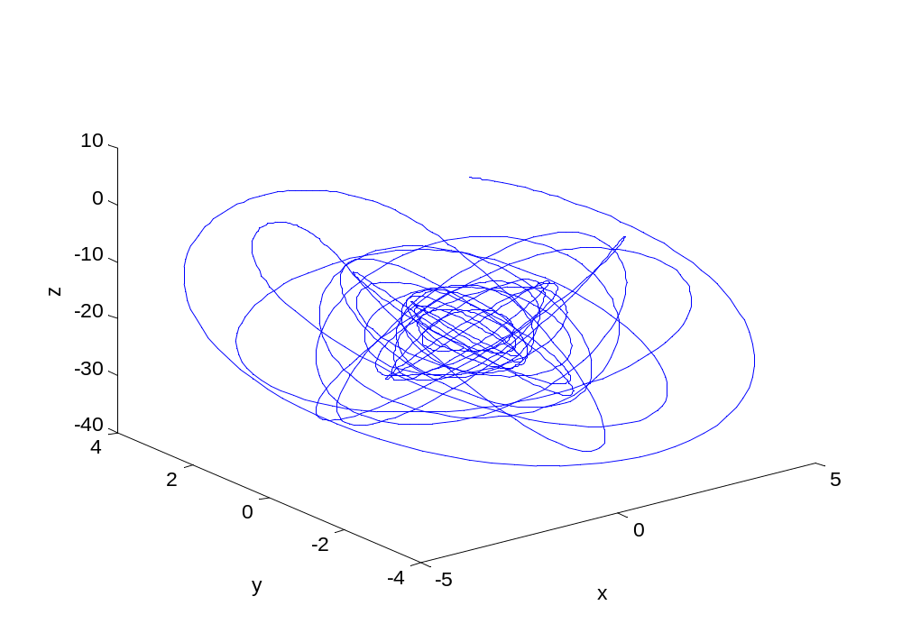
With Damping

Slide 15
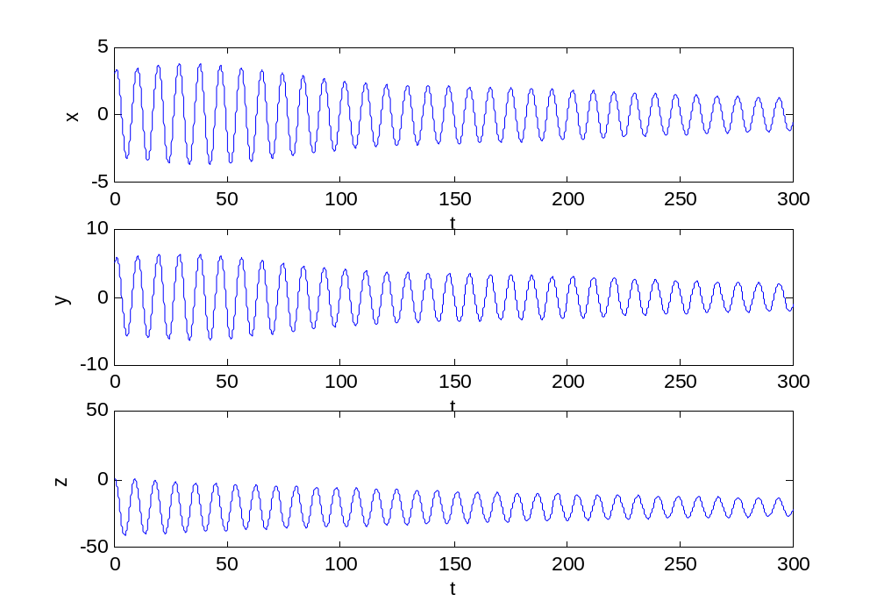
Plots of the Motion on Each Axis vs. Time, With Damping

