Slide 1

The
Rose Curve
by: Hans Goldman and Katie Jones

Slide 2

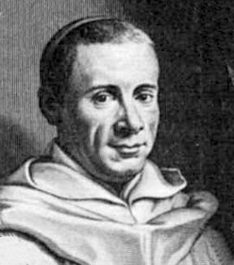
History
The Rose curve originally studied by Luigi Guido Grandi in the 1700’s.
Grandi first named the curve Rhodonea which translates to rose.
Grandi was a Mathematics professor at the University of Pisa, Italy.
He also introduced Leibniz’s work with calculus to Italy.

Slide 3
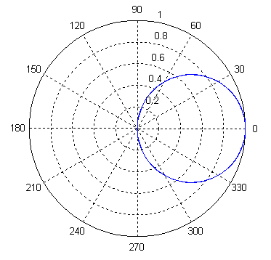
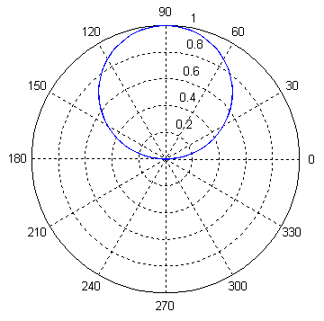
What’s a Rose?
Cos(θ) Sin(θ)
The rose is a sinusoid in polar coordinates.
The equation:
r = a*cos(kθ)
or
r = a*sin(kθ)
The two graphs only differ by a rotation of π/2.

Slide 4
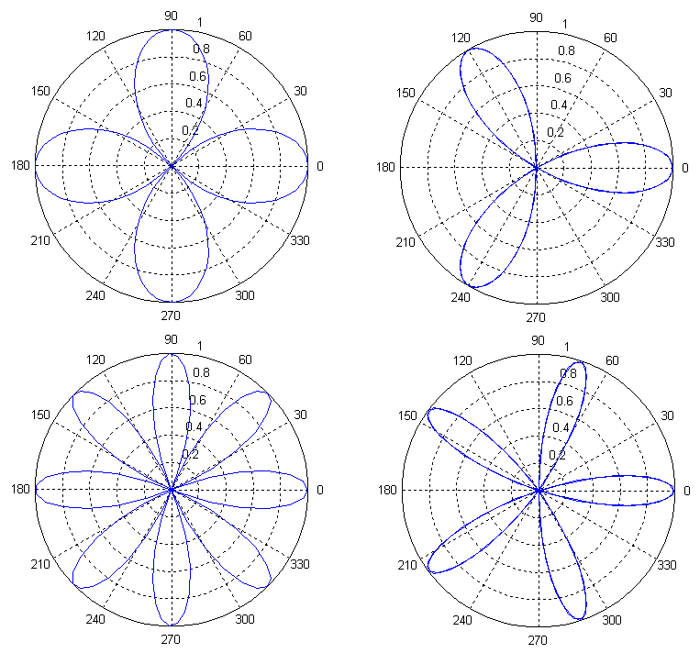
Behavior of a Rose
k = 2 k = 3
Here are some examples of
r = a*cos(kθ),
where “k” increases and “a” is equal to 1.
If “k” is even the number of petals is 2k and if “k” is odd the number of petals is k.
k = 4 k = 5

Slide 5
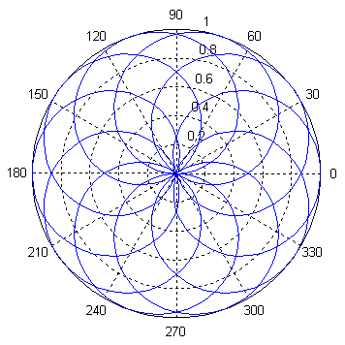
A Fraction Example
Here is an example of “k” as a fraction and theta going from 0 to 12π.
r = sin(5/6*θ)

Slide 6
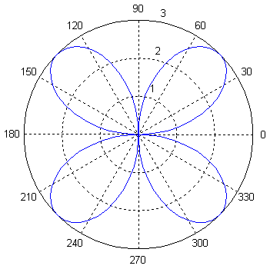
The role of “a”
“a” is the amplitude of the sine function, therefore, it makes sense that “a” controls how far out the graph extends from r = 0 when used in the rose curve.
r=3*sin(2θ)
Notice the graph extends to 3

Slide 7
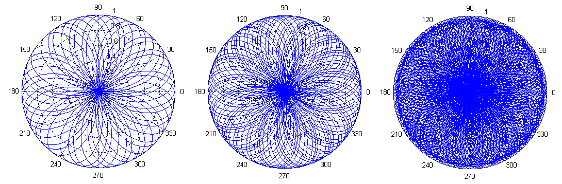
When “k” is Irrational
Here is an example of “k” as a irrational number as theta goes from 0 to 20π, 40π, and 150π respectively.
r = sin(√5*θ)

Slide 8
Parameterization of the Rose
y
P(r,θ) or P(x,y)
r
y
r = a * sin(kθ)
θ
x
x
cos(θ) = x/r
sin(θ) = y/r
x = a*cos(kt) * cos(t)
y = a*cos(kt) * sin(t)
x = r*cos(θ)
y = r*sin(θ)

Slide 9
Bibliography
http://www-groups.dcs.st-and.ac.uk/~history/Curves/Rhodonea.html
http://www.xahlee.org/SpecialPlaneCurves_dir/Rose_dir/rose.html
http://www.2dcurves.com/roulette/rouletter.html
http://mathworld.wolfram.com/Rose.html
http://en.wikipedia.org/wiki/Rose_curve
http://www-groups.dcs.st-and.ac.uk/~history/Biographies/Grandi.html
http://www.answers.com/topic/rose-mathematics
Weisstein, Eric. Concise Encyclopedia of Mathematics

