Slide 1
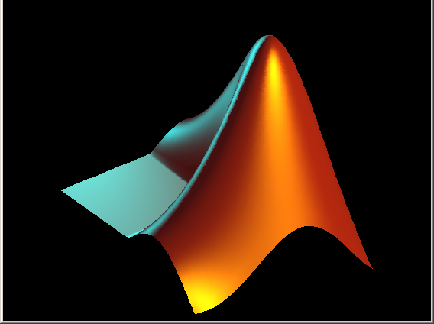
Graphical tutorial:
How to get data from Excel
and plot it in MATLAB
Print instructions and follow along

Slide 2
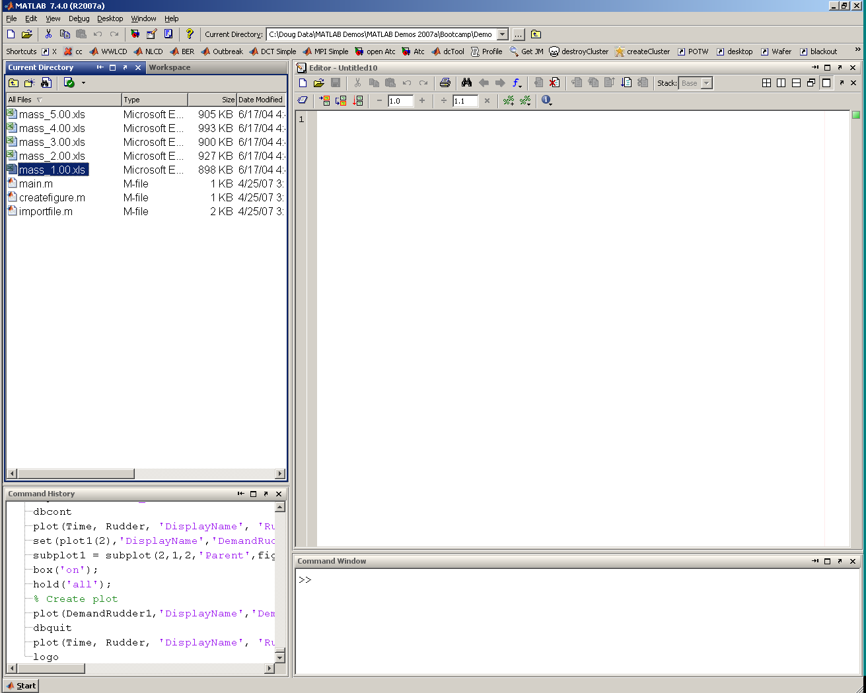

Double click file
1
Import

Slide 3
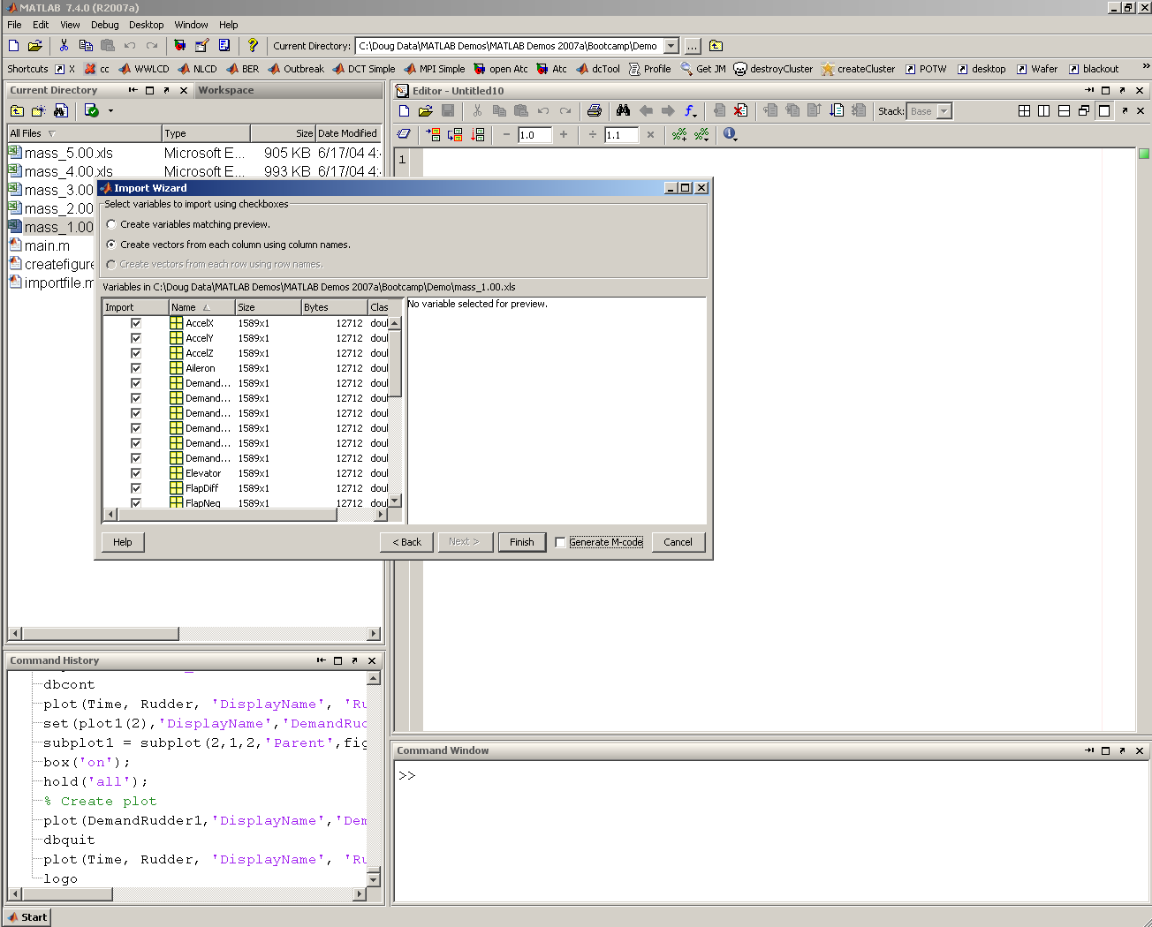
A) Choose variable names
2
B) Finish
Import

Slide 4
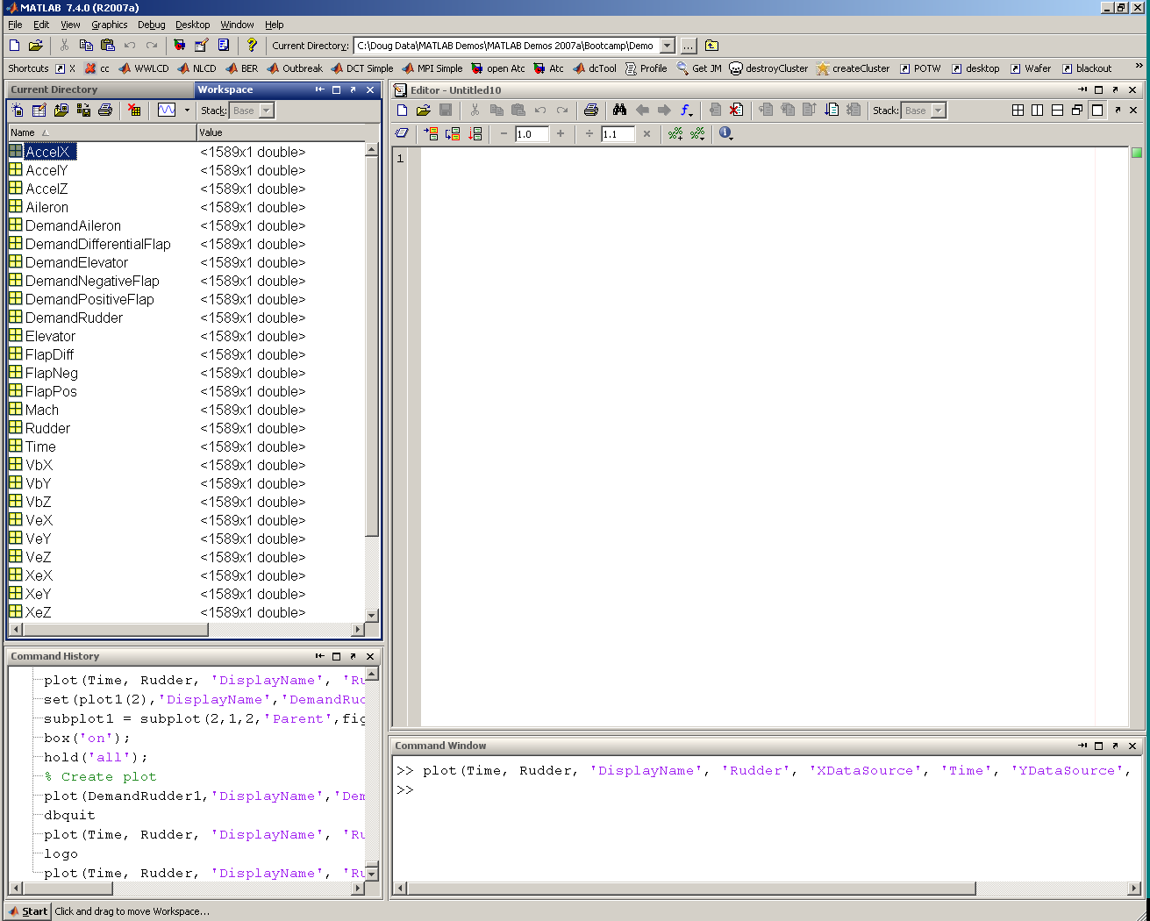
Select Workspace tab
3
Visualize

Slide 5
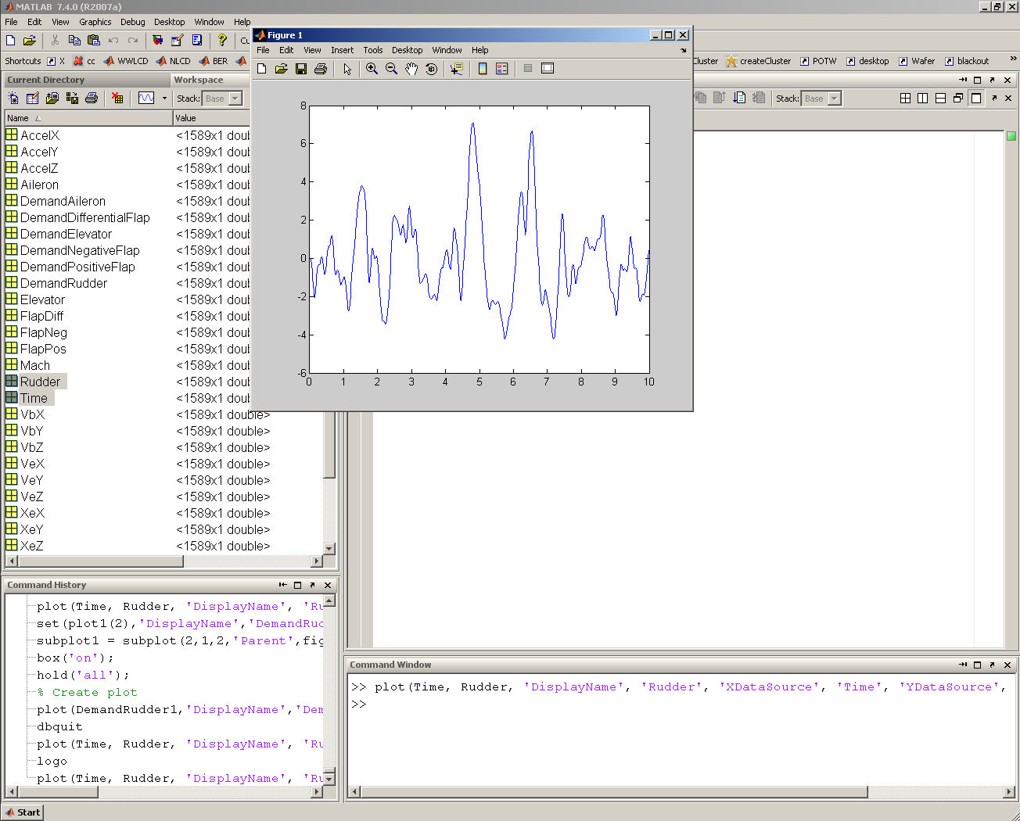
C) Click plot tools
B) Click line plot
A) Multi-select vectors
4
Visualize

Slide 6
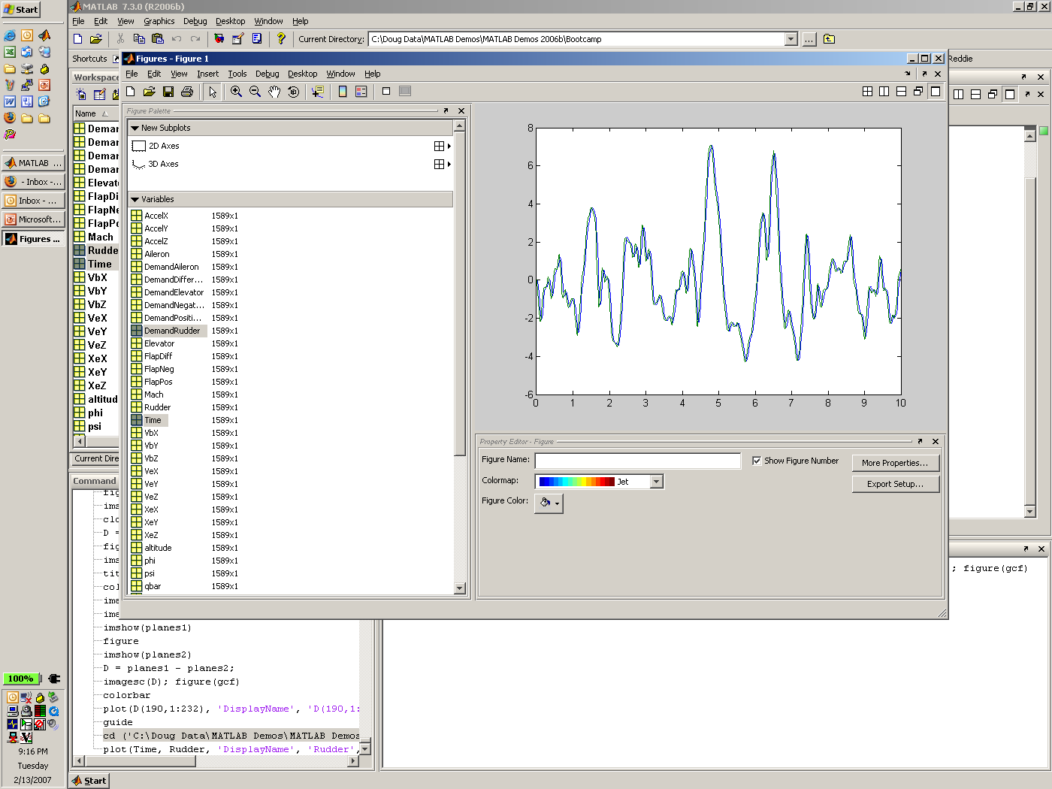
B) Drag & drop
5
A) Multi-select vectors
Visualize

Slide 7
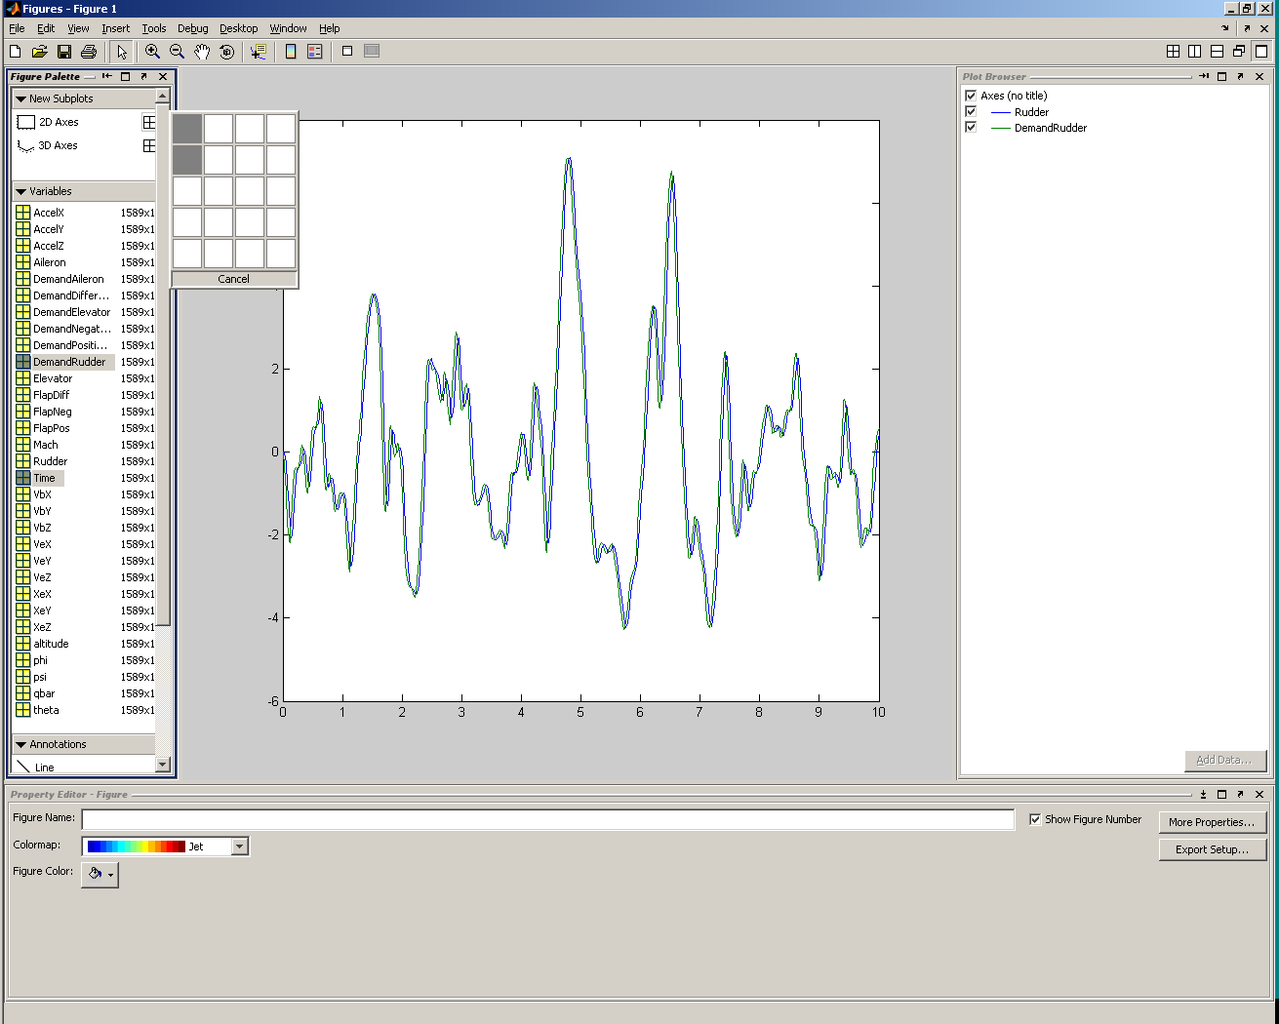
B) Drag out 2x1 array
A) Click 2-d axes
6
Visualize

Slide 8
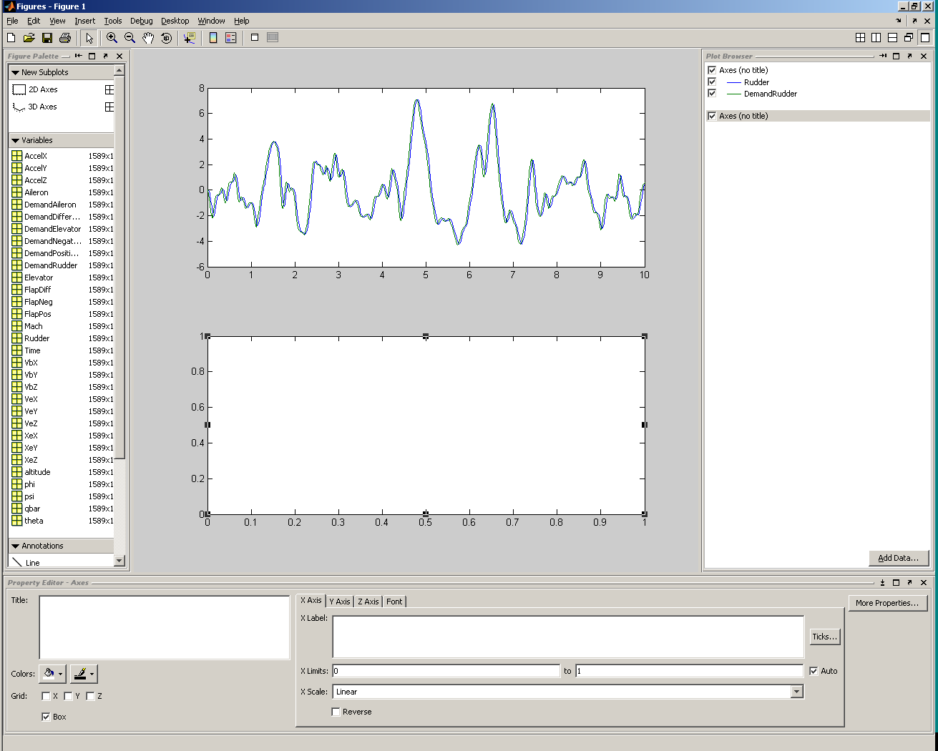
A) Select new axes
B) Add data
7
Visualize

Slide 9
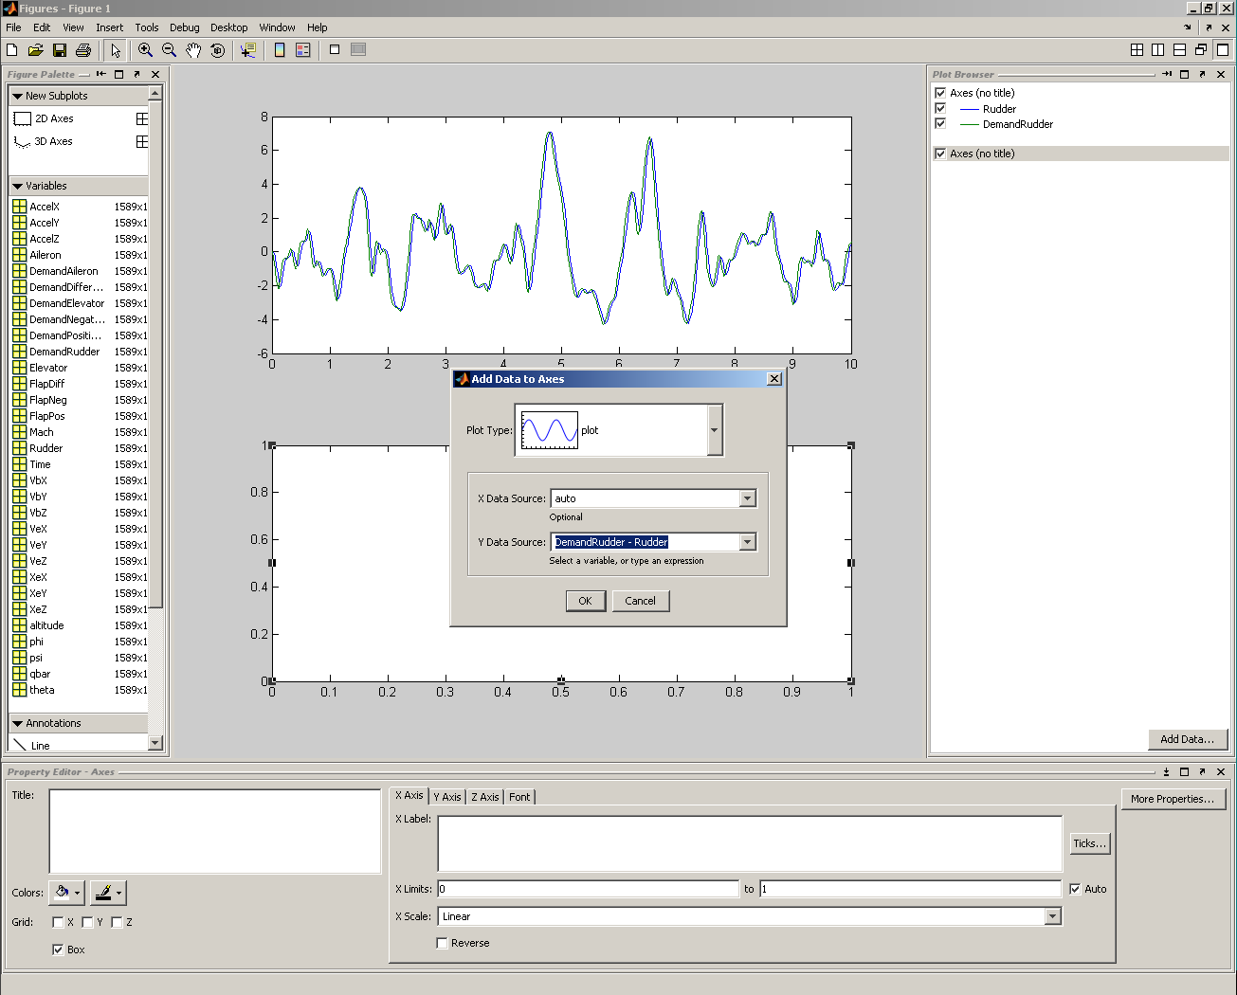
Y data source: DemandRudder - Rudder
8
Calculate

Slide 10
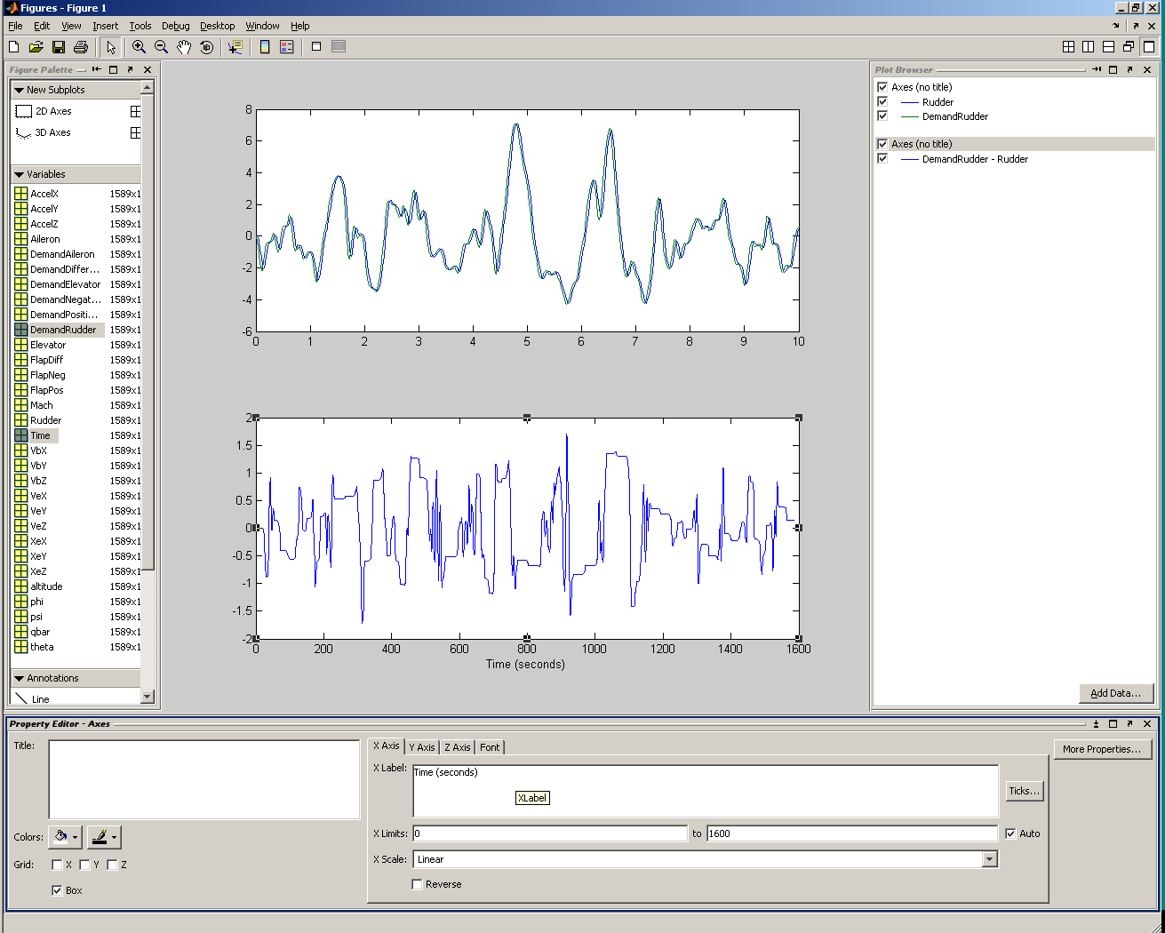
9
Customize
Define axis labels and title

Slide 11
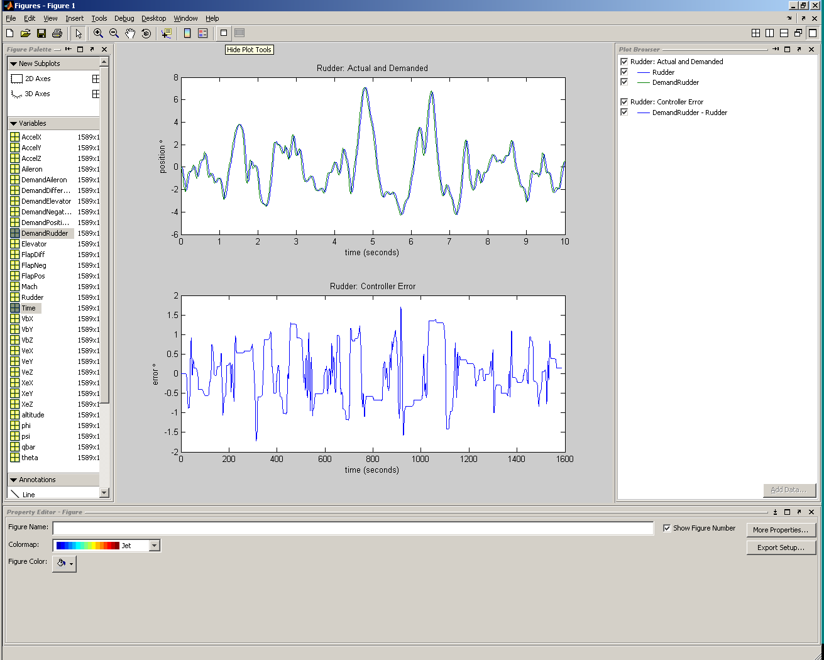
Click to hide plot tools
10
Finish

Slide 12
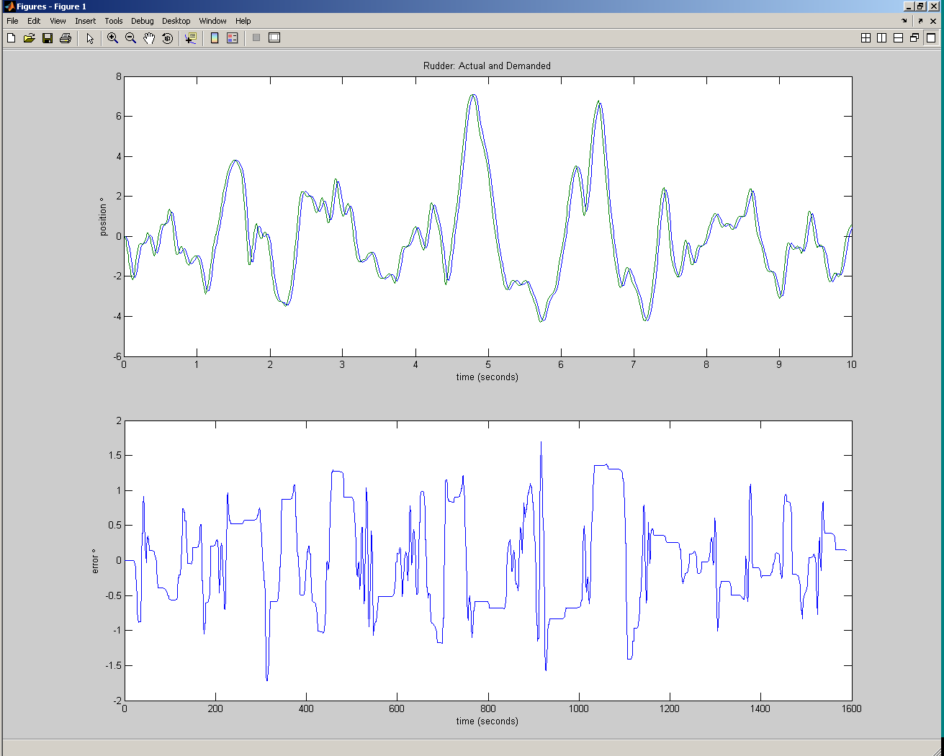
11
Done!

