Slide 1

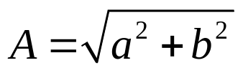
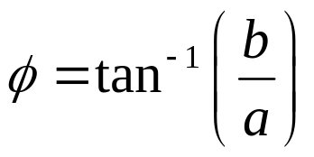

If
, is a complex number in rectangular form,
then the magnitude in polar form is,
and
the phase in polar form is,
Accordingly, the polar form of z is given as,

