Slide 1
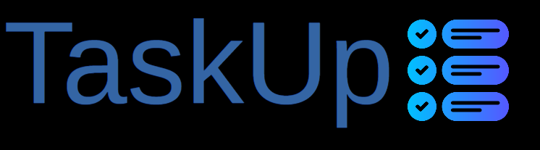
Project Management & Collaboration System
Team Board & Admin Dashboard
Advanced Project Oversight & User Management
Manage, Discuss, and Succeed Together
Smart Solutions for Team Collaboration

Slide 2
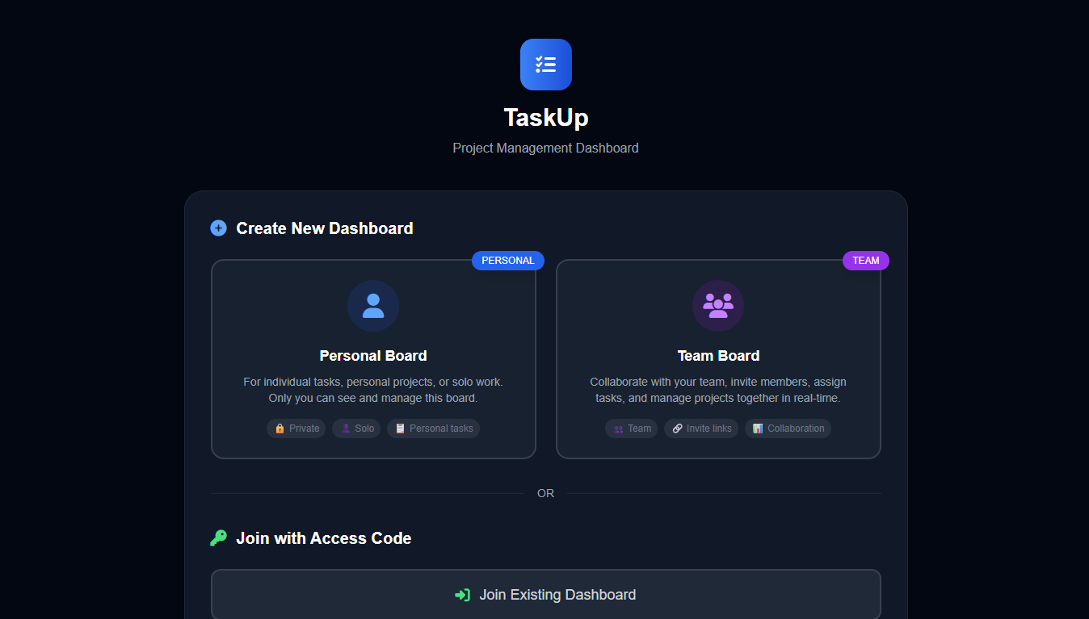
Create a personal board
Create a team board

Slide 3
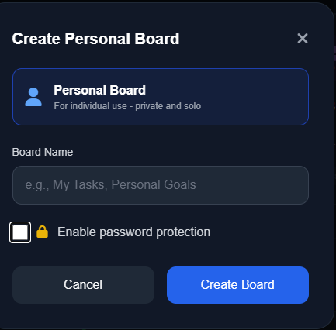
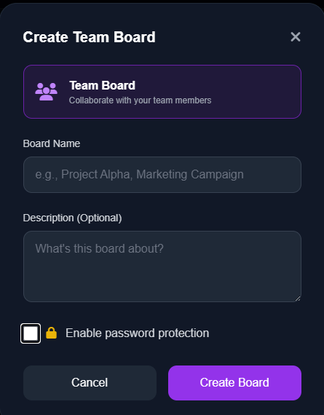
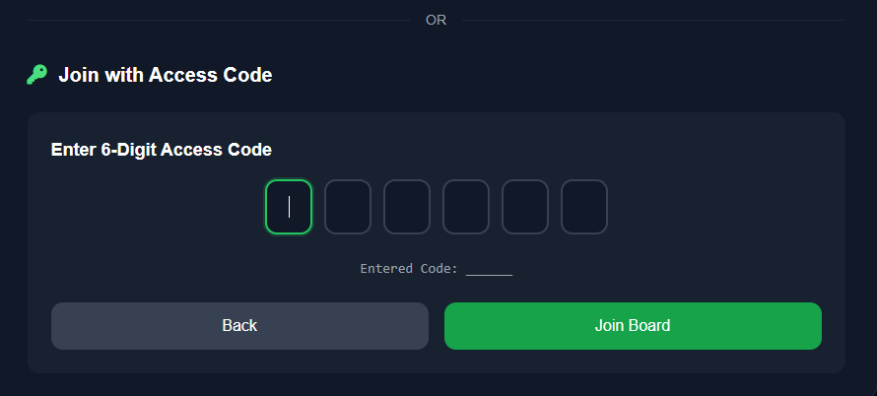
Connect to or create rooms
quickly and easily

Slide 4
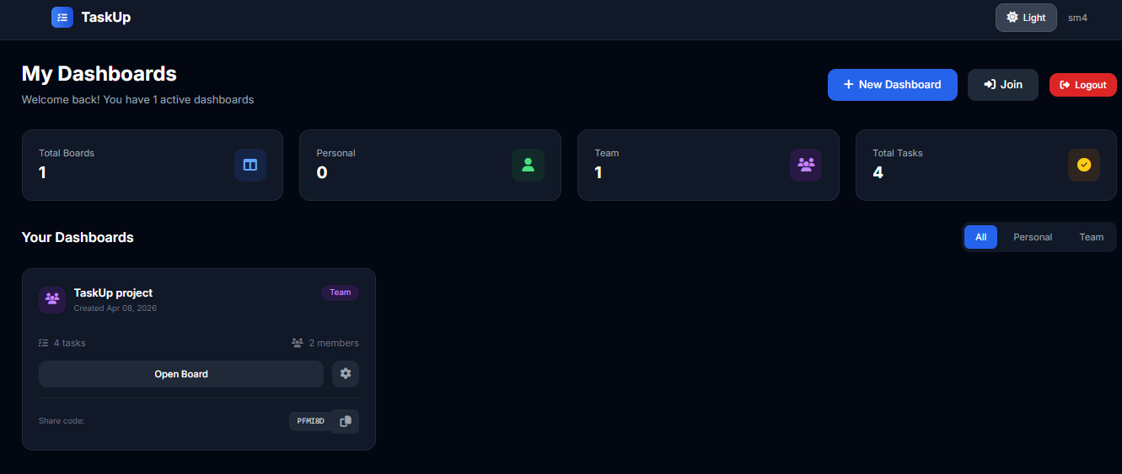
Access your boards and statistics

Slide 5
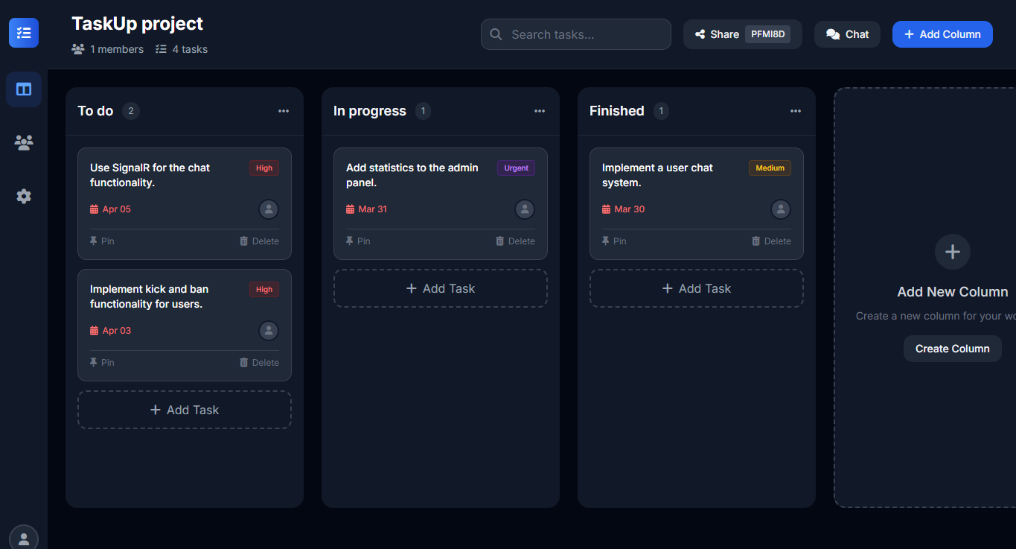
Manage your project with your own group

Slide 6
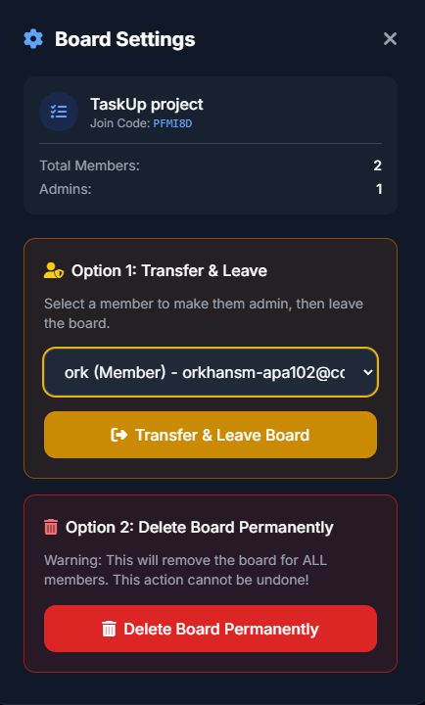
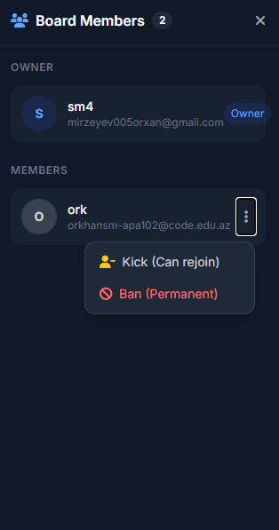
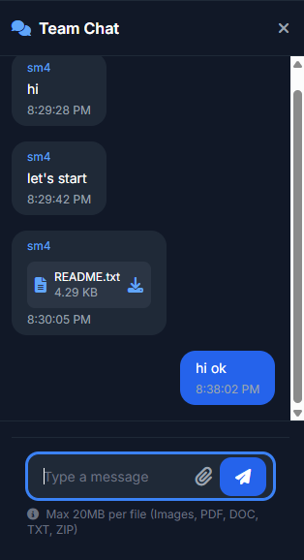
Discuss the project with the chat feature.As an admin, you have the right to kick and ban users

Slide 7
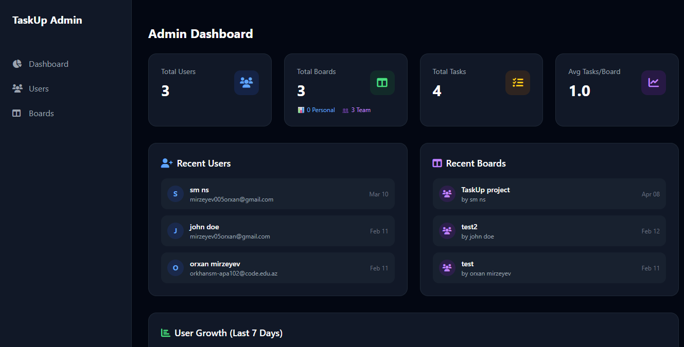
Access your boards and statistics
As an admin, you can monitor and intervene via the admin dashboard.

Slide 8
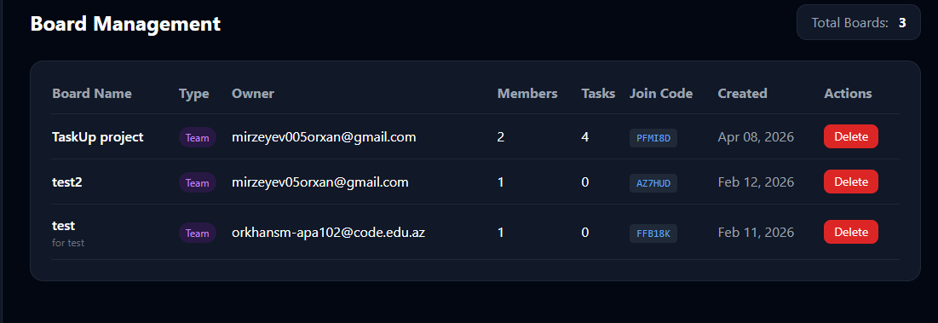
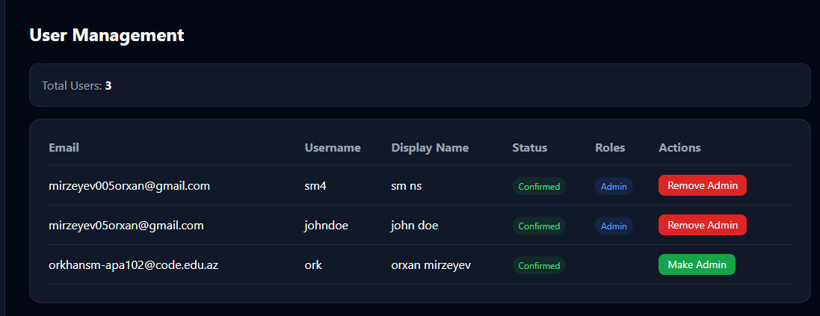
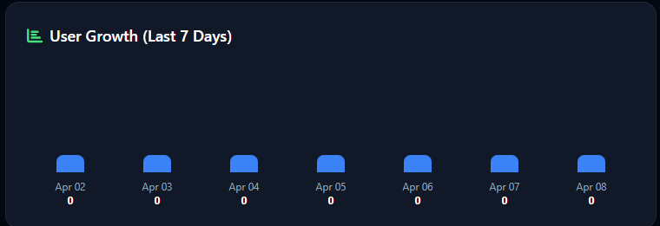
Manage user roles and boards

