Slide 1
Welcome to our Mini Socket Project
Team members:
Orkhan Hashimli
Afrasiyab Khalili

Slide 2
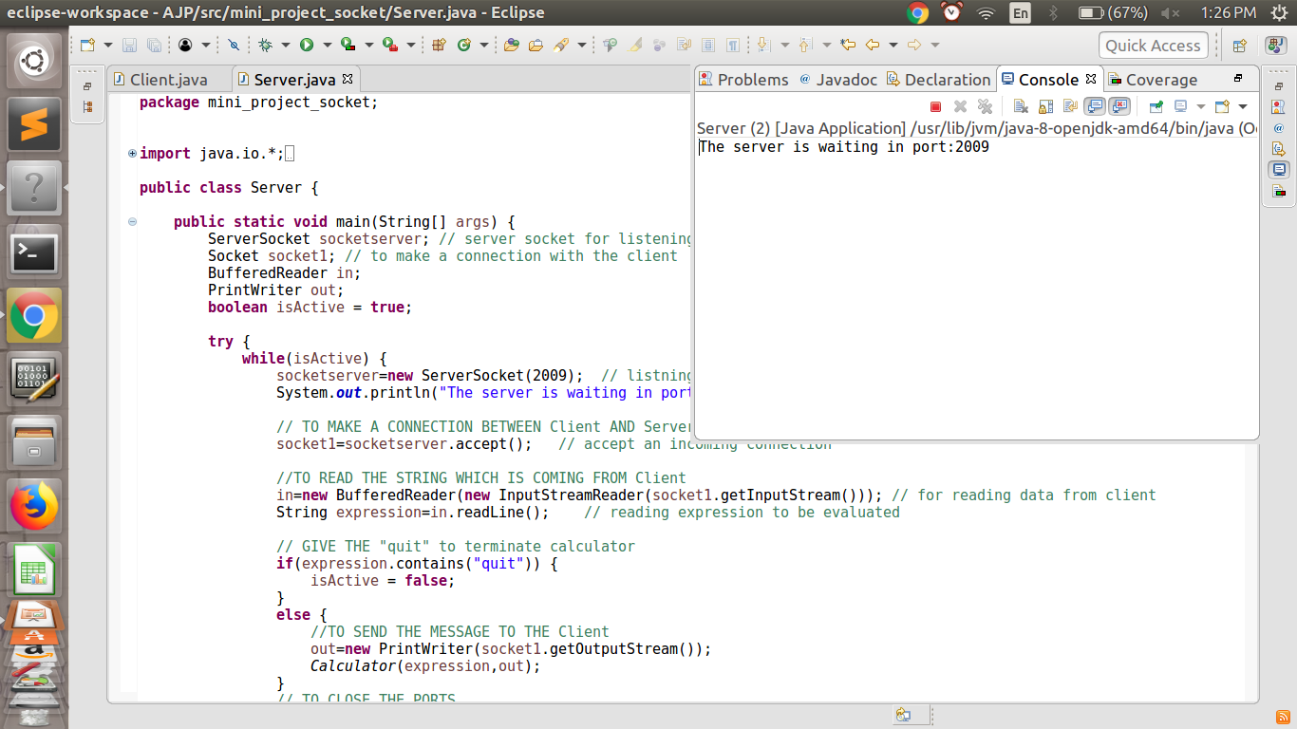
Server side

Slide 3
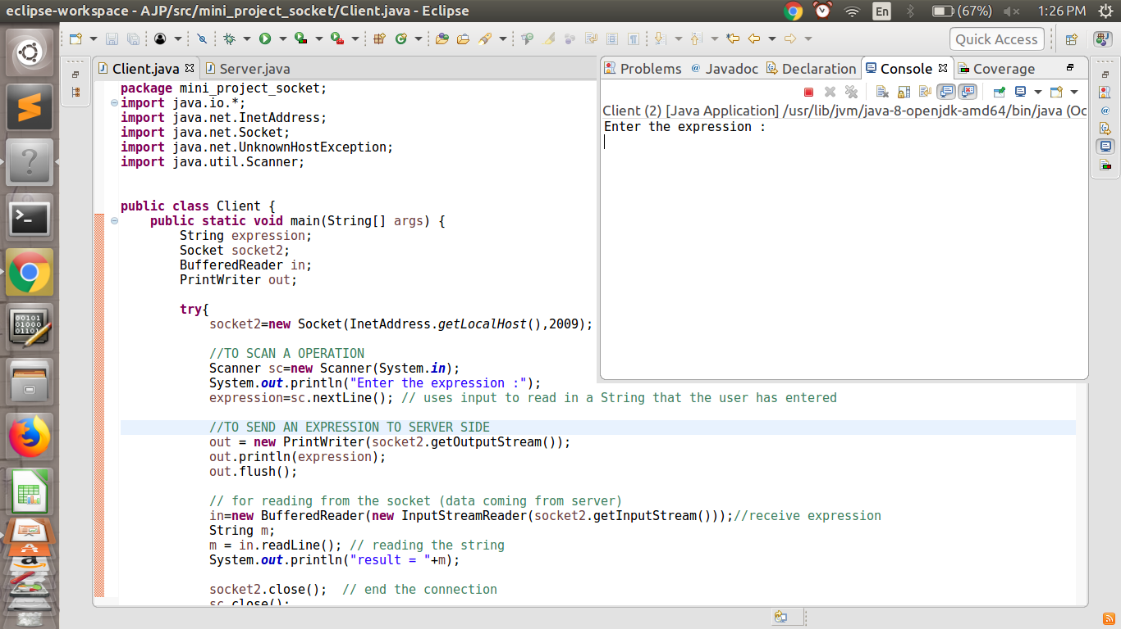
Client side

Slide 4
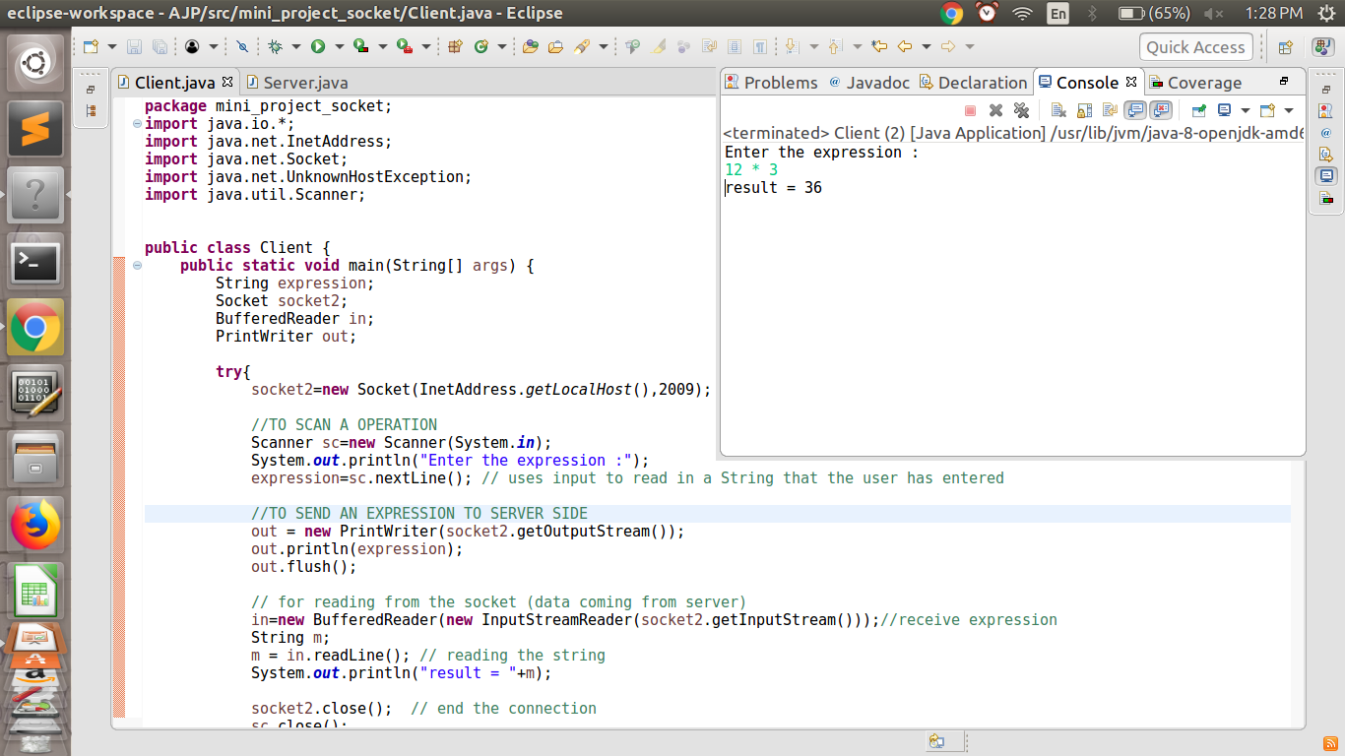

Slide 5
Thank you for Attention

