Slide 1
Web fundamentals Checkpoint
Questions
1- How does the web work ?
2- What do you need to be a good web developer ?
3- Why did you choose to learn web development ?

Slide 2
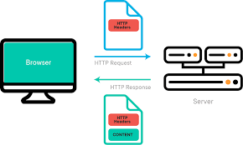
1- How does the web work ?
The web is based on a client-server architecture.
The client(the user) trough a web browser search for something. It cant be a research or a direct URL ;
The browser sends a request to a web server ;
The web server which stores websites receives the request and sends back a response(images, videos, HTML,CSS, …)
The browser receives these files and uses them to construct and display the webpage

Slide 3
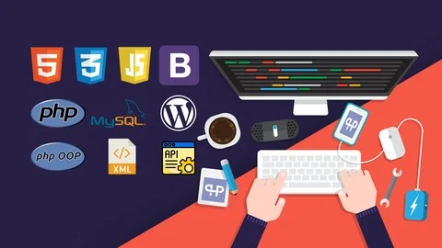
2- What do you need to be a web developer ?
You need a combination of skills in front-end and back-end and some more soft skills
Front-end : HTML to structure the page, CSS for styling, Javascript to add interactions and some front-end frameworks(Angular, React);
Back-end : Server sides languages like PHP, Javascript, Python, Databases like SQL to store datas; be familiar with APIs(Application Programming Interface)
Soft Skills : Problem Solving, Communication, Attention to detail,Teamwork etc...
You may also learn Git as a version control system to versions of your code and for better collaboration

Slide 4
1-Why did I choose to learn web development?
It wasn't entirely my choice at first. But I decided to continue because I liked the practical aspect. You see what you're creating. Creating services that others can use to make their daily lives easier is also very appealing. There's also the accessibility of training—you can find resources everywhere, you just have to know where to look. And let's be honest, it also pays well. It's for all these reasons that I want to become a web developer and make it my career.
KOUADIO KOFFI ORLANDAISE JUNOIR

