Slide 1


IoT-Hackathon
Transforming the World Through Quality
sqs.com

Slide 2



Systemübersicht
Sensor BME280
Temperatur
Feuchtigkeit
Druck
Sensor Taster
2x
Aktor RGB LED
2x bzw.
LED Ring
MQTT Publisher & Subscriber Node-Red
Raspberry PI
DASHBOARD GRAFANA
Raspberry PI
Onewire
DIGITAL
DIGITAL
MQTT
MQTT
HTTP
MQTT Publisher & Subscriber WEMOS D1
ESP8266 NodeA / NodeB
MQTT
MQTT Broker
Mosquitto
Raspberry PI
TIMEBASED DB INFLUXDB
Raspberry PI
MQTT
HTTP

Slide 3
NodeA
NodeA
NodeA
NodeA
Node-Red
GRAFANA
NodeA
NodeA
MOSQITTO
INFLUX DB
NodeB
NodeB
NodeB
NodeB
NodeB
NodeB
NodeB
NodeB

Slide 4

Node A - Hardware

Slide 5
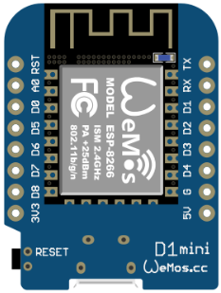
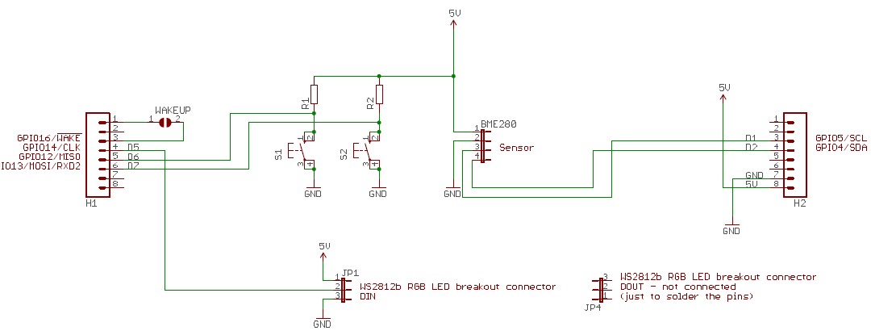

Slide 6
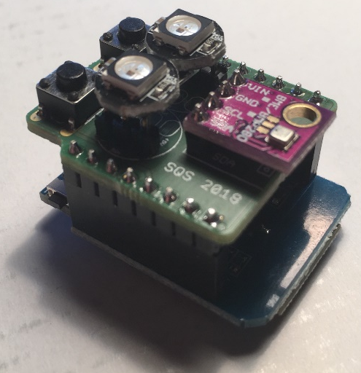
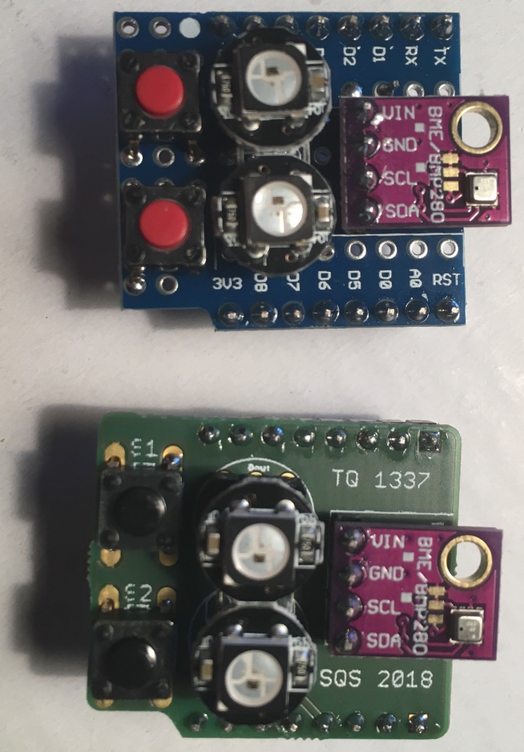
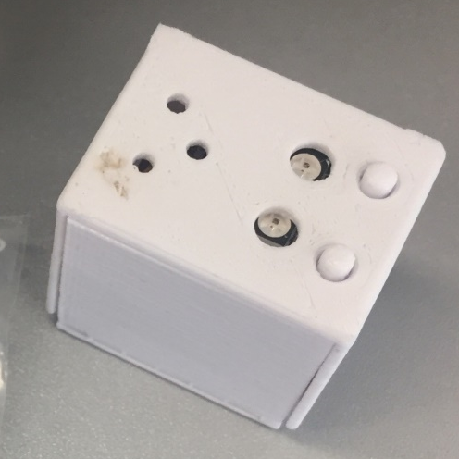

Slide 7
Node B - Hardware

Slide 8
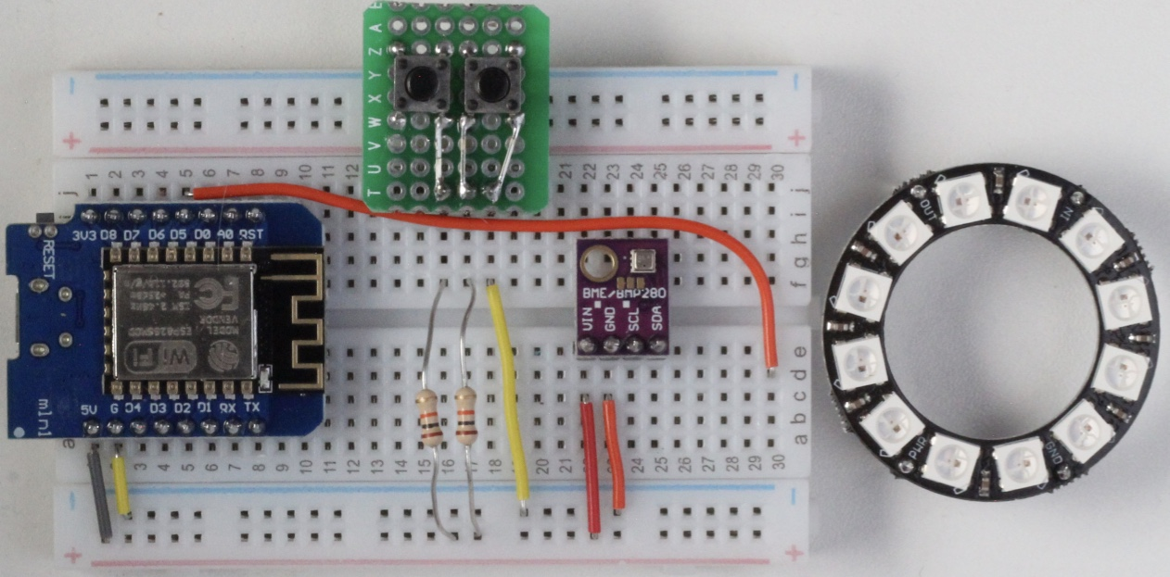

Slide 9
IN
PWR
GND

Slide 10
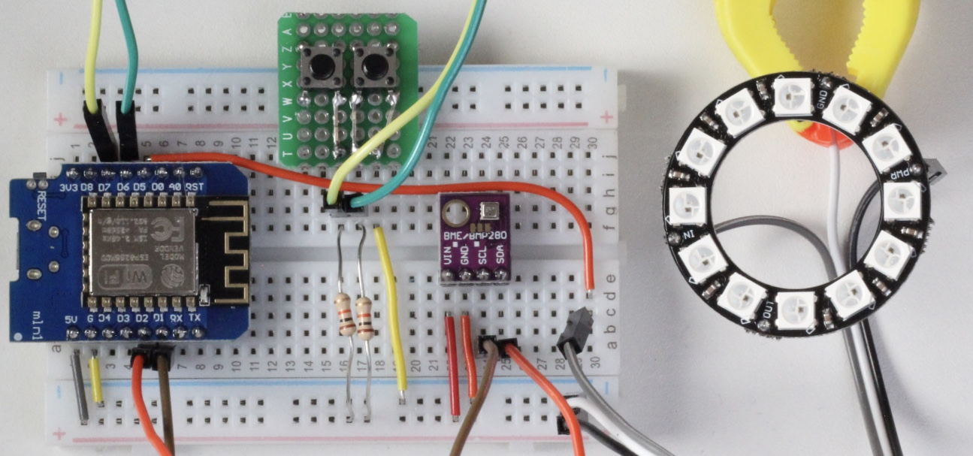

Slide 11
Software

Slide 12
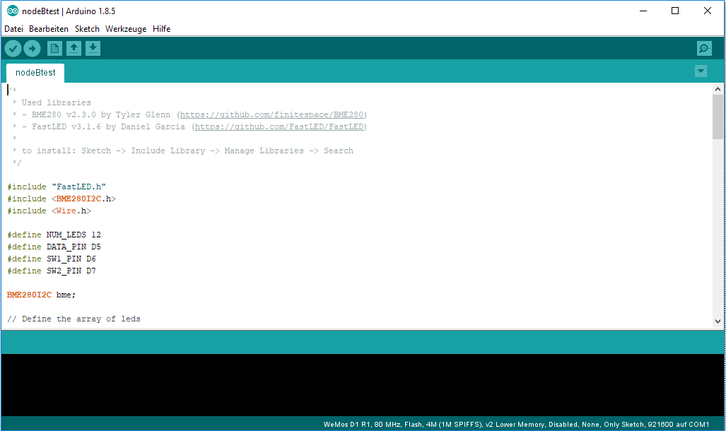
Programmierung mit der Arduino Entwicklungsumgebung

Slide 13
