Slide 1
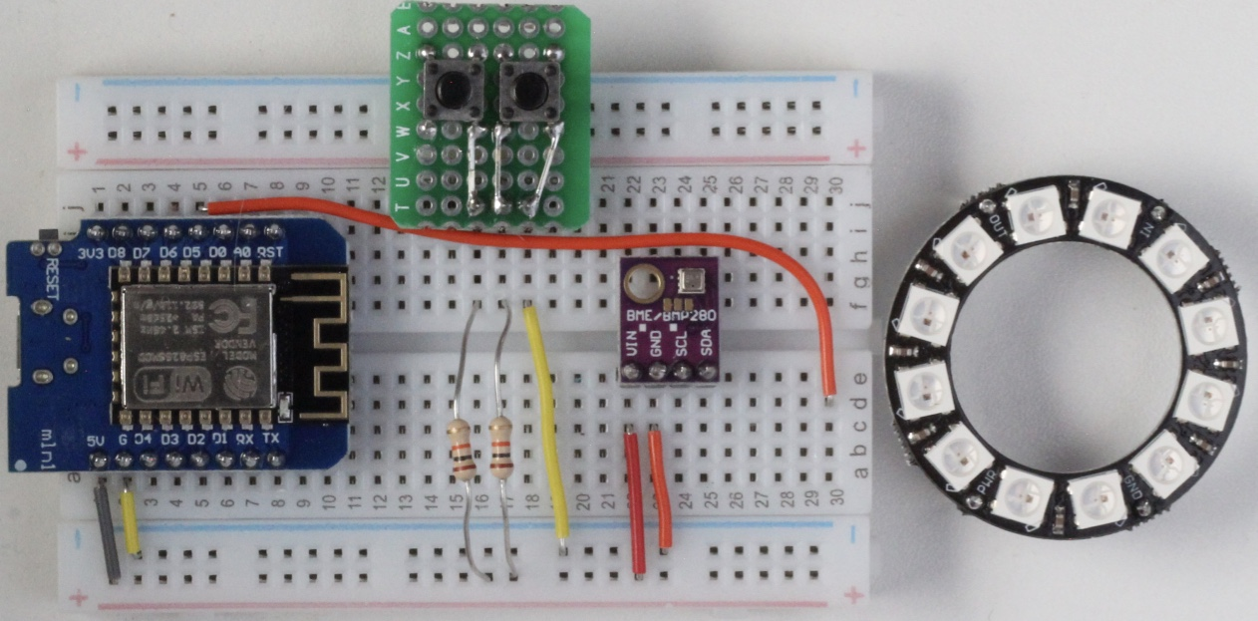

Slide 2
IN
PWR
GND

Slide 3
