Slide 1

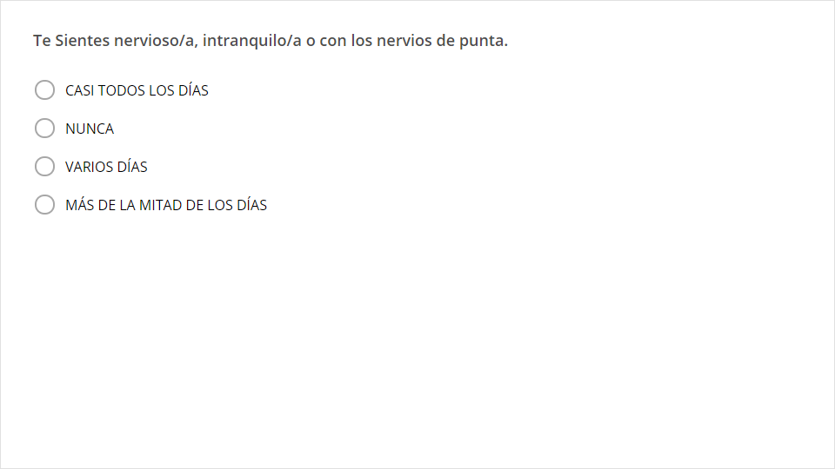
Quiz
Click the Quiz button to edit this object

