Slide 1

HTML 2
Batch 17 | Bootcamp Frontend Web Development

Slide 2


Frontend Developer
Rizky Ramadhan
at Telkom Indonesia (2021 - present)
Mentor
Tech Content Creator
2022 - present
Frontend Dev @Telkom Indonesia
Tech Content Creator
Frontend Mentor
at dibimbing.id (2022 - present)
LinkedIn:
/in/rizkykyra

Slide 3
Outline
Text Element: List
Table
Forms
Form Elements
Attributes of Form Elements
Fieldset

Slide 4
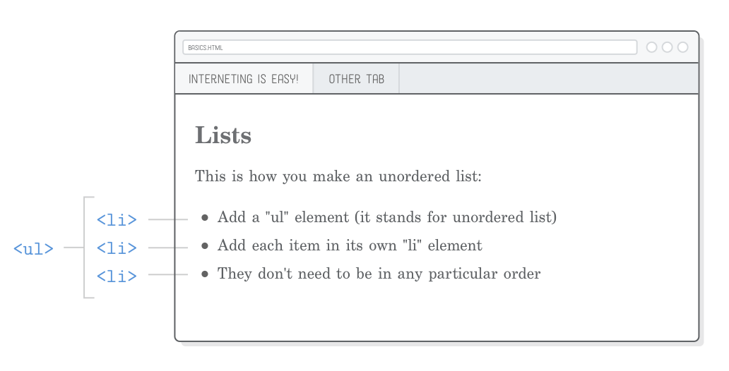
Text Element: List
HTML lists allow web developers to group a set of related items in lists. There are two different types of lists that are commonly used in HTML.
First is an ordered list starts with the (<ol>) tag. Each list item starts with the (<li>) tag.
Second is an unordered list starts with the (<ul>) tag. Each list item starts with the (<li>) tag.

Slide 5
Let’s Code

Slide 6
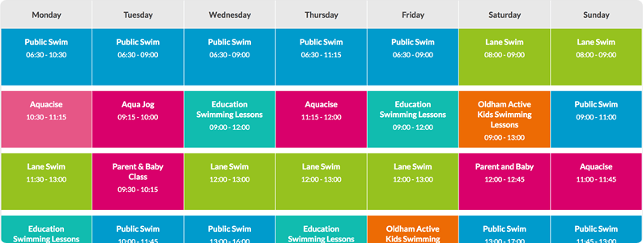
Table
HTML tables are a fundamental part of web development, providing a structured way to organize and display data. They allow you to arrange information into rows and columns, making it easier for users to interpret and understand the content

Slide 7
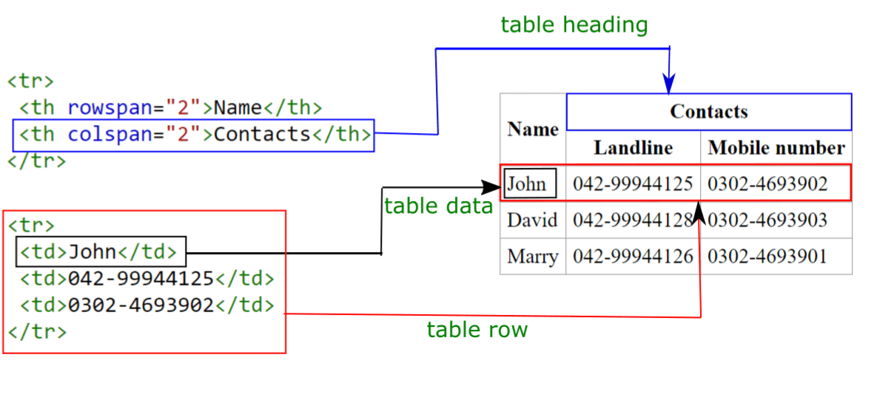
Table Element
HTML table is created using the (<table>) element.
The table is divided into rows using the (<tr>) (table row) element.
Within each row, data is organized into cells using the (<td>) (table data) element.
Headers can be defined using the (<th>) (table header) element within the (<tr>) element.
The (<th>) element is used to label the columns or rows of the table.

Slide 8
Table Attributes
These attributes can be applied to the (<table>), (<tr>), (<th>), and (<td>) elements to control the appearance and behavior of HTML tables.
border: Specifies the width of the border around the table and its cells.
align: Specifies the horizontal alignment of the table.
width: Sets the width of the table.
cellpadding: Controls the space between the content of a cell and its border.
cellspacing: Controls the space between cells.
bgcolor: Sets the background color of a table cell.
colspan: Defines the number of columns a cell should span.
rowspan: Defines the number of rows a cell should span.
bordercolor: Sets the color of the table border.
summary: Provides a summary or description of the table's content.
caption: Adds a caption to the table, providing a title or description.
border-collapse: Specifies the border-collapse behavior.

Slide 9
Let’s Code

Slide 10
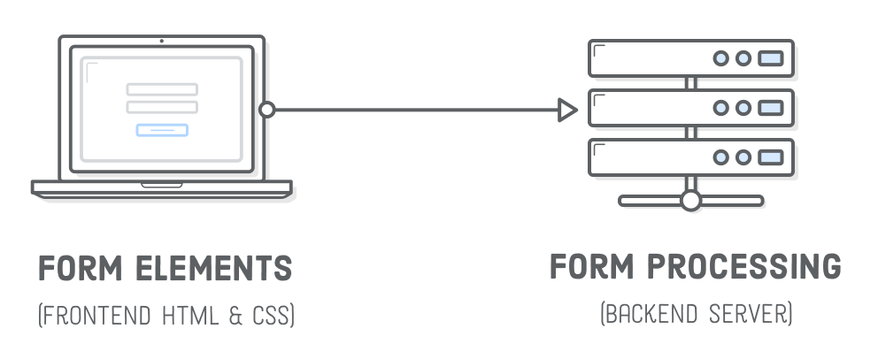
HTML Forms
HTML forms are essential for web development, enabling user interaction and data submission. Form elements are vital for creating dynamic web pages, facilitating input of various information types, from text to complex selections.

Slide 11
Let’s Code

Slide 12
Ice Breaking

Slide 13
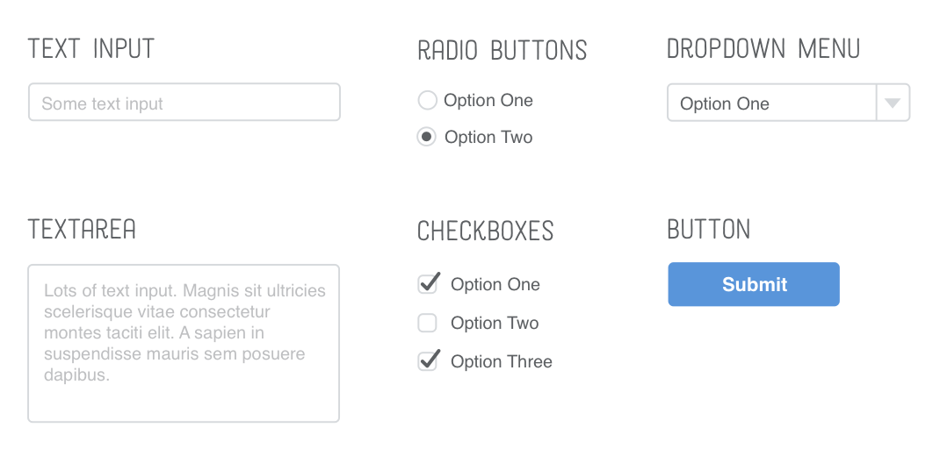
HTML Form Structure
HTML forms are created using the (<form>) element, serving as containers for various form elements. Within a form, you can incorporate different input elements such as (<input>), (<textarea>), (<select>), and more.

Slide 14
Commonly used form elements
<input>: Represents various types of user input fields, such as text boxes (type="text"), password fields (type="password"), checkboxes (type="checkbox"), radio buttons (type="radio"), and more.
<textarea>: Allows users to input multiline text, suitable for longer responses or comments.
<select>: Creates a dropdown menu, enabling users to choose from a list of options.
<button>: Represents a clickable button within a form, often used for form submission or triggering specific actions.
<label>: Associates a label with a form element, improving accessibility and providing a visual indication of the purpose of the associated input.
<fieldset> and <legend>: These elements are used to group related form elements within a container (<fieldset>) and provide a caption (<legend>) for the grouping.
<input type="file">: Creates a file input field, allowing users to upload files.
<input type="date">, <input type="time">, <input type="datetime-local">: These input types allow users to select dates, times, or both.

Slide 15
Let’s Code

Slide 16
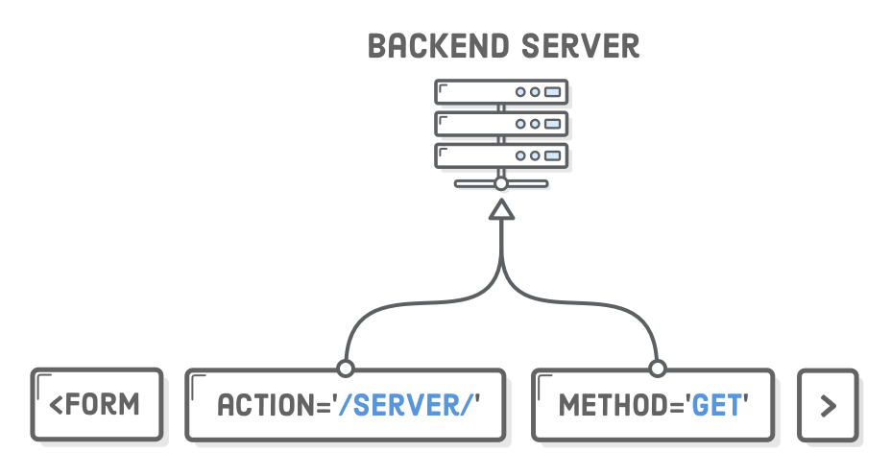
Attributes of Form Elements
Every HTML form begins with the aptly named (<form>) element. It accepts a number of attributes, but the most important ones are (action) and (method).

Slide 17
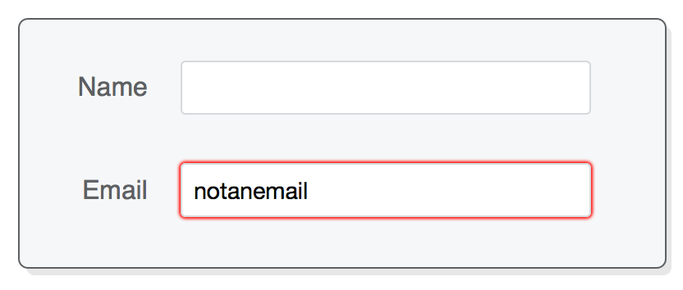
Attributes of Form Elements
The (<input/>) element’s type attribute also lets you do basic input validation. Attributes like (required), (placeholder), and (pattern) contribute to form validation and user guidance.

Slide 18
Let’s Code

Slide 19
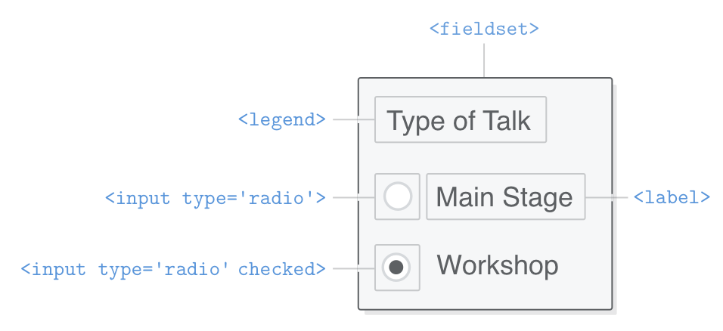
Fieldset
The <fieldset> element in HTML is used to group related form elements within a container. It's often employed in combination with the <legend> element to provide a caption or description for the grouped elements.

Slide 20
Let’s Code

Slide 21
ASSIGNMENT!!!
https://docs.google.com/document/d/1_4tRFtmGzo9T1X1HDG8Jk0WOTs2wSIguBLMUY-pGxIo/edit?usp=sharing

Slide 22
Terima
Kasih.
Let’s discuss! ======================= reference: developer.mozilla.org

