Slide 1

CSS 2
Batch 17 | Bootcamp Frontend Web Devlopment

Slide 2


Frontend Developer
Rizky Ramadhan
at Telkom Indonesia (2021 - present)
Mentor
Tech Content Creator
2022 - present
Frontend Dev @Telkom Indonesia
Tech Content Creator
Frontend Mentor
at dibimbing.id (2022 - present)
LinkedIn:
/in/rizkykyra

Slide 3
Outline
Span and Div
Border Property
Width and Height
Layout

Slide 4
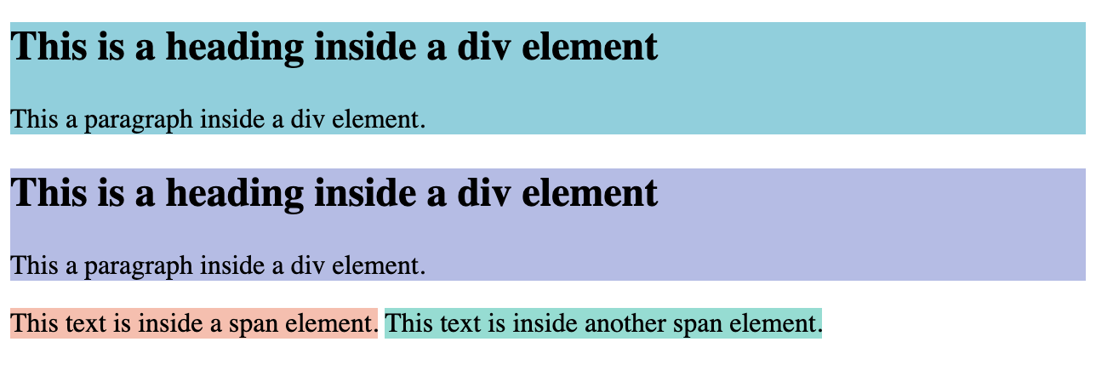
Span and Div
Span: used for inline styling
Div: used for block/container styling

Slide 5
Let’s Code

Slide 6
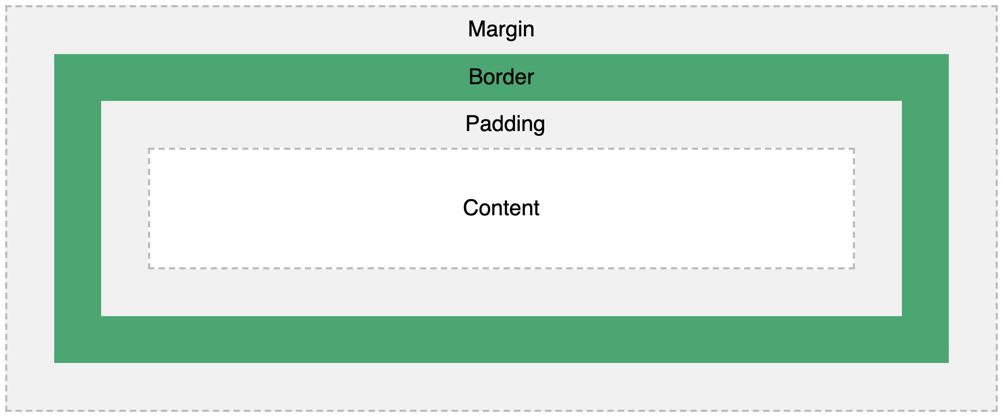
HTML box model

Slide 7
Border Properties
border-width
border-style
border-color
border-radius
Let’s jump into hands-on to understand more!

Slide 8
Let’s Code

Slide 9
Width and Height
Width: defines the content width Height: defines the content height
Let’s jump into hands-on to understand more!

Slide 10
Let’s Code

Slide 11
Ice Breaking

Slide 12
Layout
There are 3 ways to style the HTML layout:
Floats
Position
Display (Box Model, Flexbox, Grid)

Slide 13
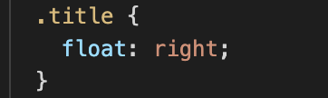
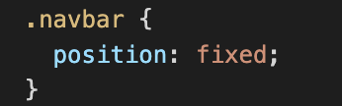

1 Float
Usually used in a paragraph. Values: none (default), left, right
2 Position
Used to specify behavior of an element . Values: static (default), fixed, sticky, relative, absolute.
6 of 11
Notes:
https://developer.mozilla.org/en-US/docs/Web/CSS/position

Slide 14
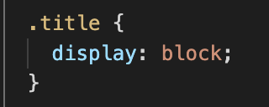
3 Display
Values: block (default), inline-block, inline, none, flex, grid
7 of 11

Slide 15
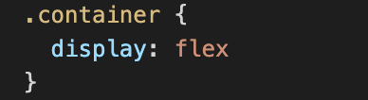
Detailed Explanation
Display: Flex
Most used in modern Web Apps. It makes the elements positioning flexible, no need to hassle with float and position for most cases.
Learn how to use flexbox: https://flexboxfroggy.com/
8 of 11

Slide 16
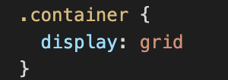
Detailed Explanation
Display: Grid
Used for pages that contains list of products. The structure is similar to table.
The concept is used in Bootstrap Framework.
Learn how to use grid:
https://cssgridgarden.com/ https://css-tricks.com/snippets/css/complete-guide-grid/ https://grid.layoutit.com/ https://learncssgrid.com/
9 of 11

Slide 17
Let’s Code

Slide 18
Challenge!

Slide 19



Recreate this logo using HTML and CSS

Slide 20
Terima
Kasih.
Let’s discuss! ======================= reference: developer.mozilla.org

