Slide 1
Welcome
To The Research Final Presentation

Slide 2

Department of Computer Science and Engineering
Supervised by:
Md. Mijanur Rahman
Assistant Professor, Dept. of CSE
Submitted by:
Mashruful Hasan Md Shahadat Hossain Ornab biswass
ID: 20200000000119 ID: 2020000000117 ID: 2020000000095
Batch: 54 Batch: 54 Batch: 54

Slide 3
Research Topic
Breast Cancer Classification Using Machine Learning Algorithms

Slide 4
Contents
Introduction
Objectives
Related Works
Methodology
Result and Discussion
Conclusion
Reference

Slide 5
Introduction
Breast cancer is the second most common cancer after lung cancer and one of the main causes of women's death worldwide.
Difficulty in identifying breast cancer at early stage
Two types of breast cancer : 1.malignant and 2. Benign
Aid of classification algorithms
Algorithms applied:
    K-Nearest Neighbor
    Decision Tree
    Random Forest Classifier
    Naive Bayes Classifier
    Logistic Regression
Algorithms applied on the WDBC dataset.

Slide 6
Objectives
Early prediction can slow down the progress of the disease and reduce the mortality rate through appropriate therapeutic interventions at the right time.
Develop a classification algorithm that can effectively predict and classify the breast cancer.
Find out the highest accuracy.
Calculate the performance of classification algorithms.
Compare the effectiveness.
Produce reliable results.

Slide 7
Related Works
Ref. No. | Name And Period | Datasets | Algorithms | Accuracy
[1] | Rasool et al, 2022 | WDBC and BCCD | SVM, LR, KNN, Ensemble Classifier | 99.3%, 98.06%, 97.35%, 97.61%
[2] | Roy et al, 2021 | WBC and WDBC | LR,KNN,SVM,NB,DT,RF | 98.245%,97.368%,98.245%,92.105%,97.368%, 97.368%
[3] | Roy et al, 2020 | WBC and WDBC | NB,SVM,KNN,LR | 92%,96%,97%,99%
[4] | Rajaguru et al, 2019 | WDBC and WBC | DT,KNN | 91.23%,95.61%
[5] | Gupta et al, 2018 | WDBC and WBC | MLP,DT,SVM,KNN | 97.7%,90.9%,93.9%,94.4%
[6] | Ertel Merouane, 2022 | WBC and WDBC | SVM,KNN,LR,NB | 90.6%,86.1%,80.6%,51.7%

Slide 8
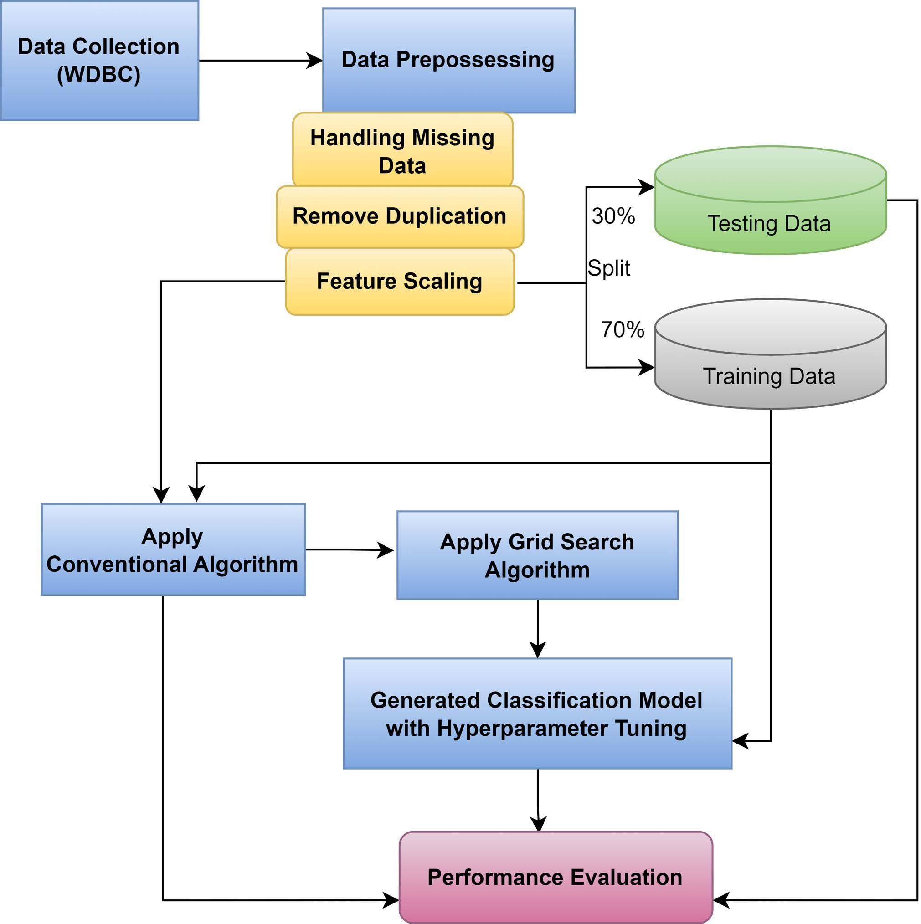
Methodology
Data Collection
Data Pre-processing
Algorithm Used
Figure 1. Model For Researched System

Slide 9
Data Collection
Wisconsin Breast Cancer Dataset (WDBC)
Aggregated from Kaggle
569 instances
32 features.

Slide 10
Dataset Description
Feature Name | Feature Description
Radius | The average distance between the spots at the circumference's center and edges.
Texture | Grayscale value's SD. Perimeter Gross separation exists between the snake's points.
Perimeter | Gross separation exists at the snake's tip and between.
Area | Total amount of pixels inside the snake, plus one-half of each pixel outside its body.
Smoothness | Measured locally by computing the length difference, the variation in radius length.

Slide 11
Data Pre-processing
First checked the dataset
Extracted unnecessary features
Scaling dataset

Slide 12
Algorithm Used
    K-Nearest Neighbor
    Decision Tree
    Random Forest Classifier
    Naive Bayes Classifier
    Logistic Regression

Slide 13
Experimental Result
Performance Evaluation Metrix
Confusion Metrix
AUC & ROC Curve
Accuracy
Precision
Recall
F1 Score

Slide 14
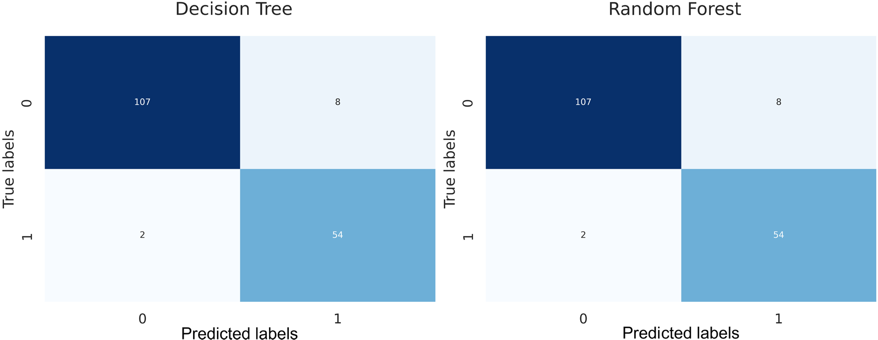
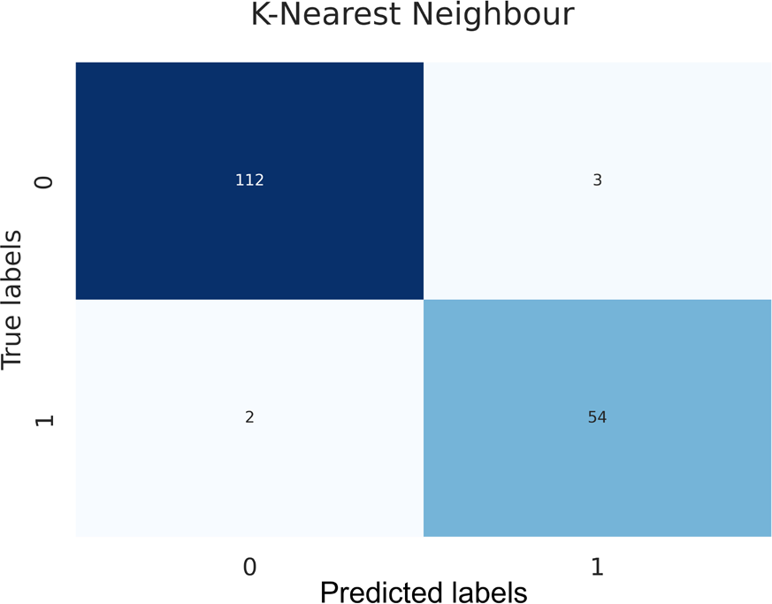
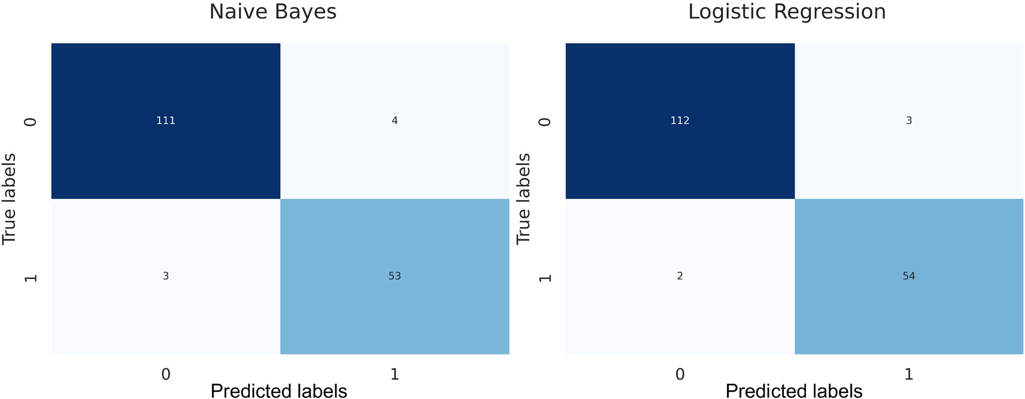
Experimental Result (cont.)
TP: True Positive (Correctly Identified)
FP: False Positive (Correctly Rejected)
TN: True Negative (Incorrectly Identified)
FN: False Negative (Incorrectly Rejected)
Figure 3. Confusion matrix after tuning.

Slide 15
Experimental Result (cont.)
Table:3. Performance Evaluation
Performance | Hyperparameter Tuning | DT | RF | KNN | NB | LR
Accuracy | With | 94.15% | 97.08% | 98.83% | 95.91% | 97.08%
 | Without | 93.56% | 97.08% | 96.49% | 95.91% | 96.49%
Precision | With | 95% | 97% | 99% | 96% | 97%
 | Without | 94% | 97% | 96% | 96% | 96%
Recall | With | 94% | 97% | 99% | 96% | 97%
 | Without | 94% | 97% | 96% | 96% | 96%
F1 Score | With | 94% | 97% | 99% | 96% | 97%
 | Without | 94% | 97% | 96% | 96% | 96%

Slide 16
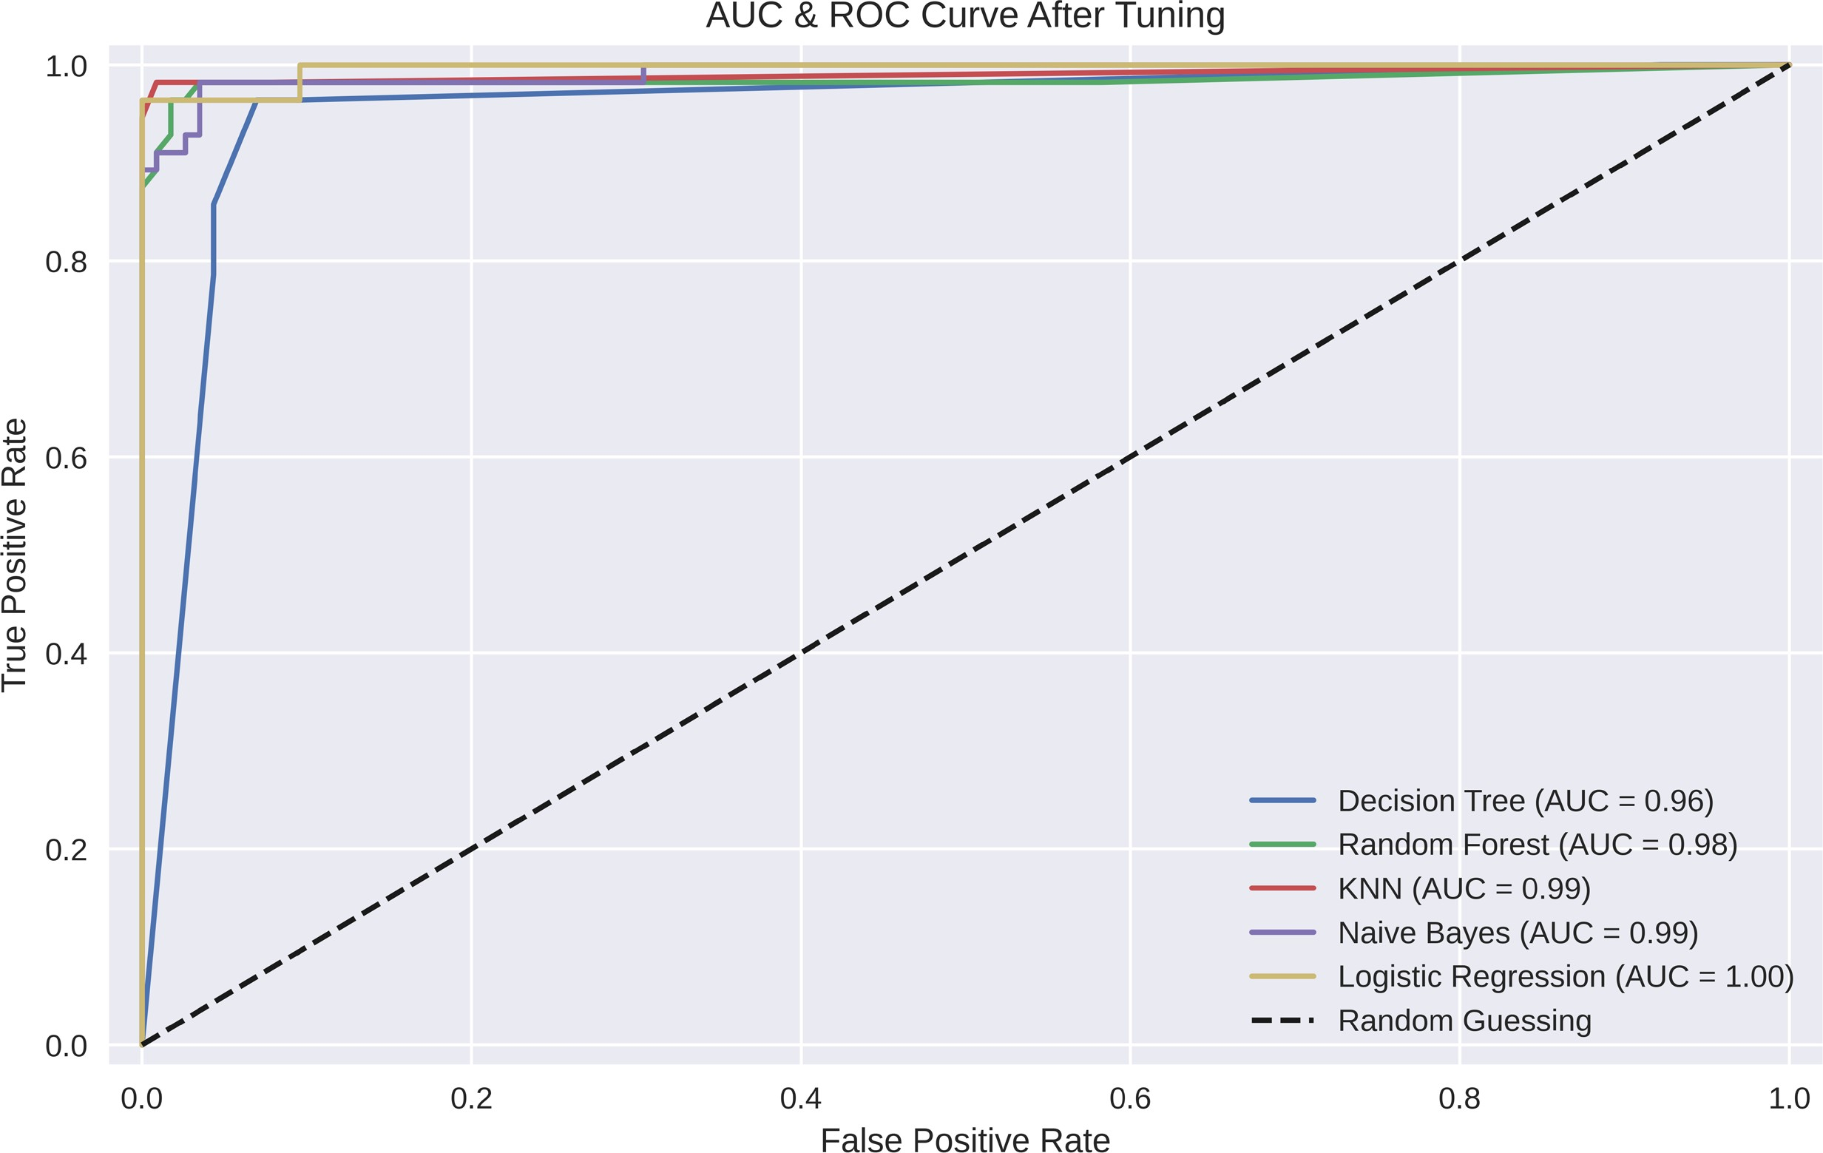
Experimental Result (Cont.)
Figure 4. AUC and ROC curve after tuning.

Slide 17
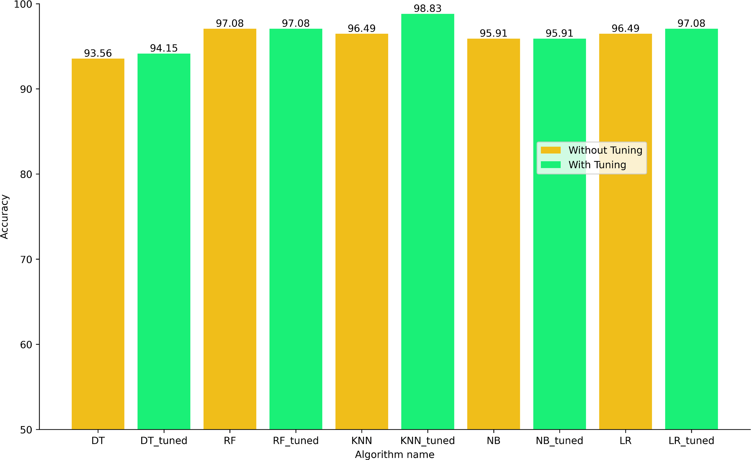
Experimental Result (cont.)
Figure 5. Result analysis on accuracy.

Slide 18
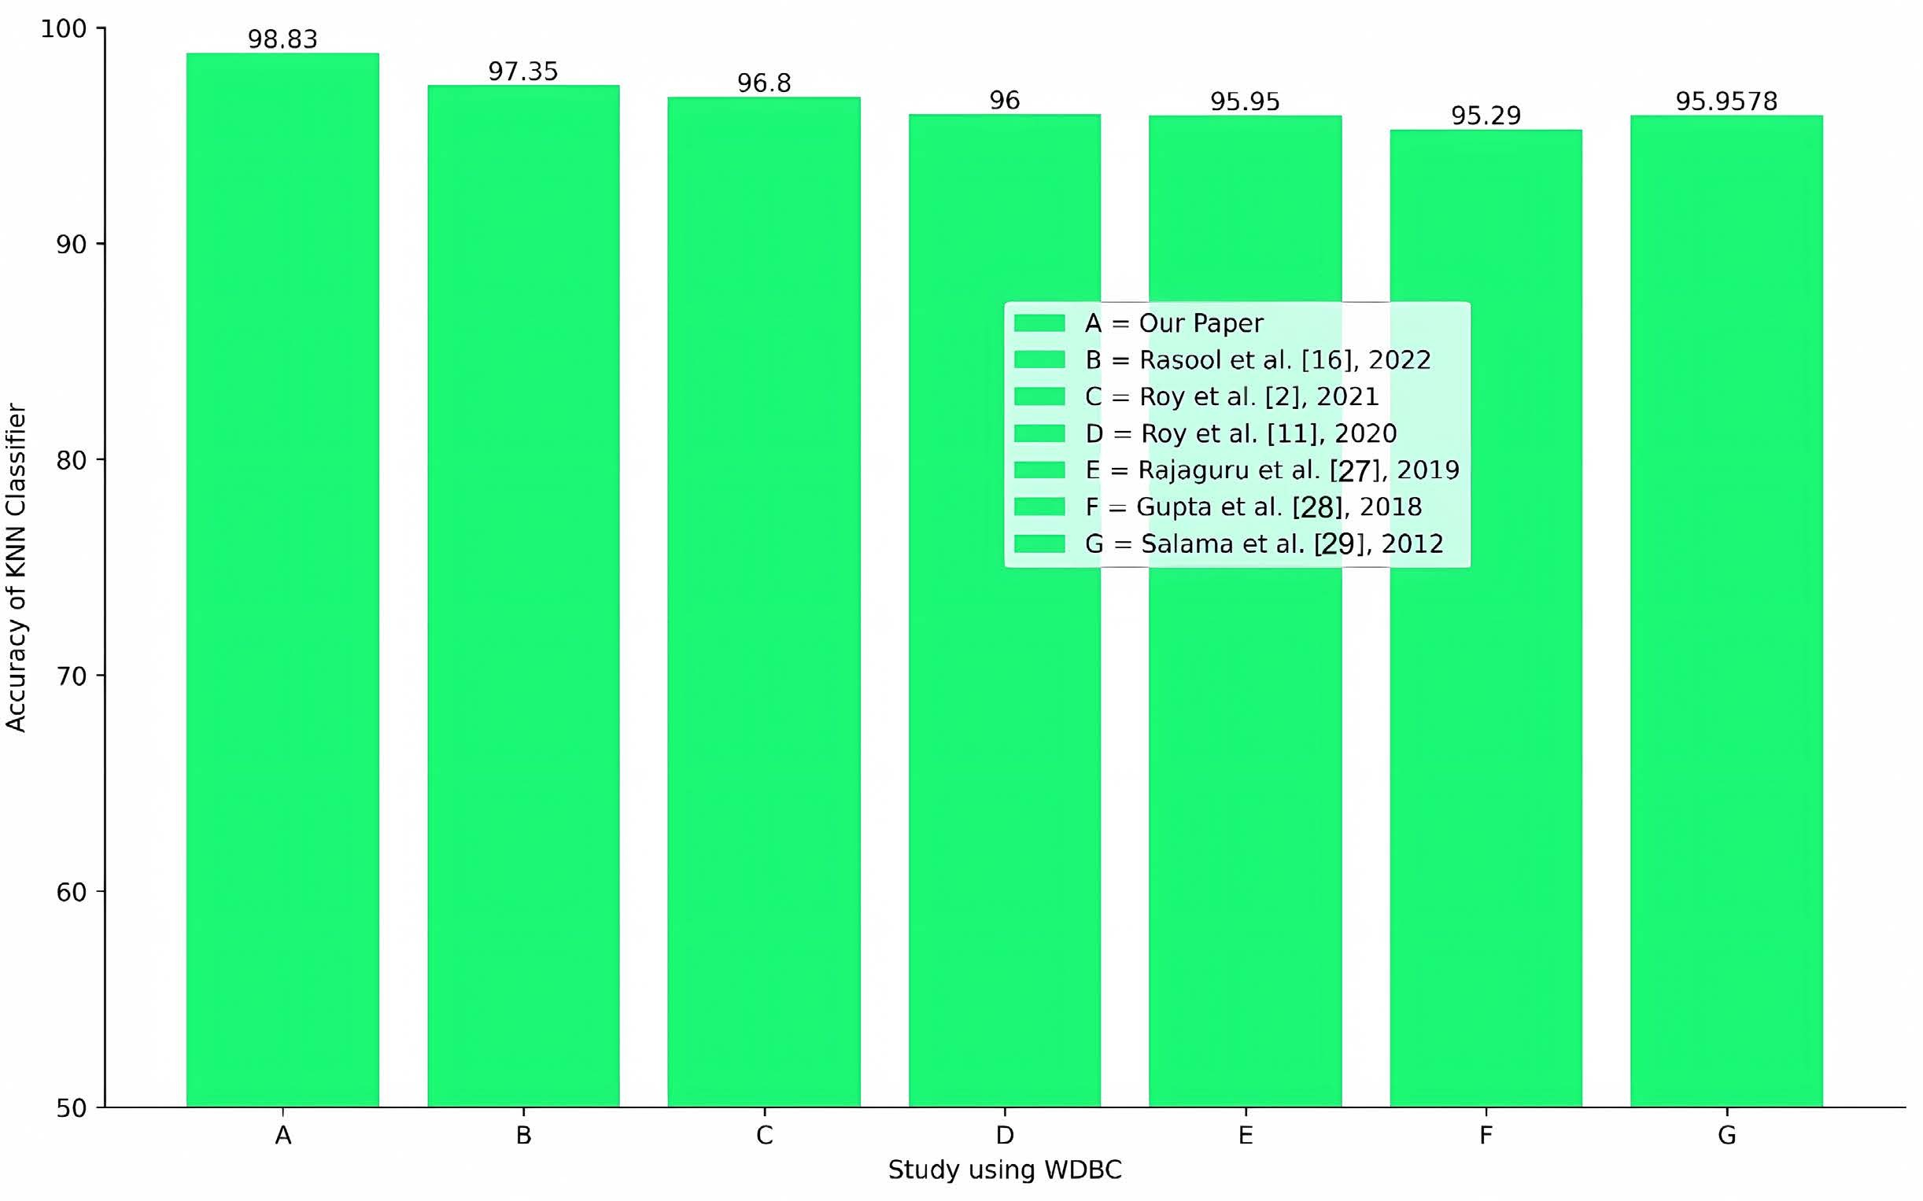
FINAL OUTPUT (cont.)
Figure 6. Result in comparison with existing work.

Slide 19
CONCLUSION
This study will help:
The healthcare professional
To predict breast cancer early
Got 98.83% accuracy in KNN
Scope for Future work

Slide 20
References
Rasool, A., Bunterngchit, C., Tiejian, L., Islam, M.R., Qu, Q. and Jiang, Q. (2022) Improved Machine Learning-Based Predictive Models for Breast Cancer Diagnosis. International Journal of Environmental Research and Public Health, 19, Article 3211. https://www.mdpi.com/1660-4601/19/6/3211 https://doi.org/10.3390/ijerph19063211
Roy, S., Gawande, R., Nawghare, A. and Mistry, S. (2021) Comparative Study of Machine Learning Algorithms for Detecting Breast Cancer. International Journal of Computer Science Trends and Technology (IJCST), 9, 103-111.
Roy, B.R., Pal, M., Das, S. and Huq, A. (2020) Comparative Study of Machine Learning Approaches on Diagnosing Breast Cancer for Two Different Dataset. Pro-ceedings of 2020 2nd International Conference on Advanced Information and Com-munication Technology (ICAICT), Dhaka, 28-29 November 2020, 29-34. https://ieeexplore.ieee.org/abstract/document/9333507 https://doi.org/10.1109/ICAICT51780.2020.9333507
Rajaguru, H. and Chakravarthy, S.R. (2019) Analysis of Decision Tree and K-Nearest Neighbor Algorithm in the Classification of Breast Cancer. Asian Pacific Journal of Cancer Prevention, 20, 3777-3781.
Gupta, M. and Gupta, B. (2018) A Comparative Study of Breast Cancer Diagnosis Using Supervised Machine Learning Techniques. Proceedings of 2018 Second In- ternational Conference on Computing Methodologies and Communication (ICCMC), Erode, 15-16 February 2018, 997-1002. https://doi.org/10.1109/ICCMC.2018.8487537
Salama, G.I., Abdelhalim, M.B. and Zeid, M.A. (2012) Breast Cancer Diagnosis on Three Different Datasets Using Multi-Classifiers. International Journal of Computer and Information Technology, 1, 36-43.
Merouane, E. and Said, A. (2022) Prediction of Metastatic Relapse in Breast Cancer using Machine Learning Classifiers. International Journal of Advanced Computer Science and Applications, 13, 176-181. https://doi.org/10.14569/IJACSA.2022.0130222

Slide 21

Any Question?

