Slide 1
Context-Aware Academic Help Chatbot
Course: CEN 352 – Artificial Intelligence
Student: Ornela Senja
Year: 2025-2026
This project focuses on the design and implementation of a context-aware academic help chatbot using artificial intelligence techniques. The system allows students to interact with a chatbot through natural language and receive helpful academic responses in real time.

Slide 2
INTRODUCTION
Chatbots are artificial intelligence systems designed to communicate with users using natural language. They are widely used in education, customer support, and information systems. In an academic environment, chatbots can help students quickly access important information without searching through multiple resources.
This project presents a context-aware academic help chatbot that assists students by answering questions related to studies, exams, and subjects. The chatbot provides instant responses and improves the learning experience by being available at any time.

Slide 3
PROBLEM STATEMENT
Students often face difficulties when they need quick academic help, such as understanding study topics or finding exam-related information. Traditional academic platforms are usually static, meaning students must manually search for information, which can be time-consuming and frustrating.
The problem addressed in this project is the lack of an intelligent, interactive system that can understand student questions and respond appropriately. A chatbot powered by artificial intelligence can solve this problem by providing fast, accurate, and user-friendly academic assistance.

Slide 4

PROJECT OBJECTIVES
The main objectives of this project are to design and implement an intelligent chatbot capable of understanding user input and responding correctly. The chatbot should classify user intentions, manage conversational context, and generate meaningful responses.
Another objective is to apply artificial intelligence techniques learned in the course, including machine learning and rule-based reasoning. Additionally, the project aims to create a functional and interactive user interface using Streamlit.

Slide 5
INTELLIGENT AGENT CONCEPT
In artificial intelligence, an intelligent agent is an entity that perceives its environment, makes decisions, and performs actions to achieve specific goals. The chatbot in this project functions as an intelligent agent.
It perceives the environment through user text input, reasons by applying machine learning and logical rules, and acts by generating appropriate responses. This agent-based approach allows the chatbot to adapt its behavior based on user interactions.

Slide 6
PEAS FRAMEWORK
The PEAS framework is used to describe the task environment of an intelligent agent.
Performance Measure: Accuracy and F1-score of intent classification, as well as correct responses.
Environment: A text-based, partially observable, and static environment.
Actuators: Text responses displayed in the chatbot interface.
Sensors: User text input entered through the Streamlit application.
This framework helps define how the chatbot operates and how its performance is evaluated.

Slide 7
AI TECHNIQUES USED
This project integrates two main artificial intelligence techniques. The first technique is machine learning, which is used to classify user intent based on text input. This allows the chatbot to understand what the user is asking.
The second technique is rule-based reasoning, which is used to generate appropriate responses and manage conversational flow. By combining these techniques, the chatbot becomes more flexible and intelligent than a simple rule-based system.

Slide 8

INTENT CLASSIFICATION (MACHINE LEARNING)
Intent classification is a key component of the chatbot. The system uses TF-IDF (Term Frequency–Inverse Document Frequency) to convert user text into numerical features. These features are then used by a Naive Bayes classifier to predict the user’s intent.
The model is trained on predefined academic intents and saved for later use. During runtime, the chatbot loads the trained model and predicts the intent of each user message in real time.

Slide 9

CONTEXT AWARENESS AND MEMORY
Context awareness allows the chatbot to remember previous user interactions and respond more intelligently. In this project, context is managed using Streamlit session state.
The chatbot stores the last detected intent and subject, which enables it to understand follow-up questions. This feature improves the user experience by making conversations more natural and meaningful.

Slide 10
SYSTEM ARCHITECTURE
The system architecture consists of several interconnected components. First, the user enters a message through the Streamlit interface. The input is then sent to the intent classification model.
After the intent is predicted, the chatbot logic determines the correct response based on the intent and conversation context. Finally, the response is displayed back to the user in the web interface.

Slide 11
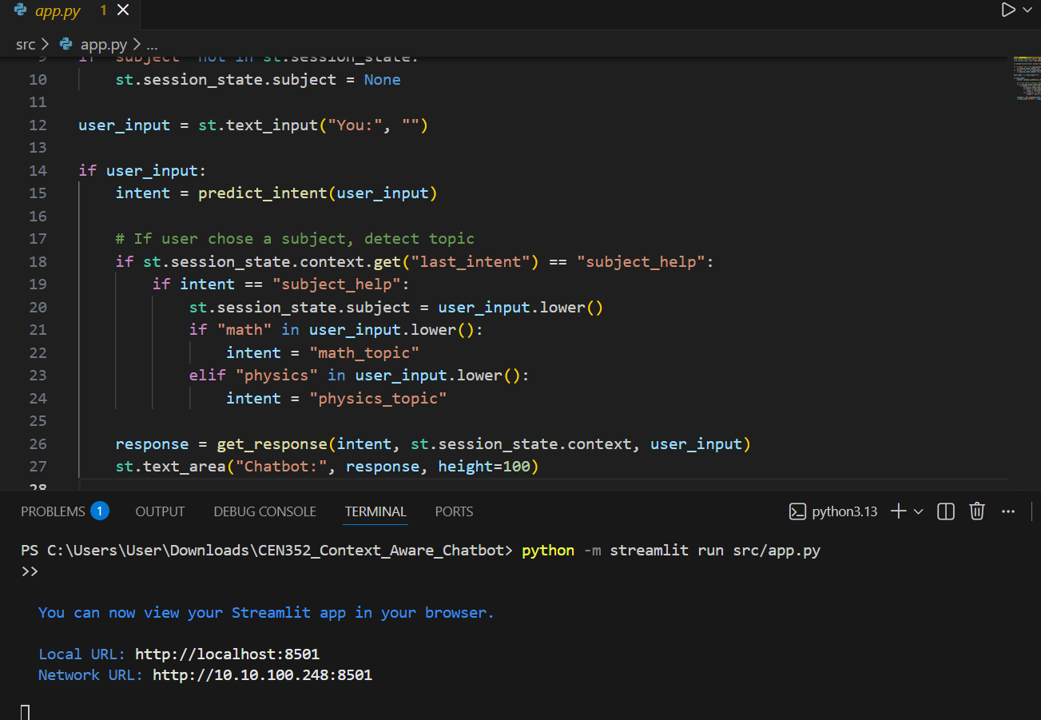
CODE EXPLANATION: app.py
The app.py file is the main entry point of the application. It uses Streamlit to create the user interface and handle user input. The file also manages session state to store context information.
When the user enters a message, the app predicts the intent, updates the context, and calls the chatbot logic to generate a response. The response is then displayed in the chatbot interface.
“The app.py file controls the intelligent agent. It connects user input with the intent classifier and the rule-based response logic.”

Slide 12
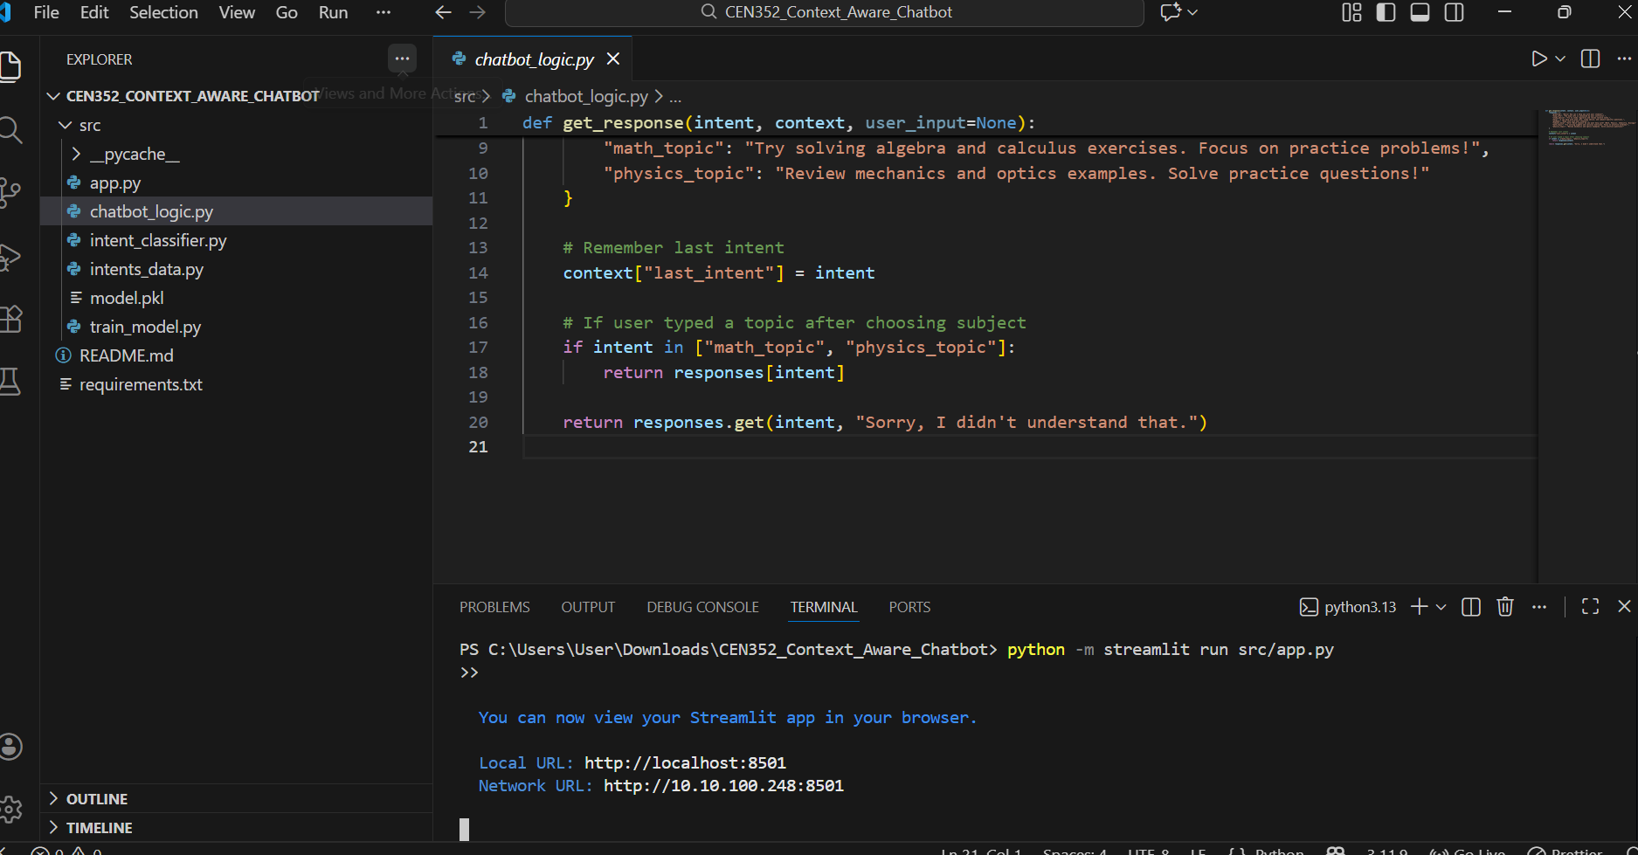
CODE EXPLANATION: chatbot_logic.py
The chatbot_logic.py file contains the logic for generating responses. It maps detected intents to predefined responses and handles fallback situations when the intent is not recognized.
This file also updates the conversation context by storing the last intent. By separating logic from the user interface, the system becomes more modular and easier to maintain.
“The chatbot logic uses predefined rules to map detected intents to responses, which is an example of rule-based reasoning.”

Slide 13
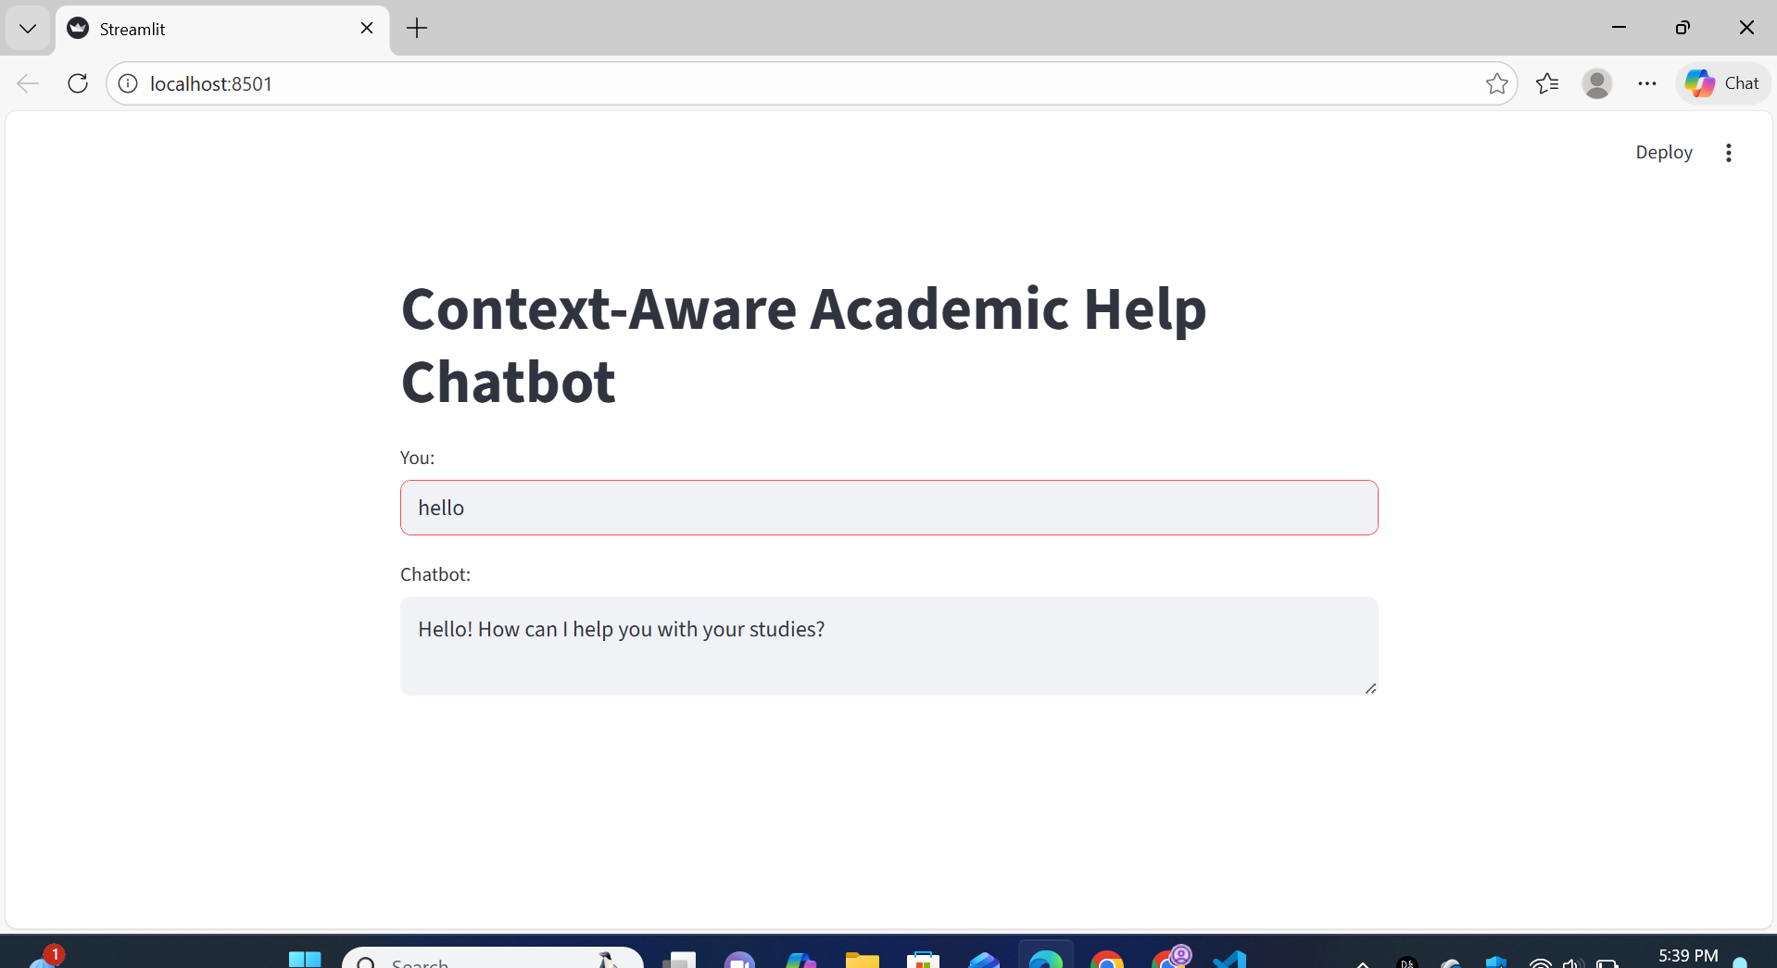
Browser view of Streamlit chatbot UI with “hello” → response

Slide 14
CONCLUSION
This project demonstrates the successful development of a context-aware academic help chatbot using artificial intelligence techniques. By combining machine learning for intent classification with rule-based logic, the chatbot can understand user questions and provide relevant academic responses. The system shows how AI concepts can be applied in a practical and useful educational application.

Slide 15
Thank you

