Slide 1
ECO-ECHO

Slide 2
Team Name: Watch dawgs Team Leader Name: Rahul sharma Project Name: eco-echo
Problem Statement:
In today's world, the global community is facing urgent challenges related to climate change, environmental degradation, and unsustainable consumption patterns. Individuals often lack accessible and engaging tools to participate in meaningful sustainability actions tailored to their daily lives. Despite growing awareness of these issues, there remains a gap in easily adopting and tracking personal sustainability practices.
EcoEcho aims to inspire and facilitate positive environmental and social impact at the individual level. Through this approach, EcoEcho aims to contribute to the broader global goals of mitigating climate change, promoting responsible consumption, and fostering sustainable communities.
Solution:
EcoEcho is a personal sustainability app designed to make it easy and rewarding for individuals to adopt eco-friendly habits in their daily lives. Our solution offers a user-friendly platform where users can discover and complete personalized sustainability tasks based on their location, preferences, and lifestyle.
Through EcoEcho, users receive a tailored set of tasks each day, week, and month, ranging from simple actions like using public transport to more impactful tasks such as planting trees or donating to local causes. These tasks are categorized by difficulty level, making it easy for users to choose actions that fit their comfort and availability.
The app provides a calming and positive user interface, encouraging engagement and making sustainability accessible to everyone. Users can upload photos as proof of task completion, fostering accountability and creating a sense of accomplishment.

Slide 3
1. Backend:
Cloud Firestore: Database management for storing user data, tasks, and community interactions.
Firebase Authentication: Secure user authentication to access the app's features.
Firebase Storage: Storage of media files such as task completion photos.
Cloud Functions: Executes on the cloud, responsible for task generation based on Gemini 1.0 Pro and other
dynamic updates.
2. Frontend:
2.1. Android Native (XML + Java):Develops the Android app interface for users to interact with tasks, community, and profiles.
Languages: Java for backend logic, XML for UI design.
Technologies: Android Native development tools.
2.2. React:
Develops the Progressive Web App (PWA) accessible on iOS, macOS, Windows, and web browsers.
Languages: JavaScript for frontend logic.
Technologies: React framework for PWA development.
3. Technologies:
Gemini 1.0 Pro: Utilized within Cloud Functions for task generation.
Google Maps API: Used within backend logic (Cloud Functions) to generate location-based tasks.
Google Material Design: Integrated into Android Native and Progressive Web App UI components ensuring consistency and user-friendliness.
Google Analytics: Integrated into both Android Native and Progressive Web Apps for tracking user behavior.
Cloud Messaging: Utilized within backend logic (Cloud Functions) to trigger notifications based on user activity.

Slide 4
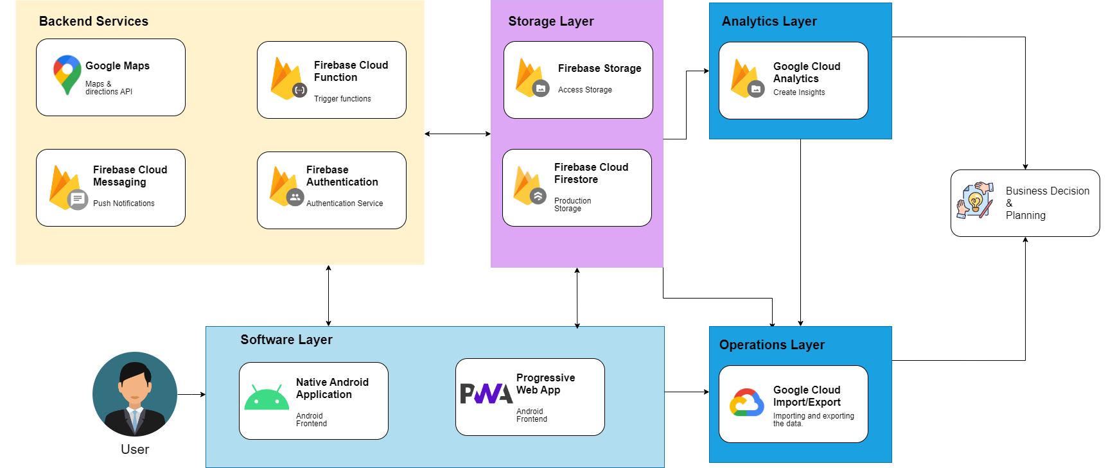

Slide 5
Use cases
Personalized Sustainability Tasks: Users can receive daily, weekly, and monthly sustainability tasks tailored to their location, preferences, and lifestyle. For example, a user living in a city might receive tasks like using public transportation instead of driving, carrying a reusable water bottle, or participating in a local cleanup event.
Task Completion Tracking: Users can track their progress in completing sustainability tasks within the app. They can upload photos as proof of task completion, fostering accountability and a sense of accomplishment. This feature encourages users to stay engaged with their sustainability efforts.
Community Engagement: EcoEcho fosters a sense of community by allowing users to share their sustainability achievements and challenges with peers. Users can interact with each other, share tips and experiences, and celebrate milestones together. This community-driven approach encourages support and motivation among users.
Location-Based Tasks: The app utilizes the Google Maps API to generate location-based tasks. For instance, users might receive tasks specific to their geographical area, such as volunteering at a local park, supporting nearby eco-friendly businesses, or participating in environmental initiatives in their community.
Educational Resources: EcoEcho can provide educational resources and tips on sustainability practices. Users can access articles, videos, and infographics within the app to learn more about environmental issues, sustainable living, and how their actions can make a difference.
Progressive Web App Access: Users can access EcoEcho not only through the native Android app but also via the Progressive Web App (PWA), making it accessible across various devices and platforms including iOS, macOS, Windows, and web browsers. This ensures that users can engage with the app regardless of their device preferences.
Task Difficulty Levels: Tasks are categorized by difficulty level, allowing users to choose actions that align with their comfort and availability. For example, users can select from easy tasks like reducing water usage at home to more challenging tasks such as organizing a community recycling event.

Slide 6
Advantages
Personalized Sustainability: EcoEcho offers personalized sustainability tasks tailored to users' location, preferences, and lifestyle. This customization ensures that users receive actionable and relevant tasks that align with their interests and capabilities.
User Engagement: The app provides a user-friendly interface and a positive user experience, encouraging engagement with sustainability practices. Features such as task tracking, community interaction, and progress sharing foster a sense of accountability and accomplishment, motivating users to continue their sustainability efforts.
Community Support: EcoEcho facilitates community engagement, allowing users to interact with peers, share experiences, and celebrate achievements together. This sense of community support provides encouragement, motivation, and a platform for knowledge exchange among users.
Accessibility: With both a native Android app and a Progressive Web App (PWA), EcoEcho is accessible across a wide range of devices and platforms, including smartphones, tablets, laptops, and desktop computers. This accessibility ensures that users can engage with the app regardless of their device preferences or operating system.
Location-Based Tasks: By leveraging the Google Maps API, EcoEcho offers location-based tasks that are relevant to users' geographical areas. This feature enables users to engage in sustainability actions that are specific to their local communities, fostering a sense of connection and impact at the grassroots level.
Scalability and Flexibility: The app's backend infrastructure, built on Cloud Firestore, Firebase Authentication, and Cloud Functions, offers scalability and flexibility to accommodate growing user needs and dynamic updates. This ensures smooth performance, security, and reliability as the user base expands and the app evolves.

Slide 7

Business model
Collaborations and promotions
Partner with eco-friendly brands and earn commissions on sales.
Consulting Services
Offer customized resource management plans for businesses.
Marketing
Collaborate with eco-friendly brands and charge for featured listings or endorsements.

Slide 8
Thank you
Team Name: Watch Dawgs

