Slide 1




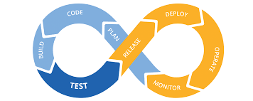


The opensource Rails Lab

Slide 2

- Who is the **target**?
Junior Rails developers without any system experience and general Developers who struggle in find Rails environments to stage his projects or get his own production servers.

Slide 3
- What's the **pain**
Today we can find a huge number of web environments prepared to PHP developers, what in my understanding is the main reason why PHP is so used on our days, and platforms as WordPress keep on the front of the web ratings.
As a Ruby in rails future developer I can see how painful is testing, debugging, staging, and deploying a website through the lack of server base tools, which can permit us to control the Rails and Ruby Versions or a simple CI/CD integration with git, or even testing SSL on VHOSTS.

Slide 4

What's the **solution**?
web management interface on rails
user management and groups and roles
server configuration (VHOSTS and SSL)
puma or unicorn integration
SSL configuration (self-generated keys or letsengrypt to prod servers)
CI/CD and git integration (as example a popup with Travis)
API Gateway for developer expose and testing consumers
Some interesting links to read
https://www.nginx.com/
https://letsencrypt.org/
https://about.travis-ci.com/

