Slide 1
Population-based Poker AI

Slide 2
Population-based Poker AI
How to
play Poker?

Slide 3
44 Hours
Population-based Poker AI
102 Agents
20’000’000
Hands Played

Slide 4
AIcrowd, PyPokerEngine
and their
Limitations
1 hand
1 hand
…
10’000 hands
2/week
Speed
Uploads
v1
v2
v3
Insights
Opponents

Slide 5
Research
Topics
Metrics
Populations
Architectures

Slide 6

Metrics
TrueSkill

Slide 7
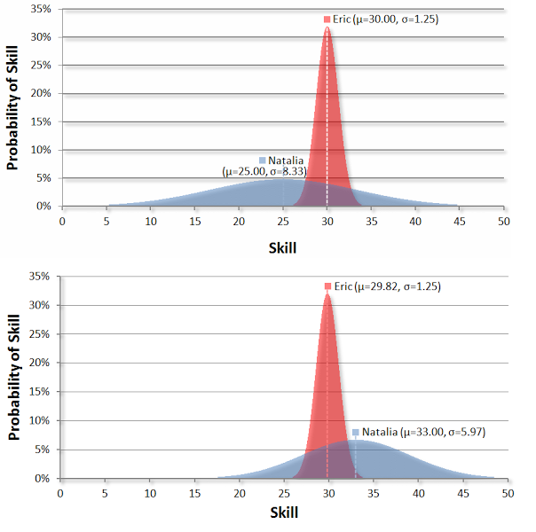
Metrics
TrueSkill Update
http://www.moserware.com/2010/03/computing-your-skill.html

Slide 8
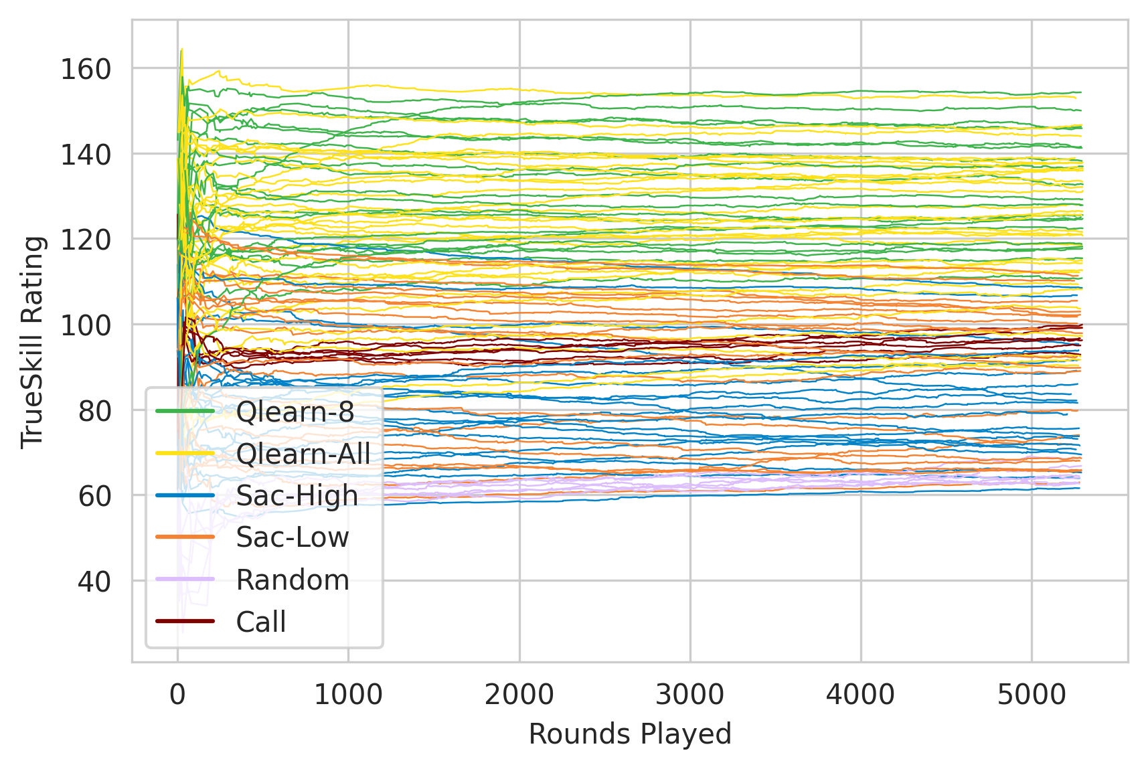
Metrics
TrueSkill

Slide 9
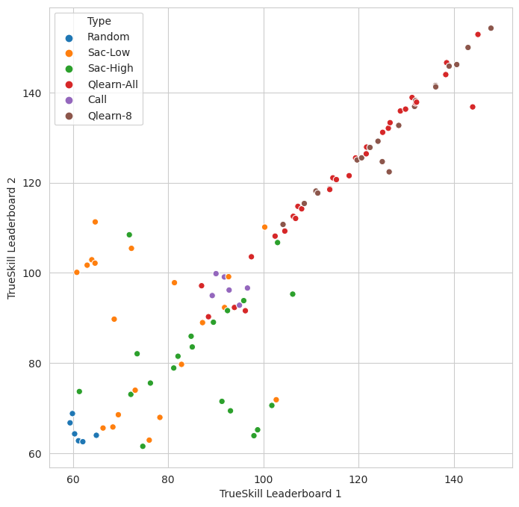
Metrics
TrueSkill Consistency

Slide 10
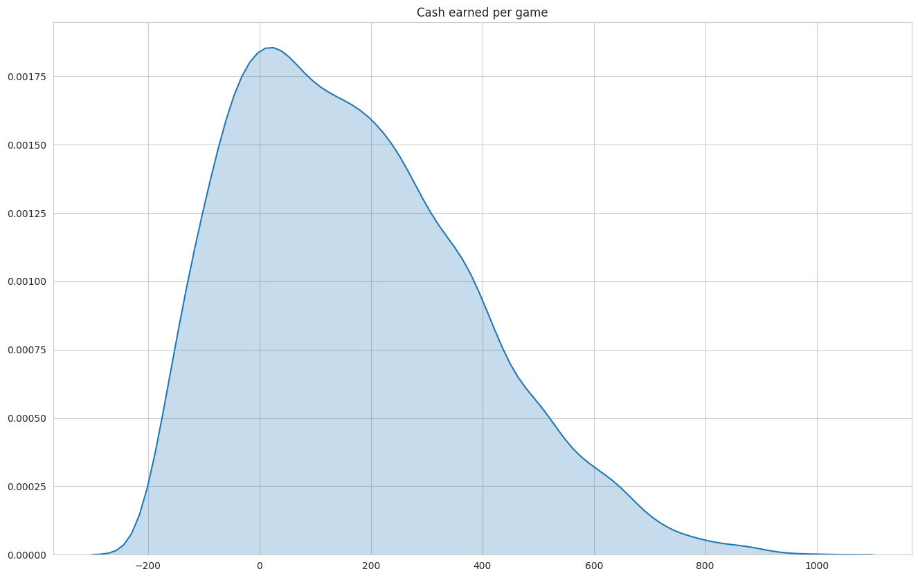
Metrics
Winnings

Slide 11
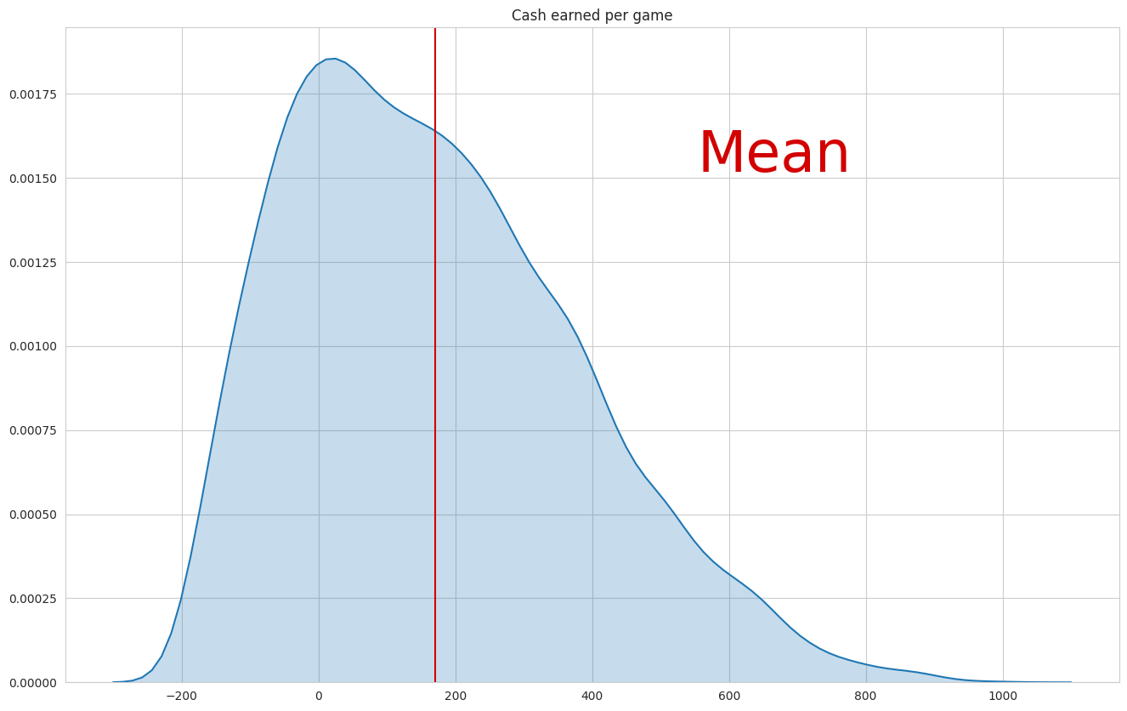
Metrics
Mean

Slide 12
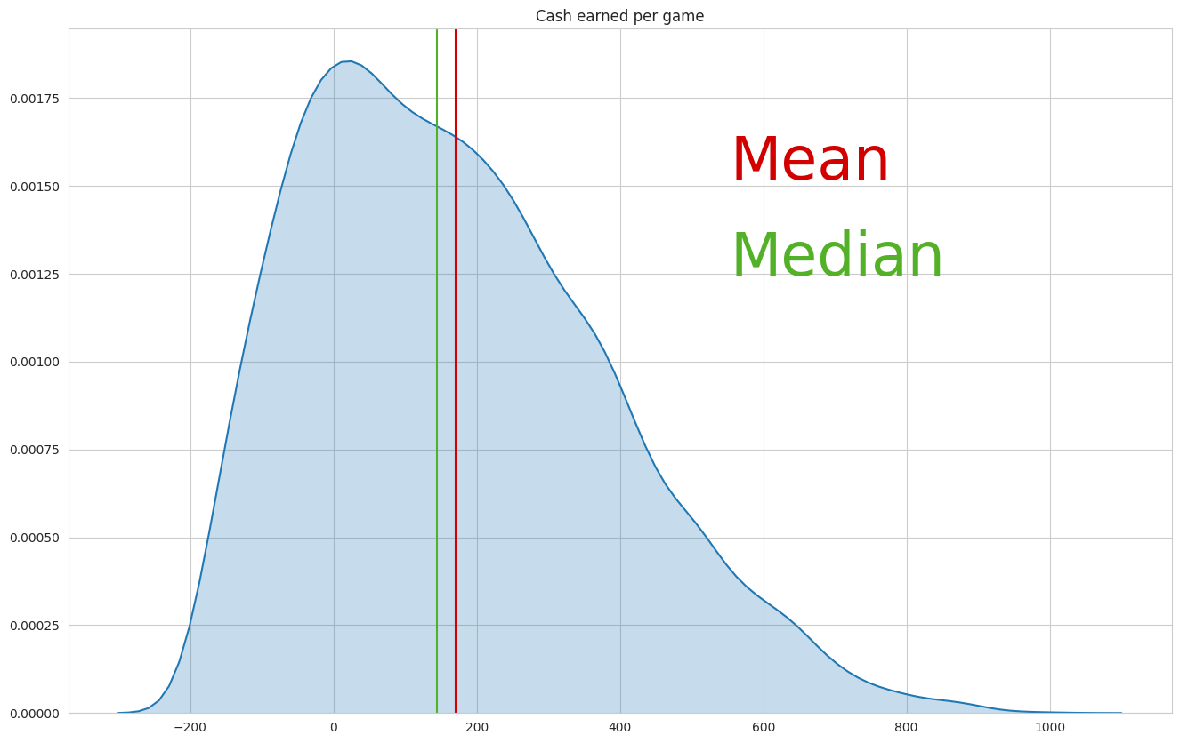
Metrics
Median

Slide 13
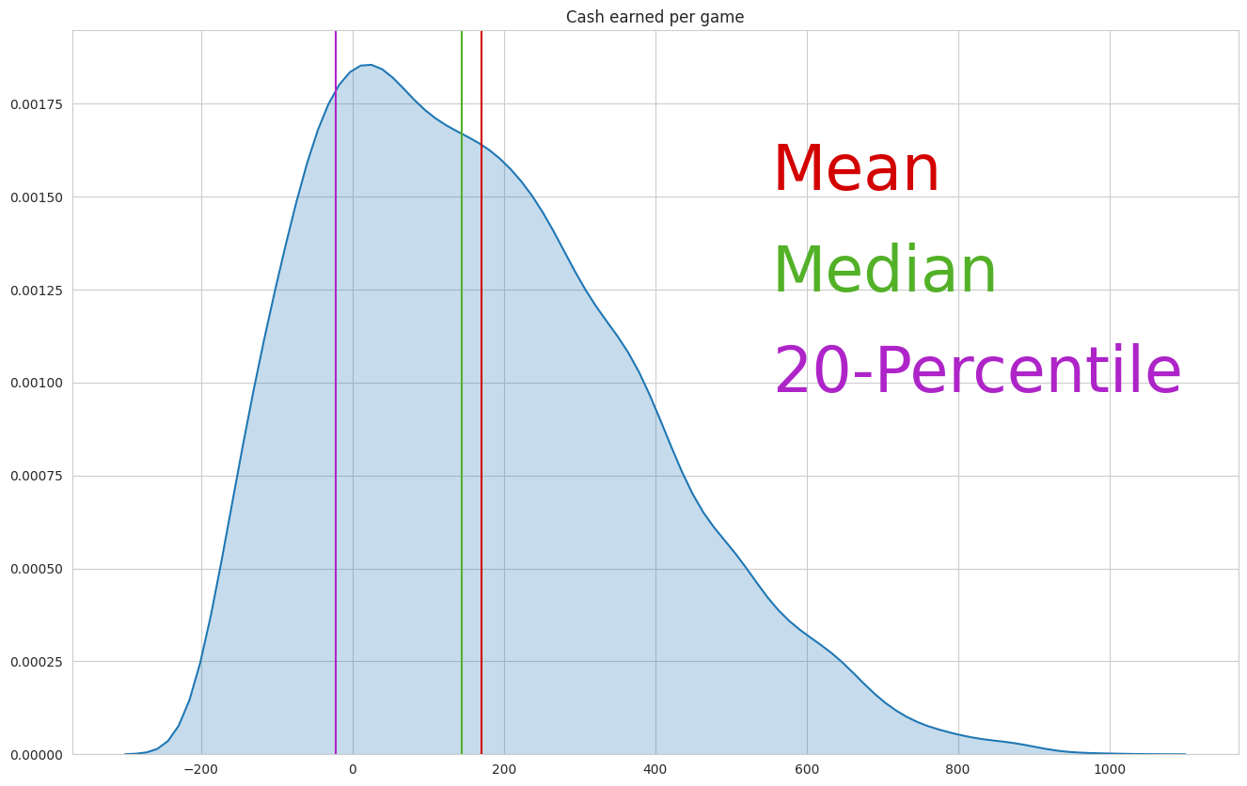
Metrics
20-Percentile

Slide 14
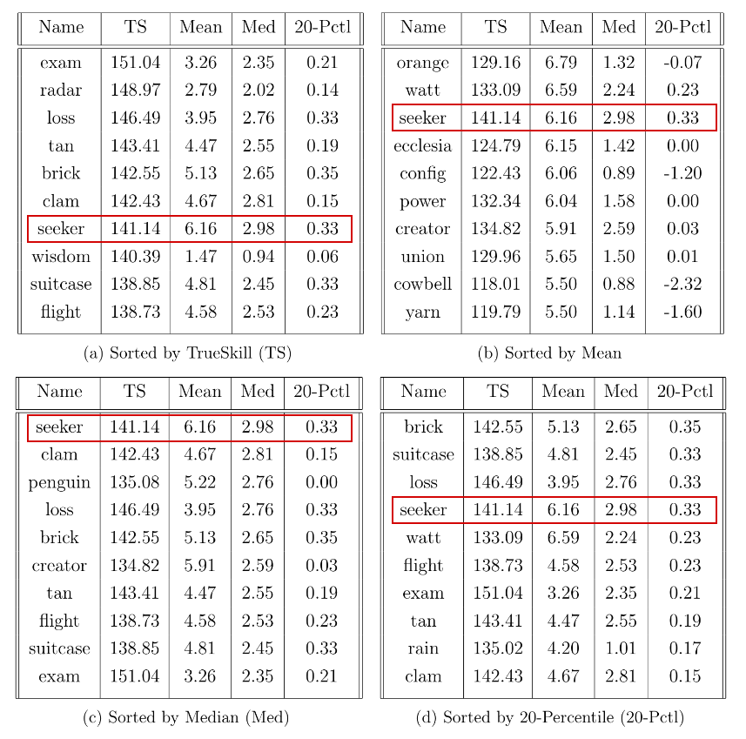
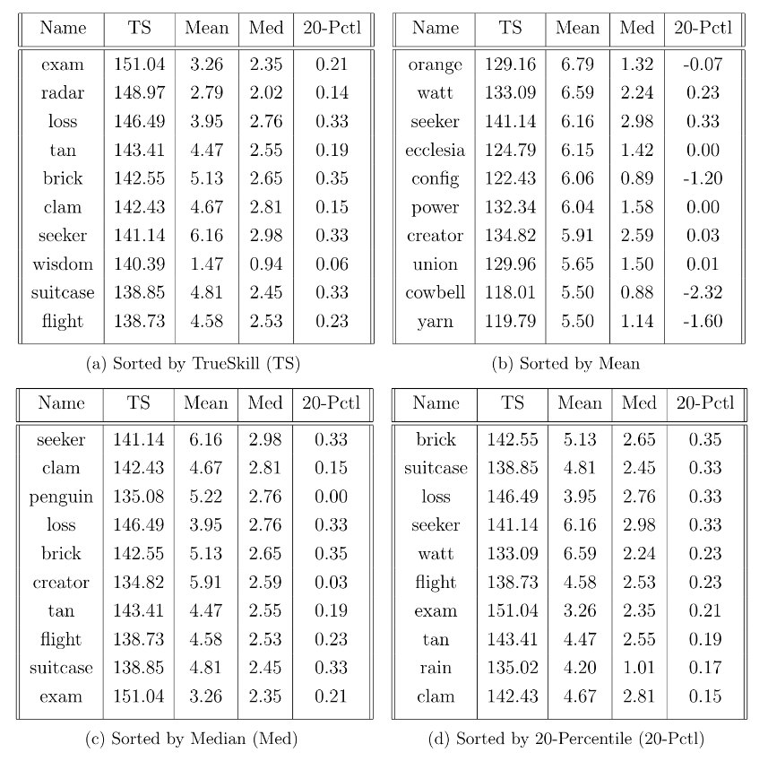
Metrics
Top 10

Slide 15
Metrics
Competition
Candidate

Slide 16
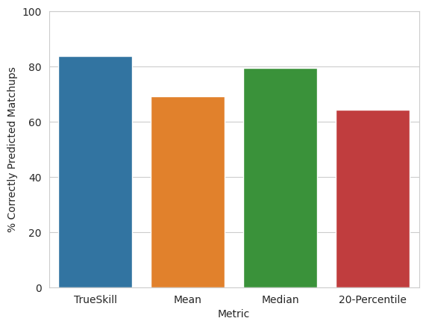
Metrics
Winrate Prediction Accuracy

Slide 17
Population
Vector
Engine
Demo

Slide 18
Population
Vector
Engine
N hands
Still running
completed
Still running
Still running
completed
Still running
completed
completed
Still running
completed
completed

Slide 19
Population
Number of Agents
Division X
Teachers
Baseline
Students
Clone
Frozen copy
select
select
Match (10’000 Hands)
learn

Slide 20
Mixed
Divisions
Single Type
Divisions
Population
Composition
of Agents
vs
Actionspace
predictable?

Slide 21
Random
Matchup
Climbing
Matchup
Population
Matchup
Generation
vs
Agent A
Agent B
Agent C
Agent D
Agent E
Agent F
Agent A
Agent B
Agent C
Agent D
Agent E
Agent F

Slide 22
Architectures
Overview
Baselines
Reinforcement Learning
Deep Q-Learning
Soft Actor-Critic

Slide 23
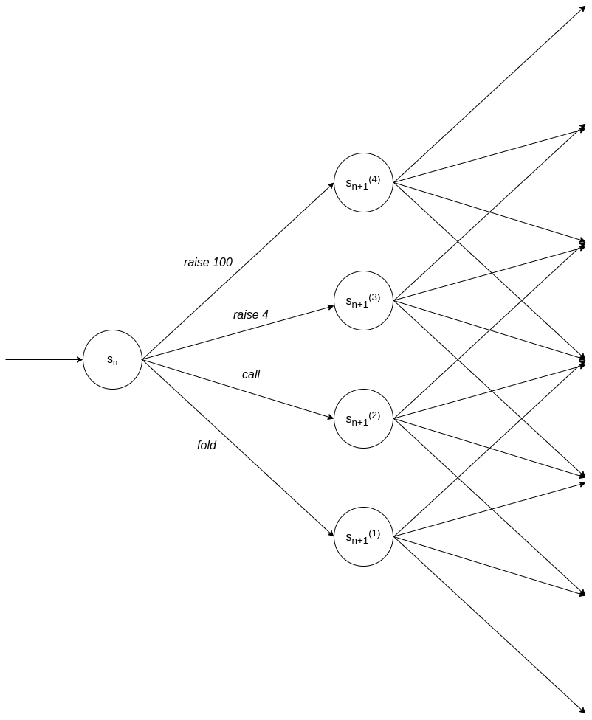
Architectures
Deep
Q-Learning

Slide 24
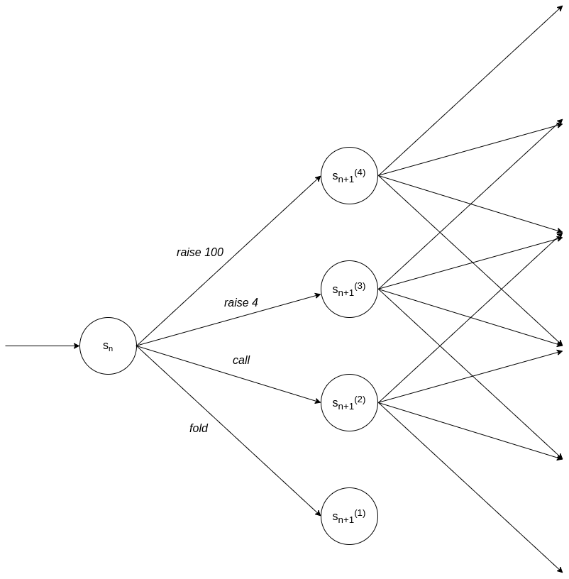
Architectures
Deep
Q-Learning

Slide 25
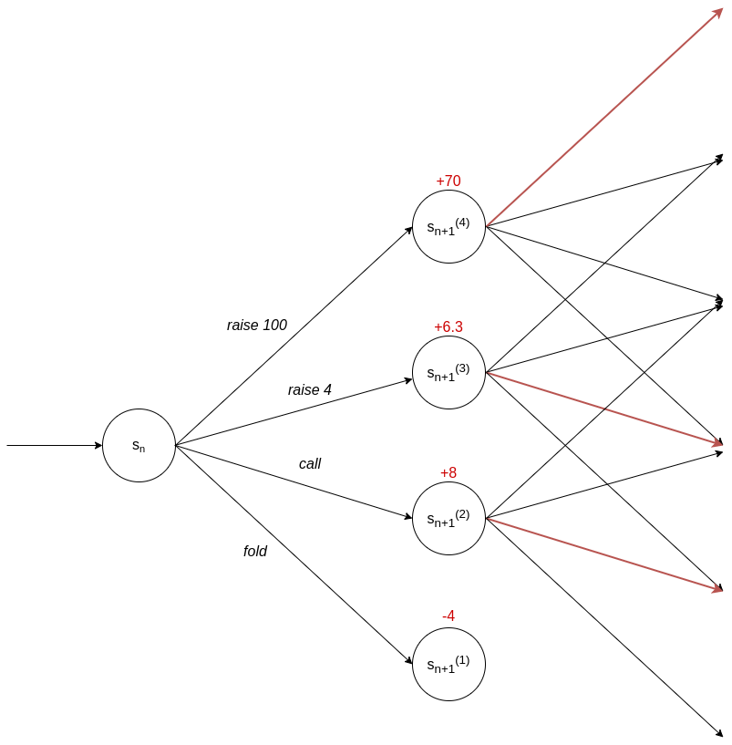
Architectures
Deep
Q-Learning

Slide 26
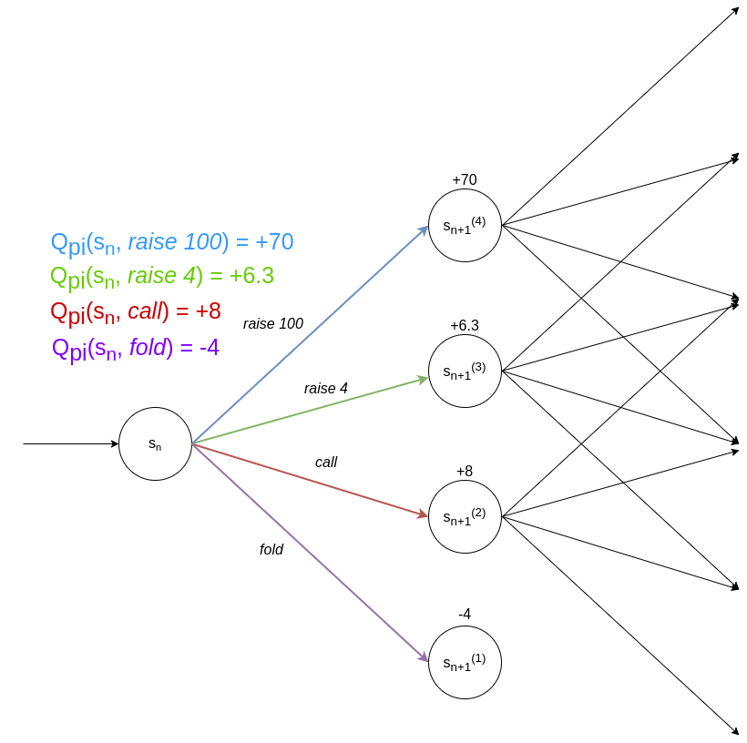
Architectures
Deep
Q-Learning

Slide 27
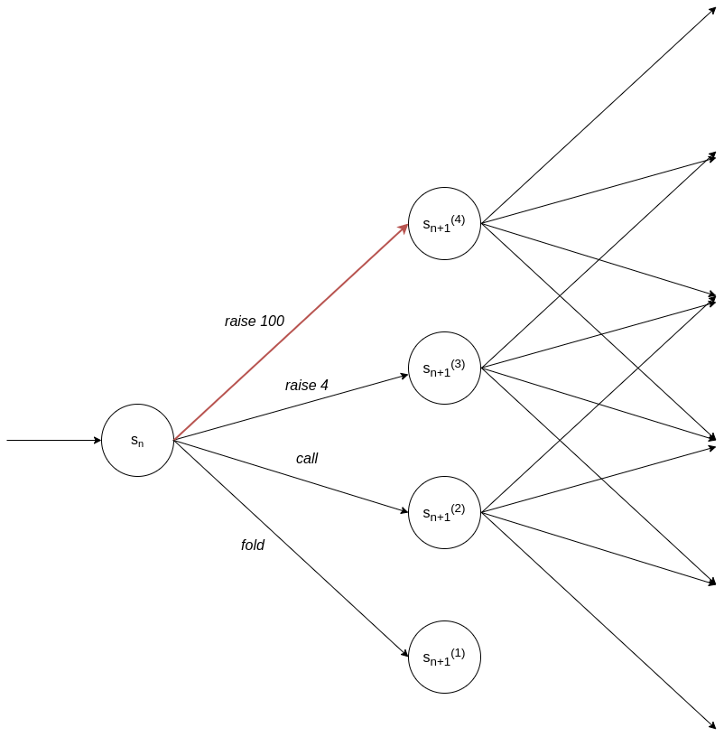
Architectures
Deep
Q-Learning

Slide 28
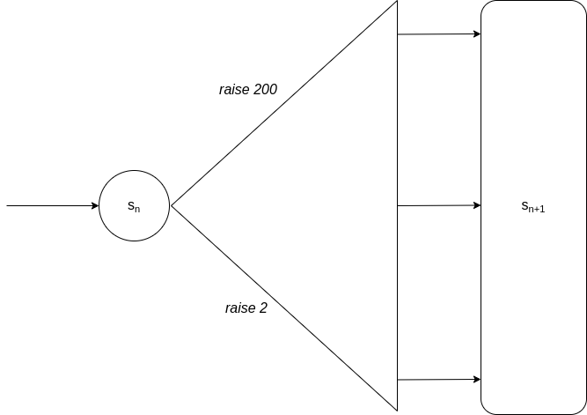
Architectures
Soft
Actor-Critic

Slide 29
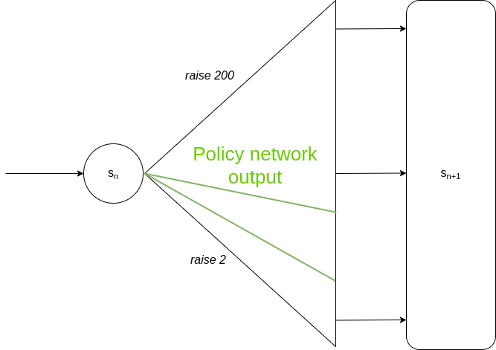
Architectures
Soft
Actor-Critic

Slide 30
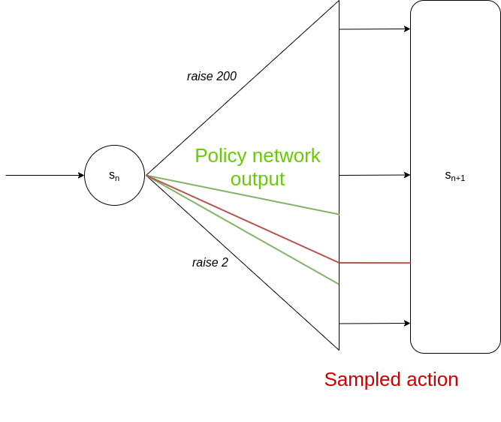
Architectures
Soft
Actor-Critic

Slide 31
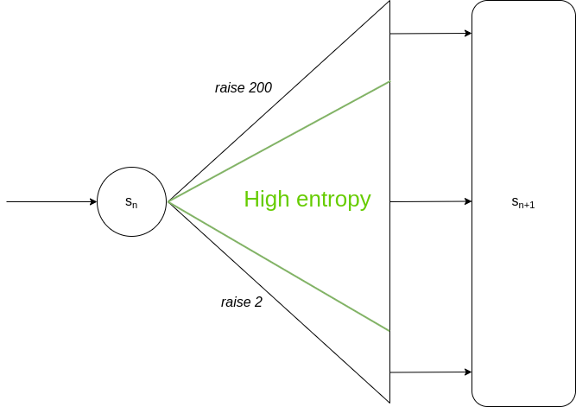
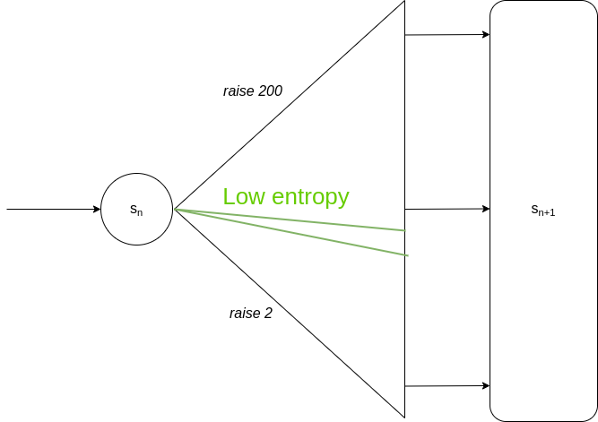
Architectures
Soft
Actor-Critic

Slide 32
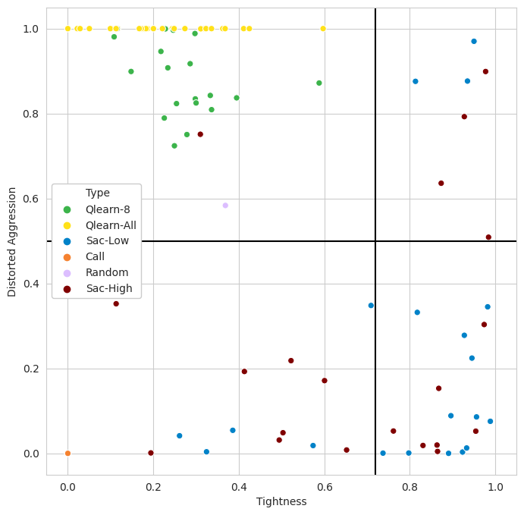
Architectures
Strategy Coverage

Slide 33
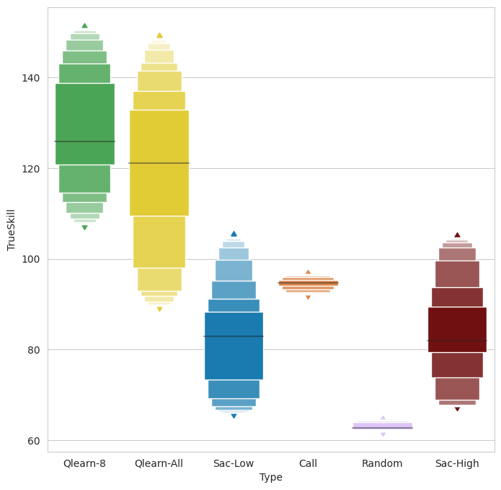
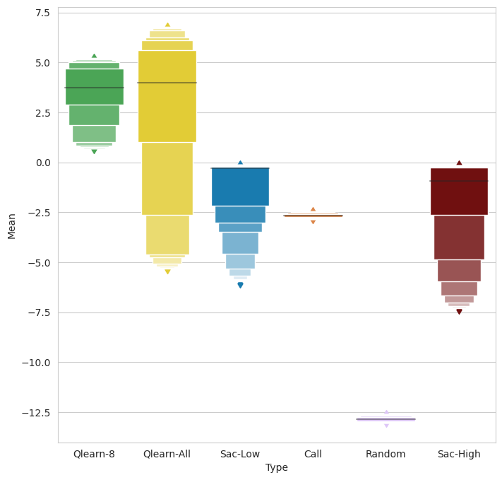
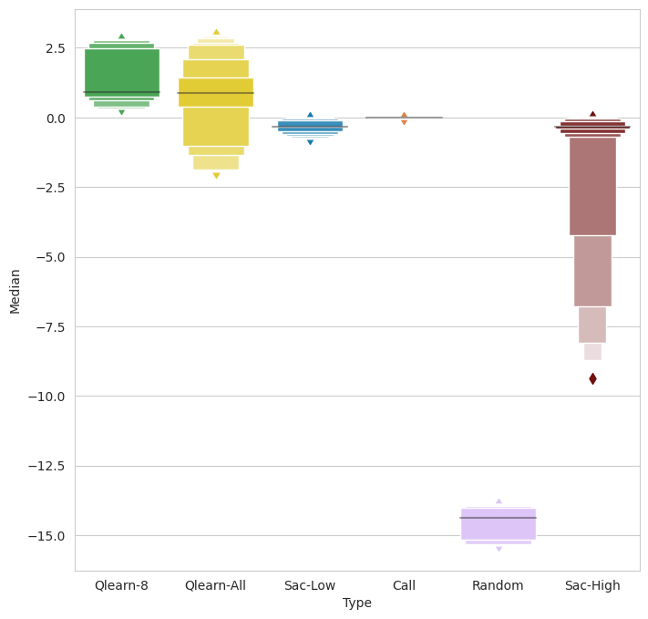
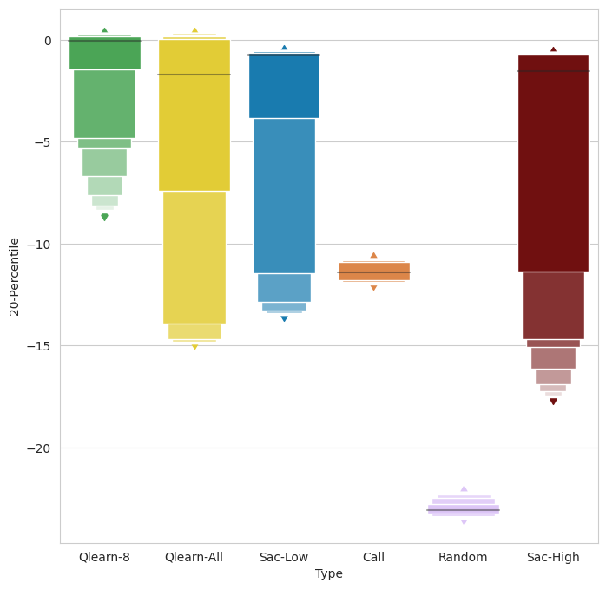
Architectures
Performance

Slide 34
Trueskill best predictor
of winner
… but inconsistent with certain agent behavior
Conclusions
Remember this!
Division insignificant
Architecture
determines
strategy
Soft Actor-Critic
underperforms heavily
High Aggression
more money
less wins

