Slide 1
FinSent
Provider-Driven Stock Intelligence Dashboard
Saad Waghoo | K. J. Somaiya School of Engineering
Department of Computer Engineering

Slide 2
Agenda
1. Problem, motivation, and product thesis
2. Exchange-first architecture and provider strategy
3. Intelligence pipeline, scoring, and data honesty
4. Dashboard walkthrough with real implementation highlights
5. Engineering progress, limitations, and roadmap

Slide 3
Executive Summary
FinSent is a multi-market stock intelligence platform that combines provider-backed quotes, recent ticker-specific news, structured LLM interpretation, and deterministic short-term scoring inside a polished Dash dashboard.
Markets
3 Exchanges
US, NSE India, and BSE India
Coverage
20 Symbols
Seeded across tech, finance, energy, and consumer
Experience
4 Pages
Summary, News Impact, Compare, and Alerts
Progress
~75%
Implementation maturity vs planned scope
What makes it strong:
Provider abstraction instead of one-off scripts
Structured Gemini analysis with parse-safe fallback behavior
Runtime badges that show live, stale, inferred, or unavailable states honestly

Slide 4
Problem Statement
Retail traders typically check prices, news, analyst updates, and social commentary across disconnected tools.
Most dashboards either show static historical values or use AI summaries without clear source ownership.
The real challenge is not just sentiment classification; it is combining market context, data freshness, and explainability in one system.

Slide 5
Where Generic Dashboards Fail
Typical student-demo weaknesses
Hardcoded tickers and CSV-driven values
No distinction between live data and stale data
LLM treated like a data source instead of an analyst
What FinSent does differently
Exchange-first flow with provider routing
Runtime honesty through source, freshness, and quality badges
Deterministic signal engine on top of structured AI output

Slide 6
Product Thesis
FinSent should feel like a real stock-intelligence workspace, not a notebook demo.
The product should tell the user what the market is doing, what the news is saying, how strong that evidence is, and whether the system trusts its own conclusion.
That is why provider abstraction, data honesty, and explanation quality matter as much as raw sentiment accuracy.

Slide 7
Platform Scope
Coverage, providers, and runtime trust model

Slide 8
Coverage Snapshot
The current build is exchange-first, with a fixed registry that maps UI tickers to provider symbols cleanly.
US Coverage
8 symbols
AAPL, AMZN, MSFT, NVDA, META, GOOGL, TSLA, JPM
NSE Coverage
7 symbols
RELIANCE, TCS, INFY, HDFCBANK, ICICIBANK, SBIN, ITC
BSE Coverage
5 symbols
RELIANCE, TCS, INFY, HDFCBANK, SBIN
Quote modes
4 states
live, stale, inferred, unavailable
News tiers
2 levels
provider-grade vs fallback-quality
Core entities
4 stores
quotes, bars, news, signal snapshots
Pages
4
summary, impact, compare, alerts

Slide 9
Provider Matrix
Layer | US path | India path | What the app does
Quote snapshot | Polygon | Kite (planned / credential-gated) | Fetches price, timestamp, freshness, and liquidity context
Historical bars | Polygon aggregates | Kite historical bars | Drives timelines, overlap analysis, and price windows
News ingestion | Polygon News | Marketaux | Normalizes article metadata and relevance
LLM analysis | Gemini | Gemini | Returns structured relevance, tone, confidence, impact, catalyst
Fallback | last-trade / prev-close / web news | web news / unavailable | Protects the UX without pretending stale data is live

Slide 10
Runtime Modes and Data Honesty
Mode 1
Market + News
Fresh quotes and recent analyzed headlines are both active
Mode 2
Market-only fallback
Quotes or bars are present, but headline support is weak or unavailable
Mode 3
News-only fallback
Headline coverage exists, but usable live market linkage is missing
Mode 4
Unavailable
The app refuses to fake live values when providers fail
This honesty layer is a major difference between FinSent and a typical student-demo dashboard.
The UI surfaces price source, news provider, provider tier, freshness age, and quality badges so the user always knows what is grounded versus inferred.

Slide 11
Architecture
How FinSent is assembled as a real system

Slide 12
High-Level Architecture
Providers
Market + News
Polygon, Marketaux, Kite plan, fallback web
User Layer
User
Ticker selection and page navigation
Frontend
Dash UI
Summary, News Impact, Compare, Alerts
State
View Model
Loads and normalizes data for figures and cards
Persistence
SQLite / SQLAlchemy
Quotes, bars, news, and signal snapshots
Intelligence
Gemini + Heuristics
Structured interpretation with deterministic signal logic
Key principle: providers fetch raw data, Gemini interprets the data, and the app owns the final composite signal.

Slide 13
Runtime Pipeline
1. User selects exchange and symbol
2. Symbol registry resolves the provider symbol
3. Market provider fetches quote snapshot and price bars
4. News provider fetches recent headlines
5. Gemini returns structured JSON or heuristic fallback is used
6. Signal engine computes deterministic composite score
7. View model renders cards, charts, tables, and alerts

Slide 14
Persistence and Data Model
Store | Purpose | Key fields
Quote snapshots | Latest market state | ticker, exchange, current price, bid/ask, provider, freshness, quality
Price bars | Historical movement | open, high, low, close, volume, interval, market timestamp
Normalized news | Headline evidence | title, source, url, provider, sentiment, confidence, parse status
Signal snapshots | Decision layer | composite score, label, action bias, mode, final reason

Slide 15
Intelligence Pipeline
Structured article analysis
relevant / not relevant
bullish / bearish / neutral
confidence and impact strength
time horizon and catalyst tag
Reliability controls
JSON parsing validation
Heuristic fallback for quota or parse failures
Cached article hashes to avoid repeat analysis
Quality badge downgraded when AI output is inferred

Slide 16
Composite Signal Engine
Inputs blended by app logic
aggregate news sentiment
article recency and relevance
market pressure and price movement
volume and liquidity context
Outputs visible in the UI
composite score
bullish / neutral / bearish label
signal confidence
plain-language explanation

Slide 17
Product Experience
What the dashboard actually shows

Slide 18
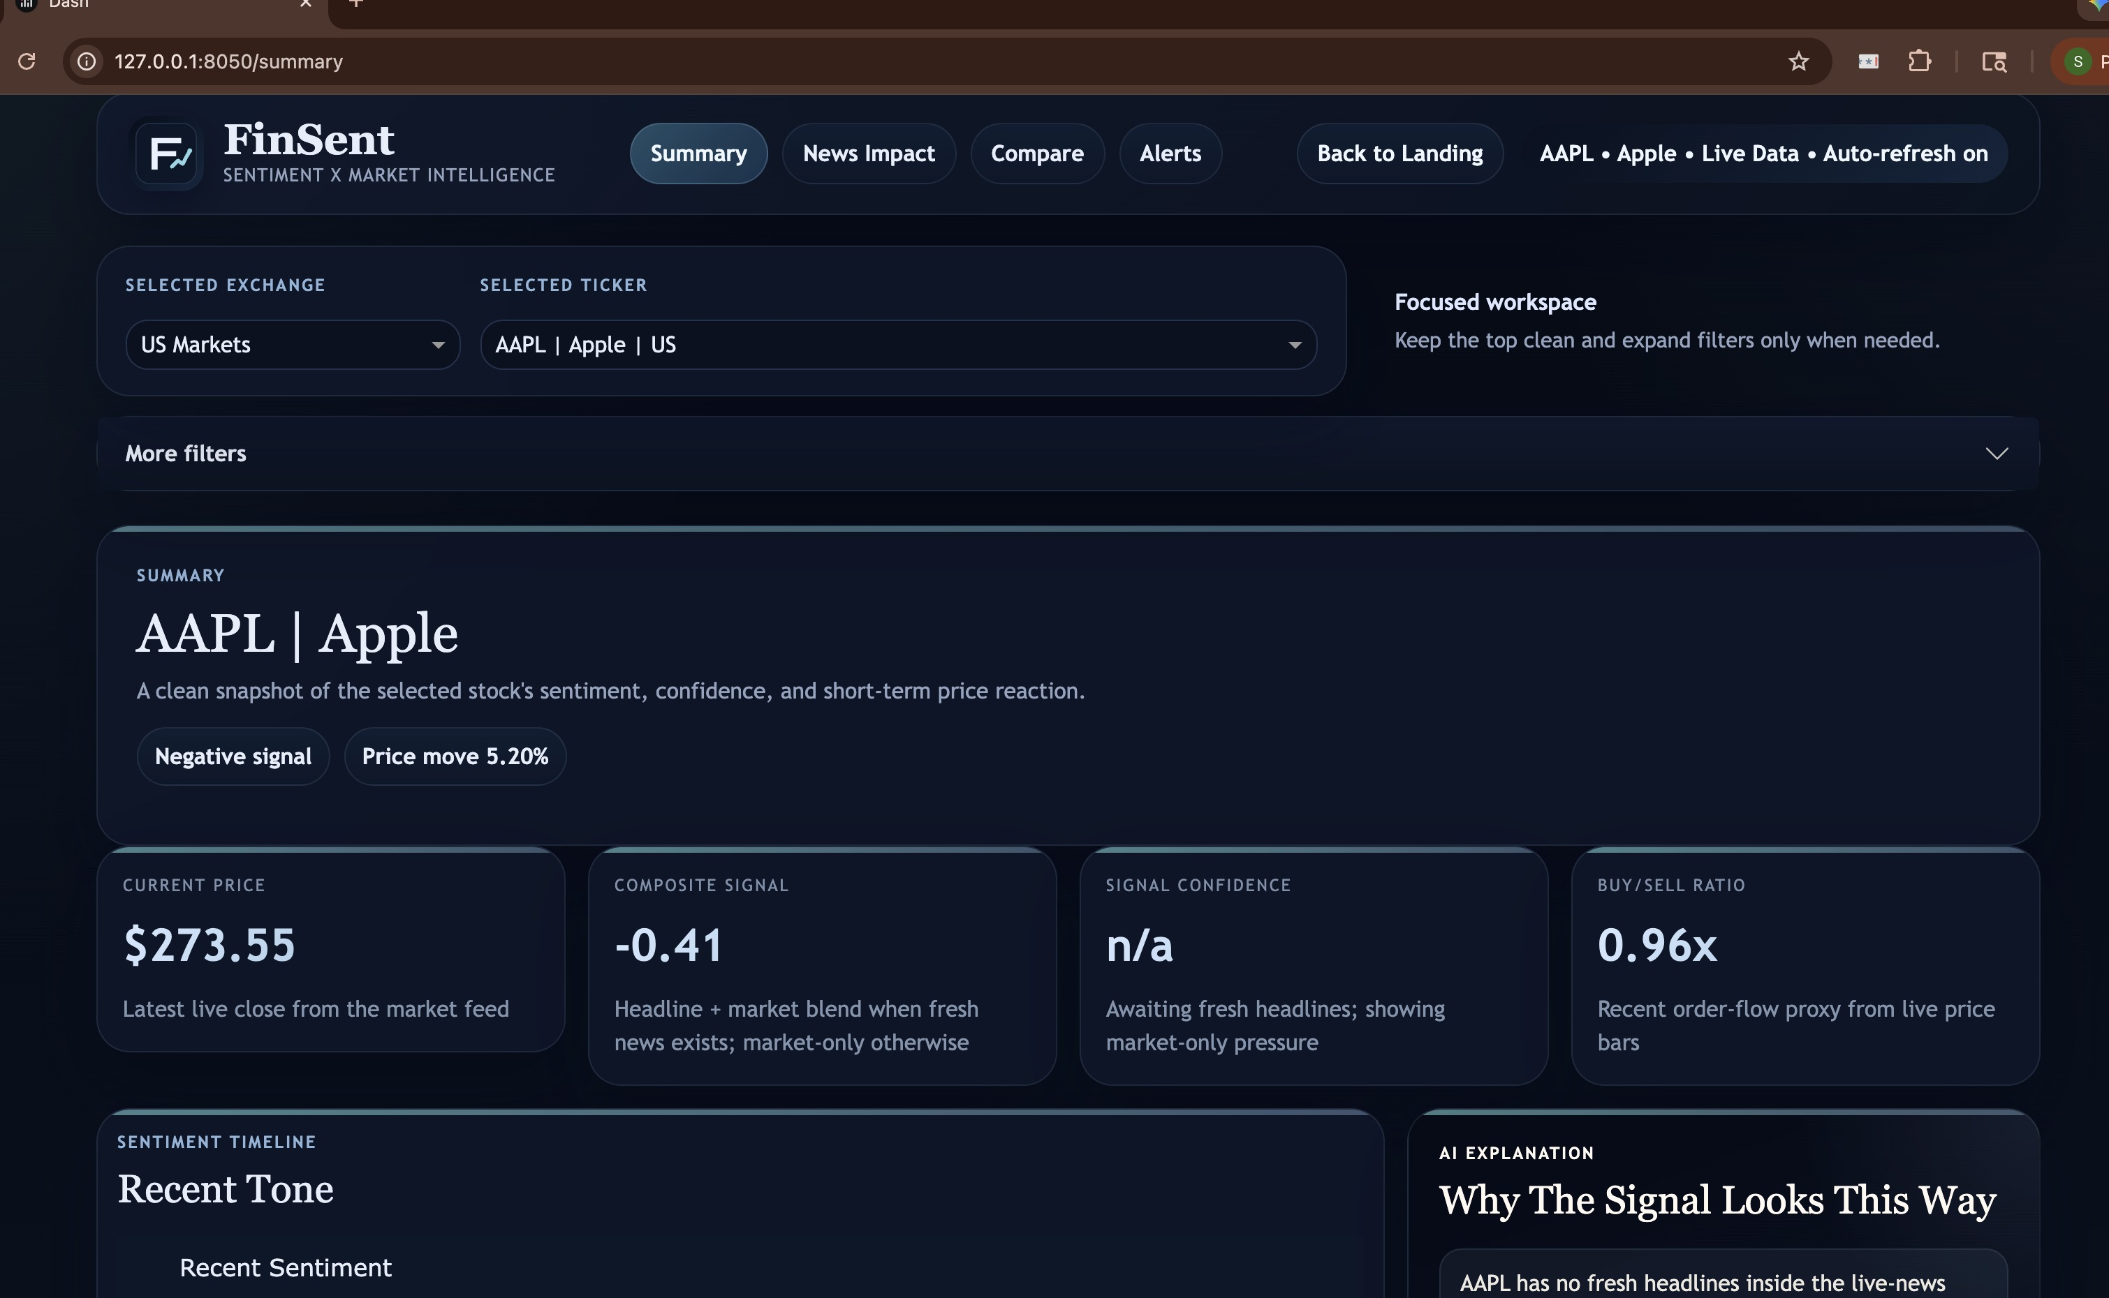
Summary Page Walkthrough
Top workspace bar
Exchange and ticker selection route the request to the correct provider stack.
Signal cards
Current price, composite score, confidence, and buy/sell proxy are shown together.
Explanation box
The system explains why the current signal looks the way it does in short readable language.

Slide 19
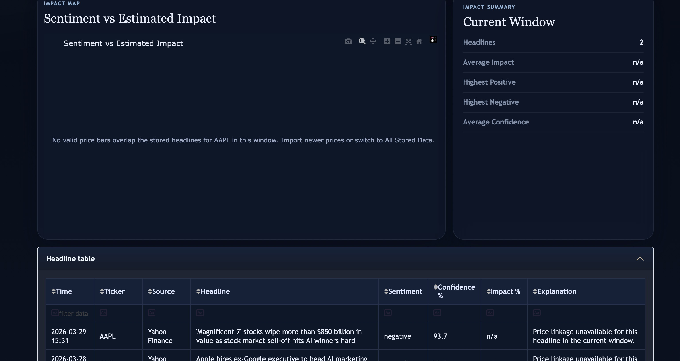
News Impact Page Walkthrough
Impact map
Plots sentiment against estimated impact when direct price overlap is available.
Current window
Compresses headline count, confidence, and impact summary.
Headline table
Shows provider, source, headline, sentiment, confidence, and explanation row by row.

Slide 20
Compare and Alerts Layers
Compare page
Peer benchmarking
Relative performance, signal leadership, news intensity, and confidence comparison across selected symbols
Alerts page
Monitoring layer
Recent signal shifts, active alerts, sector mood, and a plain-language Buy / Watch / Avoid read
These pages make the system feel less like a static analysis sheet and more like an ongoing stock-intelligence workspace.
Even where live India prices are blocked, the UX still explains what is missing instead of quietly degrading into fake values.

Slide 21
UX Trust Layer
Price source
Shows whether the price came from Polygon, Kite, or fallback logic
News provider
Surfaces Polygon, Marketaux, or fallback web source directly in the UI
Provider tier
Marks provider-grade versus fallback-quality coverage
Freshness age
Makes staleness visible instead of hiding it
Parse status
Explains when Gemini succeeded, failed, or fell back to heuristics
Mode
Communicates Market + News, Market-only fallback, News-only fallback, or Unavailable

Slide 22
Engineering Quality
Why the implementation is stronger than a static prototype

Slide 23
What Was Actually Built
Module | Responsibility | Status
market_providers.py | Quote snapshots, price bars, provider routing | Built
news_providers.py | Polygon, Marketaux, and fallback news ingestion | Built
llm_analyzers.py | Gemini structured analysis plus heuristic fallback | Built
signal_engine.py | Deterministic composite scoring | Built
intelligence_service.py | Orchestrates provider outputs into stored insights | Built
dashboard/view_model.py | Transforms persistence into cards, charts, and status labels | Built

Slide 24
Major Engineering Fixes Already Solved
Gemini quota and malformed JSON no longer break the UX; heuristic fallback fills confidence and impact safely.
News Impact tables now show all recent headlines, not just the small subset with direct price overlap.
Failed quote rows no longer override usable older rows during auto-refresh.
Ancient historical closes are blocked from appearing as fake current prices.
Charts can fall back to estimated impact when direct event-linkage is sparse.

Slide 25
Current Limitations and Mitigations
Constraint | Effect on product | Mitigation
India live quote source | NSE/BSE prices remain unavailable without Kite or a replacement provider | Complete Kite setup or replace India quote path
Polygon plan limits | US snapshot quality depends on which endpoints are allowed by the API plan | Use last-trade / previous-close fallback and label it honestly
Gemini quota | Heavy repeated refreshes can force heuristic analysis | Cache article hashes and limit analysis budget per refresh
Demo stability | Some provider outages can leave the UI sparse | Keep screenshots and runtime-state explanations ready

Slide 26
Progress vs Planned Timeline
By schedule the project is in Phase 5, but implementation maturity is already closer to late Phase 6 / early Phase 7.
Scheduled timeline completion: 45%
Actual implementation maturity: 75%
The calendar says ~45% complete; the actual build is around 75% complete because core architecture, multi-page UI, persistence, provider routing, and reliability fixes are already in place.

Slide 27
Value and Positioning
Why this is already stronger than a typical academic build

Slide 28
Why This Feels Portfolio-Grade
Architecture
Modular
Providers, LLM analysis, signal engine, persistence, and UI are cleanly separated
LLM role
Constrained
Gemini interprets fetched news instead of inventing unsupported market facts
Scoring
Deterministic
Final bullish / bearish signal is computed in application logic
UX
Honest
Live, stale, inferred, and unavailable states are visible
This is no longer a static CSV demo.
It behaves like a production-minded intelligence product: provider driven, failure aware, and explicit about uncertainty.
That separation between data ingestion, AI interpretation, and deterministic scoring is the strongest part of the build.

Slide 29
Next Steps
Near-term
Finish India live quote path with Kite or a replacement provider
Capture stable dashboard screenshots for the final viva
Run final end-to-end refresh checks across AAPL, NVDA, and India symbols
Longer-term
Move persistence from SQLite to PostgreSQL
Add authentication and background refresh scheduling
Turn the dashboard into a cloud-deployable monitoring product

Slide 30
FinSent
Provider-driven, explainable, and production-minded.
Thank you.

