Slide 1
Blind Source Separation of Microscopy obtained Images
for Super Resolution fluorescence applications

Slide 2
Background – what’s Super Resolution?
Super Resolution is the state of the art in Microscopy
This Technique achieves 10s of nanometers precision in X-Y plane
The main idea is to take advantage of statistics over time of sampled images to get better resolution, which is possible because of the fluorescence blinking

Slide 3
Background – Limitations\Motivation
Getting the wanted statistics, requires a big enough time interval
Time interval is related to separation and localization of emitters
Time dependence of the results causes limitations on time scale of observed dynamics

Slide 4
Diagram
Criterion
Equations
ICA with Max Sources – explain
Plot ICA performance (2 plots)

Slide 5
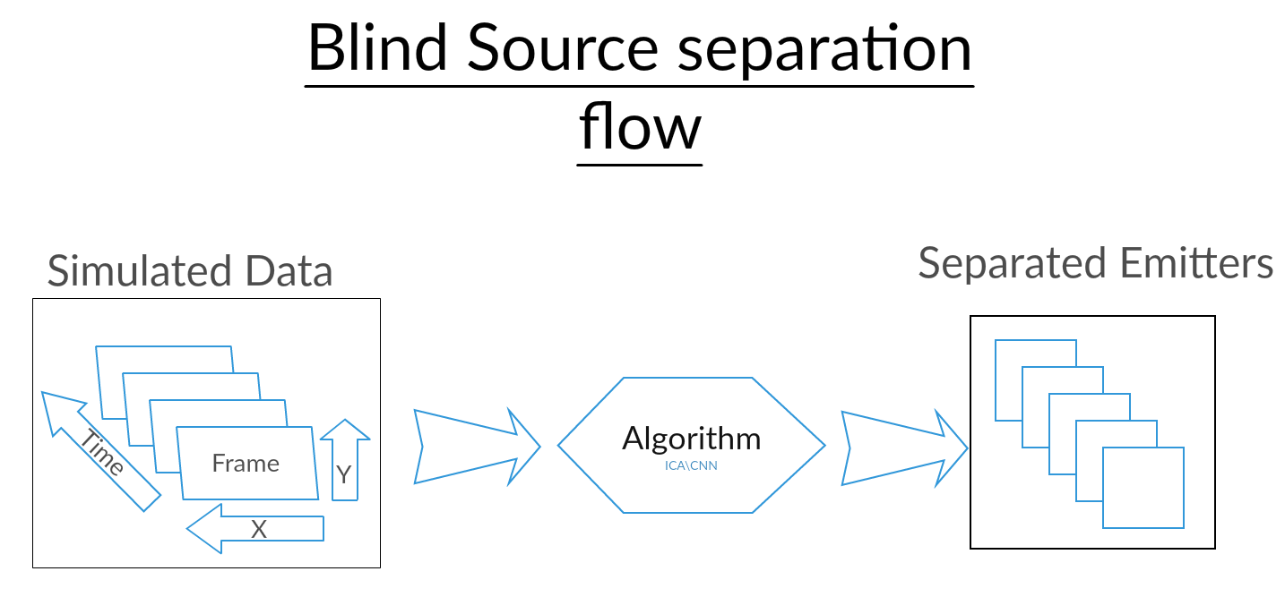

Slide 6
Hardships
Finding a criterion for “success”
Determining the input features and labels
High-dimensional data
Data pre-processing
Tensor dimensions

Slide 7
Projects Objectives
Check existing approaches to BSS (Blind Source Separation)
Recruit Tetrapod engineered PSF properties to improve results
Adjust and Execute ICA (BSS method) and quantify it’s performance
Implement and execute a NN (Neural Net) and get better performance
Try different architectures of NN and compare results

Slide 8
Project Flow
Create simulated data using Prof. Schechtman’s Tetrapod simulator
Run ICA under different conditions and observe results
Simulate a BIG database for training, validating and testing the net
Implement and run NN and optimize architecture

Slide 9
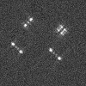
So far
Simulating data using a Tetrapod simulator – done
For example:

Slide 10
So far
Run ICA under different conditions and observe results – done
Left - Original
Right - Reconstructed

Slide 11
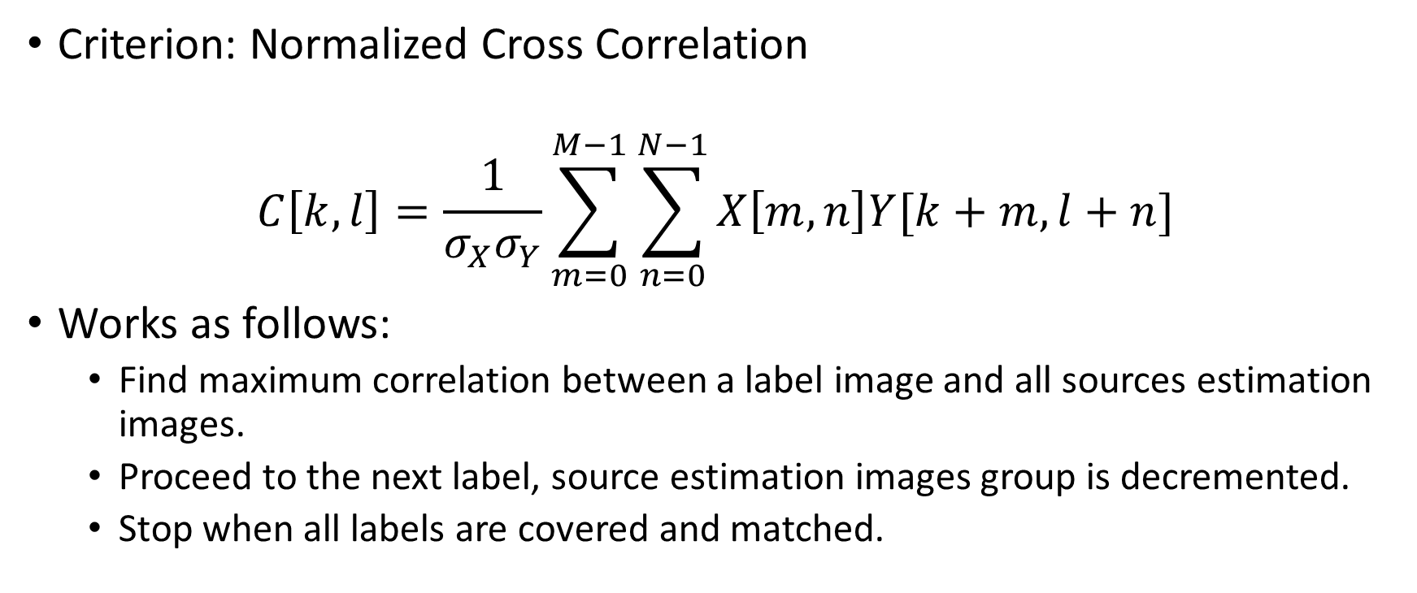
ICA Performance Demonstration
Criterion: Normalized Cross Correlation
$$C\left[k,l\right]=\frac{1}{σ_{X}σ_{Y}}\sum_{m=0}^{M−1}{\sum_{n=0}^{N−1}{X\left[m,n\right]Y[k+m,l+n]}}$$
Works as follows:
Find maximum correlation between a label image and all sources estimation images.
Proceed to the next label, source estimation images group is decremented.
Stop when all labels are covered and matched.

Slide 12
ICA Performance Demonstration

Slide 13
So far
Simulating a BIG labeled database for training - in progress
Script for generating data using Tamnun super computer – Done
Executing and validating data is correct - WIP

Slide 14
Next Steps (In more details)
Run our data generating Tamnun script to obtain our data set
Pre-process our data: batching, suitable normalization, etc.
Start with a basic 1 neuron network
Optimize the NN architecture using a validation set
Once optimized, train our NN with an optimally pre-processed training set
Test and compare with ICA performance

