Slide 1
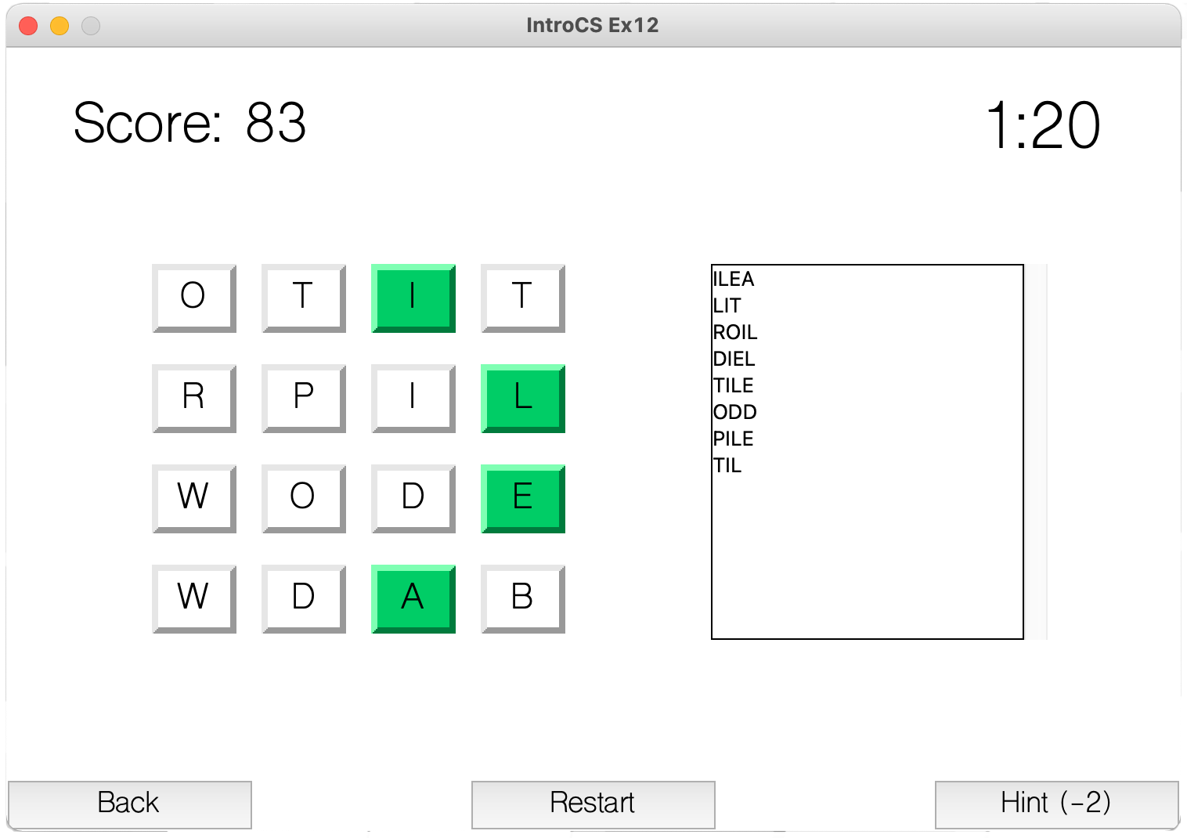
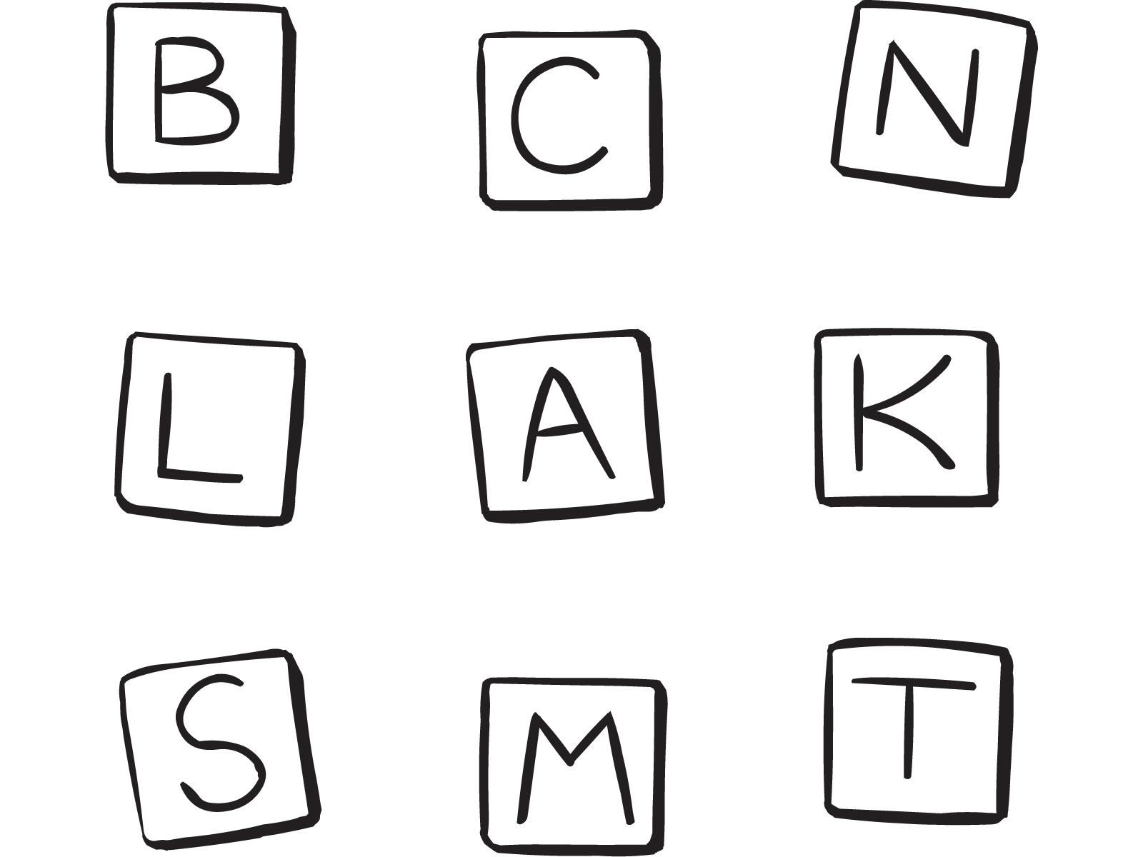
Instructions:
Your goal, should you choose to accept it, is to gain as many points as possible. To gain points, you must create words from the randomly assorted letters in the cube grid. The longer the word, the higher the point value of the word.
Gameplay:
When the game starts, a randomly generated board will be hidden until you press "Start", then the grid of cubes will be revealed and the game will start the timer at the same time.
Words should be created by using adjoining letters – the letters must touch each other – and must be able to connect in the proper sequence to spell the word correctly. The letters may join in any direction – horizontally, vertically, or diagonally. Words can be spelt in any direction, including backwards. You may not use a letter cube multiple times in a single word.
To select a word, simply click on the cube of the first letter and start dragging the mouse over the cubes in the correct order, and after you have reached the final cube release the mouse button.
You may use the hint option when needed, it will reveal for a split second a randomly existing word. Remember to use it carefully as it charges you with points.

Slide 2
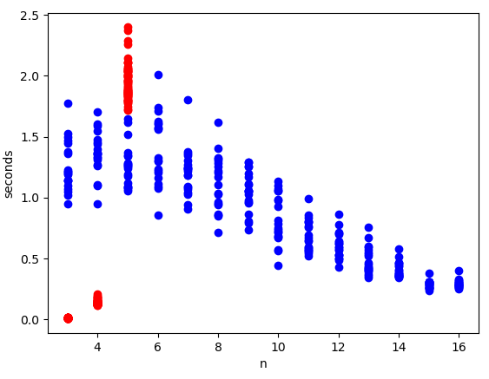
Recursive find_n_length_words
Combination based find_n_length_words

