Slide 1
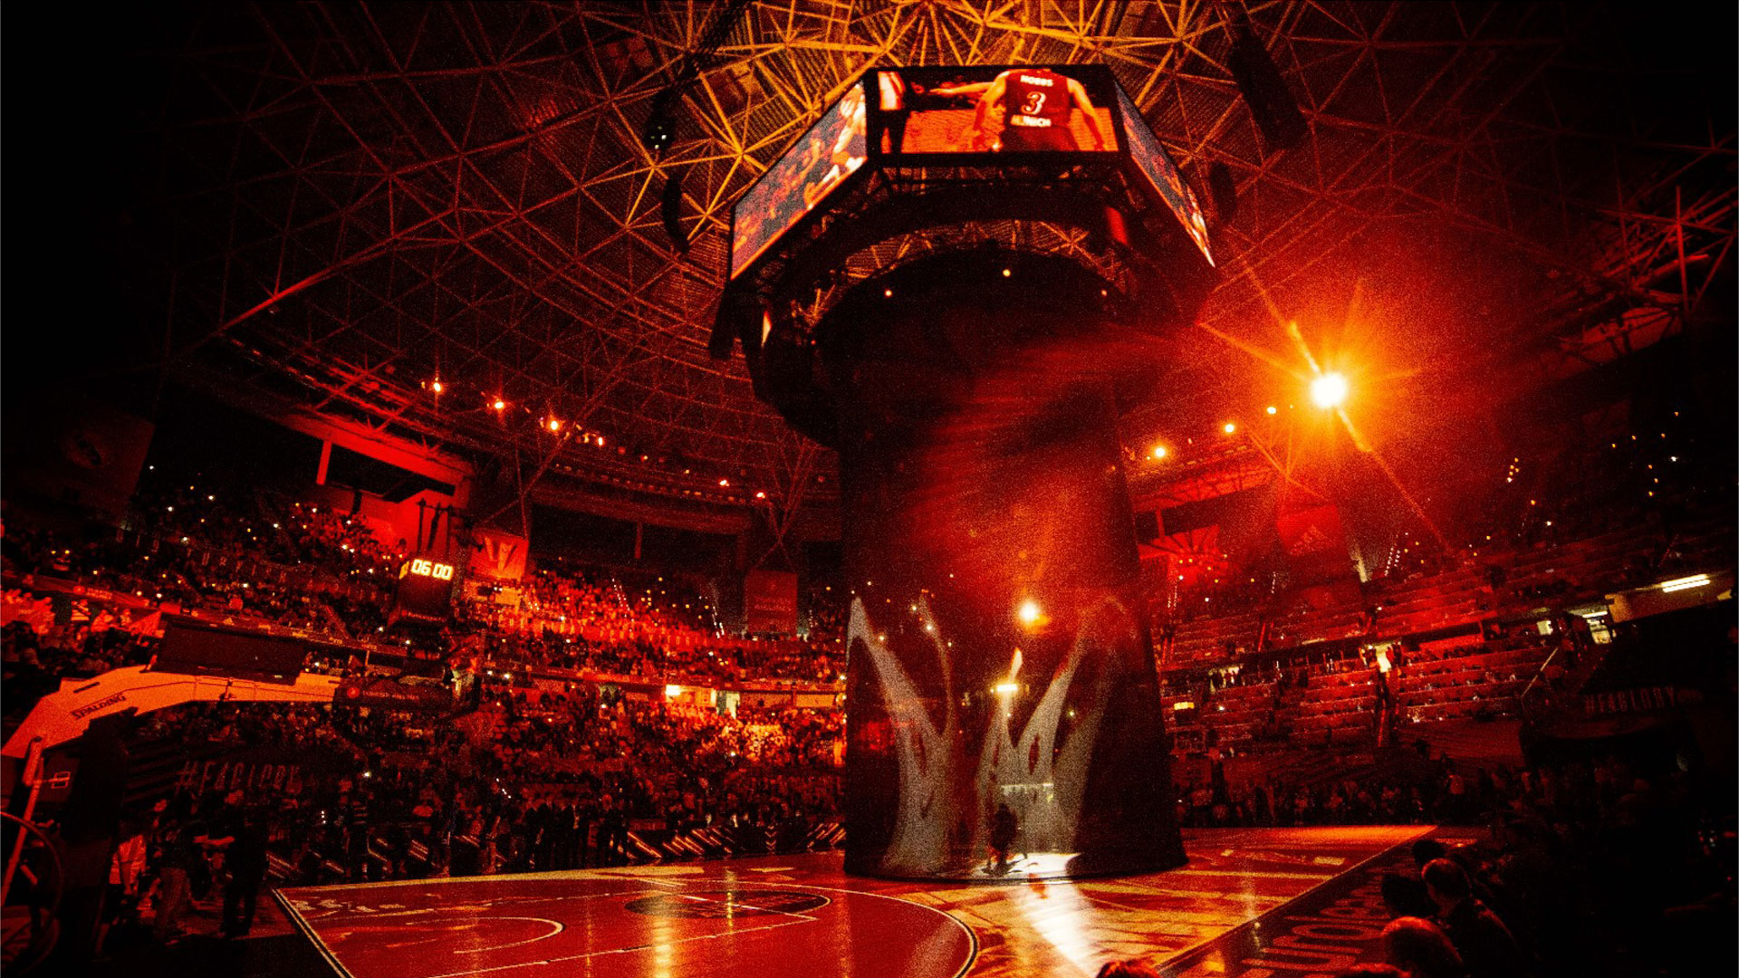
Orr Meyuchas
EuroLeague Analysis & Predition Project
TURKISH AIRLINES
EUROLEAGUE

Slide 2
Data Collection
Cleaning & Preparing Data
EDA - Visualization
Machine Leaning - model selection and validation
Summary
Introduction
The main goal is to build
machine learning algorithm
for predicting the winner of the next Euroleague Basketball game

Slide 3
Data Collection

Slide 4
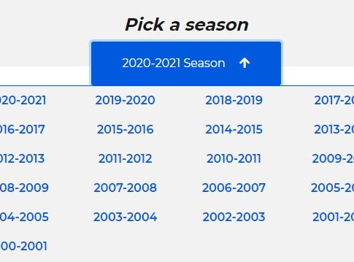
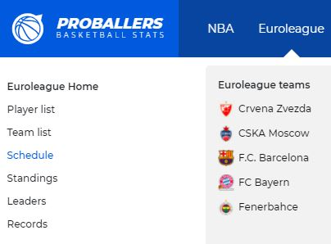
Data is collected through crawlling and scraping "Proballers basketball stats" website

Slide 5
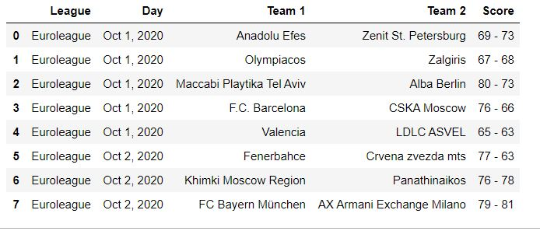
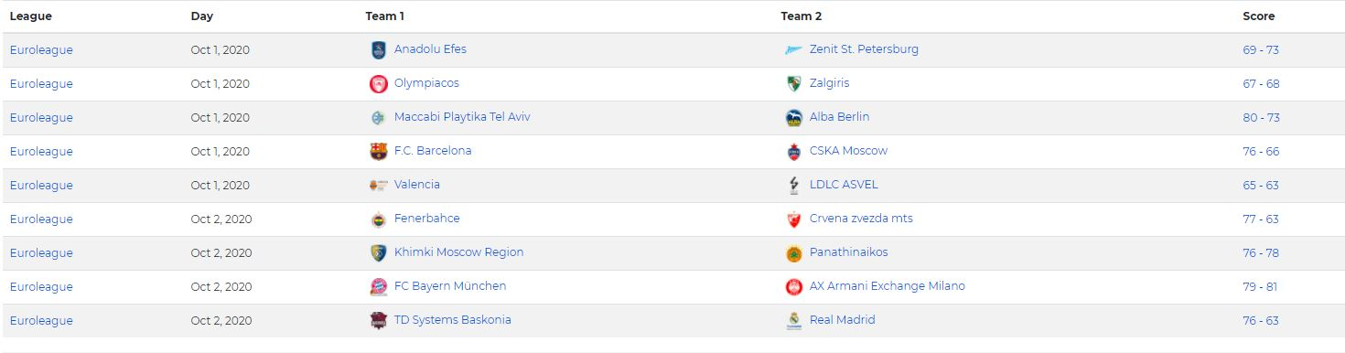
In data collection,
there are few types of data,
date, score and teams for the
last twenty years

Slide 6
Cleaning &
Preparing
Data

Slide 7
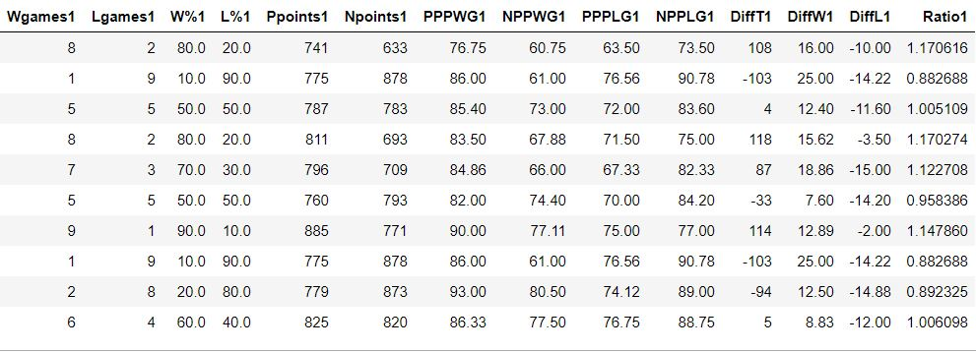
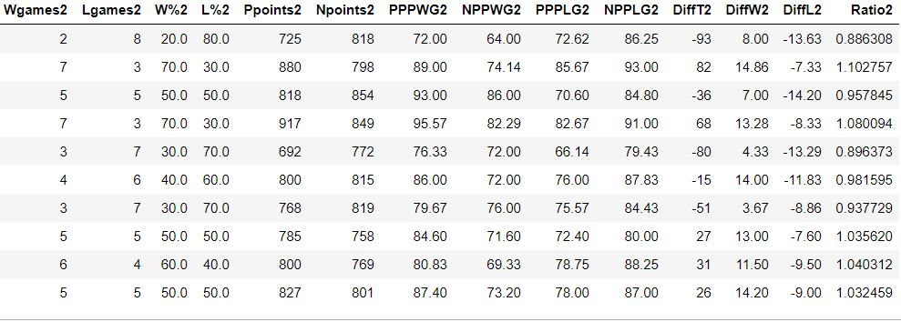
Cleaning:
Cast all scores from str to int
Remove duplicates
Fixing date format
Remove rows with not anough data
Preparing Data:
Sort the dates and add new column of the winner
Team for each row, created new columns that present the ofense
And defense for each team Based on the last ten
Games for each of the team
The ofense and defense calculated by the shooting
And obstruction abilitie
Note: explanation about the columns in the next page

Slide 8
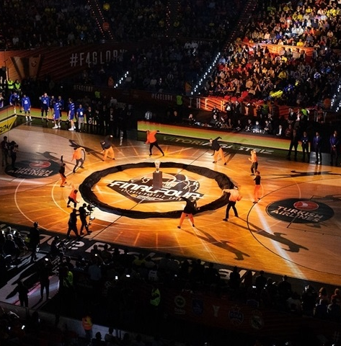
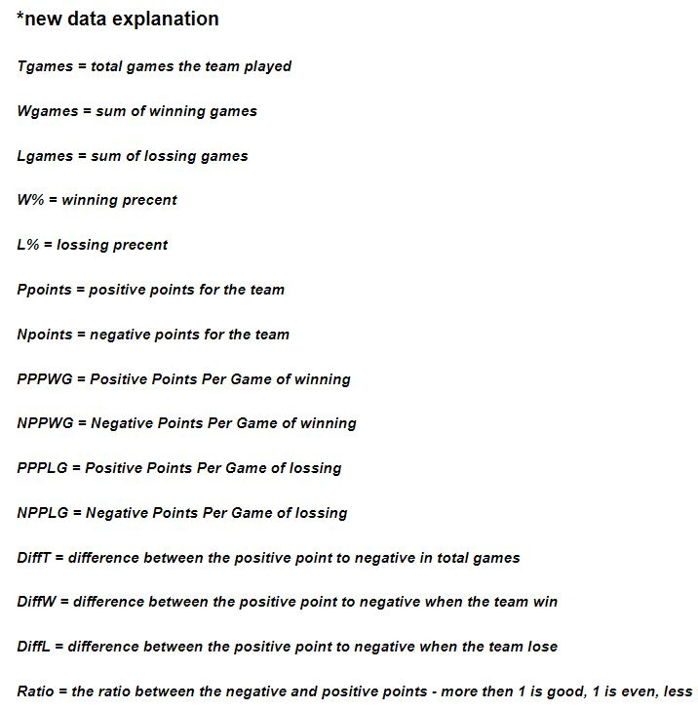

Slide 9
EDA - Visualization

Slide 10
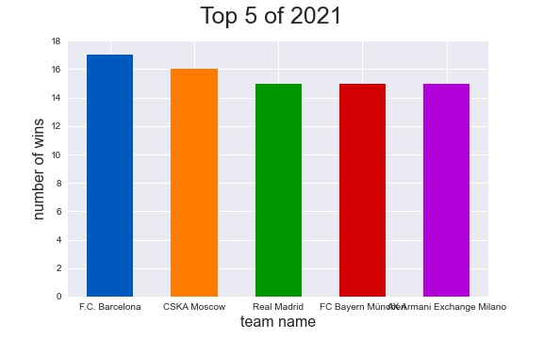

Slide 11
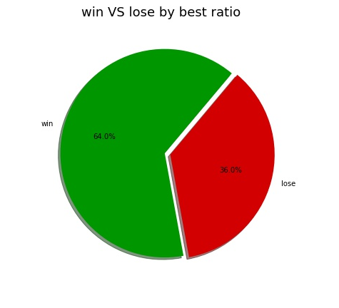
Check the connection between better ratio to winning the game
For every game in the last twenty years i checked if the team that came to the game with a higher ratio is the one that won

Slide 12
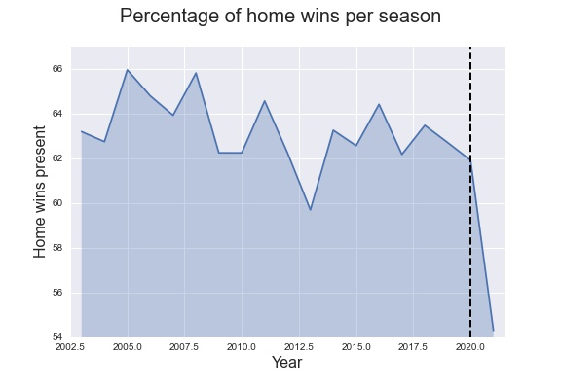
check if there is advantage to home team,
and if there was, checking if was a change on the advantage that starts on 2020,
since from that moment the games were played without fans. (Note: I'm not checking if no fans is the reason.
only check if there is change in the last year ,and i'm just guessing that is the reason)

Slide 13
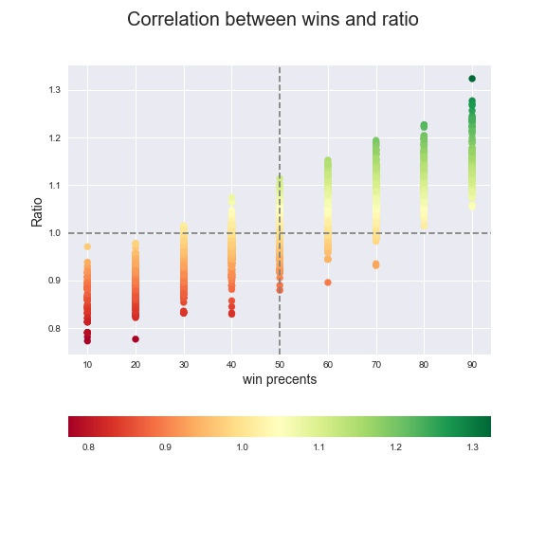
checking correlation between wins precents and ratio

Slide 14

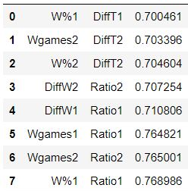
Correlation table

Slide 15
Machine Leaning- model selection and validation

Slide 16
For the purpose of learning the machine I did few steps:
consolidated the information of all the years
removed rows without statistics of the last 10 games
Creat column of binary value by who win- home team = 1, away team = 0
I used Standard Scaler to scale the data and train with 3 models:
Decision Tree
K-Nearest Nighbors
Logistic Regression
Note:
For KNN model I checked for best k (result was 17 from 3-19)
For Decision Tree I checked max depth and min sample split
(result is 2 and 10 from 2-10 and 5-20)

Slide 17
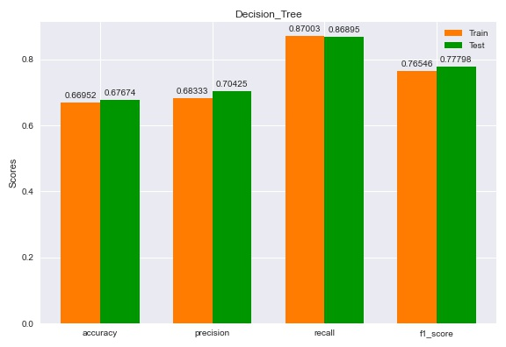

Slide 18
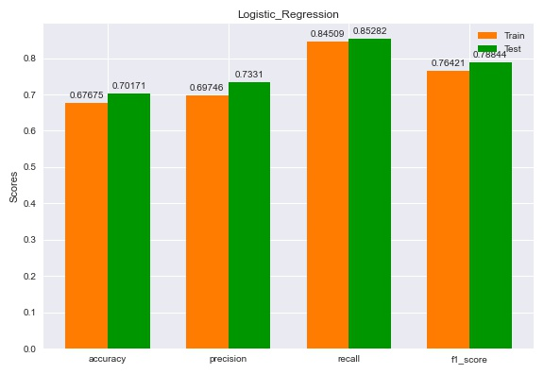

Slide 19
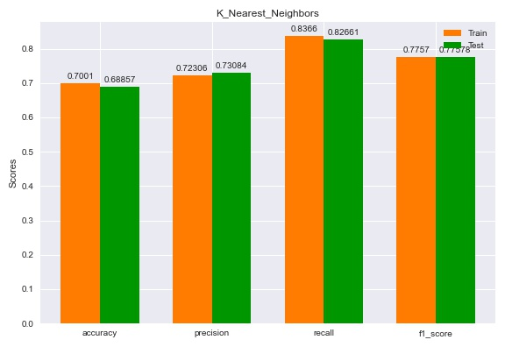

Slide 20
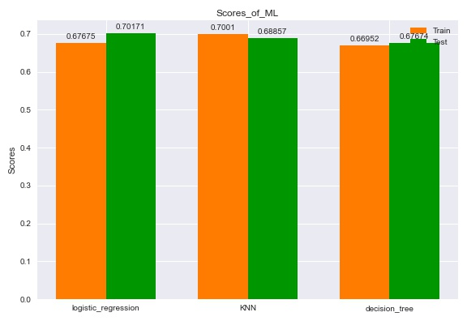
Comparison of the models according to accuracy

Slide 21
Summary

Slide 22

At first, I gathered as much information as possible, until I realized that the amount of information is not the problem, but the quality and validity of the information.
The result of a basketball game is something that depends on human factors and on the result there are a lot of influencing factors whose effect is difficult to examine, such as:
Referee, player fitness, frequency of games, etc.
Since the ultimate goal is to predict a single game, a question arose regarding the model training phase: On what basis would the model be trained to be able to attest to the reliability of the prediction?
When we talk about the last year a lot of information can be obtained but the amount of observations is small for reliable model training.
For this purpose, observations from previous years were requested, here I encountered another problem:
What data do I have 21 years back for each and every game?
Data that will be relevant to that match date?
Data I can get for all observations?
Influential data Who won the game?

Slide 23

At this point I decided to change my approach, I will get the minimum relevant information.
And from it I will make the information I need.
After a short research I discovered that a lot of influence on the game winner is due to the quality of defense and offense of each of the teams.
So I wrote functions that for each date, collect the last 10 games of each team (up to two years back from the game date), and analyze the teams' attacking and defensive ability based on their shooting and absorbing data in the last 10 games when I give importance to the amount of shots and absorbs for each game Where she won and a game in which she lost separately, and for all games.
I checked a correlation between the new data I created and who will win and found that there is.
Finally I received 70% accuracy in predicting the next game, later it will be possible to improve the prediction results by using head-to-head analysis between the teams and player analysis (this information was collected and prepared but due to lack of time was not included in the project)

