Slide 1


Privacy-Preserving Biometric Template Protection Using Homomorphic Encryption
Orel Razy
This project was supervised by Prof. Adi Akavia, Fall 2024

Slide 2
HOW WE DO IT
01
02
03
04
05
06
Background
Results
Conclusions
Research Goal
Bibliography
Extra:
Attack simulation

Slide 3
Privacy Risks and Biometric Identification
Background
Biometric identification leverages unique physiological traits, such as facial features, to authenticate individuals. While this technology has revolutionized security and authentication, it also presents significant privacy risks due to potential leaks of sensitive biometric data. Fully Homomorphic Encryption (FHE) addresses these risks by enabling computations directly on encrypted data, preserving confidentiality throughout the computation process..

Slide 4
Developing a Privacy-Preserving Biometric Pipeline
Research Goal
The primary goal of this project is to develop a privacy-preserving biometric identification pipeline that integrates vector-based facial recognition with FHE. Specifically, we evaluate the impact of precision limitations introduced by CKKS encryption on the system's accuracy and runtime performance. Initially, the project was scoped to investigate only Part A, focusing on evaluating the effect of precision limitations on biometric identification under cleartext data. However, recognizing the potential impact of integrating privacy-preserving computations, we extended our efforts to implement Part B (similarity metric computation over encrypted vectors) and Part C (privacy-preserving biometric identification). The datasets used for Parts A and C differ due to time constraints and the exploratory nature of the later phases.

Slide 5
Privacy-Preserving Biometric System Performance
Results
Scores:
Accuracy
01
96.68% top-10 match rate using encrypted cosine similarity.
Efficiency
02
Ciphertext size: 10.8 MB for 500 identities.
Overhead
03
8622.54 seconds for encrypted similarity computations.

Slide 6
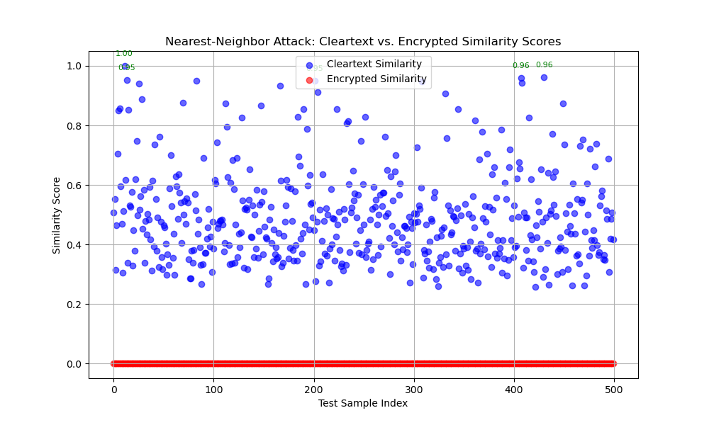
Evaluating System Robustness Under Attack
Attacking Simulation
Simulation: Nearest-neighbor attack on both cleartext and encrypted data.
Goal: Assess resilience by testing if the attacker can infer correct identities using similarity-based guesses.
Outcome: Highlight key security metrics and comparative performance.

Slide 7

Key Takeaways and Future Directions
Conclusions
Achievements
Key Metrics
Successfully implemented GhostFaceNet integrated with FHE for privacy-preserving biometric identification.
Top-10 match rate (96.68%), ciphertext size under 11 MB.
Limitations
Future Work
Computational time (8622.54 seconds) for encrypted similarity needs optimization.
Investigate parallelism and optimization techniques for reduced overhead.

Slide 8
References
Bringer, J., & Chabanne, H. An overview of secure multiparty computation in biometric identification. Proceedings of BTAS, 2013. Link
Wu, X. Accelerating Privacy-Preserving Biometric Identification with Tensor Triples. Cryptology ePrint Archive, Report 2023/1863. Link
Sperling, R. HEFT: Homomorphically Encrypted Fusion of Biometric Templates. arXiv preprint, 2022. Link
Pradel, K., & Mitchell, J. A Privacy-Preserving Biometric Authentication Protocol with Fully Homomorphic Encryption. arXiv preprint, 2021. Link
Bibliography

