Slide 1
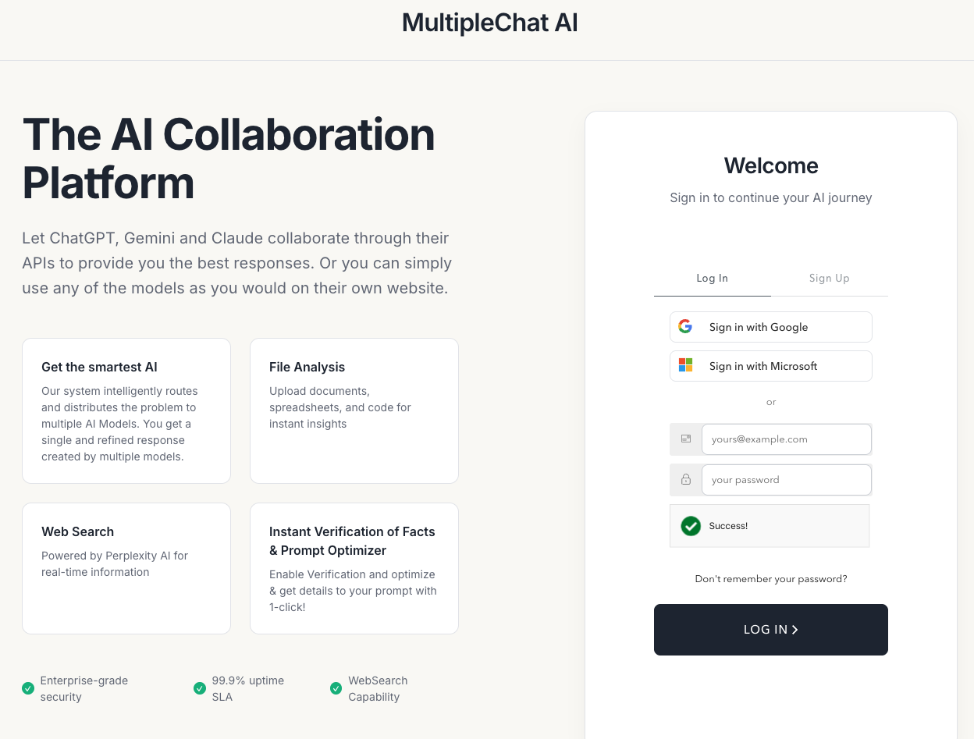
multi agent ai

Slide 2
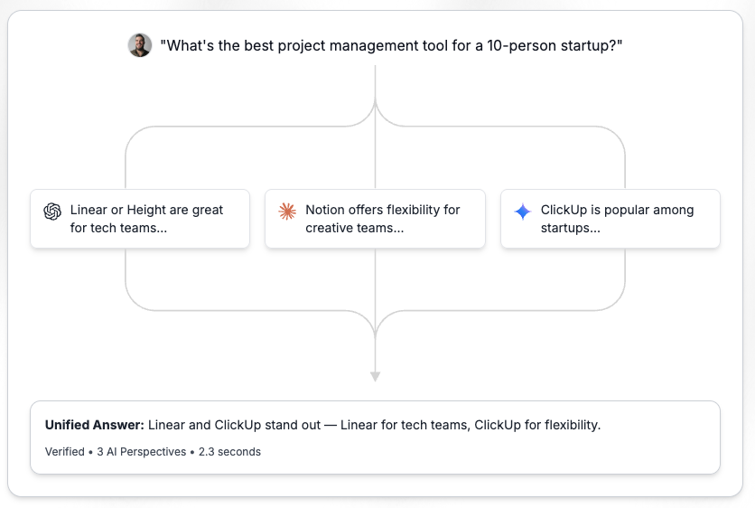
Models comparison
Multiple.chat

Slide 3
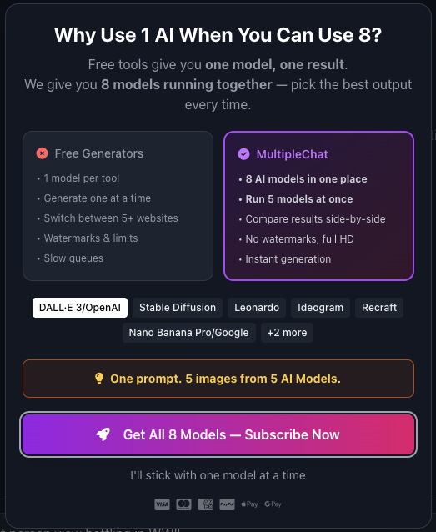
Image generation

Slide 4
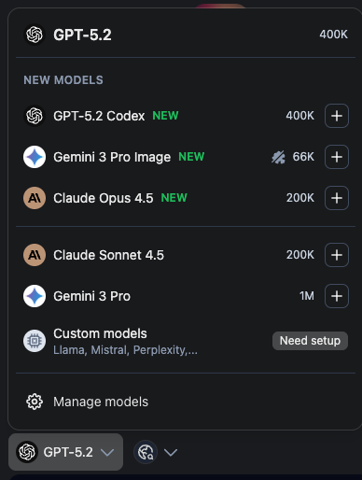
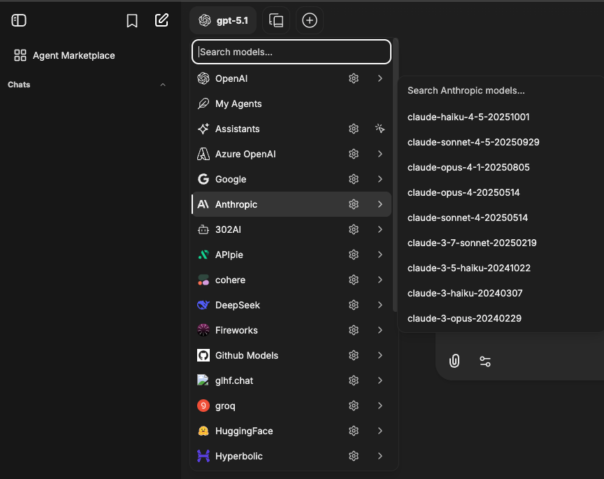
Model options
Typingmind.com

Slide 5
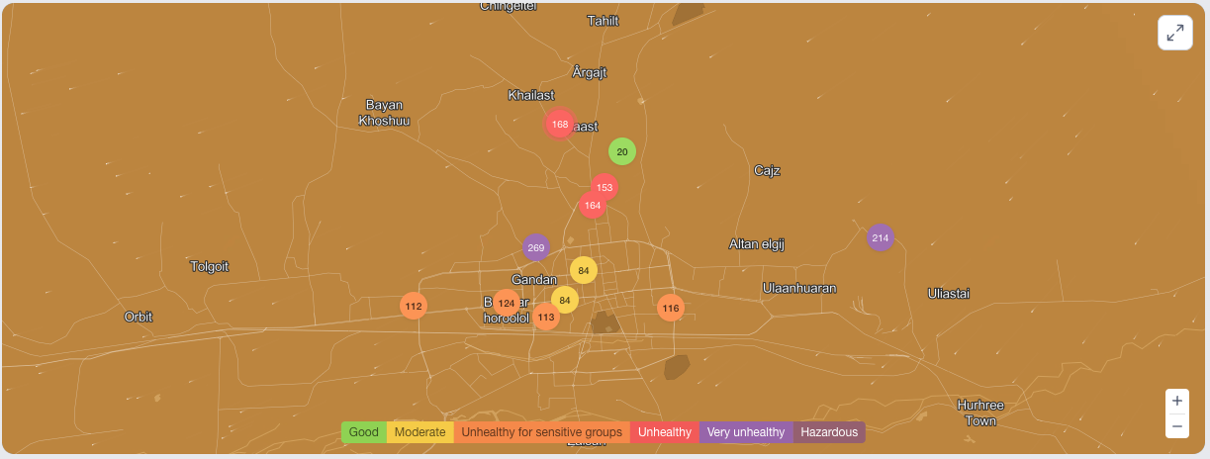
Daily life tools
Air quality
Show AQI, PM2.5, forecast trend, and simple advice.
https://www.iqair.com/mongolia/ulaanbaatar

Slide 6
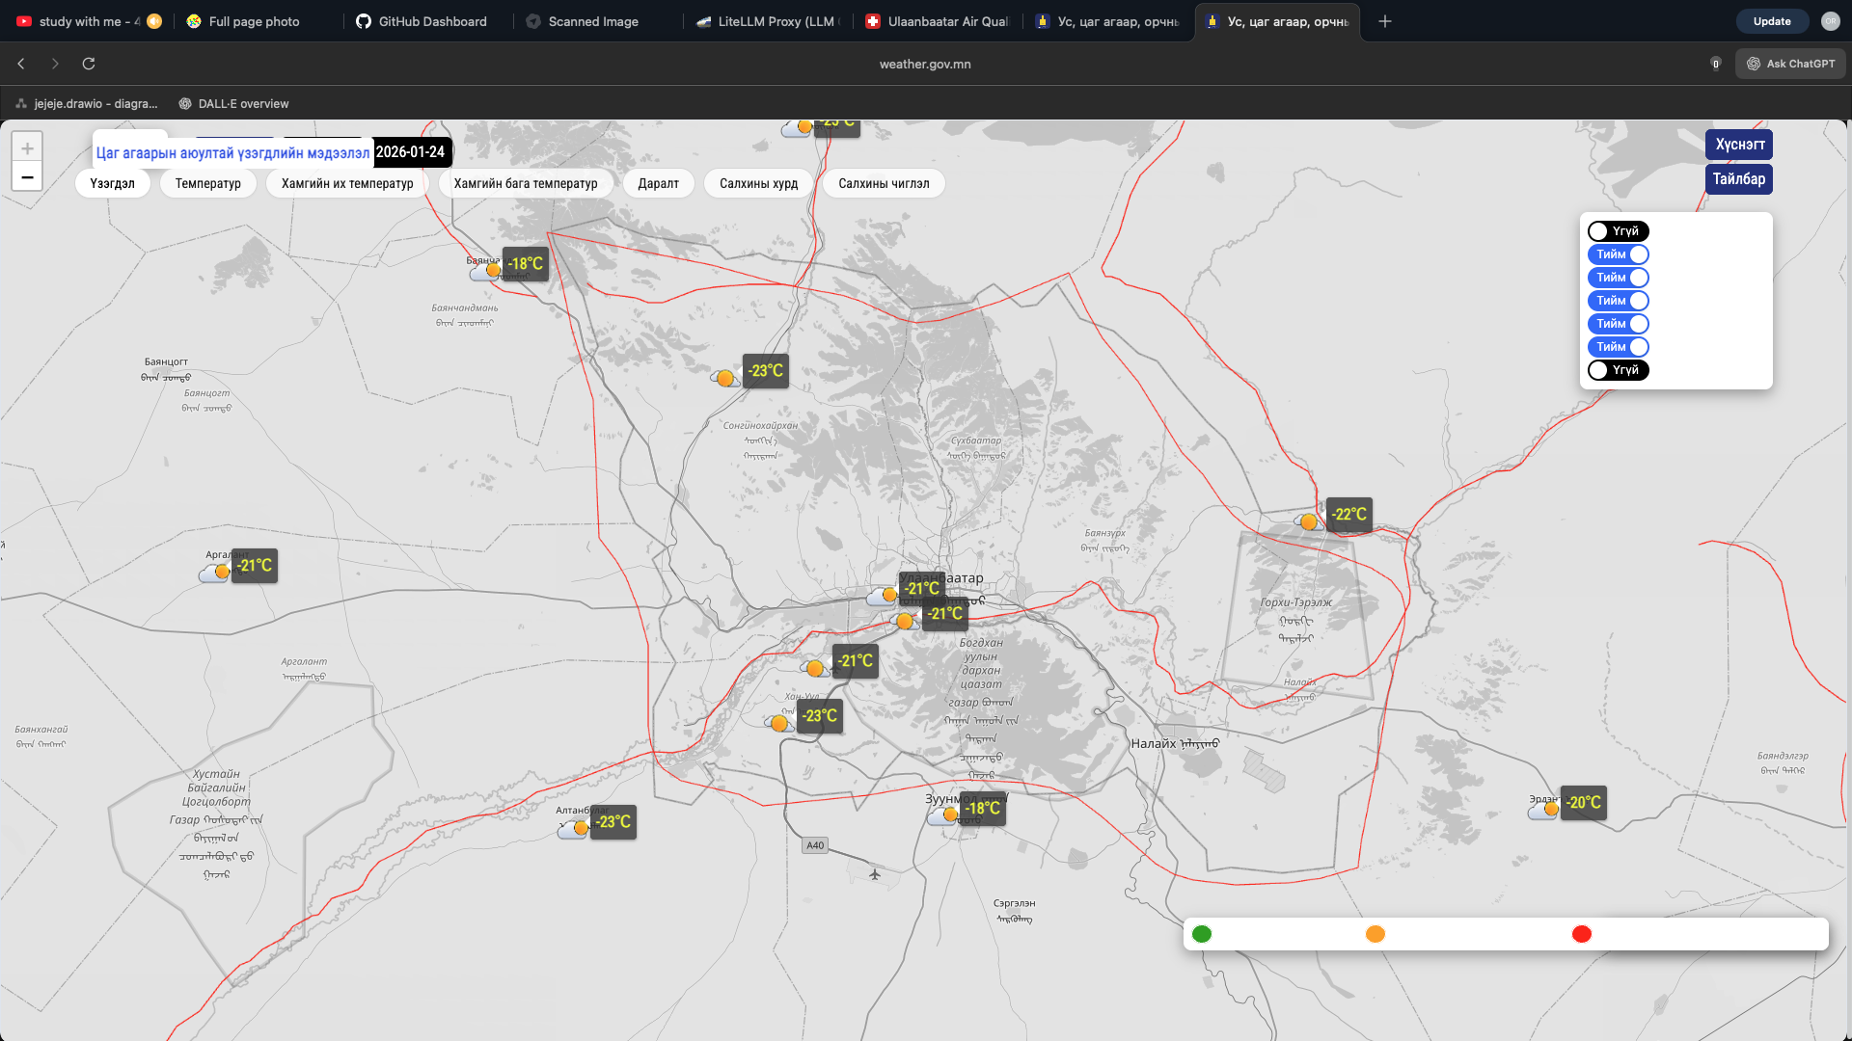
Daily life tools
Weather
Hyper-local UB districts if possible.
“What to wear” summary (wind + temp matters a lot in UB). https://weather.gov.mn/map

Slide 7
Daily life tools
Transit
Bus routes, ETAs, fare info.
“Get me from A to B” with walking + bus options.
“How crowded” would be insane if data exists (probably not).
Exchange rates
₮ ↔ USD/CNY/RUB/KRW/JPY, banks vs market, daily change.
“I’m traveling, how much should I exchange” quick calculator.
Government forms assistant (massive retention)
“Which form do I need?”
“Fill this form with me” step-by-step
Validate common mistakes (dates, registry number formats)
Generate printable doc drafts

