Slide 1
REVEALING CONTESTED MEMORY
Alma Mater Studiorum – Università di Bologna
Automatic sensitive content detection in colonial photographic archives
Digital Humanities and Digital Knowledge
Dissertation in Semantic Digital Libraries
Defended by Orsola Maria Borrini
Supervisor Prof. Giovanni Colavizza
Co-supervisor Prof. Charles Jeurgens (University of Amsterdam)
Session III
Academic Year 2022/2023
Notes:
Presentation of the thesis + The thesis positions itself at the crossroads between archival sciences and AI/ML, a new lively field emerged in the last years and with few but exemplary projects (such as the EyCon). Specifically, the approach employed here is that of postmodernism, which considers archives as active sites of contested power with harmful repercussions on underrepresented and racialised communities, and this research assess the feasibility of sensitive content detection in colonial photographic archives through an Image Classification algorithm.

Slide 2
Project phases
01
02
03
04
SENSITIVE CONTENT DEFINITION
DATA AND METHODS
RESULTS
DISCUSSION
Exploration of the results and error analysis
Discussion on the work done and possible future avenues of research
Development of a working context-specific definition and a taxonomy used as an aid to the annotation process
The data and methods used for the development of the Machine Learning pipeline
problem definition
data collection
data annotation
training

Slide 3

01 Sensitive content definition
No fixed definition of sensitive content, depends on the purview of inquiry
In the GLAM sector, institutions are addressing the issue through cautionary statements
Need to address context-specific features:
Colonialism
Photography
Archival institutions
No clear definition, depends on the goals and assets of the specific case
We accept Osterhammel’s definition encompassing all the fundamental aspects
Inherent problematic aspects of photography (Sontag, Crane)
Used as instrument in colonial dominions
Postmodern approach: archives as active sites of contested power
Traditionally highly dominated by Western perspectives
Premises and limitations: only visual content, no intersectionality
Definition of three different degrees of recognisability

Slide 4
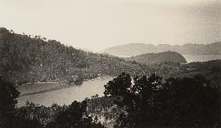
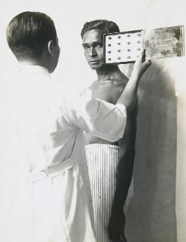
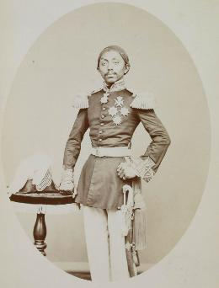
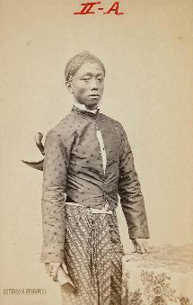
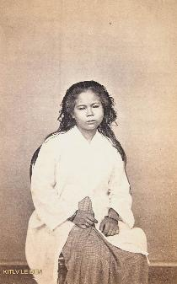
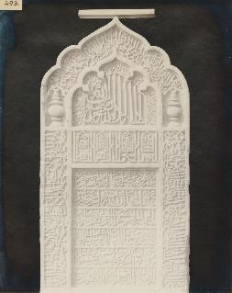
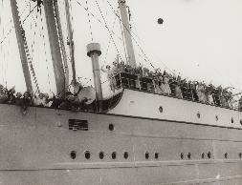
01 Sensitive content definition
Sensitive content: content which is more explicit and easily recognisable as immediately sensitive (either reiterates discriminatory beliefs, has violent graphic content or symbols and references to the colonial context)
Dubious content: unclear content which would benefit the most from the contribution of Indigenous communities and experts to the workflow (production context is ambiguous)
Not-sensitive content: content which does not display any clear or explicitly sensitive feature
!
sensitive
dubious
not-sensitive

Slide 5
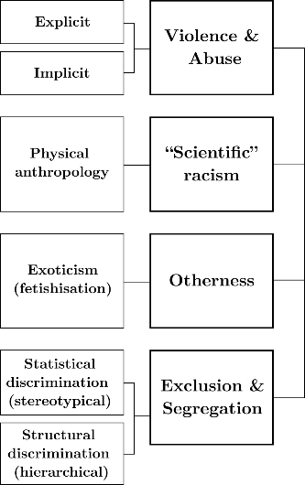
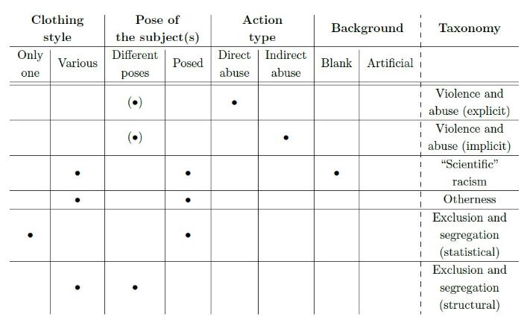
01 Taxonomy development
Observation of triggering phenoptypical characteristics (abstract categories) and selection of the most relevant combinations

Slide 6
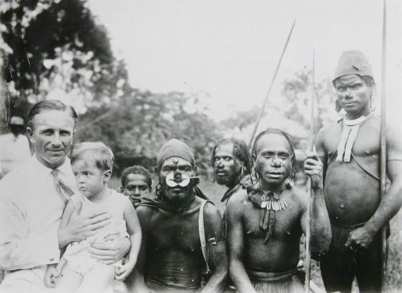
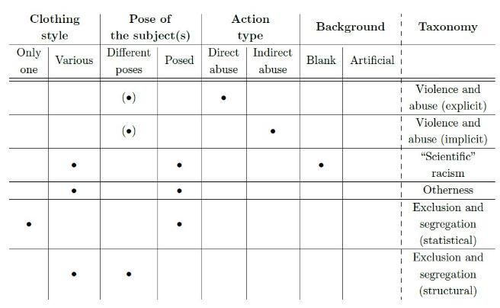
01 Taxonomy development

Slide 7
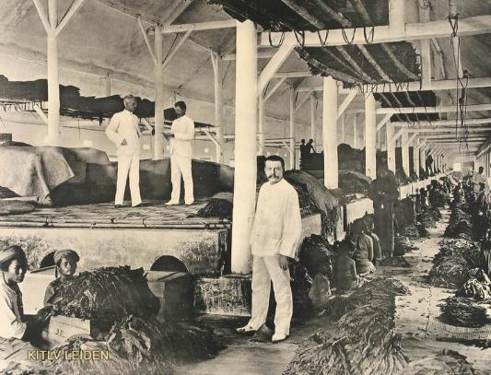
01 Taxonomy development

Slide 8

02 Data and methods
Raw data collection from two different archival sources
Data annotation through Label Studio (Image Classification template) using the taxonomy
Data cleaning
Dataset creation
Dataset composition
2177 pictures
Imperial War Museum
(IWM)
provided by the institution
199 pictures
Royal Netherlands Institute of Southeast Asian and Caribbean Studies
(KITLV)
webscraped from two different digital libraries (Het Geheugen van Nederland and Leiden University Libraries’ Digital Collections)
2336 pictures
Class | Samples | Percentage
Not-sensitive content | 1939 | 76,58%
Dubious content | 330 | 13,03%
Sensitive content | 263 | 10,39%
Imbalance!
Stratified random sampling in three sets (train, validation, test) with a 70-15-15 proportion

Slide 9


02 Data and methods
Image Classification task
Simplification of the sensitive content definition: binary definition and binary classification
Configurations
Full pre-trained network
(no frozen weights)
fullNet
Only the classifier head
(frozen weights)
sensitive
sensitive
1
dubious
not-sensitive
0
not-sensitive
Base classifier
Deep classifier (with three fully-connected layers)
Transfer learning (ResNet50) experimenting with different configurations
The best performing configuration is fine-tuned using both the train and validation set and the resulting model is deployed via the test set
Standard loss
baseC
Weighted loss
baseC-w
Standard loss
deepC
Weighted loss
deepC-w

Slide 10
02 Training setup
Experimental training done on train+validation sets to improve the hyperparameters’ configuration
Metrics: accuracy, precision (m/M), recall (m/M), f1-score (m/M)
Confusion matrix
Hyperparameter | Value
Batch size | 32
Number of training epochs | 15
Early stopping | Loss score (patience: 5)
 | baseC1 | baseC1-w | baseC2 | baseC2-w | baseC3 | baseC3-w
Learning rate | 1e-2 | 1e-2 | 1e-4 | 1e-4 | 1e-6 | 1e-6
Weight decay | 1e-3 | 1e-3 | 1e-5 | 1e-5 | 1e-7 | 1e-7
Weighted classes | No | Yes | No | Yes | No | Yes
 | deepC1 | deepC1-w
 | fullNet | fullNet-w

Slide 11
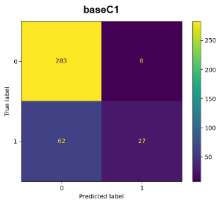
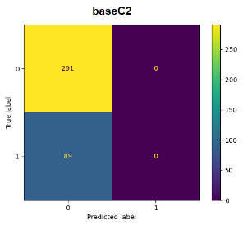
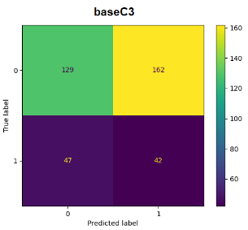
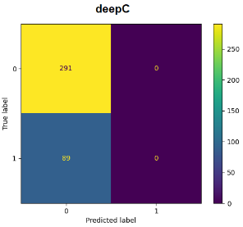
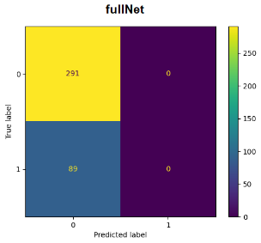
02 Training
 | baseC1 | baseC2 | baseC3 | deepC | fullNet
F1-score (Macro) | 0,662 | 0,433 | 0,419 | 0,433 | 0,433
*the runs with weighted loss function (baseC1-w, baseC2-w, baseC3-w, deepC-w, fullNet-w) tend to have similar matrices

Slide 12
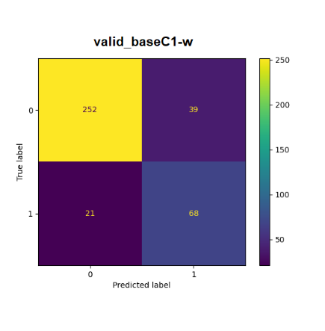
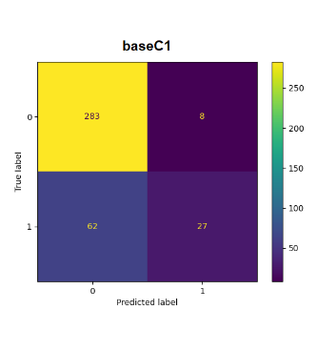
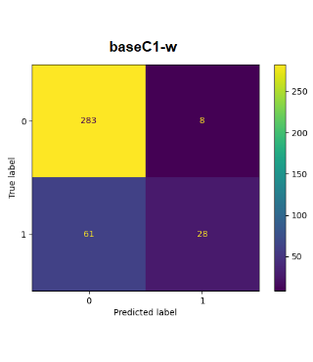
03 Results analysis
 | baseC1 | baseC1-w | valid_baseC1-w
F1-score (Macro) | 0,662 | 0,669 | 0,793
larger train dataset
larger training epochs
39 False «sensitive»
21 False «not-sensitive»

Slide 13
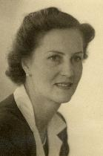
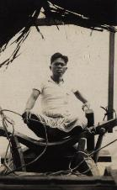
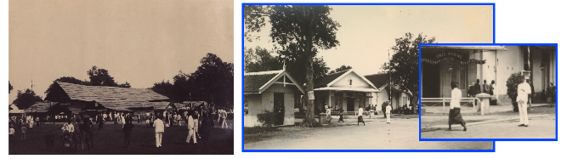
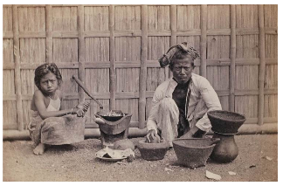
03 Results analysis
5 different misclassified photo styles (studio portraiture, populated landscapes, landscapes, CH, lifestyle documentary) + «other»
4 possible motivations: errors in the annotation phase, few training epochs, feature similarity, emphasis on larger features
false «sensitive»
error during the annotation
false «sensitive»
feature similarity
false «sensitive» - emphasis on larger features
false «not-sensitive» - few training epochs

Slide 14
04 Discussion
Feasibility of the application of binary Image Classification algorithms for automatic sensitive content detection at the cost of simplifying the issue
Limitations and issues
Dataset
Problem definition
Annotation
Algorithm
Dimensions
Quality
Balance
Cluttered images
Complexity and subjectivity
Opacity of classes’ boundaries
Intraclass variation
Similarity across classes
Small number of annotators
No specific preparation on the topic
Inadequacy of the Image Classification algorithm (feature scale variation)
Smallscale hyperparameter tuning
Annotation pilot
Further hyperparameter tuning
Exploration of different approaches: Object Detection; multimodal ML algorithms (CLIP, GLIP)
Opening access to colonial archives
Gather further insights from diverse stakeholders

Slide 15
Thank you!
Alma Mater Studiorum – Università di Bologna
Revealing Contested Memory: Automatic sensitive content detection in colonial photographic archives
Defended by Orsola Maria Borrini
Supervisor Prof. Giovanni Colavizza
Co-supervisor Prof. Charles Jeurgens (University of Amsterdam)
Session III
Academic Year 2022/2023

