Slide 1

Andy
Kate (ONLINE)
60min
insight & Action anticipate my needs
PRE-ARRIVAL PREFERENCE COLLECTION & HOW DO WE CAPTURE GUEST PREFERENCES?

Slide 2
UNDERSTANDING GUEST PREFERENCES IS ESSENTIAL
for OUR LEGENDARY SERVICE
Today, we capture data about our guests across their entire journey. We work with this information to surprise and delight!
Reservation
Notes
Guest Declared Preferences
Observed
Preferences
Guest Stated
Preferences
Traces
>
Capture the purpose
of the stay.
Web questionnaire to engage Fans.
What colleagues see and update in HMS.
Guest tells us specific preferences directly.
The specific actions that each team needs to do their job to the best of their ability.

Slide 3
Andy
Kate (ONLINE)
With GXP, WE WILL ELEVATE OUR ABILITY TO UNDERSTAND OUR GUESTS VIA ENRICHED GUEST-DECLARED PREFERENCES
NEW!
The most important data
ENRICHED
Guest Declared Preferences
Reservation
Notes
Observed
Preferences
Guest Stated
Preferences
Traces
>
Robust and globally consistent questions get to the heart of what matters to our guests all the time or for this specific stay:
Priorities when traveling
Personal interests
Purpose & interests for the upcoming stay
Specific room preferences
Dietary preferences
Capture the purpose of the stay.
What colleagues see and update in HMS.
Guest tells us specific preferences directly.
The specific actions that each team needs to do their job to the best of their ability.

Slide 4
Andy
Kate (ONLINE)
Preferences Capture
5 min
insight & Action anticipate my needs
How do we capture preferences today?
Take action:
Step 1: Grab your group or partner and huddle up!
Step 2: Discuss & Answer the Big Questions!
  Which guests will receive personal 1:1 outreach today?
  Which guests get generic outreach?
  How do we track and follow up to ensure top guests have been engaged pre-arrival?

Slide 5

Andy
Kate (ONLINE)
10 min
What commonalities or differences
do we have across pre-arrival engagement today? How do you reach out to guests at your hotel?

Slide 6
Colleague Actions
TODAY, MOST OF US SHARE THE FOLLOWING WORKLOW
Guest Experience
AWARENESS
& CONVERSION
PRE-ARRIVAL PLANNING
WELCOME
IN-STAY / VISIT
FAREWELL
POST-STAY
& AT HOME
In-room experience
Dining / Bar
Spa / Gym Visit
Leisure and Lifestyle
New Booking Handling
Booking
1
UPCOMMING BOOKINGS REVIEW
Merge and match profiles, define member tier, assign VIP code, delegate preferences for traces.
2
DELEGATE PRE-ARRIVAL JOURNEY
Review of arrivals
14, 7 & 3 days in advance.
PERSONAL OUTREACH
Personal outreach typically
by Guest Relations or Front Office Team.
EMAIL OUTEREACH
Property by property pre-arrival engagement sequence with different audiences and degree of automation.
Follow-up Actions
Pre-Arrival Preparation
3
Receive notification
of completion
or update
Follow-up
with guests
on preferred method of contact.
Bring colleagues into the conversation
to support
Review & assign traces for the relevant teams
to action.
4
COMMUNICATE & DELIVER PREFERENCES
Review preferences, confirm traces and prepare arrival report and VIP ‘Fan Mail’

Slide 7
Andy
Kate (ONLINE)
THROUGH GXP, WE ARE AUTOMATING PRE-ARRIVAL ENGAGMENT TO ENHANCE PRE-STAY PREFERENCE CAPTURE
CONSISTENCY
Embrace a brand-led approach across the group that sets an elevated base standard for how and what types of preferences we capture and act on.
EFFICIENCY
Automate the highly manual process and reduce colleague time and effort invested in preferences collection and redirect that capacity towards service delivery.
EXPERIENCE
Understand guest needs on a more individual level by asking questions that matter to them and turn that information into impactful and memorable experiences on property.

Slide 8
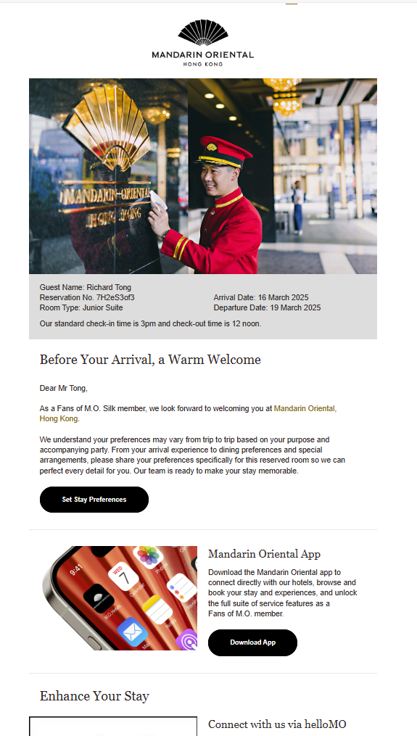
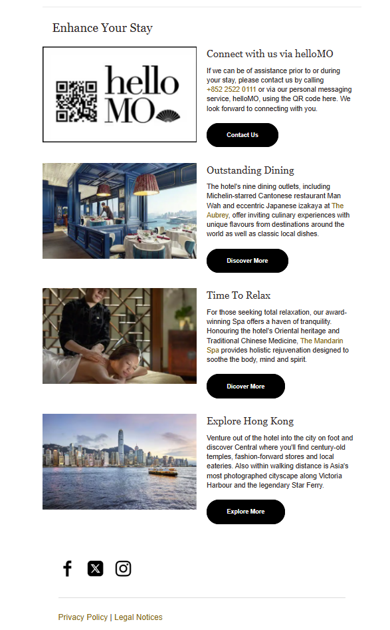
Andy
Marketing & Communication
insight & Action anticipate my needs
Prompting guests to engage earlier including to complete stay-specific preferences
The new brand-led arrival -4 day email (mock-up)
  KEY FEATURES:
  Stay-based preferences capture
  Prompt to download MO App
  Prompt to chat with hotel
  Dynamic content to showcase experiences, events & offerings
Link to sample email: Mandarin Oriental

Slide 9
Colleague Actions
Tomorrow with GXP
Guest Experience
AWARENESS
& CONVERSION
PRE-ARRIVAL PLANNING
WELCOME
IN-STAY / VISIT
FAREWELL
POST-STAY
& AT HOME
In-room experience
Dining / Bar
Spa / Gym Visit
Leisure and Lifestyle
New Booking Handling
Booking
1
UPCOMING BOOKINGS REVIEW
Merge and match profiles, define member tier, assign VIP code, delegate preferences for traces.
2
DEFINE EXCLUSIONS & DELEGATE JOURNEY
TODAY
NEW!
NEW! ALWAYS AVALIBLE
Review of arrivals
14, 7 & 3 days in advance.
PERSONAL OUTREACH FOR HIGH VALUE GUESTS
Personal outreach coordinated and supported by senior and dedicated colleague – more
to come soon on ‘The Fan Maker’
BRAND-LED EMAIL OUTREACH FOR CONTACTABLE GUESTS
Automated email sent 4 days before arrival to all bookings with associated personal email.
APP COMPLETION
OF STAY PREFERENCES FOR FMO MEMBERS ONLY
Fans with bookings can log-in and complete stay preferences. Non-members will be prompted to download App and join Fans of M.O.
NEW!
Identify The Collective guests, guests on the exclusions list, or guests who qualify for the exclusion list based on property rules and delegate appropriate pre-arrival journey for that guest.
MANDITORY for The Collective & excluded guests unless excluded by senior property management.
Arrival -4 Days
Follow-up Actions
Pre-Arrival Preparation
3
Receive notification
of completion
or update
Follow-up
with guests
on preferred method of contact.
Bring colleagues into the conversation
to support
Review & assign traces for the relevant teams
to action.
4
COMMUNICATE & DELIVER PREFERENCES
Review preferences, confirm traces and prepare arrival report and VIP ‘Fan Mail’

Slide 10
MANAGING EXCLUSIONS
Andy
Kate (ONLINE)
3
MANAGING PRE-ARRIVAL EMAIL SEQUENCE EXCLUSIONS
PRE-ARRIVAL EMAIL
4 DAYS BEFORE ARRIVAL
ELIGIBLE BOOKINGS
1. DATA EXCLUSIONS
All bookings under OTA booking source code, except OTA bookings with Fans of M.O. member ID.
EXCLUDE IF:
OTA BOOKING, NOT A FAN
BOOKING SOURCE: OTA, NOT A FAN
DAILY 4AM HKT
BATCH PROCESSED
DAILY 8AM HKT
EMAIL BLAST

Slide 11
MANAGING EXCLUSIONS
Andy
Kate (ONLINE)
MANAGING PRE-ARRIVAL EMAIL SEQUENCE EXCLUSIONS
PRE-ARRIVAL EMAIL
4 DAYS BEFORE ARRIVAL
ELIGIBLE BOOKINGS
1. DATA EXCLUSIONS
All bookings under OTA booking source code, except OTA bookings with Fans of M.O. member ID.
EXCLUDE IF:
OTA BOOKING, NOT A FAN
BOOKING SOURCE: OTA, NOT A FAN
GUEST ID FOUND ON EXCLUSION LIST
2. PROPERTY EXCLUSIONS
Each property can define the guests they wish to be excluded via the hotel specific exclusion list where any guest profile ID on that list will not be emailed by the system when the batch is processed each day at 4am HKT.
BE AWARE!
Batch will not reset. Guests will not receive pre-arrival emails from this property while they remain on this list. Cross reference and updating required regularly.
DAILY 4AM HKT
GUEST PROFILE ID
BATCH PROCESSED
DAILY 8AM HKT
EMAIL BLAST

Slide 12
Monitor Open Rate
A CLOSER LOOK AT HOW EXCLUSIONS WILL WORK
How is a hotel meant to know what to do?
How can we clean this?
Days to Arrival
T - …
T-5
T-4
T-3
T-2
T-1

Slide 13
Monitor Open Rate
A CLOSER LOOK AT HOW EXCLUSIONS WILL WORK
PRE-ARRIVAL EMAIL BATCH CREATION 04:00 HKT
How is a hotel meant to know what to do?
How can we clean this?
Days to Arrival
T - …
T-5
T-4
T-3
T-2
T-1

Slide 14
Monitor Open Rate
A CLOSER LOOK AT HOW EXCLUSIONS WILL WORK
PRE-ARRIVAL EMAIL BATCH CREATION 04:00 HKT
PRE-ARRIVAL EMAIL SENT 08:00 HKT
How is a hotel meant to know what to do?
How can we clean this?
Days to Arrival
T - …
T-5
T-4
T-3
T-2
T-1

Slide 15
Monitor Open Rate
A CLOSER LOOK AT HOW EXCLUSIONS WILL WORK
PRE-ARRIVAL EMAIL BATCH CREATION 04:00 HKT
PRE-ARRIVAL EMAIL SENT 08:00 HKT
STAY PREFERENCES OFFLINE
24hr to arrival
How is a hotel meant to know what to do?
How can we clean this?
Days to Arrival
T - …
T-5
T-4
T-3
T-2
T-1

Slide 16
Monitor Open Rate
A CLOSER LOOK AT HOW EXCLUSIONS WILL WORK
PRE-ARRIVAL EMAIL BATCH CREATION 04:00 HKT
PRE-ARRIVAL EMAIL SENT 08:00 HKT
STAY PREFERENCES OFFLINE
24hr to arrival
How is a hotel meant to know what to do?
How can we clean this?
Days to Arrival
T - …
T-5
T-4
T-3
T-2
T-1
A
SCENARIO A
‘Early’ Guest Booking Window
WEB | STAY PREFERENCES FLOW
*
APP | STAY PREFERENCES

Slide 17
Monitor Open Rate
A CLOSER LOOK AT HOW EXCLUSIONS WILL WORK
PRE-ARRIVAL EMAIL BATCH CREATION 04:00 HKT
PRE-ARRIVAL EMAIL SENT 08:00 HKT
STAY PREFERENCES OFFLINE
24hr to arrival
How is a hotel meant to know what to do?
How can we clean this?
Days to Arrival
T - …
T-5
T-4
T-3
T-2
T-1
A
SCENARIO A
‘Early’ Guest Booking Window
WEB | STAY PREFERENCES FLOW
*
APP | STAY PREFERENCES
B
SCENARIO B
‘Late’ Guest Booking Window
*
APP | STAY PREFERENCES

Slide 18
Monitor Open Rate
A CLOSER LOOK AT HOW EXCLUSIONS WILL WORK
PRE-ARRIVAL EMAIL BATCH CREATION 04:00 HKT
PRE-ARRIVAL EMAIL SENT 08:00 HKT
STAY PREFERENCES OFFLINE
24hr to arrival
FINAL VIP ARRIVALS REVIEW
XX:XX
How is a hotel meant to know what to do?
How can we clean this?
Days to Arrival
T - …
T-5
T-4
T-3
T-2
T-1
C
SCENARIO C - VIP
‘Early’ VIP Guest Booking Window
*
APP | STAY PREFERENCES
REVIEW & ADD TO EXCLUSIONS LIST
DELEGATE FOR 1:1 OUTREACH
UPDATE HMS FOR TRACABILITY

Slide 19
Monitor Open Rate
A CLOSER LOOK AT HOW EXCLUSIONS WILL WORK
PRE-ARRIVAL EMAIL BATCH CREATION 04:00 HKT
PRE-ARRIVAL EMAIL SENT 08:00 HKT
STAY PREFERENCES OFFLINE
24hr to arrival
FINAL VIP ARRIVALS REVIEW
XX:XX
How is a hotel meant to know what to do?
How can we clean this?
Days to Arrival
T - …
T-5
T-4
T-3
T-2
T-1
C
SCENARIO C - VIP
‘Early’ VIP Guest Booking Window
*
APP | STAY PREFERENCES
REVIEW & ADD TO EXCLUSIONS LIST
DELEGATE FOR 1:1 OUTREACH
UPDATE HMS FOR TRACABILITY
D
SCENARIO D - VIP
‘Late’ VIP Guest Booking Window
*
APP | STAY PREFERENCES
DELEGATE FOR 1:1 OUTREACH & UPDATE HMS
UPDATE HMS FOR TRACABILITY

Slide 20
QUICK
RECAP WHAT CHANGES
NEW BOOKING HANDLING & EXCLUSIONS
PRE-ARRIVAL ENGAGEMENT
ARRIVAL PLANNING
1
Work with existing processes to identify changes and define clear ownership of exclusions and delegation process.
When reviewing a booking, confirm guest tier and IF guest is already on the exclusions list to ensure all VIP guest bookings are reviewed for 1:1 outreach.
Closely monitor the 4-day booking window and double check for short, VIP bookings and act quickly to reach out
3
Be aware and on the lookout for
the new stay-based preference submissions that will be flowing into HMS and Guest Lens (from guest completion in-App or online prompted by the automated T-4 pre-arrival email)
4
Review and prioritise Guest Declared Profile & Stay Preferences in planning and preparation to make sure we capture what matters most to guests and deliver the 'preferences in action' framework
2
3
Notes:
1/ how are you doing it today? Do you have a process in place today?
Who is responsible for putting exclusions on the list? Who does the HNW outreach? How will you onboard them?
2/ if you don’t have a process in place today, what is required to fit this workflow?
3/ For the 4 day booking window, do you have a process for double checking for short booking window VIP to determine outreach required.
Prepare your teams for the impact of this new process in place
4/ be aware, guests are updating their information in the app as well (without direct conversation with our teams).

Slide 21
Andy
Kate (ONLINE)
20min
insight & Action anticipate my needs
How will we capture preferences with GXP?
Take action:
Step 1: Get your group or partner and huddle up!
Step 2: Review how you work today to discuss & answer the Big Questions!
  Which guests will we exclude?
  How do we track Collective Guests and excluded guests to ensure pre-arrival outreach (where relevant)?
  Who will coordinate the outreach and follow-up?

Slide 22
Andy
Kate (ONLINE)
10 min
Let’s be inspired by everyone’s plans.

Slide 23
60min
Insight & Action Make me Feel Relaxed & at home
excite me & make me feel special
PREFERENCES IN ACTION: WHERE CAN WE SHOW OUR GUESTS
WE UNDERSTAND THEIR NEEDS?

Slide 24
We will now work together to agree the global minimum guideline for service delivery and inspire each other with how we might elevate with +1 Service.
Andy
Kate (ONLINE)
By asking guests pre-arrival questions
we are setting their expectations for our service.
Notes:
Let’s dive into the journey…
this will be workshopped and tailored to each of your properties

Slide 25

GLOBAL Minimum service GUIDELINE
Andy
Kate (ONLINE)
GUEST Profile & preferences in action
GLOBAL CONSISTENCY
LOCAL MAGIC
+1 SERVICE OPPORTUNITY
Aligned with our LQA/LQE standards and Service Pillars, this is the minimum experience a guest can expect to receive across all properties based on their declared profile & stay-specific preferences.
The opportunity to go above and beyond the minimum service standard based on the guest declared profile and stay-specific preferences.

Slide 26
Andy
Kate (ONLINE)
WE HAVE IDENTIFIED FOUR Categories OF ACTION
Guest Experience
AWARENESS
& CONVERSION
PRE-ARRIVAL PLANNING
WELCOME
IN-STAY / VISIT
FAREWELL
POST-STAY
& AT HOME
In-room experience
Dining / Bar
Spa / Gym Visit
Leisure and Lifestyle
Colleague Service Action
PROACTIVE OUTREACH
ROOM ALLOCATION
& SET UP
SURPRISE
& DELIGHT
SERVICE TEMPO
How we engage pre-stay to ensure our guests feel REASSURED their needs are understood and to help them get the most out of their stay.
This includes:
Relevant and contextual service offerings based on why they are staying with us, who they are with and what they want to explore.
Important!
Marketing Consent is required.
How we assign the room, prepare the space and amenities to ensure guests feel AT HOME in our home.
This includes:
Room set up
Type of amenities
Amenities placement
Robe & slipper size
In the future, we aim to cover;
Mini-bar set up
Placement of flyers & information
The soft touches that demonstrate
a deep sense of connection and care and make guests and their companion feel SPECIAL.
This includes:
Welcome amenity
MO WOW moments
FMO milestones
Glitch recovery
FMO chef’s exclusive
Gifting
The pace, timing and attentiveness that makes a guest feel their CONTEXT is understood and that needs are effortlessly met.
This includes:
Check-in
Check-out
Room introduction
Referrals & recommendations
Notes:
This is the what we will be embodied at your property.
For you to find your magic.

Slide 27
guest profile PREFERENCES
NEW!
UPDATED
How can we make you most comfortable in your room?
What is your in-room water preference?
FREE TEXT
GGGUE
STILL
WT03
SPARKLING
WT02
BOTH
WT99
This is our first port
of call for us to know who this person is and what matters to them.
REVIEW & DELEGATE
Property team to review & delegate to stay preferences and stamp with [date & property].
NOTES: How do we disseminate into actual actions?
-Take preferences and copy paste to departmental codes as ”Global Preferences”
If Other Language,
Do we retain a copy?
!! If Inappropriate
!! DON’T MODIFY GUEST ENTERED INFORMATION: Leave this is the format the guest delivered to maintain the integrity of the content.
Any chances to this text box will pass through to the colleague.
  If we change it, it changes for the guest as well.
TWO WAY?
Traces, Requests, Add Amenity,
ROOM ALLOCATION & SET UP
- ALL ROOMS to have 1 Large Still & 1 Large Sparkling water available upon rooming and turn down.
- IF STILL; add extra still water to the room and place still water at the bedside during turndown.
IF SPARKLING; add extra sparkling water to the room and place sparkling water at the bedside during turndown.
IF BOTH; keep 1 Large Still & 1 Large Sparkling water
This is an existing standard,
but we will put new emphasis and focus on moving forward.

Slide 28
GUEST DECLARED STAY BASED PREFERENCES
NEW!
NEW!
to pull out a few ideas, C & Y, lets talk to get more specific.
What is the purpose
of this stay?
Who will accompany you
on this stay?
What do you wish to explore during your stay?
BUSINESS
APW-BS
TRAVELING ALONE
APH-01
CULINARY & WINE
AA-WIN
LEISURE
APW-LS
SIGNIFICANT OTHER
APH-02
BARS & NIGHTLIFE
AA-BAR
BOTH
APW-MX
INFANT(S) / TODDLER(S)
APH-BY
SPA & BEAUTY
AA-SPA
CHILD(REN)
APH-CH
FITNESS & WELLNESS
AA-FIT
TEENAGER(S)
APH-TN
SPORTS & ADVENTURE
AA-SPO
ADULT FAMILY / FRIENDS
APH-EL
ARTS
AA-ART
SOMEONE ELSE
APH-OT
CULTURE & EVENTS
AA-CUL
COUPLE ACTIVITIES
AA-COU
FAMILY TIME
AA-FAM
NEW!
IF BUSINESS or BOTH,
PROACTIVE OUTREACH +1 – share the in room set-up options (monitor, chair)
ROOM ALLOCATION & SET UP no amenities placed on desk, ensure desk power outlets are available and accessible
SET SERVICE TEMPO anticipate express tempo in all guest-facing interactions (FO/F&B/CON/TR)
IF LEISURE;
- PROACTIVE OUTREACH* recognize & refer to interests for with relevant +1 Service.
IF, INFANT(S) / TODDLER(S) or CHILD(REN), or TEENAGER(S),
PROACTIVE OUTREACH* to understand ages and 2) provide family offerings and services and 3) confirm number of rooms and if connecting.
ROOM ALLOCATION & SET UP 1) ensure all FHLSS standards are met, 2) refer to standards SOP and 2) provide age-appropriate welcome amenities
SET SERVICE TEMPO prepare family check-in
IF SOMEONE ELSE,
- PROACTIVE OUTREACH* then reach out to understand who and how we can prepare.
IF MARKETING CONSENT, REFER TO [COMPANIONS];
PROACTIVE OUTREACH* reach out with relevant activity and offer to support itinerary planning that align further to preferences
+1 OPPORTUNITIES ROOM ALLOCATION & SET UP
IF WINE, provide [SOMMOLIER INSIGHTS] in room.
IF YOGA, place yoga mat visibility in the room and provide wellness & fitness facilities card
IF SPA & BEAUTY, provide spa menu.

Slide 29
GUEST DECLARED STAY BASED PREFERENCES
NEW!
NEW!
Do you have any dietary preferences we should consider for this stay?
Is there anything else we can do
to make this stay more memorable?
SAVORY
DISAV
FREE TEXT
APNOTE
DISWT
APNOTE
SWEET
HEALTHY & LIGHT
DIHEA
VEGETARIAN
DIVGT
VEGAN
DIVEG
REMOVE IN ROOM ALCOHOL
DINAL
NO PREFERENCE
DINONE
No longer are we guessing.
We will know how to delight our guest.
REFERENCE AS PIRIORTY for all amenities, MoWOW, FMO Milestone and Chefs Exclusive and Glitch Recovery
IF NO IN-ROOM ALCOHOL,
- ROOM ALLOCATION & SET UP all alcohol from mini-bar removed and replace with other drinks and 2) place [Alcohol removed on request card]
REVIEW & DELEGATE
Property team to review & delegate to stay preferences and stamp with [date & property].
This is our first port
of call for us to know what matters for this stay.

Slide 30
GUEST DECLARED STAY BASED ARRIVAL INFOMRATION
NEW!
What time can we expect your arrival at the hotel?
Would you like us to arrange your transfer to the hotel?
What is your preferred method
of contact for us to support
any requests you make regarding this stay?
PROACTIVE OUTREACH recognize arrival time and set expectations
SET SERVICE TEMPO anticipate arrival
+1 Service Opportunities
ROOM ALLOCATION & SET UP review room allocation & prioritisation
PROACTIVE OUTREACH connect with transfer services
PROACTIVE OUTREACH reach out to guest using contact information provide

Slide 31
QUICK
RECAP WHAT CHANGES
GUEST DELCARED TAKE PRIORITY
REVIEW REFINE & ALIGN WHAT YOU OFFER TODAY
TRUST THE TRAINING INPLACE
1
Now that we have asked, we must reflect that preference in our service delivery.
Consider how to prepare your teams and procedures to review guest declared codes, especially profile & stay based free text, before arrival.
2
Not every guest will get a welcome amenity, but for guest who do – we will ensure their preferences are acknowledged
4
We know how to even the most unreasonable request today. What is new is that we may need to address these requests in writing.
Review protocols in place for how we handle these conversations in writing and provide teams with templates and support need as they build their confidence.
3
Less is more, especially when it is it a thoughtful gesture.
Work with your F&B teams to refine welcome amenities to reflect preferences and operational requirements of your property.

Slide 32
Andy
Kate (ONLINE)
Note: These are dummy profiles created
for demonstration purposes only
Action Make me Feel Relaxed & at home,
excite me & make me feel special
The Genie | Prince Aladdin | Princess Jasmine
2nd Stay 3-night stay Standard Room | Silk Member ID: 977YY6 Booking T-6 5 days Junior Suite | The Collective + Pearl ID: F6G853 Booking Time: T-4 10 nights Superior Suite
PROFILE N/A | PROFILE WATER: Still Water LINENS: Changed every day IN ROOM COMFORT: I love a large bath, plenty of towels and a big TV for movies | PROFILE WATER: Sparkling Water IN ROOM COMFORT: When I travel for work. I appreciate a quite and completely black room with plenty of green tea in a big tea mug.
STAY PREFERENCES Purpose: Leisure Traveling with: Alone Interested to explore: Bars & nightlife, Arts & culture Dietary: Sweet MEMORABLE: “I would sure love an upgrade and a view of the park.” ARRIVAL: 3pm TRANSFER: no | STAY PREFERENCES PURPOSE: Mixed TRAVELING WITH: Children, teenager DIETARY: Savory, sweet, light & healthy INTERESTED TO EXPLORE: Spa & beauty, wellness, sports & adventure, arts & culture MEMORABLE: “I’m traveling with my daughter who is allergic to nuts. Please take care.” CONTACT: Whatsapp me on XX ARRIVAL: 8pm TRANSFER: yes | STAY PREFERENCES PURPOSE: Business TRAVELING WITH: Others DIETARY: Savory, Vegan, Healthy & light INTERESTED TO EXPLORE: Fitness & Wellness, Spa & Beauty MEMORABLE: “Princess is in intown to close a deal and kick off a project. She would appreciate a computer monitor in her room. ARRIVAL: 11 am TRANSFER: Yes
Putting Preferences Into Action:
Step 1: Grab your group or partner and huddle up!
Step 2: Log into Guest Lens (Alliants) and open the dummy profiles we have created
Step 3: Using the preferences action categories define how we would prepare for this guest to deliver global minimum standards and +1 service.

Slide 33
Andy
Kate (ONLINE)
10 min
PROFILE & PREFERENCES WORKSHEET
Guest Experience
AWARENESS
& CONVERSION
PRE-ARRIVAL PLANNING
WELCOME
IN-STAY / VISIT
FAREWELL
POST-STAY
& AT HOME
In-room experience
Dining / Bar
Spa / Gym Visit
Leisure and Lifestyle
Colleague Service Action
PROACTIVE OUTREACH
ROOM ALLOCATION
& SET UP
SURPRISE
& DELIGHT
SERVICE TEMPO
How we engage pre-stay to ensure our guests have what they need to get the most out of their stay.
How we assign the room, prepare the space and amenities to ensure guests feel understood and at home.
The soft touches that demonstrate a deep sense of connection and care for them and travel companions.
The pace, timing and attentiveness that makes a guest feel important and that needs are effortlessly met.
Notes:
This is the what we will be embodied at your property.
For you to find your magic.

Slide 34
10 min
Write the PRE-ARRIVAL OUTREACH email
Draft Email:
Dear
,
Follow-up Actions

Slide 35
10min
Where might we find challenges in delivering the global minimum guidelines?
Can we learn from each other to overcome these?
9 September 2026
Notes:
COLLEAUGE TO DRIVE THE CONVERSATION & RESOLUTION
FACILITATOR TO STRUCTURE:

