Slide 1

SD5531 / TEAM 2
Yichen Zhang | Kecheng Zhu | Haolin Yang | James Eric Liu
Leopard Gecko
Behavior
Monitoring
Project 2 • Video Recording Module
Assignment 2
Project scope and technical exploration
Notes:
Our proposed system connects sustained observation with learning about individual leopard geckos. This draft contains section A and reserved pages for sections B and C.
Source: Gecko_Refined_Brief(1).pdf, page 1. Supplied by the team. Assignment 2 requirements screenshot: section A covers project scope and its relation to the final project goal. All statements describe proposed capabilities, not completed results. Concept artwork is illustrative, not a photograph of project equipment or evidence.

Slide 2

A
PROJECT
SCOPE

Slide 3
A PROJECT SCOPE
Purpose and wider project goal
Sustained evidence for
student observation
1
2
3
Observation and research
Behavior and environment
Care communication
Find target events, compare dates and develop questions using live views and recorded evidence.
Compare how geckos use the enclosure alongside layout, environmental conditions and operation records.
As an extension, students select a clip, add an observation and ask a teacher to review it.
03
Notes:
The course-wide goal links science and technology learning with gecko care and wellbeing. Our contribution is reviewable evidence for learning, comparison of enclosure use and communication with teachers. Care communication is an extension in the latest brief, not an automatic health assessment. These are proposed benefits to validate with users.
Source: Gecko_Refined_Brief(1).pdf, page 1. Supplied by the team. Assignment 2 requirements screenshot: section A covers project scope and its relation to the final project goal. All statements describe proposed capabilities, not completed results. Concept artwork is illustrative, not a photograph of project equipment or evidence.

Slide 4
A PROJECT SCOPE
System scope
One observation record
for each identifiable gecko
01
Capture and retain
Video and thermal-array acquisition, server storage and remote access.
02
Identify and locate
Explore pattern-based identity and locate the gecko in the image.
03
Organize and share
Associate records and analysis with time, region and the shared interface.
Individual identification remains subject to experimental validation.
04
Notes:
The system includes image and thermal acquisition, server storage, individual identification and location, and behavior information organization. The intended output feeds the project shared interface. A separate demonstration interface depends on time. Pattern recognition and reliable identity must be tested.
Source: Gecko_Refined_Brief(1).pdf, page 1. Supplied by the team. Assignment 2 requirements screenshot: section A covers project scope and its relation to the final project goal. All statements describe proposed capabilities, not completed results. Concept artwork is illustrative, not a photograph of project equipment or evidence.

Slide 5
A PROJECT SCOPE
Behavior observation
Activity and stillness
Location, movement and changes in activity.
Hide and region use
Entry and exit, hiding, and time spent in heating and humid areas.
Feeding, drinking and defecation
Timestamp candidate clips for students to replay and confirm.
The timeline connects every event to evidence that users can review.
05
Notes:
This scope distinguishes basic activity and location records from candidate clips of more specific behaviors. Feeding, drinking and defecation clips require review and confirmation. A candidate event is not a confirmed behavior. Missing or invisible footage does not establish absence of activity.
Source: Gecko_Refined_Brief(1).pdf, page 2. Supplied by the team. Assignment 2 requirements screenshot: section A covers project scope and its relation to the final project goal. All statements describe proposed capabilities, not completed results. Concept artwork is illustrative, not a photograph of project equipment or evidence.

Slide 6

A PROJECT SCOPE
A PROJECT SCOPE
Thermal observation
Thermal observation
Surface temperature
during valid visible periods
Associate thermal records with the gecko’s location, behavior and environmental temperature.
Validate measurement performance experimentally.
Retain gaps when measurement is not possible.
06
06
Notes:
The latest brief proposes surface temperature monitoring by associating image location and thermal-array readings during valid visible periods. This is a measurement goal requiring experimental validation. The artwork is decorative and is not a thermal measurement or result.
Source: Gecko_Refined_Brief(1).pdf, page 2. Supplied by the team. Assignment 2 requirements screenshot: section A covers project scope and its relation to the final project goal. All statements describe proposed capabilities, not completed results. Concept artwork is illustrative, not a photograph of project equipment or evidence.

Slide 7
A PROJECT SCOPE
Information students can use
Spatial use
Behavior timeline
Dwell-time heatmaps and movement paths.
Time-stamped events linked to replayable clips.
Observation timing
Teacher review / extension
Suggestions based on individual history, with past clips as references.
Student-selected clips with notes for a teacher to review.
07
Notes:
These are intended information outputs rather than existing system results. Students can view live images and retrieve historical footage by time. Observation-time suggestions use past records as references. Suspected unusual behavior reporting is initiated by students and submitted to teachers, not generated as a diagnosis.
Source: Gecko_Refined_Brief(1).pdf, page 2. Supplied by the team. Assignment 2 requirements screenshot: section A covers project scope and its relation to the final project goal. All statements describe proposed capabilities, not completed results. Concept artwork is illustrative, not a photograph of project equipment or evidence.

Slide 8
A PROJECT SCOPE
Delivery scope and boundaries
Within the proposed scope
Validation required
Capture and storage
Identification and location
Behavior information organization
Data sharing and record alignment
Camera count and placement
Based on enclosure and team designs
Pattern-based identification
Behavior recognition
Surface temperature measurement
Automatic anomaly detection and
health diagnosis are outside
the current deliverables.
Shared interface integration is planned.
A standalone demo depends on time.
08
Notes:
Our group proposes capture, storage, identification and location, information organization and sharing. Alignment with other groups covers time, areas and environmental records. The interface integration is an intended arrangement rather than a completed agreement. The team has not yet supplied its section B technical plan or section C detailed collaboration plan.
Source: Gecko_Refined_Brief(1).pdf, page 2. Supplied by the team. Assignment 2 requirements screenshot: section A covers project scope and its relation to the final project goal. All statements describe proposed capabilities, not completed results. Concept artwork is illustrative, not a photograph of project equipment or evidence.

Slide 9
A PROJECT SCOPE
Project validation
Can sustained records help students
understand individual behavior?
Find opportunities to observe
Compare records and develop research questions
Use evidence in learning and care communication
09
Notes:
This slide states the brief’s intended validation question. It does not claim measured educational improvement. The project seeks to determine whether continuous recording and organized behavioral information help students find observation opportunities, understand individual patterns and support evidence-based learning and care communication.
Source: Gecko_Refined_Brief(1).pdf, page 1. Supplied by the team. Assignment 2 requirements screenshot: section A covers project scope and its relation to the final project goal. All statements describe proposed capabilities, not completed results. Concept artwork is illustrative, not a photograph of project equipment or evidence.

Slide 10

BA
TECHNICAL
EXPLORATION

Slide 11
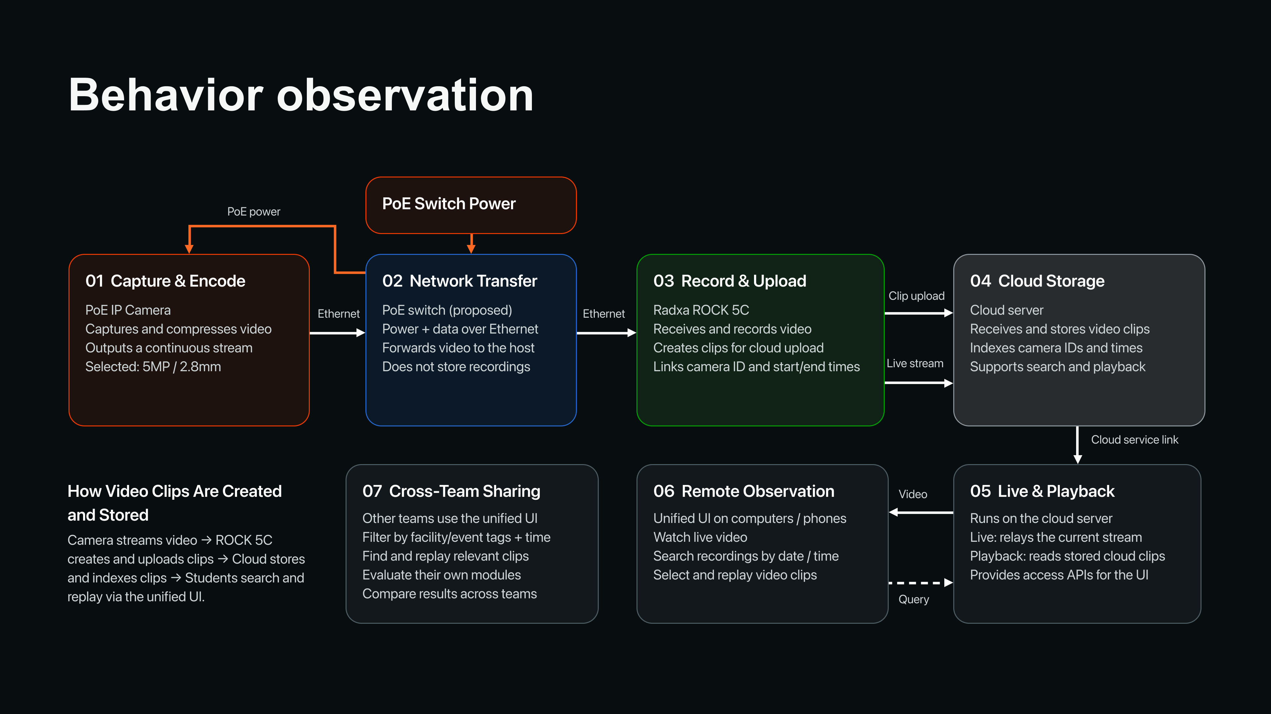
11

Slide 12
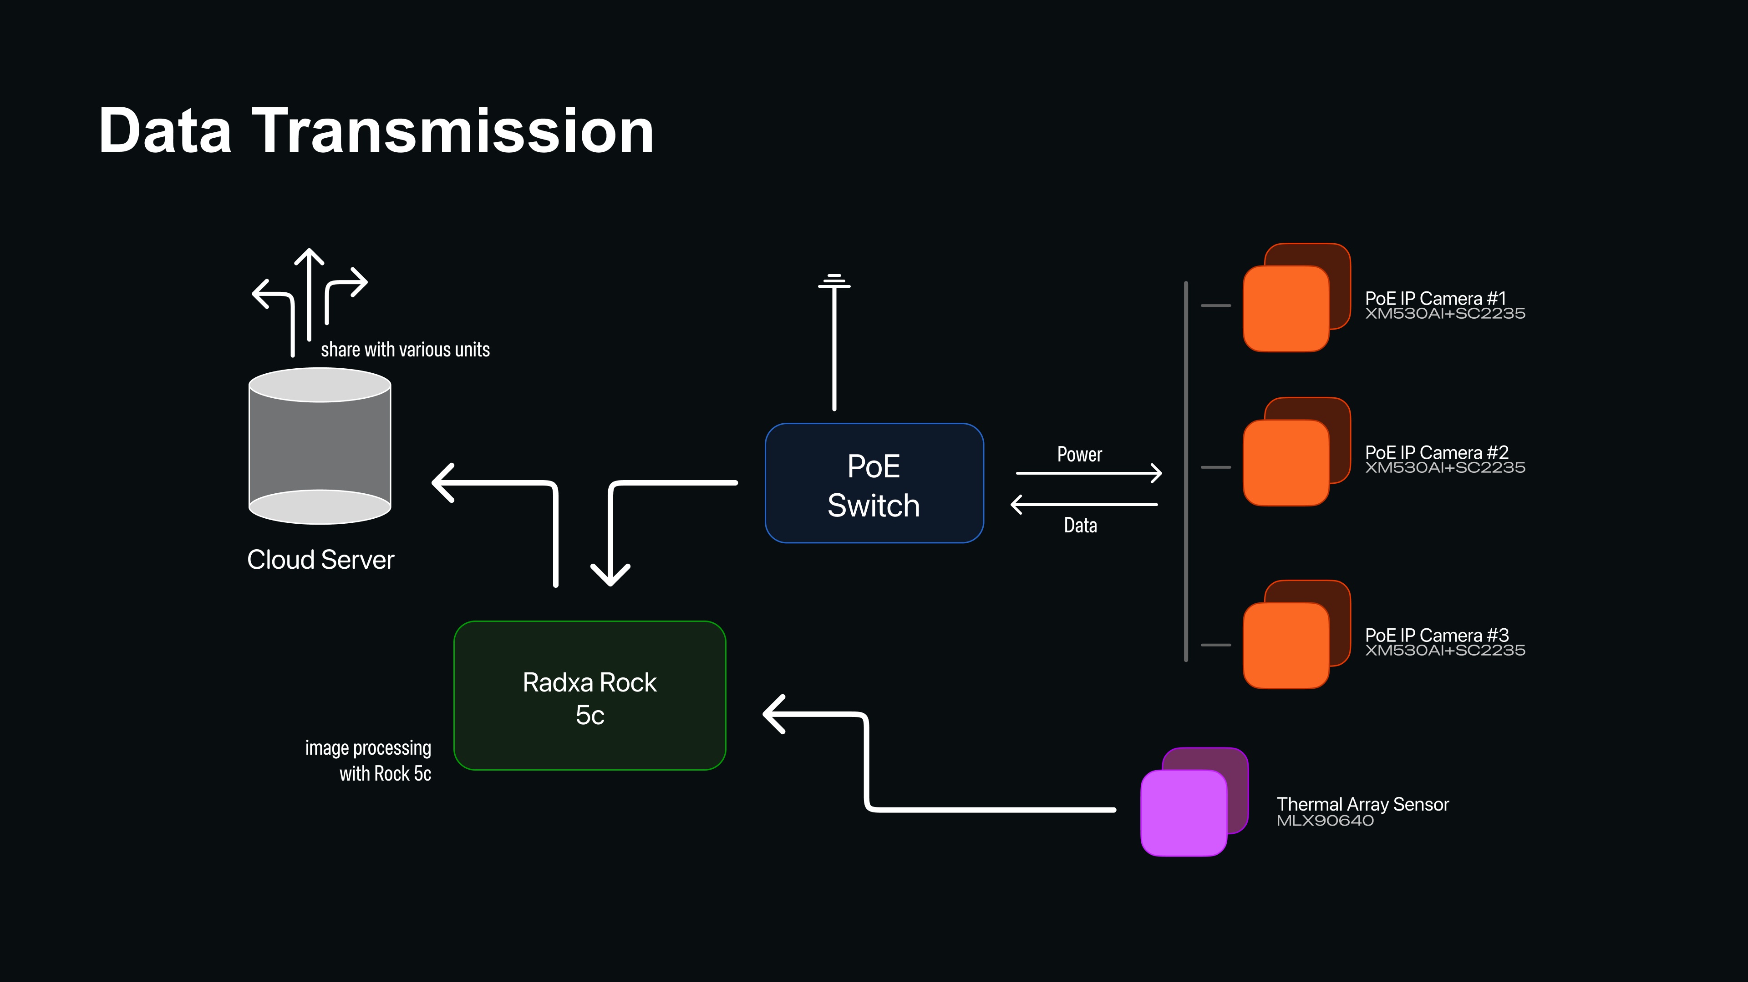
15

Slide 13
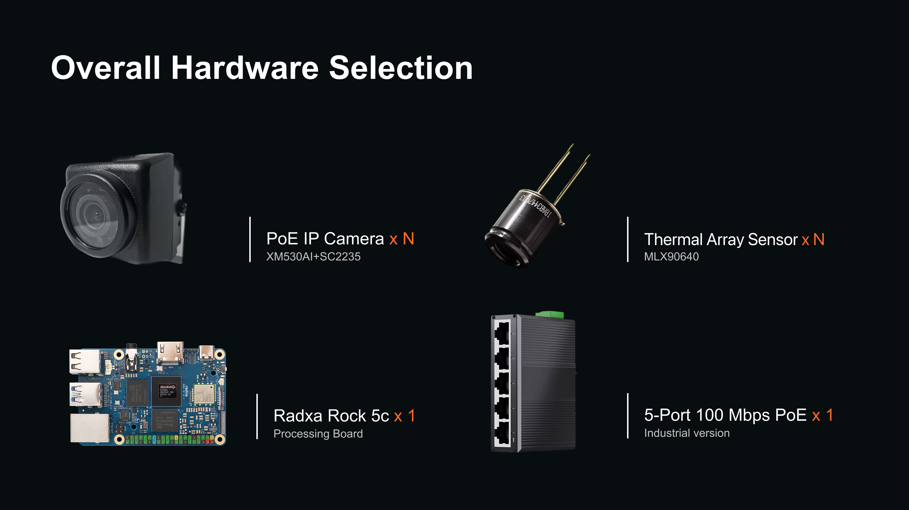
15

Slide 14
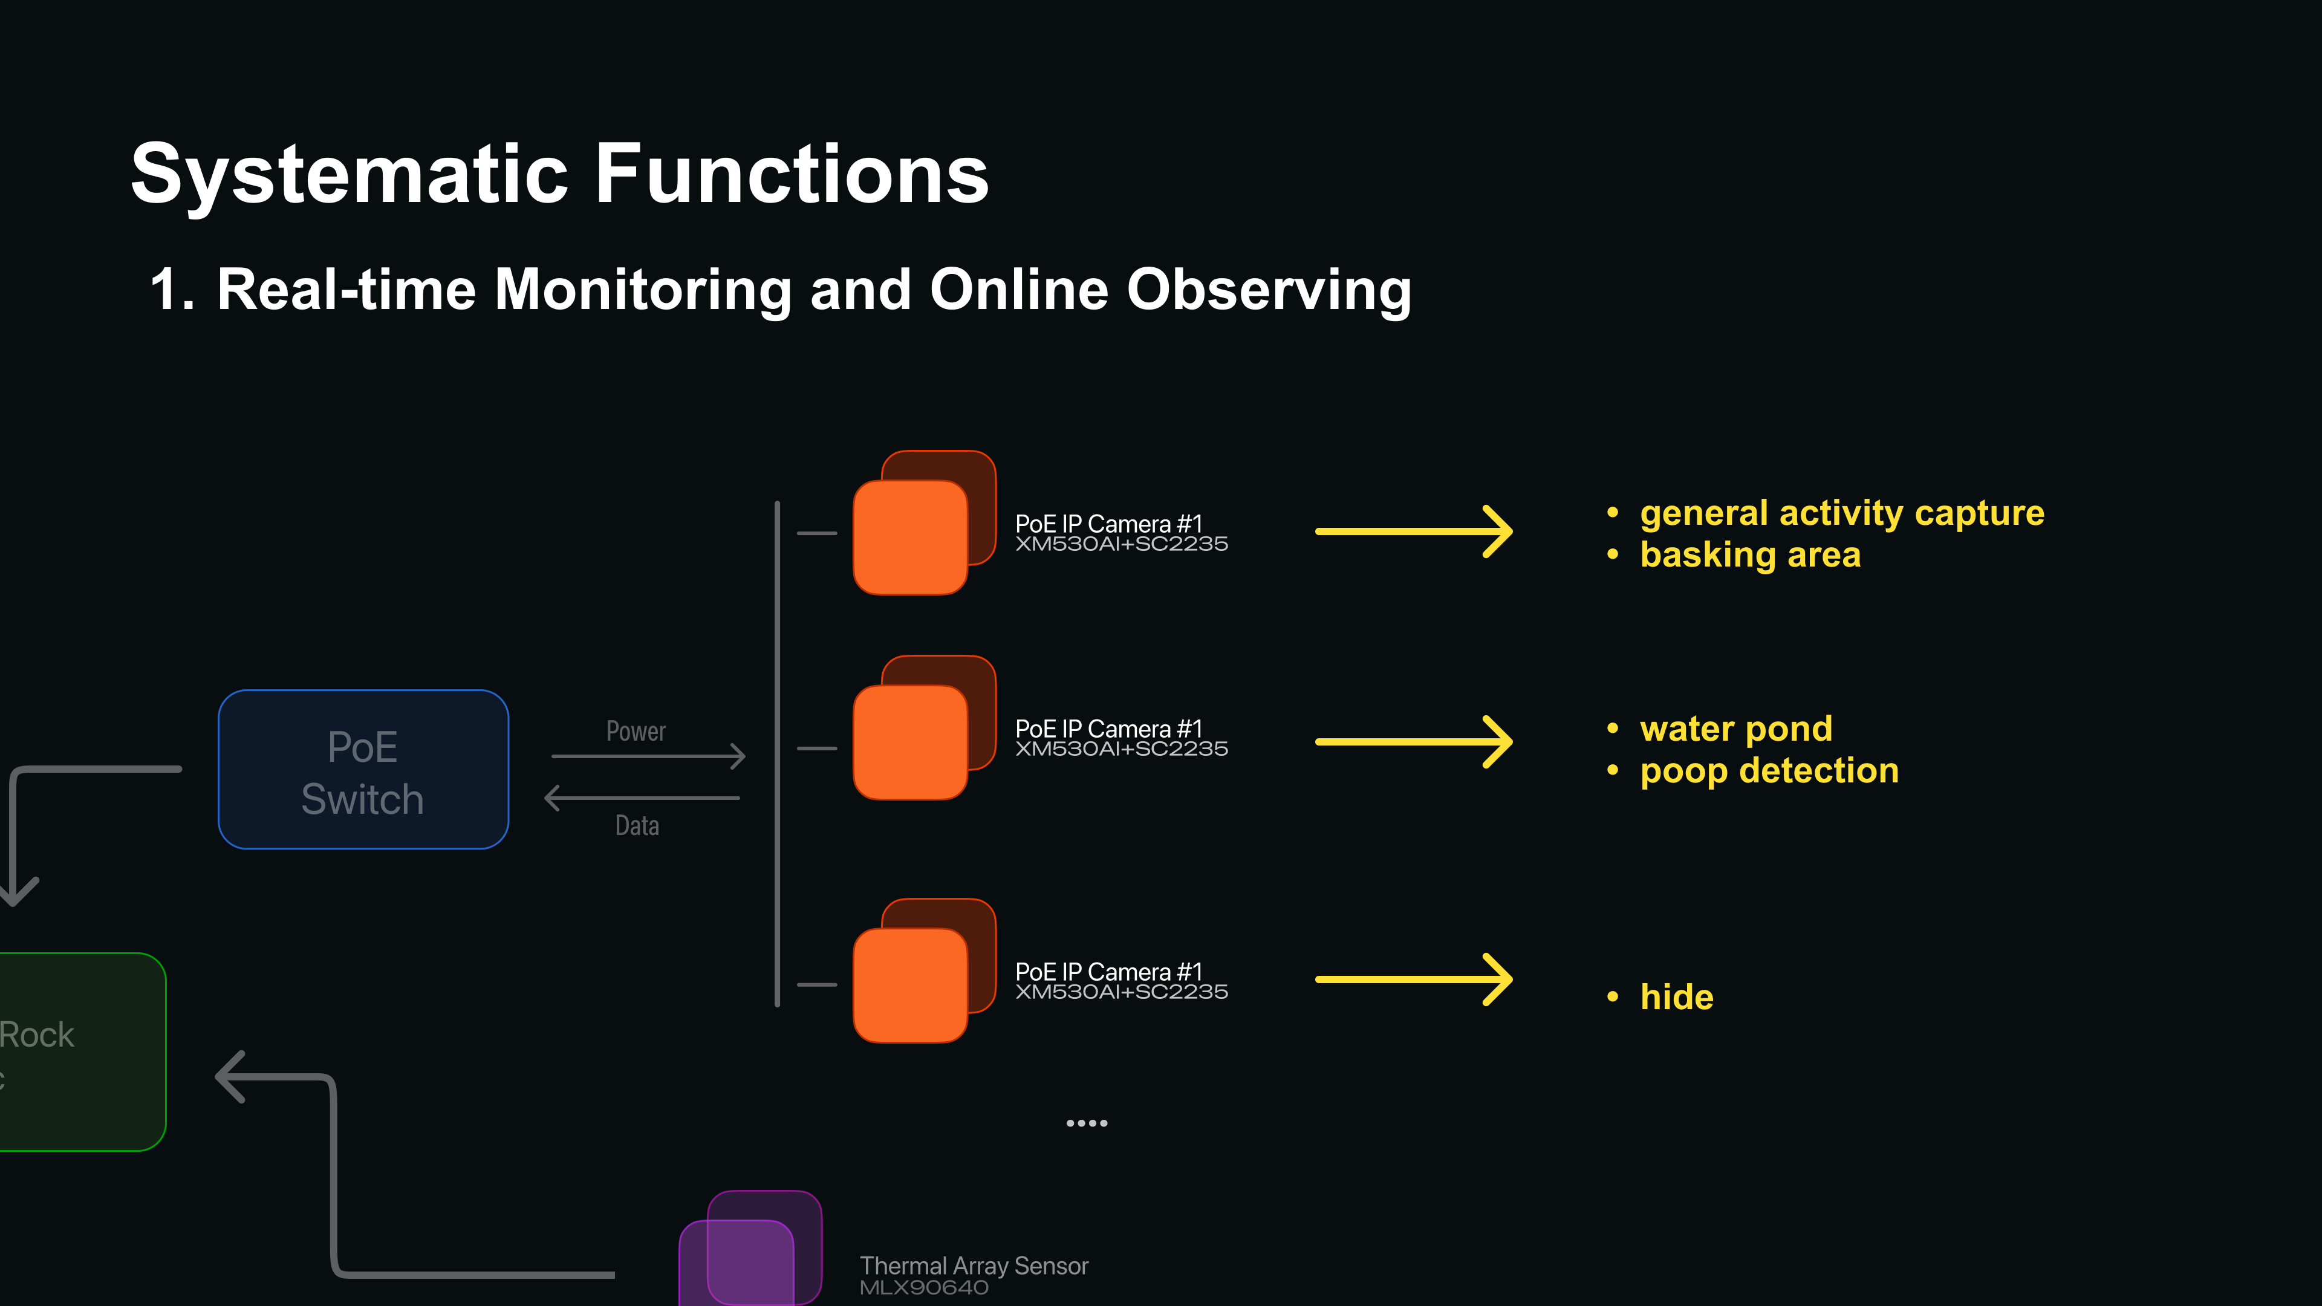
15

Slide 15
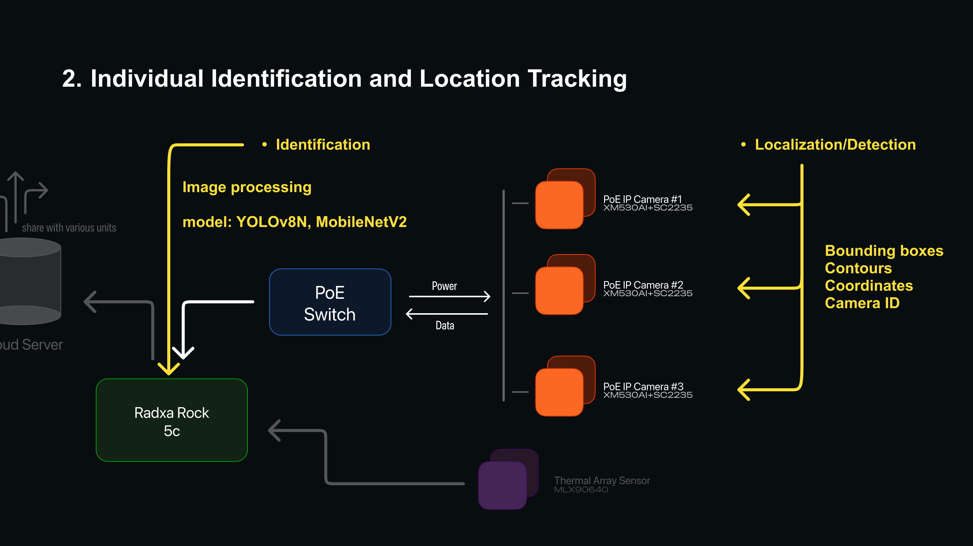
15

Slide 16
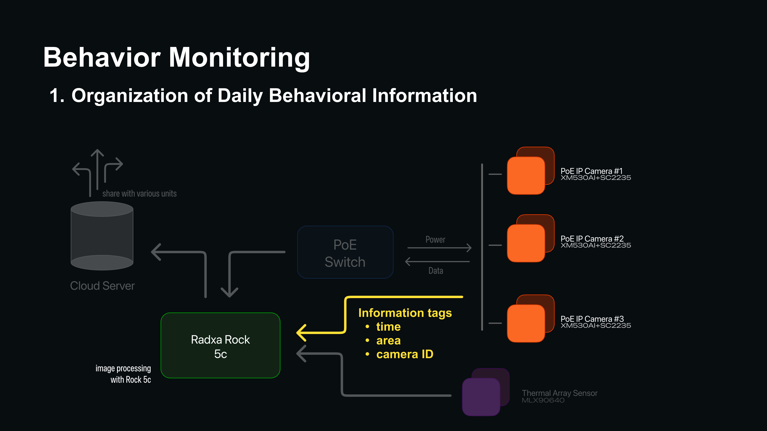
12

Slide 17
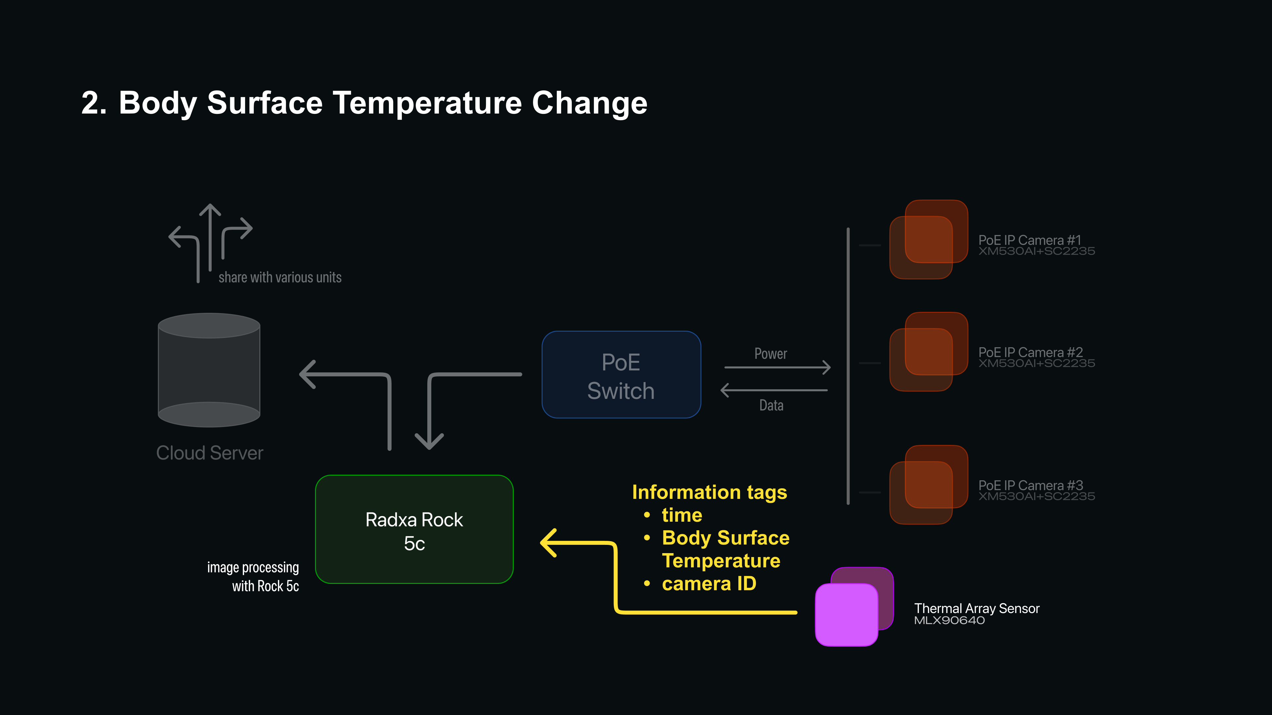
13

Slide 18
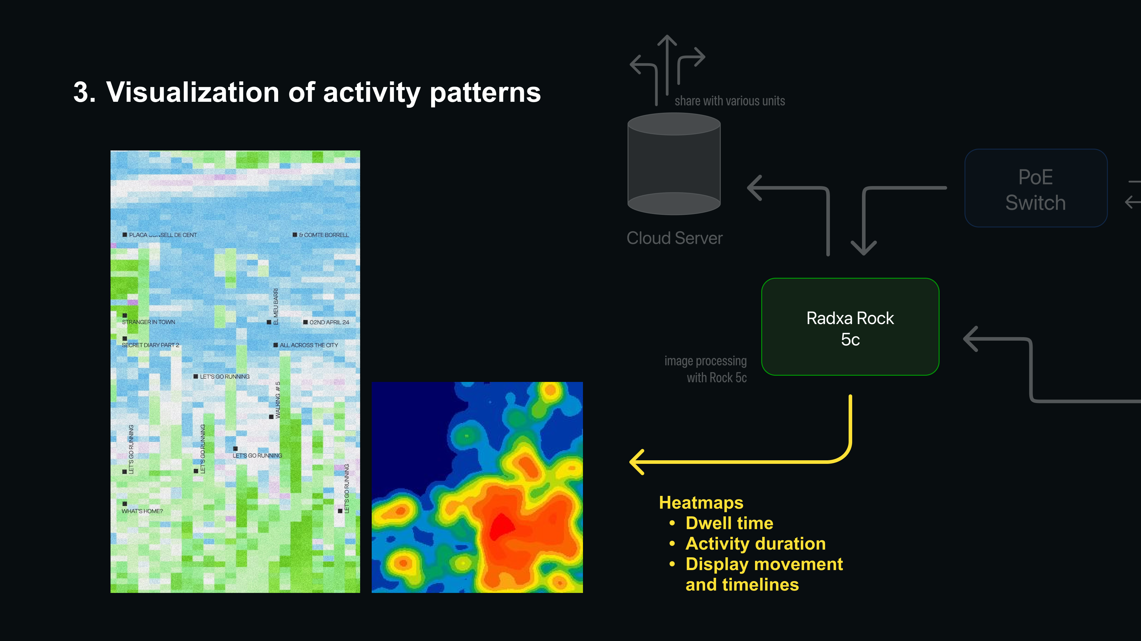
14

Slide 19
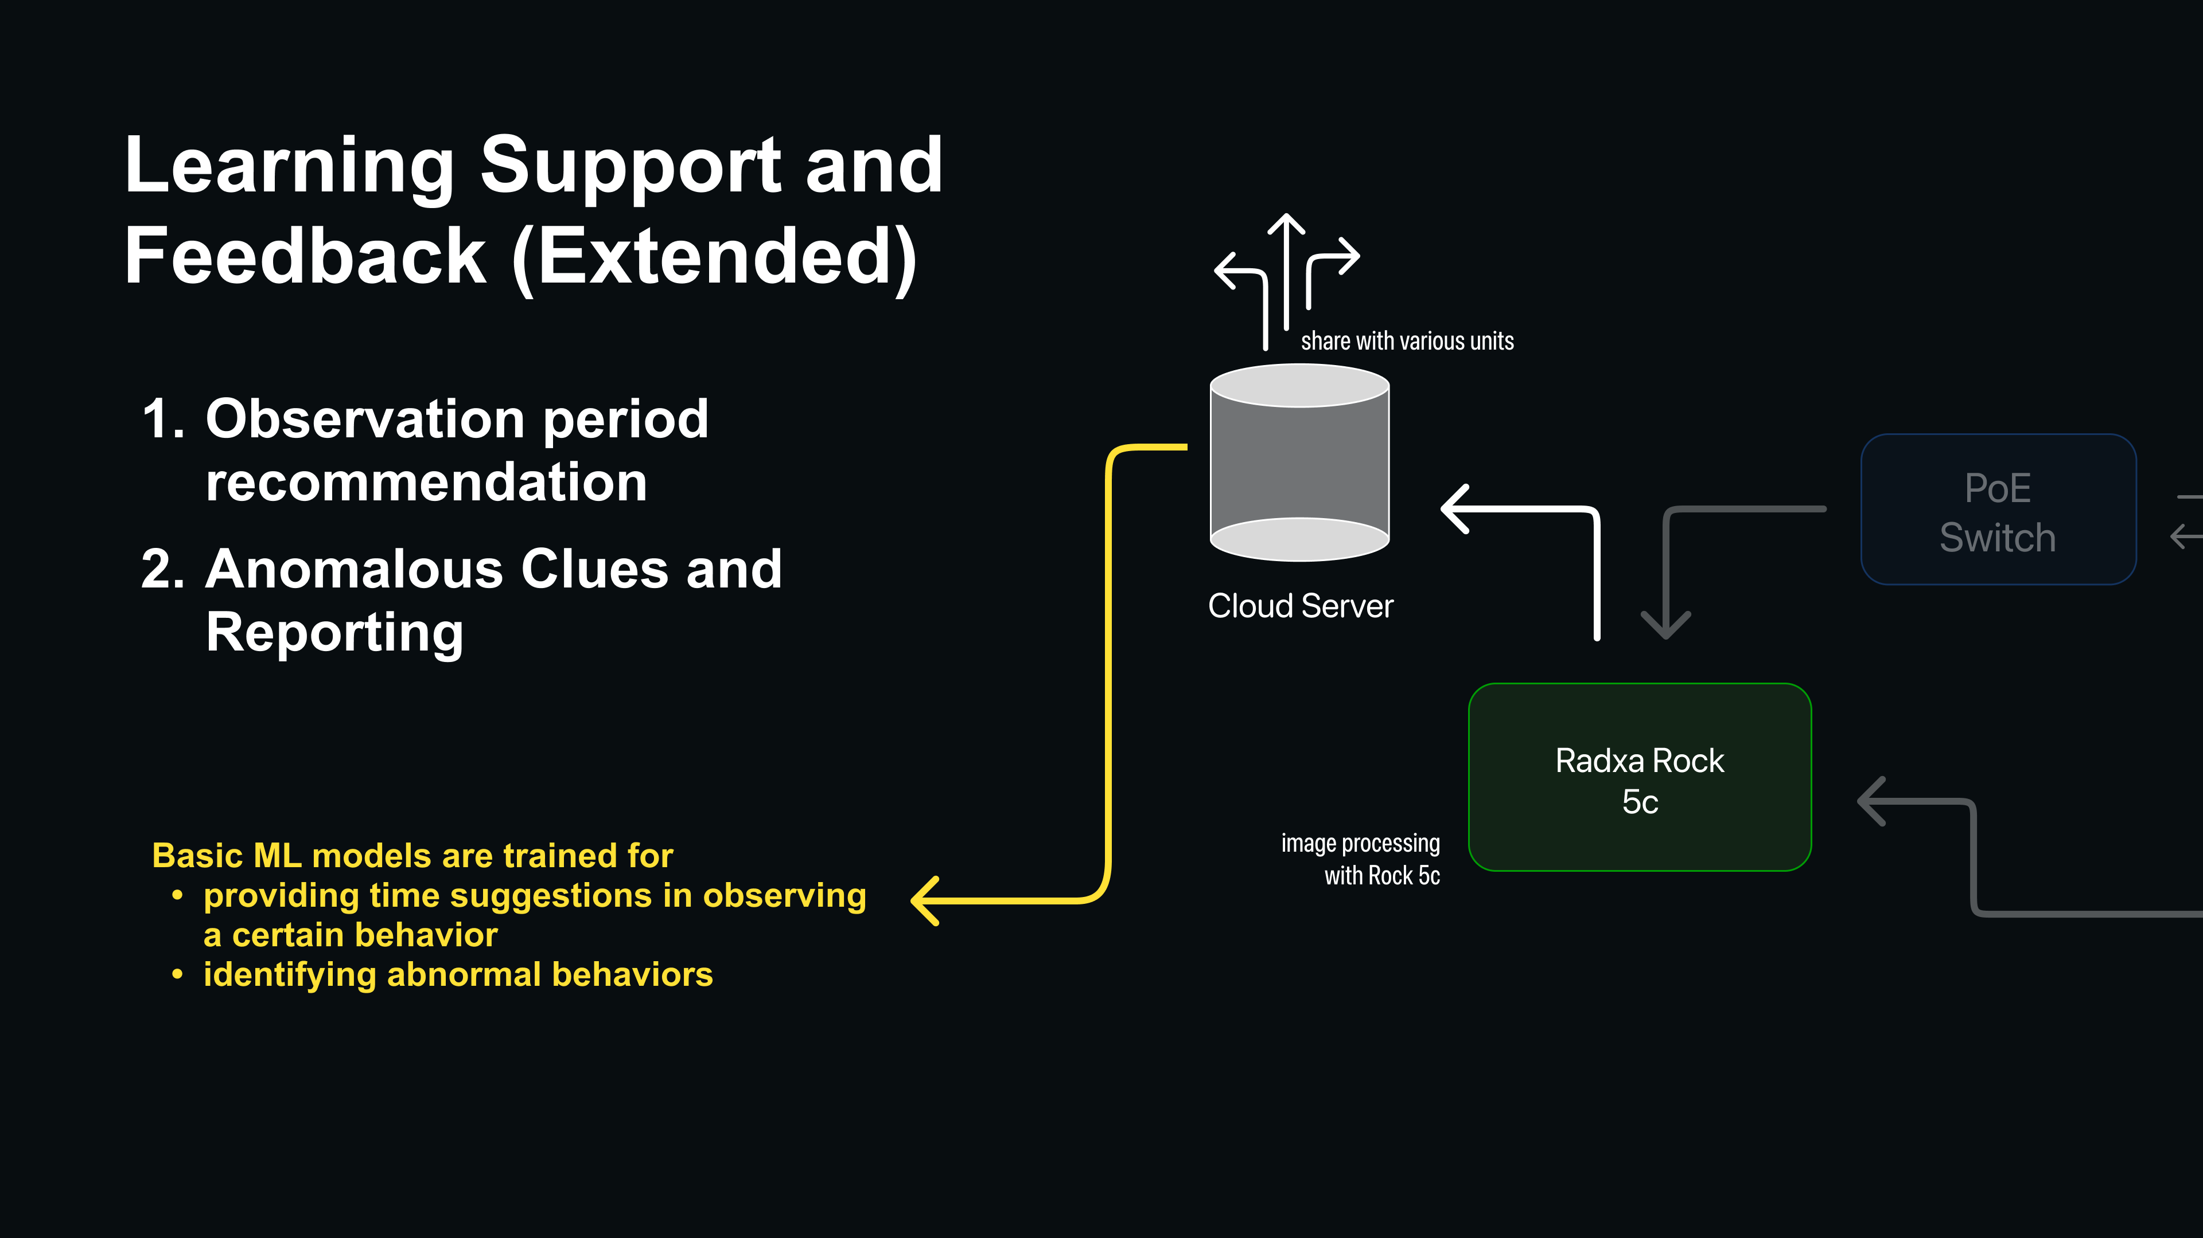
15

Slide 20
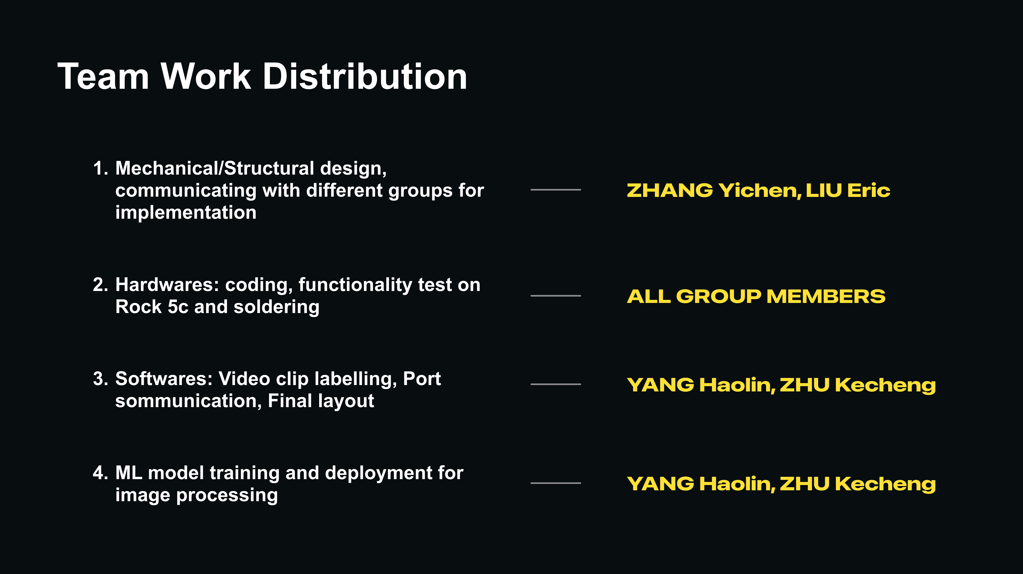
15

Slide 21

CBA
CROSS-TEAM
COLLABORATION

Slide 22
C CROSS-TEAM COLLABORATION
Team inputs and outputs | 1 / 3
Partner team | Partner team provides | Our team provides | Proposed camera view
P1 Enclosure | Confirm dimensions, layout, access points, mounts and cable routes. Map blind spots together. | Movement paths and spatial heatmaps. | Top view of the main activity area. Add an angled view where obstructed.
P3 Hide | All entrances, internal structure, temperature, humidity and existing occupancy signals. | Entry and exit counts and dwell times. | Angled view of entrances, covering thresholds and entry / exit paths.
P = Project number. Camera views are proposals for testing and may be shared.
17
Notes:
Source: Gecko_各组合作计划.pdf, page 1. English translation of the supplied discussion draft. Camera positions are proposed and require testing. P refers to Project number.

Slide 23
C CROSS-TEAM COLLABORATION
Team inputs and outputs | 2 / 3
Partner team | Partner team provides | Our team provides | Proposed camera view
P4 Basking / heating | Upper and lower structures, heat-source positions, on / off logs and measured temperatures. | Dwell records for each level. | Top view of the slate. Check whether the lower entrance is visible.
P5 Water / humidity | Bowl position, temperature and humidity sampling points, refill and humidification logs. | Visits and candidate drinking clips. | View from above and to the side, keeping the mouth visible above the bowl rim.
P = Project number. Camera views are proposals for testing and may be shared.
18
Notes:
Source: Gecko_各组合作计划.pdf, page 1. English translation of the supplied discussion draft. Camera positions are proposed and require testing. P refers to Project number.

Slide 24
C CROSS-TEAM COLLABORATION
Team inputs and outputs | 3 / 3
Partner team | Partner team provides | Our team provides | Proposed camera view
P6 & P7 Environment / defecation | Confirm responsibilities first. Provide defecation areas, substrate, cleaning and lighting logs. | Before / after comparisons and event replay. | Fixed top view of the target substrate area.
P9 Feeding | Confirm responsibility for actual feeding. Provide feeding-area structure, feeding times and quantities. | Prey-capture clips and feeding clips confirmed by review. | Close angled top view covering food, mouth and approach paths.
P = Project number. Camera views are proposals for testing and may be shared.
19
Notes:
Source: Gecko_各组合作计划.pdf, page 1. English translation of the supplied discussion draft. Camera positions are proposed and require testing. P refers to Project number.

Slide 25
C CROSS-TEAM COLLABORATION
Collaboration process
Stage | Joint action
01 Requirements | Each team names one contact and selects the 1–2 most important observation events.
02 Layout | Combine camera views and cable routes with P1. Identify blind spots and removable parts for cleaning.
03 Joint trial | Each team selects one event. Manually compare video with sensor records and correct occlusion or misclassification.
04 Integration | Standardize timestamps and region / individual IDs. Deliver heatmaps, activity distributions and event replay.
20
Notes:
Source: Gecko_各组合作计划.pdf, page 1. English translation of the supplied discussion draft. Camera positions are proposed and require testing. P refers to Project number.

Slide 26
C CROSS-TEAM COLLABORATION
Shared agreements
Responsibilities
Functional teams own module data. Our team integrates video and activity timing. Confirm event labels together.
Record quality
Log invisible periods and stream interruptions. Confirm drinking and feeding through review.
Layout and thermal views
Update the layout after moving modules or cameras. If thermal arrays are used, give them a direct view without ordinary glass in between.
Coordination to confirm
Assign responsibility for app and algorithm integration.
21
Notes:
Source: Gecko_各组合作计划.pdf, page 1. Translation of the proposed shared agreements in the discussion draft. Overall purpose: use synchronized video and environmental data to record individual behavior, activity timing and spatial use.

Slide 27

SD5531 / TEAM 2
Yichen Zhang | Kecheng Zhu | Haolin Yang | James Eric Liu
THANK YOU
Notes:
Our proposed system connects sustained observation with learning about individual leopard geckos. This draft contains section A and reserved pages for sections B and C.
Source: Gecko_Refined_Brief(1).pdf, page 1. Supplied by the team. Assignment 2 requirements screenshot: section A covers project scope and its relation to the final project goal. All statements describe proposed capabilities, not completed results. Concept artwork is illustrative, not a photograph of project equipment or evidence.

