Slide 1

SMART INDIA HACKATHON 2026
TITLE PAGE
Problem Statement ID – 26167
Problem Statement Title –
Theme – Space Technology
PS Category – Software
Team ID –
Team Name – TensorTitans
SatQuery AI - An Interactive Vision-Language Assistant for Multimodal Remote Sensing Image Analysis through Text Queries

Slide 2
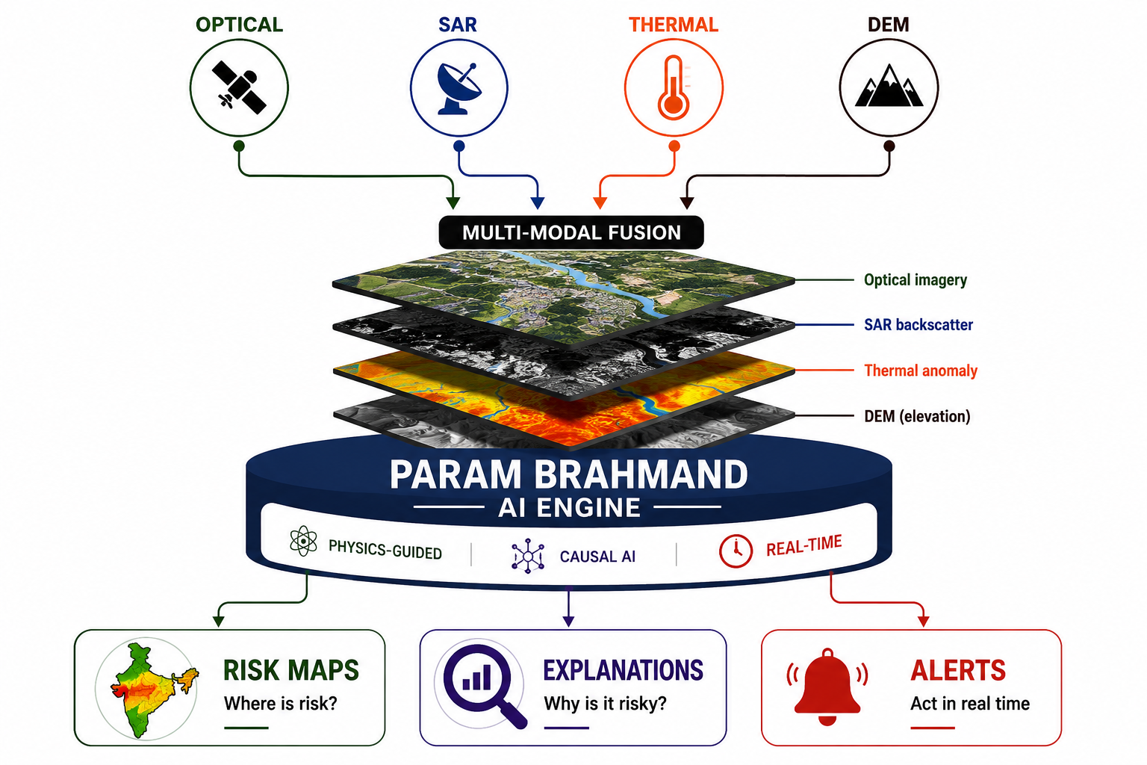





IDEA TITLE
Tensor Titans
Param Brahmand
Vishwaroopa AI
Proposed Solution
An AI-powered geospatial platform that combines Optical, SAR, Thermal and DEM data with Physics-guided and Causal AI to detect environmental risks early and provide explainable, real-time alerts.
Addressing the Problem
Solution Overview
Clouds & darkness →
Optical data becomes unreliable
Multimodal Data
Optical + SAR + Thermal + DEM
Fragmented datasets →
Hard to build a complete picture
Physics & Causal AI
Fewer false alarms, better reasoning
False alarms →
Delayed response & wasted resources
Early Risk Prediction
Probabilistic hazard maps & alerts
Complex tools →
Difficult for non-expert users
Accessible Intelligence
Simple dashboard + 22 languages

Slide 3

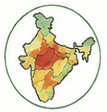
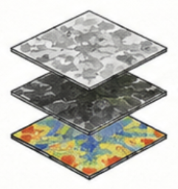
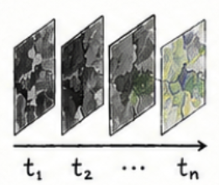
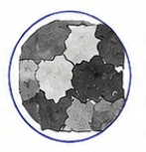






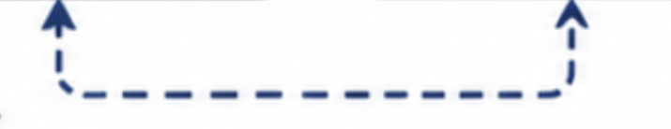
TECHNICAL APPROACH
Tensor Titans
INPUTS
OUTPUTS
1
2
3
4
OPTICAL / MULTISPECTRAL
PHYSICS-FIRST REPRESENTATION
GEO-MAMBA 3.0 BACKBONE
SPECIALIST AGENT
ROUTING (SANKALPA-PARAM)
CAUSAL & PHYSICS VALIDATION
RISKS MAPS
High Resolution Imagery
128-D Physics Manifold
(SIRTI + Indices)
Spatio-Temporal Understanding
Navagraha Specialist Agents
Vivek-Causal + GeoCP-v2 + Dharma-Chakra
Where is the risk?
SAR
CHANGE MASKS
All-Weather Radar Data
What has changed?
THERMAL
Convert raw data into physical features invariant to conditions & sensors
Linear State Space Model learns and tracks patterns across space and time efficiently.
Autonomous router selects best expert(s) for the query & task (e.g. flood, deforestation, urban)
Causal reasoning, uncertainty quantification & hard physics rules ensure reliable and explainable predictions.
ALERTS
Heat & Emission Information
Act in real-time
VQA & CAPTIONS
DEM
Ask in natural language
Elevation & Terrain Data
Continuous Feedback & Learning

Slide 4





FEASIBILITY AND VIABILITY
Tensor Titans
FEASIBILITY
(Can we build it?)
VIABILITY
(Will it deliver impact?)
ACCESS TO DATA
STRONG REAL-WORLD NEED
ISRO satellites (Cartosat, RISAT, Resourcesat) and open datasets (Sentinel, Landsat) available.
Tackles national challenges: disasters, agriculture, defense, environment.
PROVEN TECHNOLOGIES
MEASURABLE IMAPCT
Proven AI & SAR technologies ready to integrate.
BUILD
Earlier warnings • Better decisions • Fewer losses
COMPUTE & INFRASTRUCTURE
SCALABLE & COST EFFECTIVE
Cloud/HPC + ISRO infrastructure support training & inference.
VALIDATE
Uses existing infrastructure; designed for nationwide scale.
TECHNICAL INTEGRATION
SCALABLE
SUSTAINABLE SOLUTION
Modular architecture fuses optical, SAR, DEM & ancillary data.
Supports conservation & climate resilience.
RISK MITIGATION
ALIGNED WITH NATIONAL GOALS
Physics-guided models + uncertainty estimation reduce false alarms.
Supports Digital India, Atmanirbhar Bharat, disaster-resilient Bharat.

Slide 5
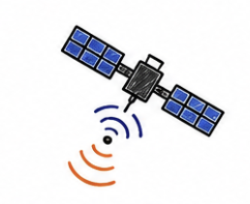

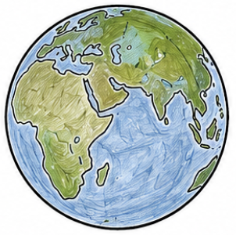
IMPACT AND BENEFITS
Tensor Titans
WHO WE IMPACT
WHAT WE DELIVER
DISASTER RESPONDERS (NDMA, SDRF)
EARLIER
All-weather awareness for faster response.
Risks identified before escalation
GOVERNMENT & POLICY MAKERS
SMARTER
Better planning, infrastructure & resource decisions.
Physics + causal reasoning: Fewer false alarms
DEFENCE & STRATEGIC AGENCIES
LOWER LOSS
Real-time monitoring of critical areas & assets.
Protect infrastructure, crops & resources
FARMERS & RURAL COMMUNITIES
From Space Data
To Secure Decisions
SAFER
Early warnings for crops, water & land health.
Better preparedness and response
RESEARCHERS & STUDENTS
SCALABLE
Open insights and datasets for research & innovation.
From local hazards to national monitoring

Slide 6






RESEARCH AND REFERENCES
Tensor Titans
PROBLEM & DATASETS
EARTH OBSERVATION
RESEARCH METHODS
SIH 2026 – PS 26167 (ISRO SAC)
SatQuery AI
Source: SIH 2026 Problem Statement
ISRO – Earth Observation Satellites
Source: https://www.isro.gov.in
PolSAR / PolInSAR
MESMA & Spectral Unmixing
BigEarthNet.txt – 2026
Large‑scale multi‑sensor image‑text dataset for Earth observation.
Source: https://txt.bigearth.net
ISRO – NISAR Mission
Source: https://www.isro.gov.in/NISARSatellite.html
Vision‑Language Models (VLMs)
BigEarthNet v2.0 / reBEN Refined Sentinel‑1 + Sentinel‑2 dataset for remote sensing benchmarking.
Source: https://bigearth.net
Causal AI – Structural Causal Models
ESA – Copernicus Sentinel Missions
Source: https://www.esa.int/Applications/Observing_the_Earth/Copernicus/
Uncertainty Quantification
Key Textbook References
James B. Campbell, Randolph H. Wynne & Valerie A. Thomas — Introduction to Remote Sensing, 6th Ed.
John A. Richards — Remote Sensing Digital Image Analysis: An Introduction, 5th Ed.
Judea Pearl — Causality: Models, Reasoning, and Inference, 2nd Ed.

