Slide 1
Outline of section
Why image reproducibility is essential
What image manipulation is allowed?
Publish images that are legible & reporducible in future
Guidelines on publishing images ethically
4 easy steps to ethical presentation of image data
Tools & repositories: check and store images
Further reading material

Slide 2
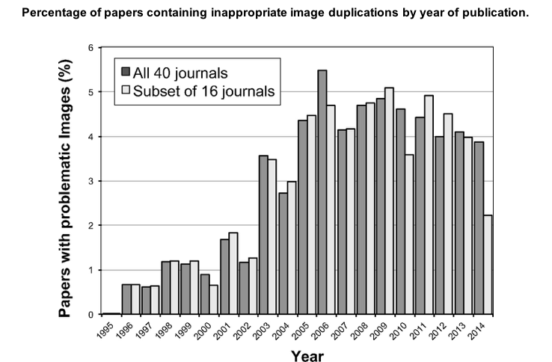
Image manipulation increased in digital age
Article by Elizabeth Bik, 2016, DOI: 10.1128/mBio.00809-16
Notes:
More: EXAMPLES: https://twitter.com/MicrobiomDigest/status/901677063161004032

Slide 3
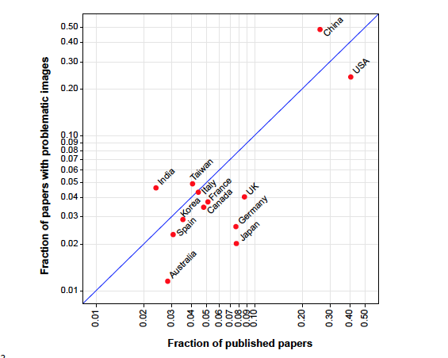
… and manipulation increased with more papers published around the world
Article by Elizabeth Bik, 2016, DOI: 10.1128/mBio.00809-16
Notes:
More: EXAMPLES: https://twitter.com/MicrobiomDigest/status/901677063161004032

Slide 4
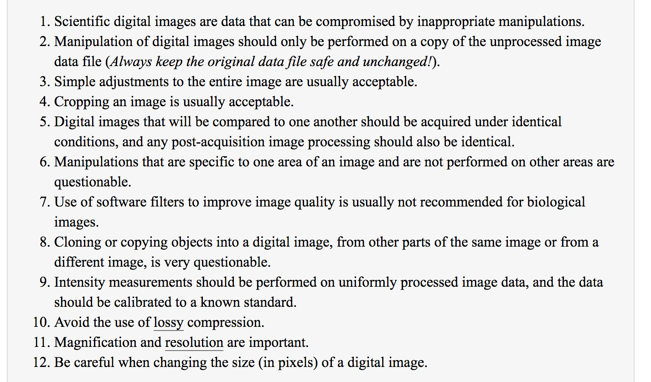
What manipulations of images are ethical and allowed?

Slide 5
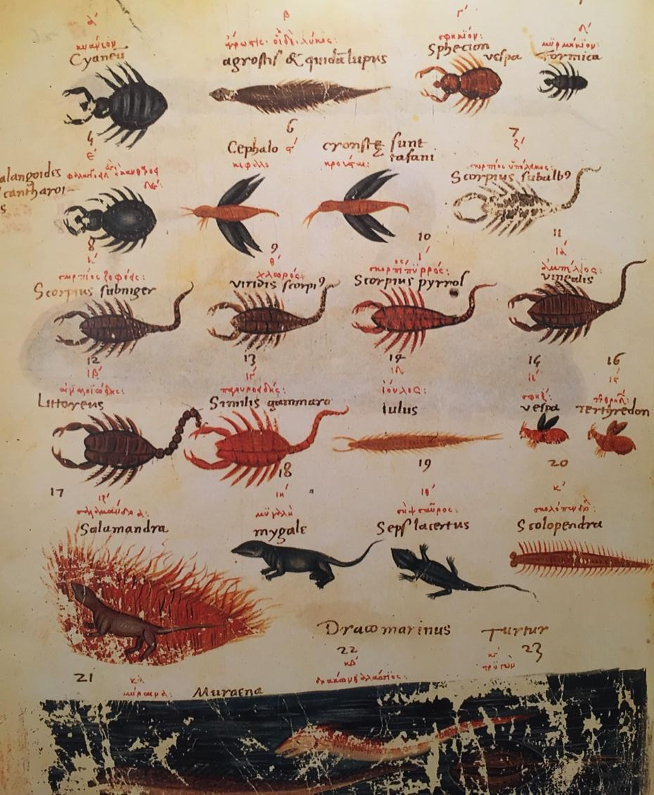
Images
Images have a long history in sciences, from drawings and copperplates prints, to photographs, microscopy images and movies.
Image objectivity has always been a discussion point: is a drawing better than a photo? Can we trust deconvolution software? Is rotation of a digital image fasification?
Alfred Stückelberger, Bild und Wort
Unbekannt ~200 AD
Transcript ~500 AD

Slide 6
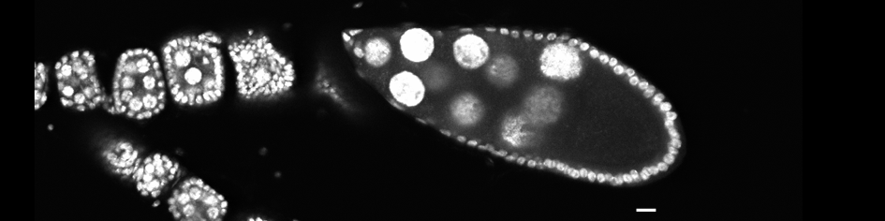
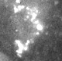
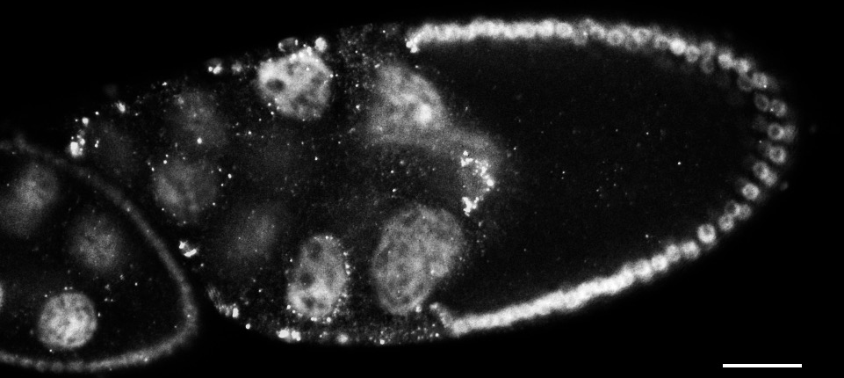
4-steps to reproducible image presentation:
Every image needs a title, explanation of colors, and scale bar
Choose a fitting magnification and zoom
Focus on tissue
Focus on subcellular localization
Focus on group of cells
30um

Slide 7
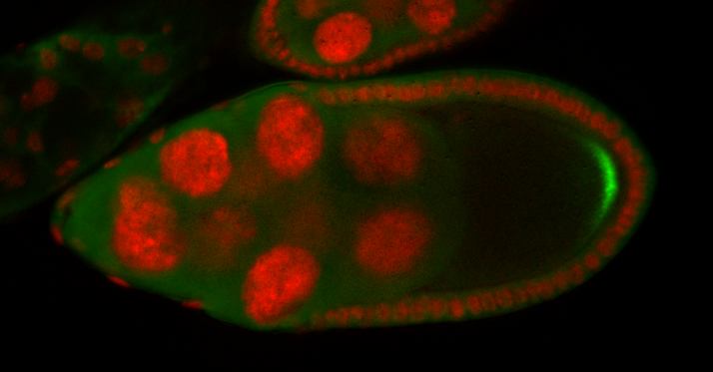
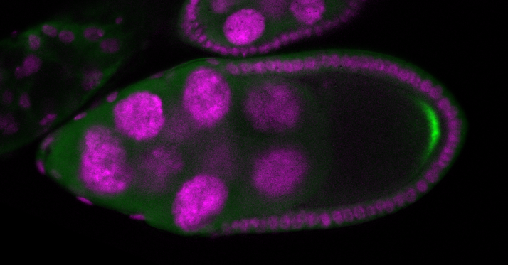
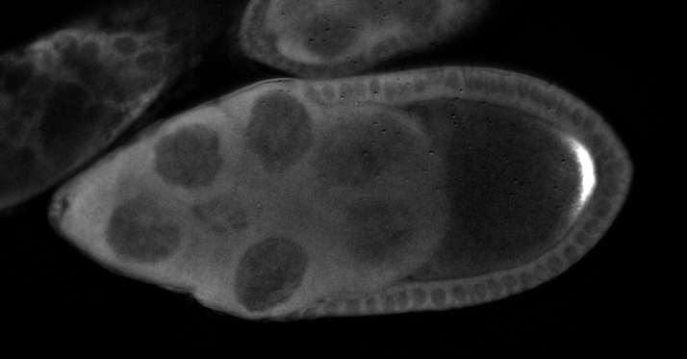
4-steps to reproducible image presentation:
Every image needs a title, explanation of colors, and scale bar
Choose a fitting magnification and zoom
Explain colours and make them accessible!
Colors are explained…
… and accesible to color-blind.
Sometimes more is visible in black/white, which has better contrast.
30um
Green = osk mRNA
Red = DNA in nuclei of egg chamber cells
Green = osk mRNA
Magenta = DNA in nuclei of egg chamber cells
osk mRNA

Slide 8
4-steps to reproducible image presentation:
Every image needs a title, explanation of colors, and scale bar
Choose a fitting magnification and zoom
Explain colours and make them accessible!
Use labels if necessary
Lines: most ancient way to label stuctures
Letter code: works for many stuctures.
Arrows: sometimes confusing, traditionally reserved for movements
A
D
migrating cell cluster*
A
A
C
30um
B
A
A
A
E
Nurse cell
Oocyte
A – nurse cell nuclei
B – migrating cell cluster
C – posterior pole of oocyte
D – oocyte nucleus
E – somatic cell layer
Oocyte
* Ambiguous arrow: could indicate cell position or direction of migration.
Nurse cell
Posterior pole

Slide 9
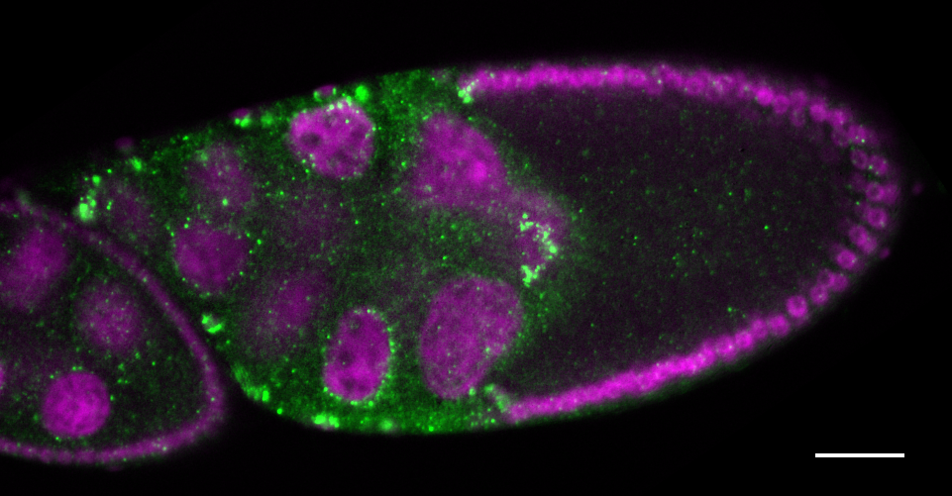
4-steps to reproducible image presentation:
Every image needs a title, explanation of colors, and scale bar
RNA distribution in cells of the fruit fly egg chamber (stage 9)
30um
What is the scale? What species? What do the colors mean?
Green = mRNA
Magenta = DNA in nuclei of egg chamber cells

Slide 10
Tools and image repositories
Image processing
FIJI, imageJ: both free, plugins available, large user communities
Photoshop: proprietary
Check for image manipulation (works even on pdfs!)
InspectJ: plugin for FIJI
Online forensic tool: https://29a.ch/photo-forensics/#forensic-magnifier
Images can be deposited:
Zenodo, figshare: free online repositories that provide DOI. Upload limit zenodo: 50GB per dataset. Zenodo: supported by CERN, EU

Slide 11
Train yourself!
There is a exhaustive resource from the UAB Center for Ethics and Values in the Sciences with funding from the US Department of Health & Human Services, Office of Research Integrity.
They provide: online tutorials, videos, guidelines, examples of questionable practices, case studies.
https://ori.hhs.gov/education/products/RIandImages/default.html

Slide 12
Reading material

