Slide 1
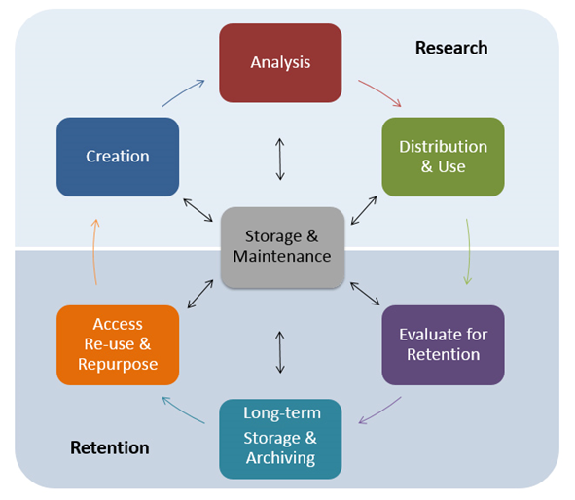


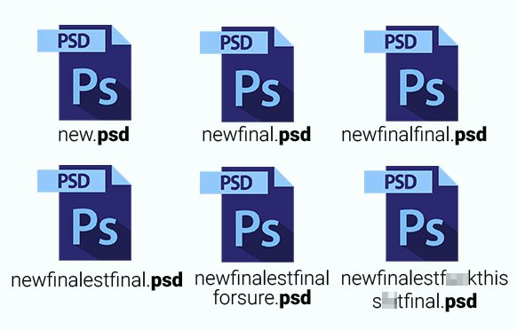


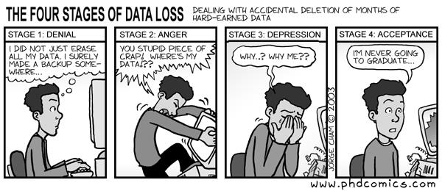
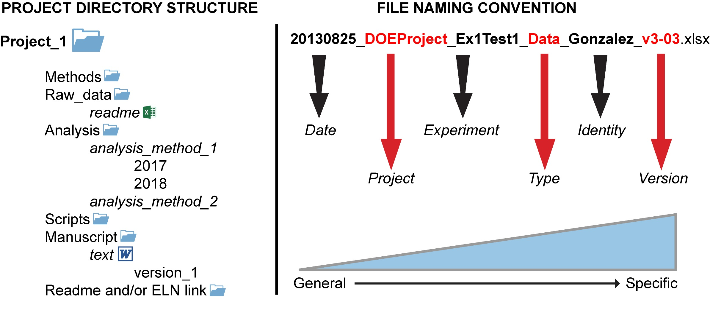

Effective data management to promote reproducibility
Authors: Ben Schwessinger, Diep Ganguly, Peter Crisp
Presenters:
What is data management?
What do I need for a data management plan?
The organization, curation, and storage of data or information in a manner that promotes accessibility, and effective and reproducible processing.
Data standards (including some level of data screening)
Practical, organised file naming conventions and folder structure
Include date in yyyy-mm-dd format
Use meaningful abbreviations
Have group identifiers
Document your decisions
Be consistent
Reliable storage options (including ample space)
Have effective means of backing your data up
Utilize available purpose-built software
LabArchives (https://www.labarchives.com/)
Open Science Framework (https://osf.io/)
PrometheusWiki (http://prometheuswiki.org/tiki-custom_home.php)
Findable
Accessible
Interoperable
Reusable
Source: https://datamanagement.hms.harvard.edu/
Benefits
It's good for (open) science!
Improved research quality and reproducibility
Increased accessibility and visibility of your research
Better for collaboration
Better data archival and retention
Easier data submission
START EARLY! A data management plan should be incorporated during research development
What to incorporate into a data management plan?
Scales of data management = folder structure, file naming conventions, file types, README files etc.
What data will be produced as a part of the project
How each type of data will be organized, documented, standardized, stored, protected, shared and archived
Who will take responsibility for carrying out the activities listed above
When these activities will take place over the course of the project (and beyond)
Metadata
Resources
Reproducibility in plant science https://community.plantae.org/organization/reproducibility-in-plant-science/dashboard
File naming conventions http://www.exadox.com/en/articles/file-naming-convention-ten-rules-best-practice
Folder organization https://zapier.com/blog/organize-files-folders/
Harvard University Data Management page https://datamanagement.hms.harvard.edu/
Kbroman Lab (Short primer on data storage and handling form Kbroman) http://kbroman.org/dataorg/
Purdue Library (Short primer on data management and file naming conventions) http://guides.lib.purdue.edu/c.php?g=353013&p=2378292
Data One Best Practices (Detailed resource on how to handle data throughout its life-cycle) https://www.dataone.org/best-practices
Mantra (Free online course for handling digital data) https://mantra.edina.ac.uk/
https://plantae.org/experimental-reproducibility-101-part-1/
eLIFE Ambassadors 2019 CC-BY 4.0 International license.

