Slide 1

Explainable Methods
Orthogonal Research and Education Laboratory
Champaign-Urbana

Slide 2

Move away from statistics and modeling as an exercise in button-pressing or parameter-guessing.

Slide 3
X
Reproducible analysis and models require a deeper understanding of these methods and how they behave.
Models do not only “fit” data, but also “interplay” with data.

Slide 4
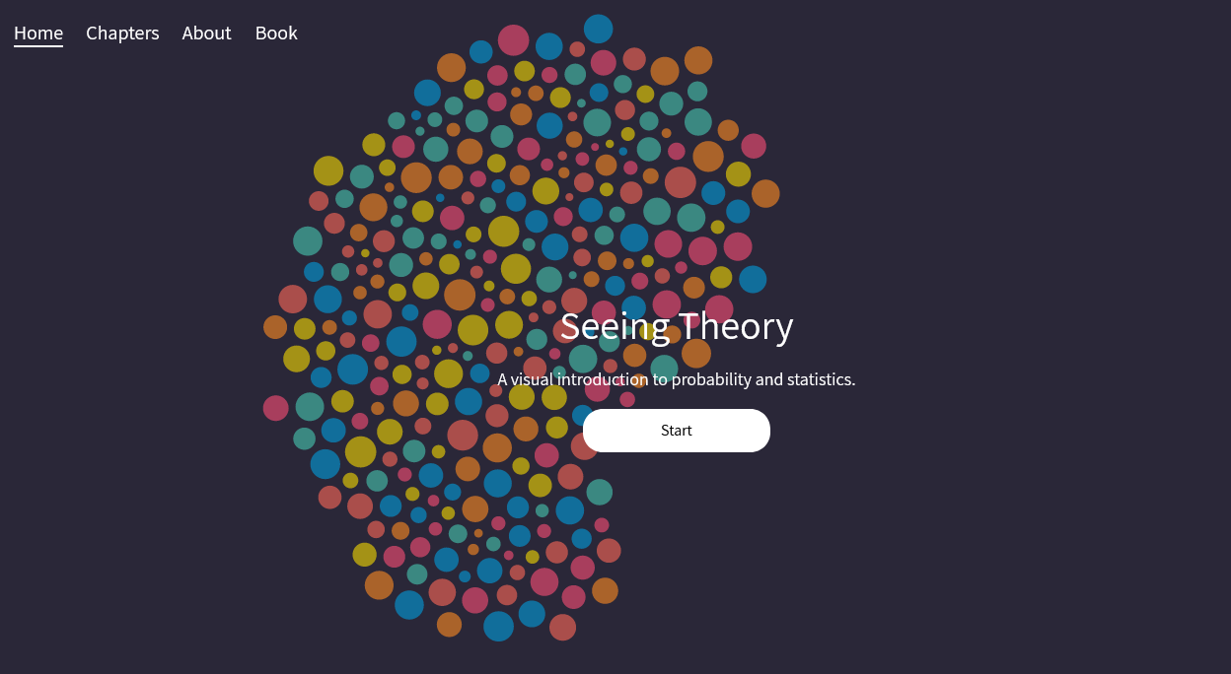
X
Visualizing process can also be important part of understanding.
Seeing Theory (https://seeing- theory.brown. edu/): helps reader develop intuitions about how to use methods, not just steps in a sequence.

Slide 5
Analytical models are generally chosen for their suitability to the problem (e.g. does not violate assumptions):
In explainable methods, there are two other considerations to keep in mind:
1) choose a model because it is easy to explain (simpler model is better).
cluster analysis rather than deep learning.
2) choose a model because you can explain it (complexity is fine if you can explain).
deep learning with significant open-access annotation.

Slide 6
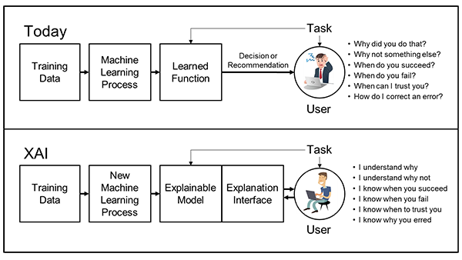
Explainable AI (XAI):
* “interpretability” of complex algorithms (machine learning, neural
networks).
* “opening the black box”, people have a social right to know.

Slide 7
Explainable Methods (XMethods):
“interpretability” of analytic processes. Go beyond workflows; what does a “solution” or “significance” mean?
implications and generalizability of results.
community should be able to engage with results in the form of a model (e.g. possibility space, annotated algorithm).

Slide 8
Guidelines and Principles (1, 2):
Model completeness
can we explain the basics of your technique and show how the assumptions are not violated?

Slide 9
Guidelines and Principles (1, 2):
Model completeness
can we explain the basics of your technique and show how the assumptions are not violated?
2) Model Interrogation:
can we test models with synthetic controls, pseudo-data, and
rival hypotheses?

Slide 10
Guidelines and Principles (3, 4):
3) Model transparency:
does your public repo include simulation code, tutorials, visualizations, or white (theory) papers?

Slide 11
Guidelines and Principles (3, 4):
3) Model transparency:
does your public repo include simulation code, tutorials, visualizations, or white (theory) papers?
4) Model interpretability:
can you retrieve the steps and explain how they produce your result?

Slide 12
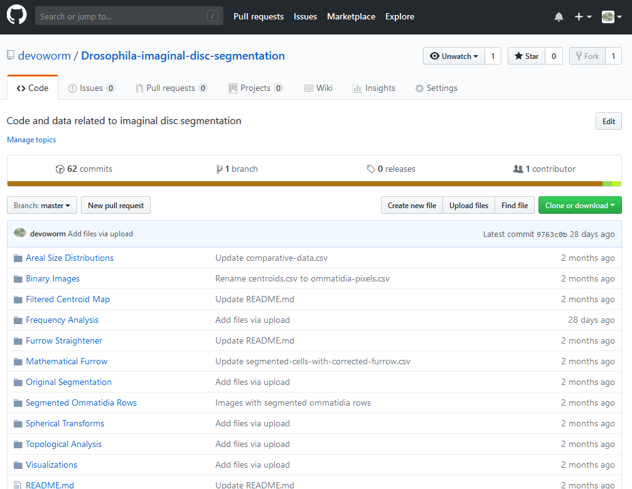

A starting point: preprint and accompanying version-controlled repository.

Slide 13
TRAINING
SET
TESTING
SET
VISUALIZATION
EXPLORATORY ANALYSIS
FORMAL ANALYSIS
SANDBOX
RAW DATA
ANNOTATION
FEATURE SELECTION
PUBLISHED DATASET

Slide 14
Potential Exercises:
Choose a method and create an explainable framework.
repository of pseudo-data, simulations, graphs.
create a pipeline for analysis and/or diagram the method of your choice.
What are the assumptions of your method, and how does this relate to your use of the model?
are the results replicable, or is there variation? How does model respond to various degrees of noise? Do you expect outcomes to be deterministic or stochastic?

