Slide 1
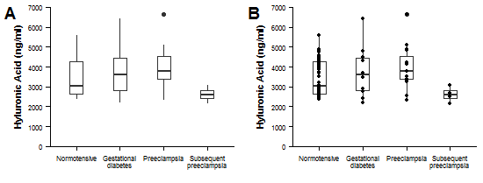
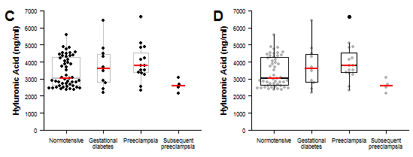
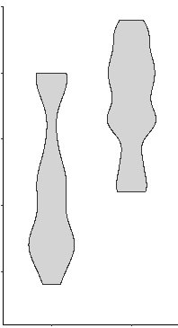
Show the data instead of a bar graph for continuous data Author Tracey Weissgerber, PhD, Mayo Clinic, QUEST, BIH Center for Transforming Biomedical Research Presenter Presenter name, affiliation here
This seems like a last point…
What can I do to encourage others to use more informative papers in figures, talks & posters?
Banish bar graphs from your papers & talks, request more informative figures as a reviewer & editor, talk to editors about changing journal policies, work with statistics instructors to organize data presentation & statistics training for trainees, junior investigators, senior researchers
LO
GO
Why shouldn’t I use a bar graph for continuous data?
Different datasets can lead to the same bar graph:
Do I need expensive software?
No, there are lots of free, user-friendly tools:
Does it matter how I did my analysis?
How do I design figures that match my study design & analysis?
List some here
Yes! The figure structure gives the reader information about your design & analysis. Avoid sending mixed messages, especially with small datasets.
For simple analyses of small datasets, it’s often clearest to show one graph per analysis that includes all groups, time points or conditions in the analysis.
a
Symmetric
Outlier
Bimodal
Unequal n
b
c
d
e
Analysis Strategy | Example | Figure Structure | Illustration
Comparing groups | Figure compares wild type vs. knockout mice | One figure showing all groups that were included in the analysis
Repeating the same analysis on different dependent (outcome) variables | Figure compares wild type vs. knock out mice. Three different tests are performed on different biomarkers. | Separate panels for each analysis (i.e. dependent variable)
Comparing groups with pooled subgroups | Figure compares wild type vs. knockout mice. Male and female mice are pooled. | One figure showing all groups that were included in the analysis; data points for different subgroups are shown in different colors
Stratified analysis | Figure compares wild type vs. knockout mice. Separate analyses are performed for males and females. | Separate panels for each analysis When possible, using the same scales can facilitate visual comparisons
Testing for an interaction | Figure compares four different groups of mice (wild type / female, knockout / female, wild type / male, knockout / male). The analysis tests for an interaction between strain and sex. | One figure showing all groups included in the analysis
Test | p value
T-test: Equal var. | 0.044 | 0.041 | 0.040 | 0.124
T-test: Unequal var. | 0.044 | 0.041 | 0.040 | 0.054
Wilcoxon | 0.053 | 0.065 | 0.014 | 0.177
Experimental goal: Compare wild type vs. knockout mice
Statistical analysis: t-tests were used to compare values for each dependent variable (biomarker A, B and C).
WT
KO
…but bar graphs convey a clear message. Sometimes it’s hard to see what’s going on with dot plots.
Can I just add data points to my bar graph?
Biomarker A
Biomarker B
Biomarker C
The data may suggest different conclusions from the
summary statistics.
✗
Sending Mixed Messages
Figure structure erroneously suggests that authors also intended to compare biomarkers A, B and C
WT
KO
WT
KO
WT
KO
Can I use a bar graph even if my data are normally distributed?
Not really, because:
Emphasize summary statistics & de-emphasize data points to convey a clear message while allowing readers to critically evaluate the data
Why dot plots are better than bar graphs with points
✗
WT
KO
Bar graph with dot plot
Clear communication
Figure structure matches study design & analysis, shows that the authors did not intend to compare biomarkers
Female
Male
A: Bar graph (mean ± SE)
B: Bar graph with
dot plot
C: Dot plot
Bar graphs
Don’t allow you to critically evaluate continuous data
Arbitrarily assign importance to bar height, rather than focusing on how the difference between means compares to the variability in the data
Step 1: Use symmetric jittering to make all points visible
Step 2: Emphasize summary statistics
Shading obscures points
Bars & vertical lines are chart junk. The solid shape creates the illusion of certainty without adding information.
The “Zone of Irrelevance” falsely alters our perception of the size of the difference
“Within-the-bar bias”: We incorrectly believe that points are more likely to fall within the bar than above the bar
✔
Zone of
Invisibility
1
Biomarker A
Biomarker B
Biomarker C
WT
KO
WT
KO
Range of
Observed
Values
2
4
Female
Male
Zone of
Irrelevance
3
Zone of Irrelevance
WT
KO
WT
KO
WT
KO
WT
KO
WT
KO
0
How do I make effective box or violin plots with dot plots?
Plots to use for normally distributed, continuous data:
When is it appropriate to show summary statistics like error bars, box plots or violin plots?
A: Box plot
Limited information with small or medium sample
sizes
B: Box plot with unjittered dot plot (strip plot)
Small improvement, but there are too many
overlapping points to interpret the data
✔
Dot plot
Figure Types | Example | Type of Outcome Variable | What the Plot Shows | Sample Size | Data Distribution | Best Practices
Dot plot |  | Continuous | Individual data points & mean or median line Other summary statistics (i.e. error bars) can be added for larger samples | Very small OR small; can also be useful with medium samples | Sample size is too small to determine data distribution OR Any data distribution | Make all data points visible - use symmetric jittering Many groups: Increase white space between groups, emphasize summary statistics & de-emphasize points Only add error bars if the sample size is large enough to avoid creating a false sense of certainty
Dot plot with box plot or violin plot |  | Continuous | Combination of dot plot & box plot or violin plot (see descriptions above and below) | Medium | Any | Make all data points visible (symmetric jittering) Smaller n: Emphasize data points and de-emphasize box plot, delete box plot and show only median line for groups with very small n Larger n: Emphasize box plot and de-emphasize points
Box plot |  | Continuous | Horizontal lines on box: 75th, 50th (median) and 25th percentile Whiskers: varies; often most extreme data points that are not outliers Dots above or below whiskers: outliers | Large | Do not use for bimodal data | List sample size below group name on x-axis Specify what whiskers represent in legend
Violin plot |  | Continuous | Gives an estimated outline of the data distribution. The precision of the outline increases with increasing sample size. | Large | Any | List sample size below group name on x-axis
Bar graph |  | Counts or proportions | Bar height shows the value of the count or proportion | N/A | N/A | Do not use for continuous data
Summary statistics are only meaningful when there are enough data to summarize…
We can easily see the magnitude of the difference & overlap between groups
Features that affect our interpretation (i.e. points, summary statistics, sample size) are clearly visible
Ineffective
for small or
medium n
100 random samples
n = 5 / sample
100 random samples
n = 20 / sample
Normotensive
Gestational
diabetes
Preeclampsia
Subsequent
preeclampsia
Normotensive
Gestational
diabetes
Preeclampsia
Subsequent
preeclampsia
Why shouldn’t I use box plots for bimodal data?
Effective
for small n (C) or
medium n (C or D)
C: Emphasizing dot plots
Small sample sizes: emphasize what is known (dots)
& de-emphasize what is uncertain (box plots)
D: Emphasizing box plots
Symmetric jittering
Box width proportional to n
n in x-axis label
No box plot for very small groups
For the sample sizes shown in this figure, C is best. If all groups have larger samples, you can choose C or D.
These strategies also work for dot plots with violin plots.
Population mean ± SD
Box plots conceal the two peaks. Bimodal distributions are easier to see with small (dot plots) or larger (violin plots) samples
With small samples, means and SDs can be very different from the true population values…
Normotensive
n = 50
Gestational
diabetes
n = 10
Preeclampsia
n = 15
Subsequent
preeclampsia
n = 4
Normotensive
n = 50
Gestational
diabetes
n = 10
Preeclampsia
n = 15
Subsequent
preeclampsia
n = 4
Figures are published in the following papers: DOI 10.1371/journal.pbio.1002128, DOI: 10/1074/jbc.RA117.000147 (add DOI for paper in review later)
n = 10
n = 15
n = 10
n = 15
Notes:
Reserve the color for the orientation, ie the boxes with the questions (Which color code we can still discuss…)
Remove the “” as it creates clutter, I used italic light for the question and immediately below bold regular for the answer. Basically, one shuod be able to just read the answers as the titles in each section..
Stick to one layout: 3 columns, then to not split middle one in half half-way down.
Outline: >listed here for us to discuss the outline step by step.<
Different datasets can lead to same graoh
Bar graph for non-nomal data
Alternative plot forms
Are dot plots hard to read? How to read a dot plot.
Show summary statistics.. When?
How to add data points to my bar
Box plots for bimodal
How I did my analysis influences the plot type
`Design figures
Effective box or violin plots wth dots…
Encourage others.

