Slide 1
Improving Reproducibility in Animal Research
Increase in tools for use of genetically modified animals have accelerated the development of human disease models
There is a lack of reproducibility and transparency of published research using animal models of human biology (pre-clinical studies)
Hindered by inadequate reporting methods
Misuse of statistical tools (P values), overinterpretation of results or statistical analysis that are not fit for purpose
Poor training in experimental design
Publication bias etc
Leading to poor translational success rate
Manolagas and Kronenberg, JBMRm 2014
Smith, Clarke and Little, Osteoarthritis and Cartilage, 2017
Notes:
https://grants-nih-gov.ezp-prod1.hul.harvard.edu/reproducibility/index.htm

Slide 2
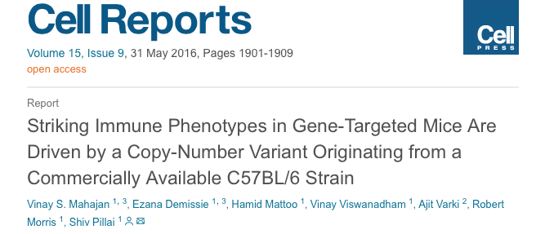
Improving Reproducibility in Animal Research
Dock2 mutant arisen from a Irf5 knock out mouse on a commercially available C57BL/6 strain
This mouse was used for backcrossing and gene targeting experiments
Phenotypes in these studies thought to be due to gene knockout are in fact due to gene duplication of Dock2
Data from these any C57BL/6 backcross that have immune or haemopoietic phenotypes need to be reassessed
Notes:
https://www.sciencedirect.com/science/article/pii/S2211124716305253?via%3Dihub

Slide 3
Planning Research and Experimental Procedures on Animals: Recommendations for Excellence
Before starting be PREPARED
Provides planning guidelines for All animal research
Can be adapted depending on use case
Aids in planning experiments that are safe, scientifically sound and addresses animal welfare
Designed for EU countries but is applicable for countries outside the EU
A checklist of 3 major topics in 15 sub-topics
Formulation of the study
Dialogue between scientist and the animal facility
Quality control of the components in the study

Slide 4
Before starting be PREPARED
Formulate
Literature
Legal
Ethics
Design
Statistics
Clear Hypothesis
Review
Local legislations
Species and suffering
Will this be reproducible?
Bias?
Lay summary
Pilot study?
Replacement, Reduction, Refinement (3Rs)
Publication of negative results?
Power calculations
Harm vs Benefit
Randomizations?
Outcomes
Smith et al., 2017 https://norecopa.no/media/7864/prepare_checklist_english.pdf

Slide 5
Before starting be PREPARED
Dialogue
Objective
Facility
Time
Education and training
Health and risks
Smith et al., 2017 https://norecopa.no/media/7864/prepare_checklist_english.pdf

Slide 6
Before starting be PREPARED
QC
Substance and procedures
Experimental animals
Quarantine and health monitoring
Housing
Experiment
Humane killing, release, re-use or re-home
Necropsy
Smith et al., 2017 https://norecopa.no/media/7864/prepare_checklist_english.pdf

Slide 7
ARRIVE safely
Animal Research: Reporting In Vivo Experiments
20 item checklist designed to advise researchers and promote good reporting
Over 600 journals endorse the guidelines but do not require or enforce it
Can be applied to any animal research
Hopes to improve transparency
Notes:
https://www.ncbi.nlm.nih.gov/pmc/articles/PMC2893951/
https://openscience.bmj.com/content/2/1/e000002#ref-4

Slide 8
ARRIVE safely
Baseline
Outcomes
Adverse events
Background- help understand motivation and context of study
Objectives- primary and secondary
Discussion
Results
Method
Implications
Translation
Funding
Introduction
Ethics
Study design
Animals
Housing
Sample size
Outcomes
Statistical methods
Abstract
Accurate summary
Title
Accurate and concise

Slide 9
Calculating sample size
Part of the ARRIVE guidelines
Too little animals leads to misleading information
Too many leads to waste (the 3Rs)
Two methods:
Power calculations (suggested) but needs prerequisites
Corrected sample size = Sample size/ (1− [% attrition/100])
Resource equation: when it is difficult to assume effect size
E = Total number of animals − Total number of groups
Software: G power, nQuery, Biomath, MINITAB, Epitools
Notes:
https://www.ncbi.nlm.nih.gov/pmc/articles/PMC3826013/

Slide 10
Considerations
The 3Vs:
Construct validity, internal validity and external validity (Würbel, LabAnimal., 2017) for harm-benefit-analysis
Stress:
Temperature, laboratory animals are kept at a constant temperature that do not reflect normal physiology (Gaskill &Garner, LabAnimal, 2017)
Husbandry, excessive noise
High doses of compounds
DEPART
Mainly for osteoarthritis research but can be broaden: Smith, Clarke and Little, Osteoarthritis and Cartilage, 2016
Notes:
https://www.nature.com/articles/laban.1220
https://www.nature.com/articles/laban.1218.pdf
https://www.nature.com/articles/laban.1223
https://www-clinicalkey-com.ezp-prod1.hul.harvard.edu/#!/content/journal/1-s2.0-S1063458416303545?scrollTo=%23hl0000567

Slide 11
https://www.nature.com/news/scientific-method-statistical-errors-1.14700
Notes:
Not needed I think

