Slide 1


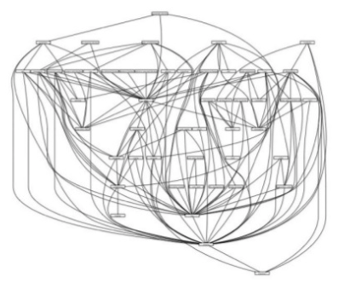
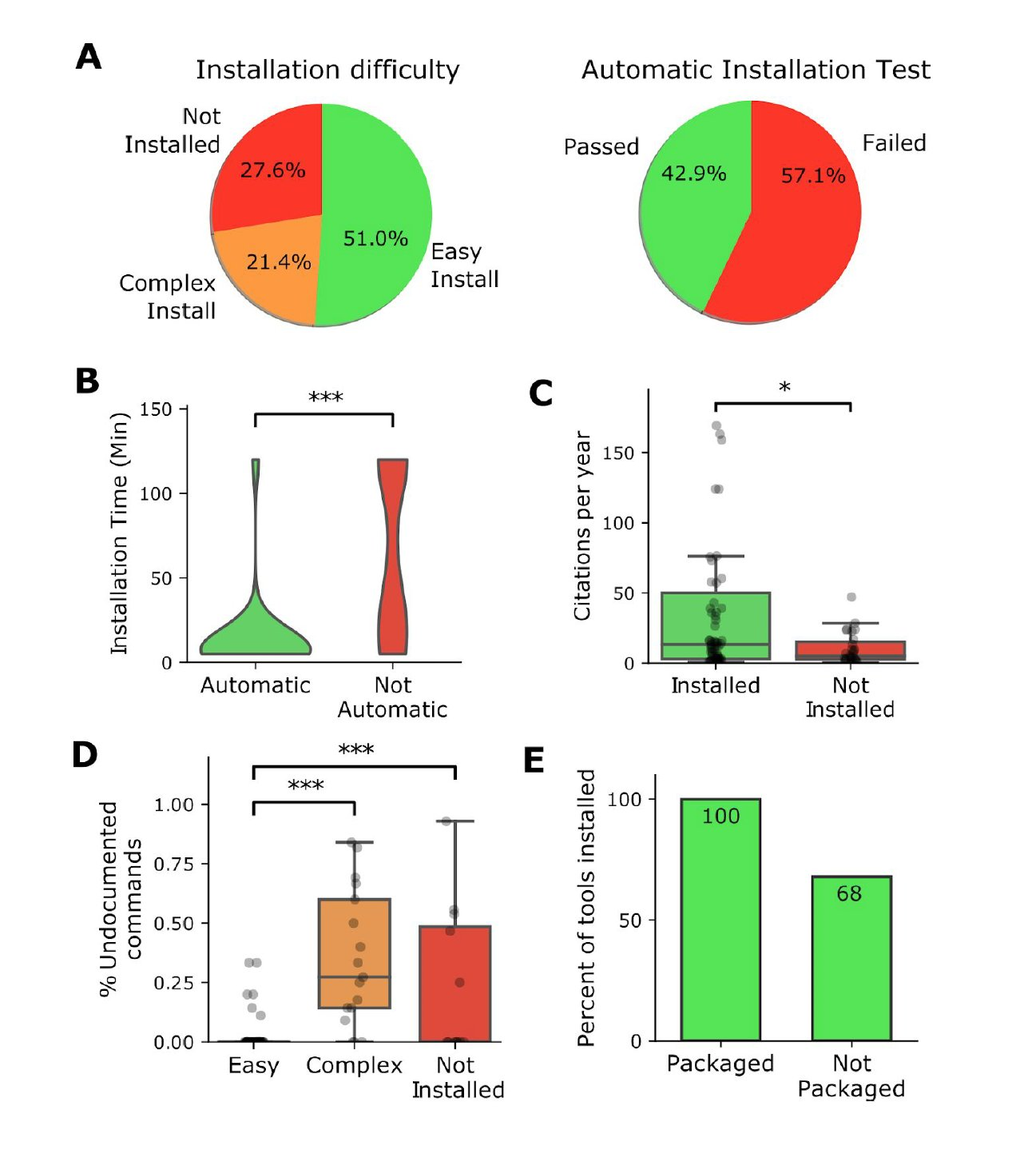











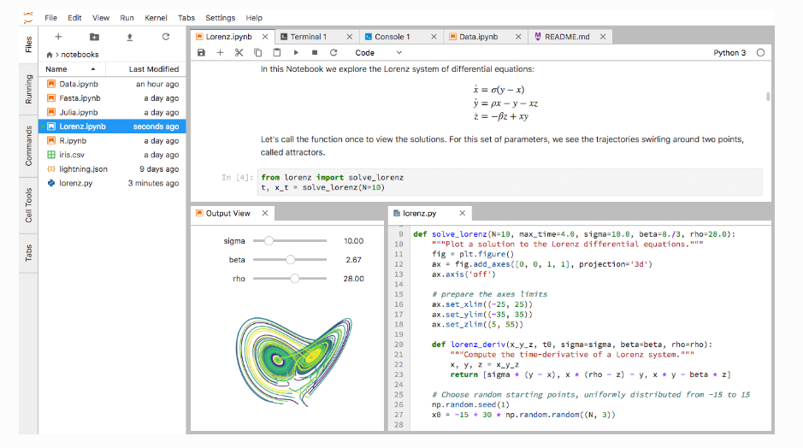
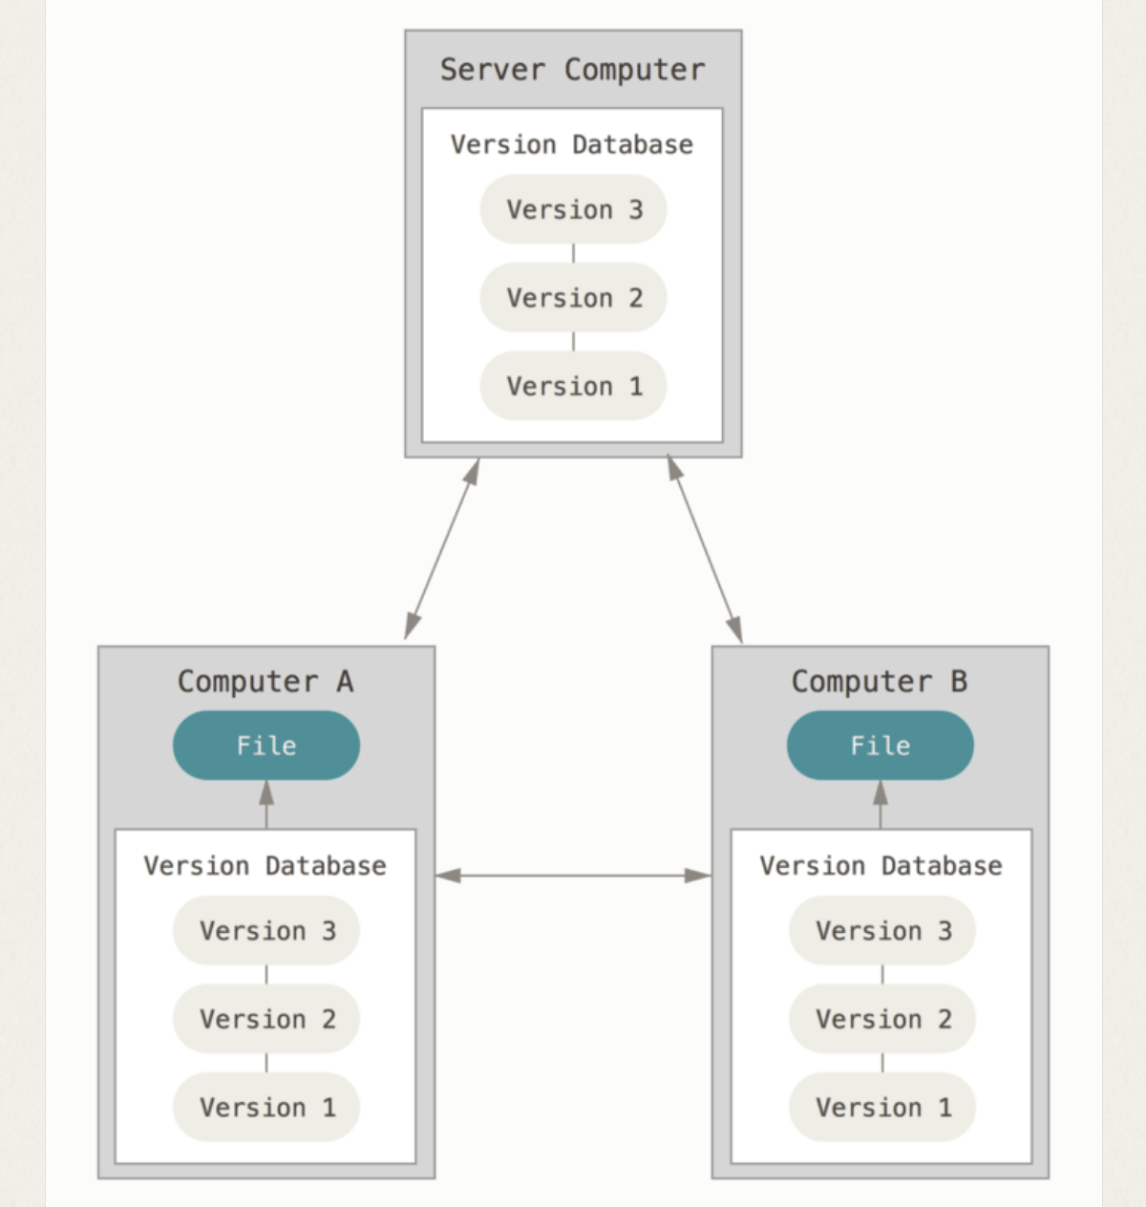
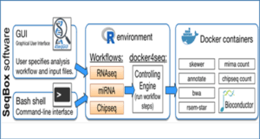
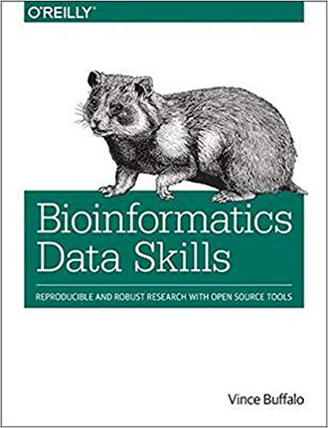

Reproducibility for Bioinformatic tools and workflows
Authors: Peter Crisp, Diep Ganguly
Presenters:
Topic →
Documentation
Version Control
Software
Why did I do this?
What version of the program, data etc… did I use?
Dependency hell
28% of the tools are impossible to install
Challenges →
How can I record the steps of a bioinformatic analysis?
Version conflict
https://www.biorxiv.org/content/early/2018/10/25/452532
Solutions →
Notebooks
Git
Managers
Containers
Notebooks are an essential tool for documenting analyses, enabling reproducibility and sharing.
Git tracks changes to files over time, enabling documentation of development and reversion to prior versions.
Managers and containers enable consistent use of software when emulating or reproducing an analysis.
Keep track of analysis
Interactive coding
Interactive data exploration
Imbedded visualization
Easy access to docstrings
Mix of code and documentation
Over 40 programming languages
Easily shared
Widgets
Interactive plots
Run remotely on server
Records and illustrates changes between versions
Lets you share code and collaborate easily
Active community with lots of tutorials and help pages
Provides a backup for all your code to be accessed remotely as needed
Handles installs and dependencies
Allows for multiple independent environments
Easily configurable
Allows for manual installs as well
Runs on all three major systems
Open source
You can package your own work and contribute
Docker runs images as containers that are
self contained with all code, programs, libraries included. No subsequent installation required.
Isolated
Portable including dissemination
Lightweight
Resources →
Resources & further reading
https://conda.io/docs/
Turns a GitHub repo with data and notebooks into a collection of interactive notebooks run in the cloud
Reproducible computational research
Sandve et al. (2013), PloS Comp Bio, https://doi.org/10.1371/journal.pcbi.1003285
Software: reproducible installation
Mangul S et al. (2018), BioRxiv, https://doi.org/10.1101/452532
Documentation
‘Bioinformatic data skills’ Buffalo http://shop.oreilly.com/product/0636920030157.do
Software carpentry https://software-carpentry.org/
Version control: http://smutch.github.io/VersionControlTutorial//
Containers:
Docker https://docs.docker.com/
Biocontainers http://biocontainers.pro
Reviewing:
Computation checklist github.com/vivekbhr/reproChecklist
Configuration, preservation, & reuse of executable code using containers for researchers
https://jupyter.org/documentation
https://www.rstudio.com/
https://bioconda.github.io/
https://git-scm.com/doc
https://snakemake.readthedocs.io/en/stable/
eLIFE Ambassadors 2019 CC-BY 4.0 International license.
Notes:
How can I reproduce a published result?
How do I archive data appropriately?
How can I analyse new data in as before?

Slide 2
Old drafts

Slide 3

Authors: Peter Crisp, Diep Ganguly
Presenters:
Reproducibility for Bioinformatic tools and workflows
Documentation
Version Control
Software
Why did I do this?
What version of the program, data etc… did I use?
Dependency hell
28% of the tools are impossible to install
How can I record the steps of a bioinformatic analysis?
Version conflict
Notebooks
Git
https://www.biorxiv.org/content/early/2018/10/25/452532
Keep track of analysis
Interactive coding
Interactive data exploration
Imbedded visualization
Easy access to docstrings
Mix of code and documentation
Over 40 programming languages
Easily shared
Widgets
Interactive plots
Run remotely on server
Records changes
Keeps track of change history
Illustrates changes between versions
Lets you share your code easily
Lets you collaborate on your code more easily
Managers
Containers
Handles installs and dependencies
Allows for multiple independent environments
Easily configurable
Allows for manual installs as well
Runs on all three major systems
Open source
You can package your own work and contribute
Docker runs images as containers that are
self contained with all code, programs, libraries included. No subsequent installation required.
Isolated
Portable including dissemination
Lightweight
https://git-scm.com/doc
https://www.rstudio.com/
https://conda.io/docs/
https://jupyter.org/documentation
https://bioconda.github.io/
Turns a GitHub repo with data and notebooks into a collection of interactive notebooks run in the cloud executable
Configuration, preservation, & reuse of executable code using containers for researchers
https://snakemake.readthedocs.io/en/stable/
Resources & further reading
Reproducible software installation
Mangul S et al. (2018) A comprehensive analysis of the usability and archival stability of omics computational tools and resources, BioRxiv, https://doi.org/10.1101/452532
Reproducible computational research
Sandve et al. (2013) Ten Simple Rules for Reproducible Computational Research, PloS Computational Biology, https://doi.org/10.1371/journal.pcbi.1003285
Documentation
‘Bioinformatic data skills’ by Vincent Buffalo http://shop.oreilly.com/product/0636920030157.do
Software carpentry https://software-carpentry.org/
Version control http://smutch.github.io/VersionControlTutorial//
Containers
Docker https://docs.docker.com/
Biocontainers http://biocontainers.pro
Notes:
How can I reproduce a published result?
How do I archive data appropriately?
How can I analyse new data in as before?

Slide 4
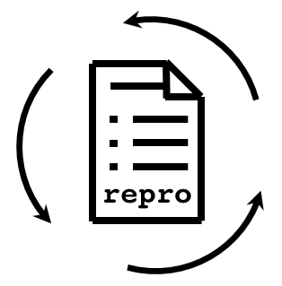
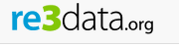



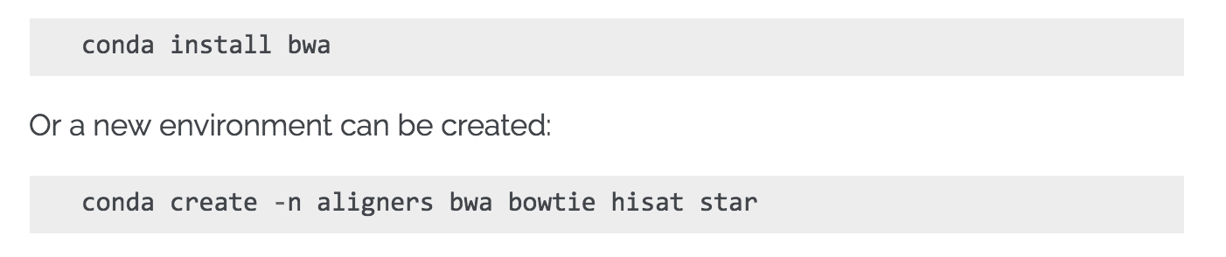
Reproducibility for Bioinformatic tools and workflows
Packages, dependencies, and environments
Data Sharing?
Data management?
Documentation
Version Control
Why did I do this?
What version of the program, data etc… did I use?
Dependency hell
28% of the tools are impossible to install
Version conflict
This is essential too: see other posters?
How can I record the steps of a bioinformatic analysis?
https://www.biorxiv.org/content/early/2018/10/25/452532
Why do versions matter?
How to install software reproducibly?
Notebooks
Git
Managers
Containers
Keep track of analysis
Interactive coding
Interactive data exploration
Imbedded visualization
Easy access to docstrings
Mix of code and documentation
Over 40 programming languages
Easily shared
Widgets
Interactive plots
Run remotely on server
Records changes
Keeps track of change history
Illustrates changes between versions
Lets you share your code easily
Lets you collaborate on your code more easily
Handles installs and dependencies
Allows for multiple independent environments
Easily configurable
Allows for manual installs as well
Runs on all three major systems
Open source
You can package your own work and contribute
Docker runs images as containers that are
self contained with all code, programs, libraries included. No subsequent installation required.
Isolated
Portable including dissemination
Lightweight
Turns a GitHub repo with data and notebooks into a collection of interactive notebooks run in the cloud executable
Configuration, preservation, & reuse of executable code using containers for researchers
Get local blast
Run local blast
Resources
‘Bioinformatic data skills’ Vincent Buffalo
https://software-carpentry.org/
https://jupyter.org/documentation
https://www.rstudio.com/
Resources
https://git-scm.com/doc
http://smutch.github.io/VersionControlTutorial//
Resources
‘https://conda.io/docs/
https://bioconda.github.io/
Resources
https://docs.docker.com/
http://biocontainers.pro
Notes:
How can I record the steps of a bioinformatic analysis
How do I record how I analysed my data?
How can I reproduce a published result?
How can I analyse new data in as before?

