Slide 1

The Re-Usefulness of Data
Orthogonal Research and Education Laboratory
Champaign-Urbana

Slide 2
Data Reuse as a Process
Primary data: data that is collected by the person or collaboration that analyzes and publishes from it.
Secondary data: data that is reanalyzed on its own, or integrated with other types of data (for meta-analysis or to answer new questions).
Tertiary data: data that is derived from secondary data, such as annotation in new contexts or processed in new ways (a network representation of secondary data).

Slide 3
Reuse of Data requires Open Data
Open Data: data that is made public and accessible. Because it is the future!
stored in a repository containing data in an easy-to-use format (csv).
data should be annotated with labels or metadata (XML framework, tags).
data should be linked to a publication, presentation, or protocol.

Slide 4
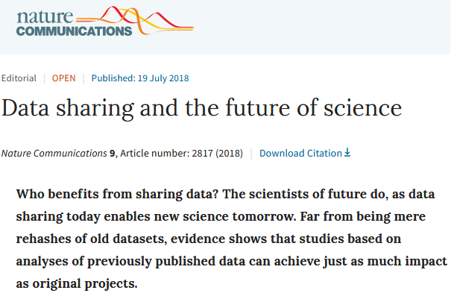
Reuse of Data requires Open Data
Open Data: data that is made public and accessible. Because it is the future!
stored in a repository containing data in an easy-to-use format (csv).
data should be annotated with labels or metadata (XML framework, tags).
data should be linked to a publication, presentation, or protocol.

Slide 5






Primary to secondary data bridge:
* repositories for genetic, microscopy, and molecular data.
* accession number and/or reference.
Combining secondary data sources:
* annotations of cellular-level data with differentiation and molecular information.
* 3-D network or tree representations.
Secondary to tertiary data bridge:
* static repositories for secondary data (doi or https).

Slide 6
Briefly….
Transformed
Data
Recoded,
projected to new space
Annotated,
Reorganized
Primary Data
Source
Processed
Data

Slide 7
Briefly….
Transformed
Data
Recoded,
projected to new space
Annotated,
Reorganized
Primary Data
Source
Processed
Data
Secondary Data
Source

Slide 8
Briefly….
Transformed
Data
Transformed
Data
Recoded,
projected to new space
Recoded,
projected to new space
Annotated,
Reorganized
Annotated,
Reorganized
Primary Data
Source
Processed
Data
Secondary Data
Source
Processed
Data

Slide 9
Briefly….
Transformed
Data
Transformed
Data
Recoded,
projected to new space
Recoded,
projected to new space
Annotated,
Reorganized
Annotated,
Reorganized
Primary Data
Source
Processed
Data
Secondary Data
Source
Processed
Data
Tertiary Data
Source

Slide 10
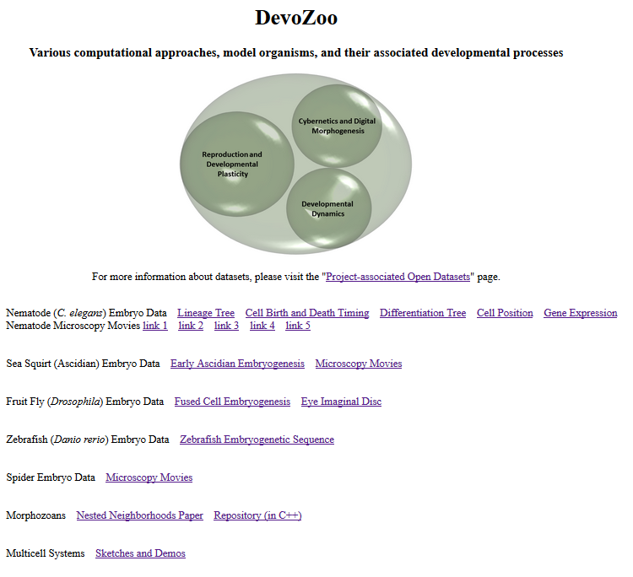
How can this be implemented in a research project?
Example: Devozoo
(https://devoworm.github.io/devozoo.htm)

Slide 11
Link to description of primary and secondary data sources

Slide 12
Secondary and Tertiary
Datasets

Slide 13
Artificial Life Architectures
and Data

Slide 14
Potential Exercises
Annotate a toy dataset (give examples of metadata, grouping variables, demonstrations of analysis).
2. Work through an exercise on data munging (cleaning) and integration.
3. Draw out a data reuse pipeline, from primary to tertiary data.
4. Build your own version-controlled project repository and directory.

