Slide 1
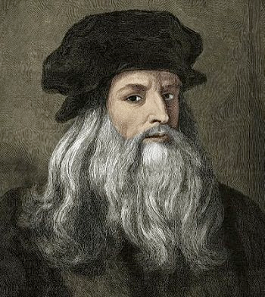
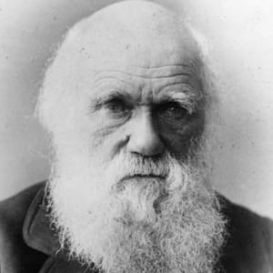
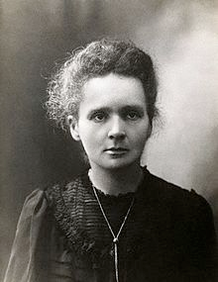
organization | documentation | analysis | dissemination
Notes:
Maybe quick question evaluted by sticky notes on who uses a ELN. Yes/No

Slide 2
Scientific record keeping at the frontline
organization | documentation | analysis | dissemination
Notes:
Maybe quick question evaluted by sticky notes on who uses a ELN. Yes/No

Slide 3
Is good record keeping important for science?
organization | documentation | analysis | dissemination
Notes:
Maybe quick question evaluted by sticky notes on who uses a ELN. Yes/No

Slide 4
Why should we keep good scientific records?
organization | documentation | analysis | dissemination
Aiding our thought process
Enabling collaboration
Recording the scientific process
Enabling communication
Protection of intellectual property
Compliance with requirements
Information synthesis
Formalization
Tool-making
Notes:
Maybe quick question evaluted by sticky notes on who uses a ELN. Yes/No

Slide 5
Has anyone ever educated you on the best practices on scientific record keeping?
organization | documentation | analysis | dissemination
Notes:
Maybe quick question evaluted by sticky notes on who uses a ELN. Yes/No

Slide 6
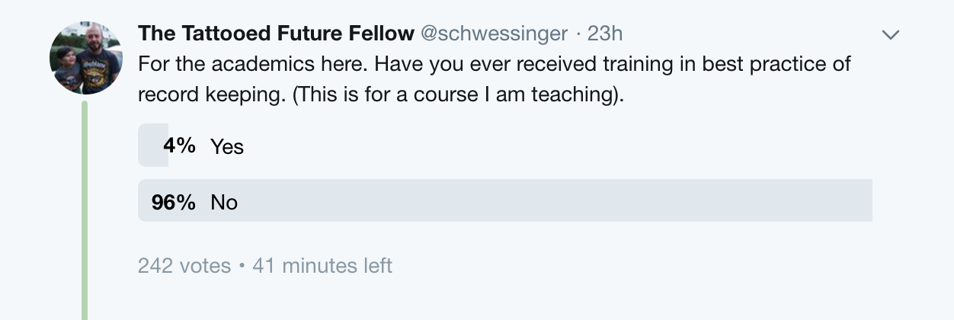
organization | documentation | analysis | dissemination
Notes:
Maybe quick question evaluted by sticky notes on who uses a ELN. Yes/No

Slide 7
“The guiding principle for notekeeping is to write with enough detail and clarity that another scientist could pick up the notebook at some time in the future, repeat the work based on the written descriptions.”
organization | documentation | analysis | dissemination
Kanare, 1985
Notes:
Maybe quick question evaluted by sticky notes on who uses a ELN. Yes/No

Slide 8
What information should good research records provide?
organization | documentation | analysis | dissemination
Notes:
Maybe quick question evaluted by sticky notes on who uses a ELN. Yes/No

Slide 9
organization | documentation | analysis | dissemination
What you did
When you did it
Why you did it
How you did it
Who did it
What project(s) it was a part of
Who thought of it
What you used (e.g. material and instruments)
Where you did it
Where the material and instruments came from
Notes:
Maybe quick question evaluted by sticky notes on who uses a ELN. Yes/No

Slide 10
organization | documentation | analysis | dissemination
What happened and what did not happen (data)
How you manipulated and analyzed the results
Your interpretation plus background
What will be the next steps in the project based on these results
Notes:
Maybe quick question evaluted by sticky notes on who uses a ELN. Yes/No

Slide 11

organization | documentation | analysis | dissemination
Notebook/methods exercise:
1. Look up your latest publication and take one section of the methods.
2. Judge if others could reproduce your results based on the descriptions.
3. Re-write the section (or parts of it) as it were a lab notebook entry.
4. Exchange both the methods section and re-write with someone you don’t know.
5. Discuss which you prefer and find easier to follow.

Slide 12
organization | documentation | analysis | dissemination
Date
Title
Project
Provide rationale for conducting the experiment
List all reagents and instruments with catalogue and lot number.
Provide calculations for solutions.
Provide details of experiments and protocol.
Run experiment. Note any deviations or specific observations
Collect and record data.
Link datasets in notebook.
Analyze data. Make note of analysis tools and outputs.
Write summary of results.
Provide your interpretation.
Outline new experiments based on your interpretation.
Adapted from Williams et al. 2008.

