Slide 1
Predicting Salaries
An approach to predicting Data scientist Salaries

Slide 2
Overview
Question
Collection methods
Models used
Conclusions

Slide 3
Question
What factor(s) most directly impact data science salaries?

Slide 4
Collection Methods
Web scraping Indeed.com
Set up a request to the URL
Extracted the information (job title, location, salary and company)
Saved to a CSV file
Performed analysis

Slide 5
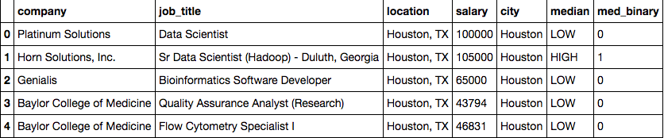
Collection Methods

Slide 6
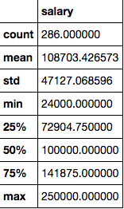
Collection Methods

Slide 7
models
Logistic Regression based on location (city) for the entire sample of job listings with an annual salary

Slide 8
Models
Senior Titles: 8
Junior Titles: 0
Scientist Titles: 108
Data Titles: 114
Manager Titles: 12
Analyst Titles: 65

Slide 9
Models
Accuracy scores for each model
Model Based on Location: | Score
Total sample | 0.716783216783
Job titles with Data | 0.763157894737
Job titles with Scientist | 0.731481481481
Job titles with Analyst | 0.676923076923

Slide 10
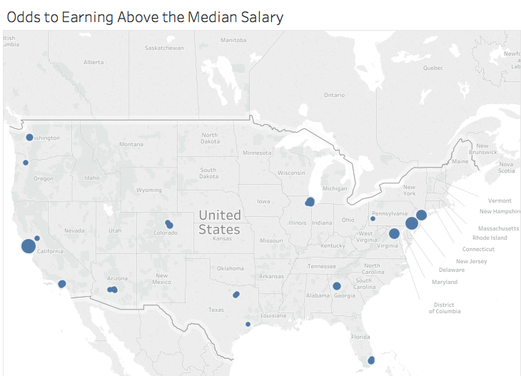

Slide 11
Conclusion
The data shows us the odds of earning above the salary mean ($100,000.00) per city.
The odds that someone would earn above the median salary is highest in San Francisco at 5.020650 and the odds that someone would earn below the median salary is lowest in Austin at 0.468744.

