Slide 1



WELCOME TO

Slide 2

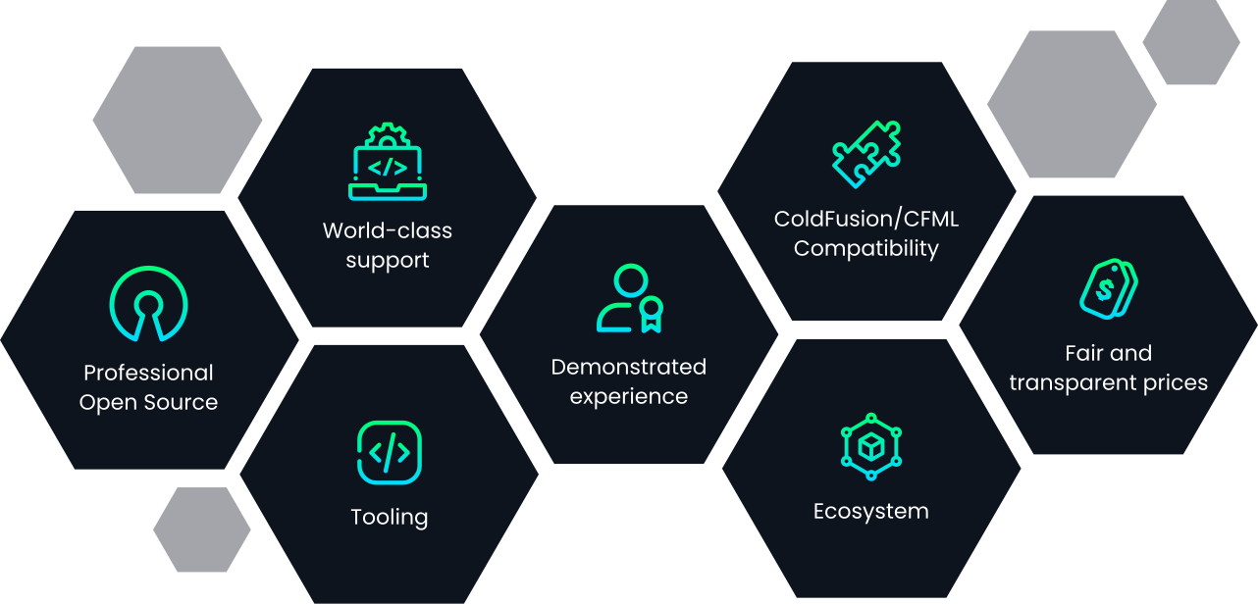
WELCOME TO

Slide 3

www.boxlang.io
Meet BoxLang!
A modern, dynamic JVM programming language and framework built for modern developers!

Slide 4




www.boxlang.io
BUILT FOR THE JVM ECOSYSTEM.
Trusted speed & scalability.
Java compatible workflows.
Open Source
Spirit
Professional Supported
Dynamic, Modular, Productive
WHAT IS BOXLANG?

Slide 5
WHY
FOR JAVA DEVELOPERS?

Slide 6



www.boxlang.io
BUILT FOR JAVA DEVELOPER
Java interop & inference.
Profesional support & innovation.
Utilize any Java library.
WHY BOXLANG FOR JAVA DEVELOPERS?

Slide 7





www.boxlang.io
MULTI-RUNTIME VERSATILITY
Desktops
Embedded
Web Servers
Mobile
Cloud
JSR223
More
WHY BOXLANG FOR JAVA DEVELOPERS?

Slide 8

www.boxlang.io
EXPRESSIVE SYNTAX
Write less, achieve more: Lambdas, Immutability, Closures & more.
WHY BOXLANG FOR JAVA DEVELOPERS?

Slide 9

www.boxlang.io
SPEED AND SCALABILITY
Harness the JVM’s power for performance you can trust.
WHY BOXLANG FOR JAVA DEVELOPERS?

Slide 10




www.boxlang.io
MULTI-LANGUAGE, MULTI-PARSER
Parse multiple languages to BL-AST.
WHY BOXLANG FOR JAVA DEVELOPERS?

Slide 11

www.boxlang.io
MADE FOR MODERN DEVELOPMENT
Native support for Serverless, Docker, Cloud, Web, Mobile with modular, plug-and-play architecture.
WHY BOXLANG FOR JAVA DEVELOPERS?

Slide 12

www.boxlang.io
NOT ONLY A LANGUAGE, BUT A FRAMEWORK!
WHY BOXLANG FOR JAVA DEVELOPERS?

Slide 13











NOT ONLY A LANGUAGE, BUT A FRAMEWORK!
www.boxlang.io
Portable, fluent tasks.
Async & parallel computing.
Caching engine & aggregator API.
Event-driven programming with interceptors.
HTTP/FTP Communications Framework
Dynamic queries & transaction management.
JSON, XML, YAML as native types
Multi-app deployment.
Hibernate ORM
PDFs, Spreadsheets and more
Email Framework
Image Manipulation
ESAPI, Encryption and more
WHY BOXLANG FOR JAVA DEVELOPERS?

Slide 14

www.boxlang.io
JVM RELIABILITY
Built on the ecosystem you know and love, with the flexibility and scalability to transform workflows.
WHY BOXLANG FOR JAVA DEVELOPERS?

Slide 15
DESIGNED FOR THE JVM REVOLUTION AND MODERNIZATION!

Slide 16
READY TO TRY BOXLANG?
Visit try.boxLang.io today!

Slide 17
www.boxlang.io

