Slide 1



UNLOCKING SUCCESS
A SHOWCASE OF SUCCESSFUL CASE STUDIES

Slide 2


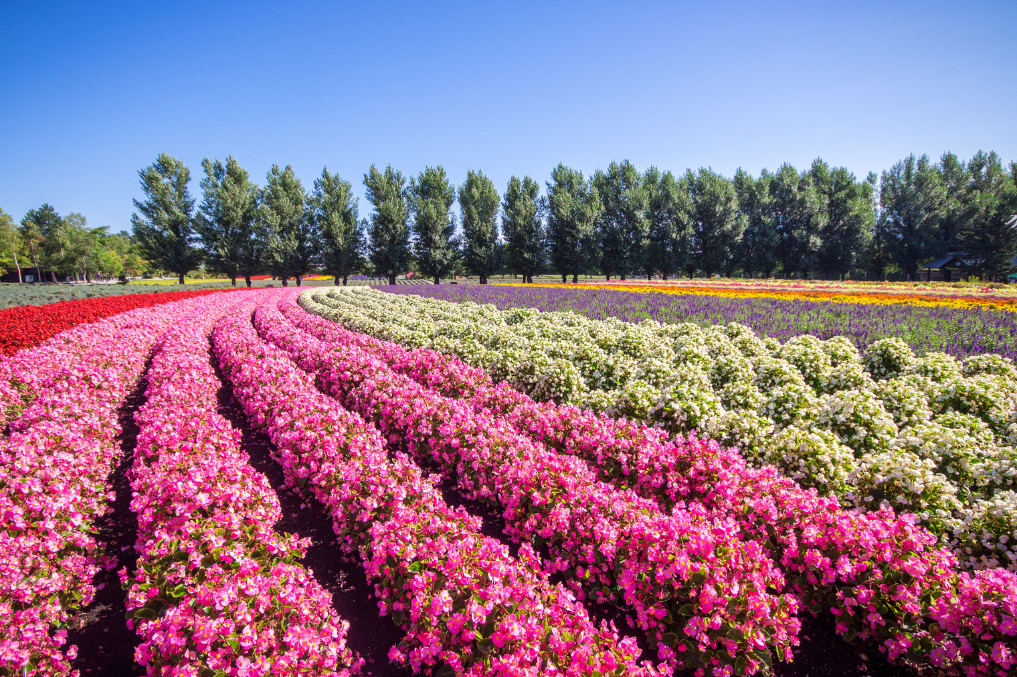



FARM MANAGEMENT SAAS
Their leading enterprise-level fam management software is tailor-made for the floral industry.
It offers a comprehensive solution for running an entire business and helps reduce costs, streamline processes, improve efficiency, and provide real-time data for farms.
Their software is built to scale and perform during peak seasons such as Mother's Day, Valentine's Day, and Women's Day.
www.ortussolutions.com

Slide 3

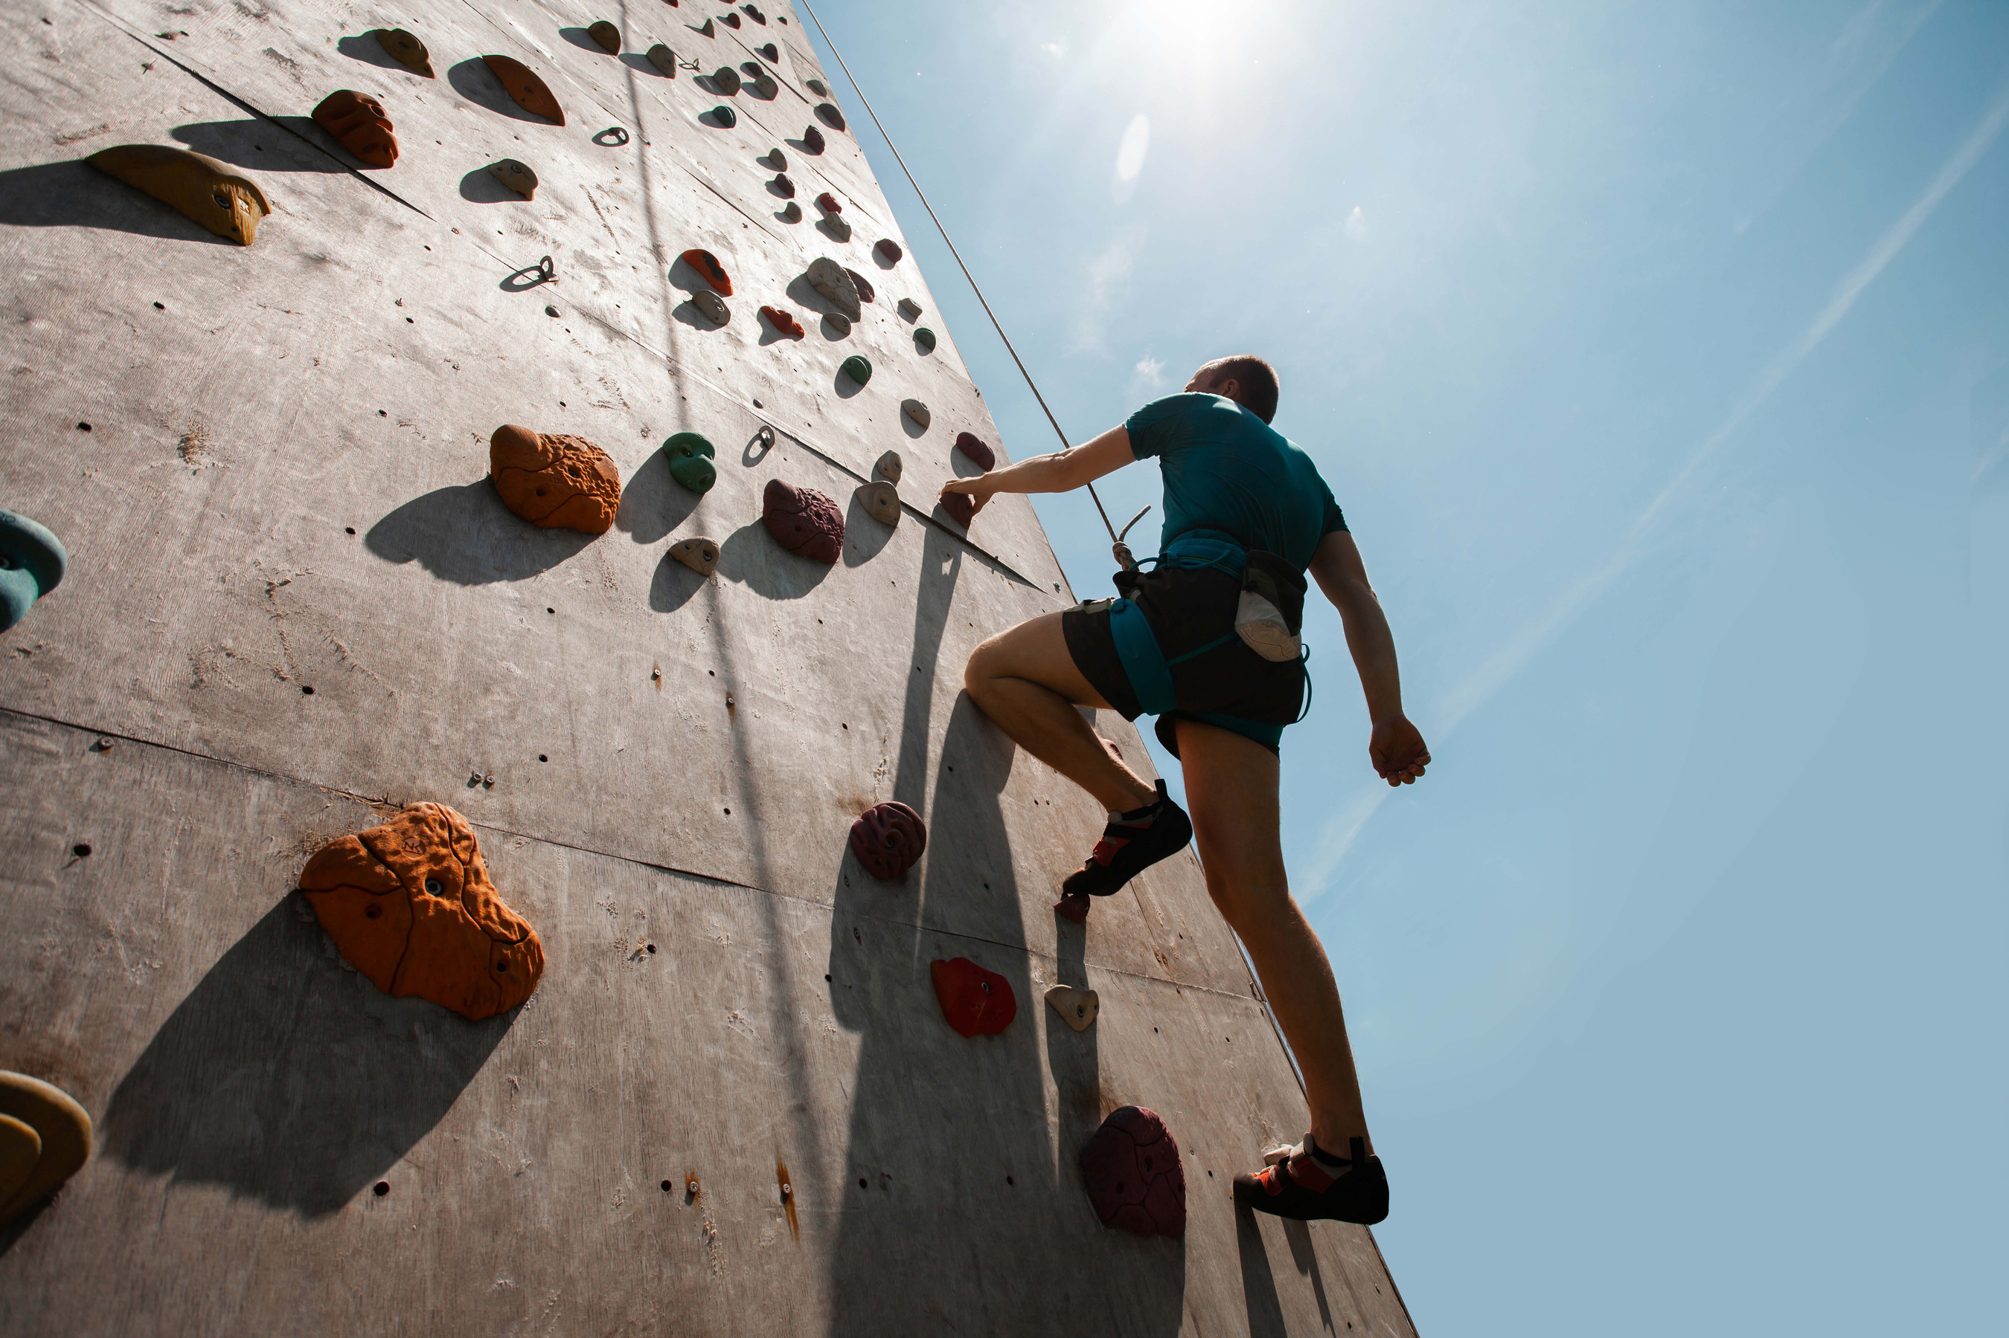

Addressing UNOSOF's UI Evolution
www.ortussolutions.com

Slide 4

Addressing UNOSOF's UI Evolution
01.
02.
03.
UNOSOF faced significant user growth projections, prompting a redesign of the UNOSOF ERP's user interface (UI).
The UNOSOF ERP required a modern UI, balancing easy adoption for new users and low resistance to change for those accustomed to the old interface.
Adapting data- and table-intensive screens for various display sizes, especially on mobile devices, presented a unique and critical challenge.
www.ortussolutions.com

Slide 5


Ortus Redesigns UNOSOF ERP's UI
www.ortussolutions.com

Slide 6
Ortus Redesigns UNOSOF ERP's UI
01.
02.
03.
Ortus initiated the redesign with comprehensive mockups of core screens and components like Login, Navigation, Filters, Data Tables, and the PO and Inventory page.
Enhanced filtering, sorting, and text search capabilities were introduced for improved user experience.
Collaborative efforts with UNOSOF involved selecting essential information for display on smaller devices.
www.ortussolutions.com

Slide 7


Enhancing UNOSOF's User Experience
www.ortussolutions.com

Slide 8
Enhancing UNOSOF's User Experience
01.
02.
The redesign significantly improved core screens, including Login, Navigation, Filters, Data Tables and the PO and Inventory page.
Successful implementation of mobile responsiveness for data- and table-intensive screens.
03.
04.
Users can now seamlessly access critical information, enhancing overall usability.
UNOSOF ERP is now well-equipped to handle continued user growth with a modernized and intuitive interface.
www.ortussolutions.com

Slide 9


STUDENT INFORMATION SYSTEM - Sapphire K12
As a single web-based software system with all the tools you need to enhance your school and student performance, SapphireK12™connects administrators, teachers, students, and parents.
Their software helps you capture and manage student data, generate compliant state reports, and gain insight into school and district performance.
www.ortussolutions.com

Slide 10

Redefining User Interfaces for Educational Excellence
www.ortussolutions.com

Slide 11


Redefining User Interfaces for Educational Excellence
01.
02.
Redesigned many user-facing screens for specific school roles and activities.
Modernized single-purpose-designed views for a user-friendly interface.
03.
04.
Existing views lacked quality and consistency, with significant diversity among them.
Discrepancies, like differences between exam and classroom interfaces, caused confusion.
www.ortussolutions.com

Slide 12

SapphireK12™ Interface Revolution
www.ortussolutions.com

Slide 13


SapphireK12™ Interface Revolution
01.
02.
Engaged experienced designers, emphasizing creative solutions for a unified and modernized environment.
Implemented a key improvement with a focus on enhancing user interaction and improving overall ease of use.
03.
Tailored views, ensuring a personalized approach for an enhanced user experience by customizing each view to meet specific user needs.
www.ortussolutions.com

Slide 14

SapphireK12™ - Elevating Education Experiences
www.ortussolutions.com

Slide 15
SapphireK12™ - Elevating Education Experiences
01.
02.
03.
Successfully redesigned to unify diverse screens, creating a consistent and user-friendly environment while enhancing user interaction.
Implemented drag-and-drop feature for significantly improved user interaction and ease of use, resulting in a personalized experience.
Tailoring each view to meet the unique needs of users resulted in a modernized interface that enhanced the overall experience for administrators, teachers, students, and parents.
www.ortussolutions.com

Slide 16


Loeb Electric sells customizable electrical panels on an industrial scale. They approached Ortus seeking help for
implementing a “Panel Builder” i.e. a way for customers’ to be able to build electrical panels onlines and to purchase them through a self-checkout service on their website.
www.ortussolutions.com

Slide 17

Streamlining Complex Bid Communication
www.ortussolutions.com

Slide 18

Streamlining Complex Bid Communication
01.
02.
Extensive communication hurdles with clients during bid creation due to dependencies and optional components.
Need for a solution that allows users without electrical expertise to make informed component choices.
www.ortussolutions.com

Slide 19

Dynamic Web Implementation for Efficient Panel Building
www.ortussolutions.com

Slide 20

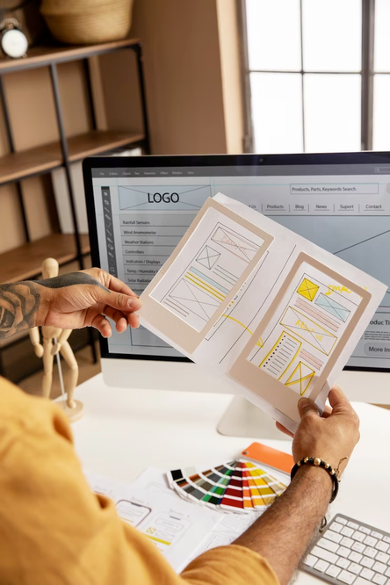
Dynamic Web Implementation for Efficient Panel Building
01.
02.
Ortus transformed Loeb's complex spreadsheet into a dynamic web application.
The Panel Builder simplified component selection, offering detailed technical specs, dependencies, compatibility, and incompatibility details.
03.
04.
Designed to empower users with limited electrical knowledge, including customers, contractors, and sales representatives.
Streamlined the process, enabling independent component selection without technician assistance.
www.ortussolutions.com

Slide 21

Enhancing Bid Efficiency and User Experience
www.ortussolutions.com

Slide 22

Enhancing Bid Efficiency and User Experience
01.
02.
The Panel Builder successfully streamlined bid creation, reducing back-and-forth communication with clients.
Users could independently select components, improving overall efficiency.
03.
04.
Users with limited electrical knowledge could confidently choose components, enhancing the user experience.
Reduced the reliance on technicians for panel building, leading to increased autonomy.
www.ortussolutions.com

