Slide 1




GSA Contract Number
DUNS Number
Cage Code
47QTCA23D00DH
015234069
6CF97

Slide 2


About Us
Ortus Solutions is a leading innovator in software development, dedicated to delivering cutting-edge web-based solutions. With a strong commitment to quality and innovation, we provide expert services in modern application development.
GSA Contract Number
47QTCA23D00DH
Formed 2006, Ortus Solutions is an established professional software development firm.
8a-certified small business with a proven track record of excellence.
Specialized in mobile and web application design, development and deployment.
Creators of 350+ web development tools powering application across the world.
Open Source Software publishers with a focus on empowering business and developers alike

Slide 3








































Our tools power Apps
Around the World!

Slide 4
Capabilities
Overview

Slide 5

Capabilities Overview
A Team
of Experts
Our Skills
Software & Mobile App Developers
We are passionate about web development
UI/UX Designers
Data Analysts
Business Analysts
Project Managers
DBAs

Slide 6
Capabilities Overview
Services
Overview
Overview
A Team
of Experts
Our Skills
Infrastructure Architects
We are passionate about web development
Software Testers
Security Auditors
DevOps Engineers
Software Architects
Senior Software Engineers

Slide 7









Capabilities Overview
Services
Overview
Overview
UX/UI Design
Business Intelligence
We offer architecture & design services for your next big project.
Centralize and automate data with a real-time BI dashboard to uncover insights, track KPIs, and enhance decision-making for your business.
Mobile App
DevOps & Infrastructure
Create fully-responsive websites, progressive apps and hybrid mobile apps.
Let us design your next server farm, CI/CD or fine tune it for optimal performance.
Legacy Modernization
Performance & Security
Bring your Legacy Applications to the twenty-first century!
Optimize performance for your apps, detect and remediate security vulnerabilities.
Quality Assurance
Expert Training
Test your application functionality, performance and security.
We have a wide selection of CFML training courses which can be delivered on-site or virtually.
Elasticsearch & Opensearch Solutions
Enhance search with expert consulting and implementation of Elasticsearch and AWS OpenSearch

Slide 8
Capabilities Overview
Services
Overview
Overview
AI Integrations
Smarter Software with AI Insight
Streamline workflows, automate tasks, and unlock insights with AI solutions tailored to your business.
OUR SIMPLE 3-STEP PLAN
1
Schedule a Discovery Call
Tell us about your challenges and goals so we can understand where AI can deliver real impact.
2
Get a Custom AI Strategy
We design a tailored plan that fits your workflows, data, and business priorities.
3
Build and Scale with Confidence
We implement intelligent solutions that grow with your needs — and support you every step of the way.

Slide 9
Areas of Software Development Experience

Slide 10


















Software Development
Travel
US State Government
US Military
Financial Services
Scientific Research
Background Checks
Insurance
Flower Farms
Catering
Retail
Real Estate
Job Boards
Transportation
Manufacturing
Fitness & Wellness
Grants Management
Education
eCommerce

Slide 11
Core
Services

Slide 12

Core Services
Support Model
  SLA-based agreements with defined response times
  Continuous support across supported technologies
  Dedicated ticketing system and asynchronous communication via Slack
Support & Consulting
We provide structured, SLA-driven support designed to keep mission-critical systems stable, optimized, and continuously evolving.
Engagement
  Flexible retainer or on-demand support
  Scalable based on client needs
  Direct access to senior engineers and product-focused consultants

Slide 13
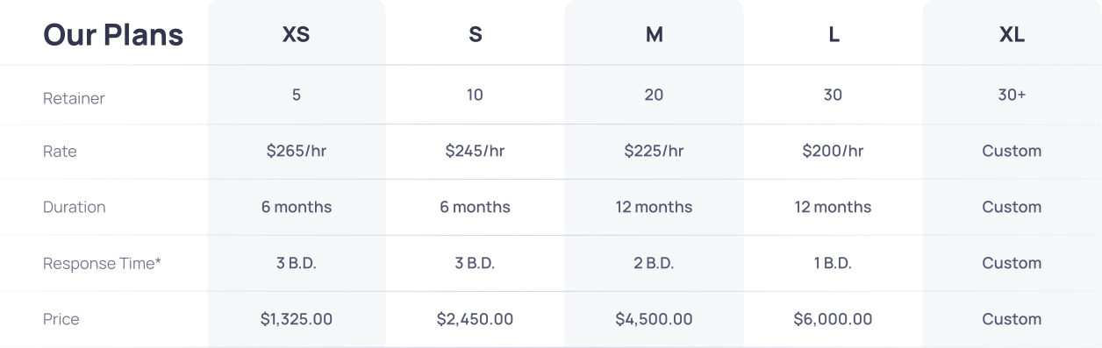
Core Services
Support & Consulting

Slide 14
Core Services
Support & Consulting
Our support programs cover the following areas:
Online private ticketing system
Servicing our open-source community since 2006!
Development discounted rates
Priority patches & updates
Custom builds
Up to 20% off training discounts

Slide 15

Core Services
Software Projects
Our Approach - Keep it Simple
Requirements Analysis
End-to-end delivery of custom software solutions tailored to your business needs.
Scope of Work & Proposal
Implementation
Monitoring
Testing & Delivery

Slide 16






Project References
NASA Portal to the Universe
Built a scalable BoxLang-powered platform delivering global space science data.
Direct Indexing Platform
Selected Highlights
Developed a value-based investment automation portal for personalized portfolio management.
InstallNet
Delivered an enterprise notification system supporting large-scale operations.
Avoya Travel
Engineered a high-performance booking engine to improve conversion and user experience.
Narvar Integration
Implemented a seamless insurance quoting integration for logistics workflows.
Loeb Electric
Built a configurable panel builder to streamline complex product configuration.

Slide 17






Project References
SBA
Modernized legacy platforms to improve scalability, performance, and maintainability.
Bridgeway
Selected Highlights
Developed secure APIs enabling seamless financial system integrations.
Serco
Enhanced US Navy critical systems to improve reliability and operational efficiency.
Simpleview
Redesigned infrastructure and remediated security vulnerabilities to strengthen compliance.
Senior Market Sales
Dental Quoting Engine for Analyzing Dental Insurance plans and total costs comparisons factoring in users’ dental hygiene.
Versa Valves
Led full system redesign and implementation to modernize operations.

Slide 18




Project References
Tau Beta Pi - Engineering Honor Society
Provisioned and deployed new infrastructure to support growth and reliability.
USRA (Meetings & Conferences App)
Selected Highlights
Built a mobile app to streamline event management and attendee engagement.
Order My Gear
Performed security audit and remediation to mitigate risk and improve compliance.
US Navy
Delivered system modernization and custom development for mission-critical environments.
West Fraser
Security Audit and Vulnerabilities Remediations
…and many more

Slide 19

Core Services
Staff Augmentation
Engagement Model
  Time & Materials or Fixed Fee
  Team composition tailored to your required skill set and tech stack
  Flexible duration: 3, 6, 9 months and beyond
The level of engagement
that your company needs
Operational Flexibility
  Typical ramp-up / ramp-down: ~1 month
  Notice period: 60 days
  Scalable team size based on evolving project needs

Slide 20










Staff Augmentation
Embedded talent within
client teams

Slide 21

Services
Secure Development Practices
Security First
Secure Environment
Isolated and auditable
Secure handling of secrets
Data Protection Controls
Code Reviews and Testing
Continous Monitoring

Slide 22

Services
Your IP is your IP
IP Ownership & Confidentiality
Work-for-hire
Open Source
Ortus Licensed Software
Reseller
BYOL
MCA+TOs
MNDA

Slide 23
Tech
Ecosystem
We believe in the power of great tools to deliver great solutions.

Slide 24
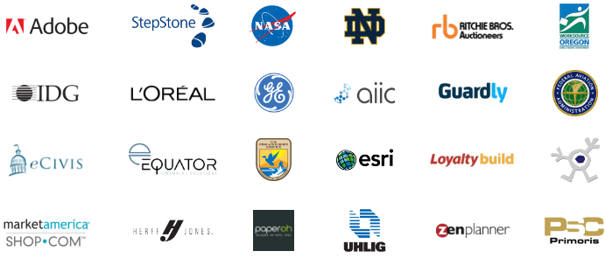

Ecosystem
ColdBox powers scalable apps since 2005 with support and training.
www.coldbox.org
ColdBox is a conventions-based MVC Framework. It provides a set of reusable code and tools that can be used to increase your development productivity, as well as a development standard for working in team environments. ColdBox is comprehensive and modular, which helps address most infrastructure concerns of typical CFML applications. It is composed of several standalone libraries that in turn compose the ColdBox Platform.

Slide 25

Core Products
Ecosystem
Ecosystem
A standalone, native tool for Windows, Mac, and Linux
CommandBox will provide you with a Command Line Interface (CLI) for developer productivity, tool interaction, package management, embedded CFML server, application scaffolding, and some sweet ASCII art.

Slide 26

Core Products
Ecosystem
Ecosystem
THE
cloud package repository.
Designed to discover, share, and manage reusable code with collaboration, scalability, and modern development workflows in mind.

Slide 27

Ecosystem
Ecosystem
A powerful professional open-source headless CMS.
Designed to scale, perform with security in mind, and multi-site ready.

Slide 28

Ecosystem
Ecosystem
Dynamic : Modular : Productive
A modern, dynamically and loosely typed scripting language for multiple runtimes.
For the Java Virtual Machine (JVM) giving you tons of Object-Oriented (OO), Functional Programming (FP) Constructs, and dynamic Metadata Programming (MP)

Slide 29

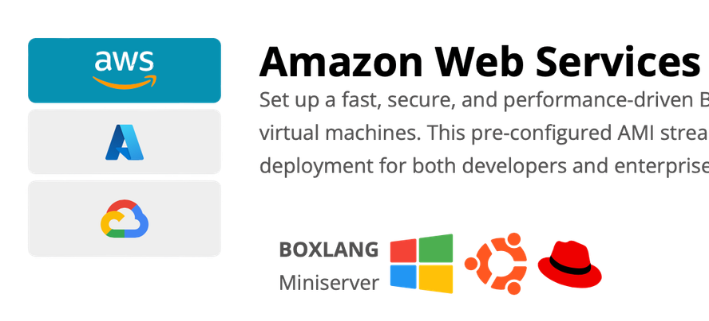

Ecosystem
Cloud Servers
Offers a seamless and high-performance Ubuntu and Windows-based environment to deploy and manage BoxLang applications on Microsoft Azure and AWS. This virtual machine is pre-configured with everything you need to start coding, deploying, and scaling your applications with ease.
a new way to the cloud
Amazon Web Services
Set up a fast, secure, and performance-driven BoxLang environment on AWS with our Ubuntu and Windows-based virtual machines. This pre-configured AMI streamlines development, offering seamless scalability and effortless cloud deployment for both developers and enterprises.
BOXLANG
Miniserver
BOXLANG
With CommandBox

Slide 30








Core Products
Ecosystem
Resellers

Slide 31
Ecosystem
Ecosystem
Web / API Development
Project Management
DBA
  ColFudsion (CFML)
  Java
  Node
  Agile / Scrum Certified
  PMP CertifieD
  Jira Specialists
  MySQL
  PostgreSQL
  Microsoft SQL
  Oracle
Front End Development
Business Inteligence
NoSQL + Caching
  Angular
  Vue.js
  Alpine.js
  Nuxt.js
  Quasar
With power BI
  Couchbase
  Redis
  Mongo DB
Quality Assurance
Cloud DevOps
Search & Booking Engines
  Automated Testing
  Integration Testing
  Unit Testing
  Performance Testing
  UI Testing
  AWS
  Digital Ocean
  Azure
  Terraform
  Gitlab
  Github Actions
  Bitbucket
  Containers
Using ElasticSearch, OpenSearch
and MeiliSearch

Slide 32
A
Distributed Team

Slide 33
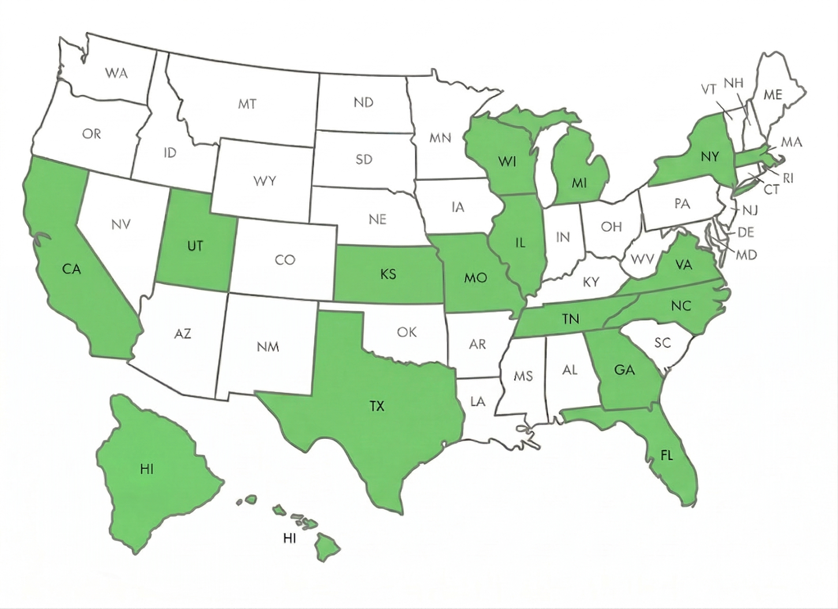
USA
Houston, TX
West Bend, WI
Reston, VA
Bakersfield, CA
Grand Rapids, MI
Antioch, TN
Holland Patent, NY
Saratoga Springs, UT
Capitan Cook, HI
Kansas City, MO
Fairfax, VA
Randleman, NC
Andover, MA
Mckinney, TX
Spring, TX
Waxahachie, TX
Plainfield, IL
Martinez, GA
Davenport, FL

Slide 34
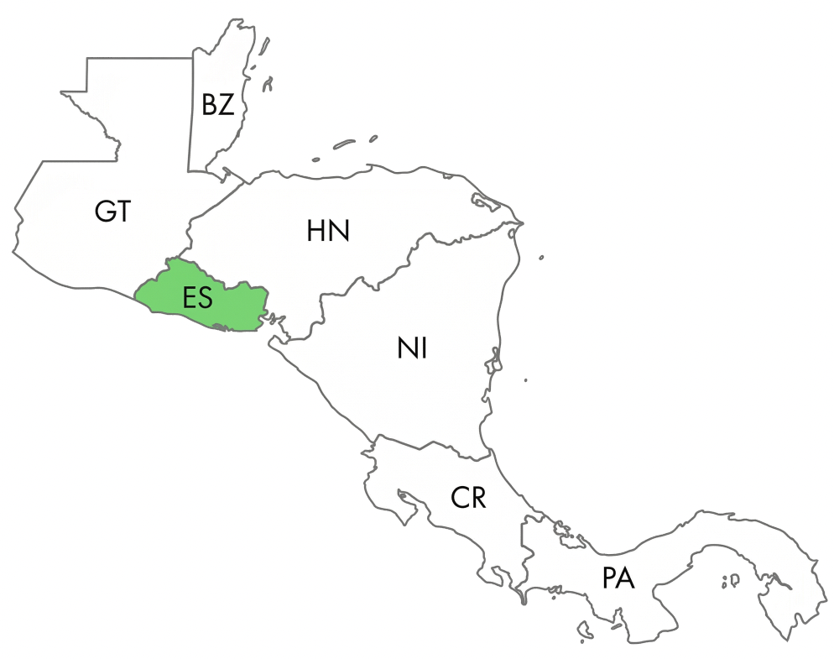
El
SALVADOR
Central America

Slide 35
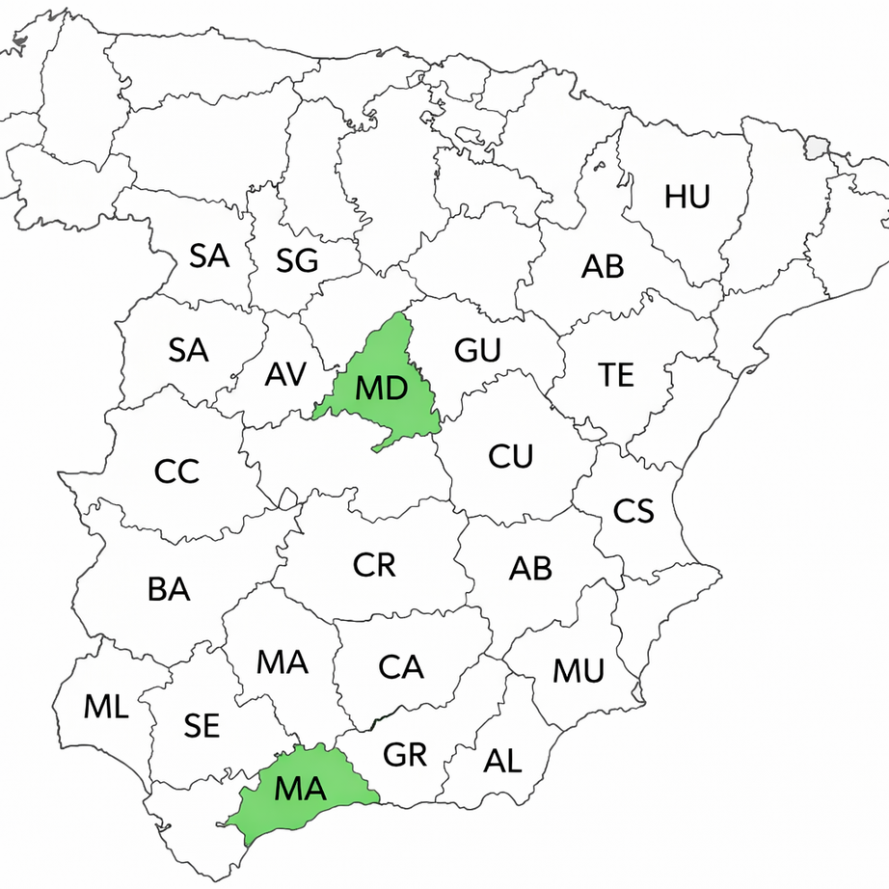
Spain
Madrid & Malaga

Slide 36
Points of Contact
Cristobal Escobar
Jorge Reyes
Luis Majano
Business Development
COO
CEO
cristobal@ortussolutions.com
jreyes@ortussolutions.com
lmajano@ortussolutions.com

Slide 37

Thank You!
Presentation 2025

