Slide 1
The Capstone Project
Oruba Abu-Eisa

Slide 2
01.
Introduction
04.
Offensive Cybersecurity
System Design, Architecture & Administration
02.
Defensive Cybersecurity
05.
Vulnerability
03.
06.
Conclusion

Slide 3
Introdiction
Royal Cars is a company that deals with car manufacturers to display and rent their cars to customers through a website
The company owns showrooms in various places where the customer can receive and return the car

Slide 4
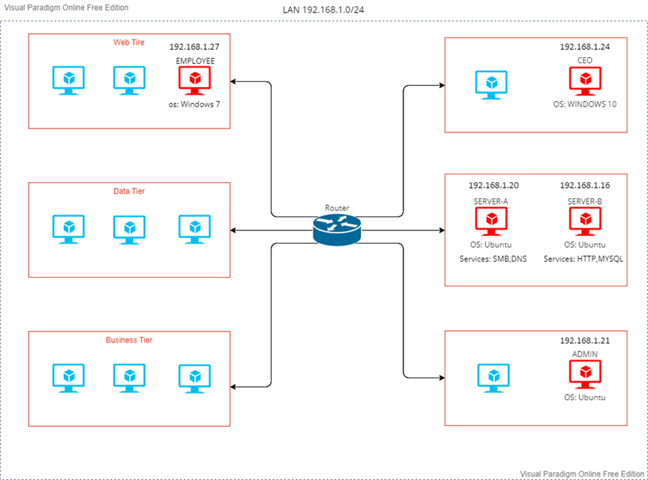
System Design, Architecture & Administration
The adjacent figure shows the design of a company internally, the distribution of machines, and how to communicate between them

Slide 5
System Design, Architecture & Administration
SMB Service
  Server Message Block (SMB) is a protocol used for file sharing and other network services between computers.
  The purpose of the SMB service is to provide a way for computers on a network to access and share resources, such as files, printers, and other devices, with each other.
DNS Service
  DNS (Domain Name System) is a service that translates human-friendly domain names (such as www.example.com) into machine-friendly IP addresses (such as 192.0.2.1).
  The purpose of the DNS service is to provide a decentralized, hierarchical system for resolving domain names to IP addresses. This allows users to access web sites, email servers, and other internet resources using easy-to-remember domain names instead of the IP addresses.

Slide 6
System Design, Architecture & Administration
MYSQL Service
  MySQL is a popular open-source relational database management system (RDBMS) that is widely used for managing and storing data in web-based applications, online platforms, and other software systems.
  The purpose of MySQL is to provide a reliable, efficient, and flexible way to store, manage, and retrieve large amounts of data.
HTTP Service
  HTTP (Hypertext Transfer Protocol) is a protocol used for transmitting data over the internet. It is the foundation of the World Wide Web and is used by web browsers, servers, and other applications to communicate with each other.
  The purpose of the HTTP service is to transfer data between a client (such as a web browser) and a server.

Slide 7
Vulnerability
Password pattern vulnerability is a security weakness where a system's password policy requires users to follow specific patterns for their passwords, making them easily guessable through brute-force methods.
The DNS (Domain Name System) Tunneling vulnerability is a security weakness in the DNS protocol that allows attackers to evade network security measures and exfiltrate sensitive data by encoding it into DNS queries and responses, bypassing firewalls and other security systems that only inspect standard network protocols.

Slide 8
Vulnerability
Windows Shell Remote Code Execution Vulnerability (MS10-046) is a security vulnerability that exists in the way that the Windows Shell, which is the interface that provides access to the files and folders on a computer, handles shortcut files (LNK files) in Windows

Slide 9
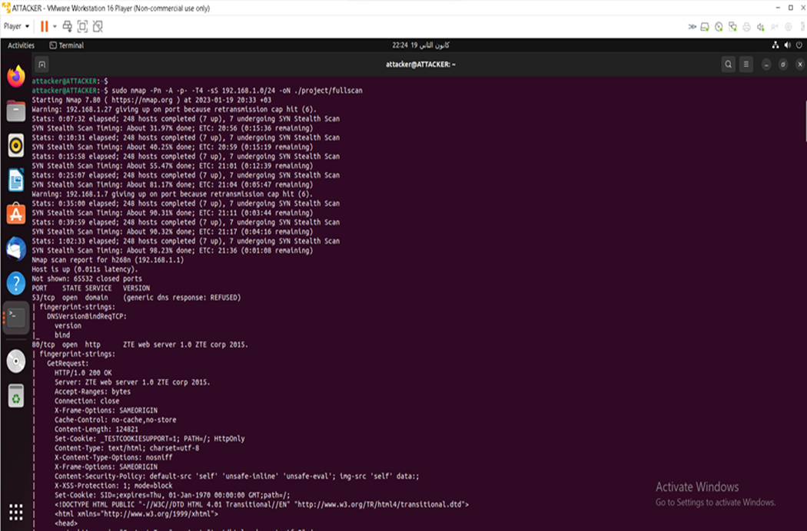
Offensive Cybersecurity(Scanning)
Network scanning is the process of discovering and identifying active devices and services on a network by sending packets and analyzing responses.

Slide 10
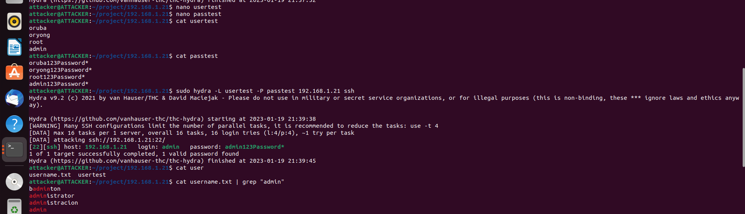
Offensive Cybersecurity(Brute-Force Attack)
A brute-force attack is a trial-and-error method used by application programs to decode login information and encryption keys to use them to gain unauthorized access to systems. Using brute force is an exhaustive effort rather than employing intellectual strategies.
hydra a very fast network logon cracker which supports many different services.

Slide 11
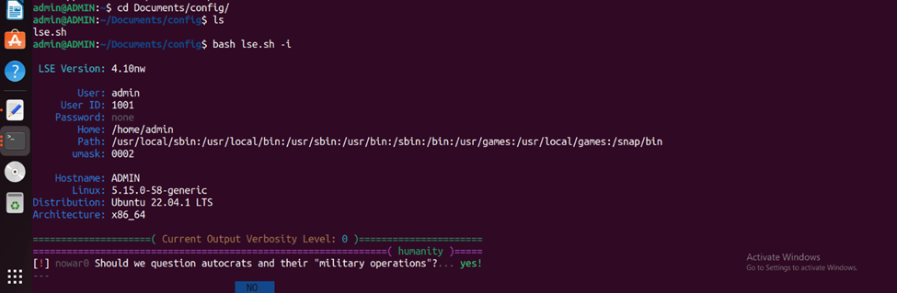
Offensive Cybersecurity(Brute-Force Attack)
Linux Smart Enumeration (LSE) which is a script that automates the process of enumeration on a Linux system during a penetration testing or security assessment engagement.
We conclude that the user has sudo privileges

Slide 12
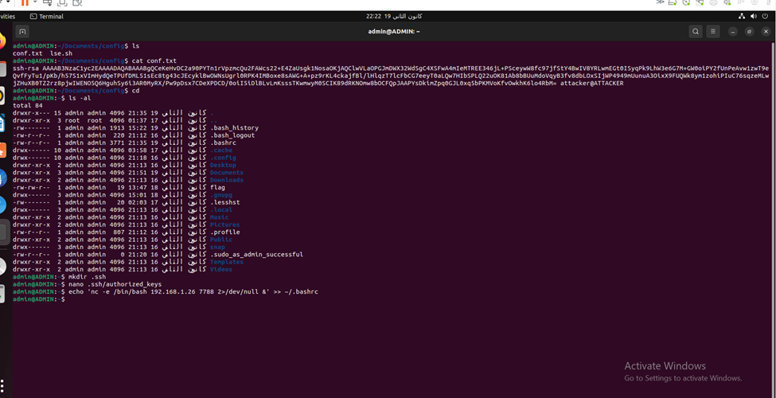
Offensive Cybersecurity(Brute-Force Attack)
The "authorized_keys" file, which is located within the ".ssh" directory, contains a list of public keys that are authorized to access the user's account via SSH.
The ".bashrc" file is a script file that is executed whenever a new instance of the Bash shell is started, including when a user logs into the system.

Slide 13
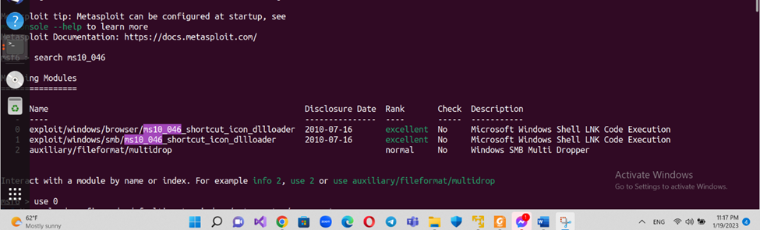
Offensive Cybersecurity(MS10_046 Attack)
Metasploit Framework Console (msfconsole) is the command-line interface of the Metasploit Framework, an open-source project that provides a platform for developing, testing, and executing exploits.
ms10_046_shortcut_icon_dllloader is a known exploit that targets a vulnerability in the Microsoft Windows operating system. The vulnerability exists in the way that Windows handles shortcut files (with the .lnk extension) that have a specially crafted icon.

Slide 14
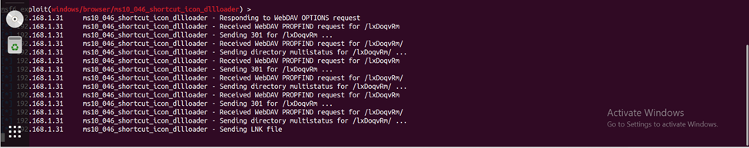
Offensive Cybersecurity(MS10_046 Attack)
A payload is the component of a cyber-attack that delivers the malicious code or action intended by the attacker.
After setting all the necessary the victim opened the hacker's URL and the hacker was able to get a reverse shell on the victim's machine

Slide 15
Defensive Cybersecurity
(Fix problems and the vulnerability)
Social Engineering: Educate Employees.
Password pattern vulnerability: the password has been changed in addition to putting the police to create passwords such as complex and not including the username and to be changed every three months in addition to the presence of a password that is used for the first time only to enter the device and is changed after that.
Windows Shell Remote Code Execution Vulnerability MS10-046: installing the security update released by Microsoft in August 2010 or update it for the latest windows version.
The DNS (Domain Name System) Tunneling vulnerability: Implement DNS filtering using a DNS proxy or firewall

Slide 16
This attack caused great losses that may end up harming the company and the company's customers only, but let's imagine that it has access to the data of banks and car companies such as eFAWATEERCOM. What is the amount of damage caused if the attack continues and is not detected?
Conclusion

Slide 17
References
https://en.wikipedia.org/wiki/Server_Message_Block
https://www.cloudflare.com/learning/dns/what-is-dns/
https://dev.mysql.com/doc/refman/8.0/en/what-is-mysql.html
https://help.synatic.com/en/articles/4719865-http-service
https://www.cloudns.net/blog/dns-tunneling-attack-what-is-it-and-how-to-protect-oursel

Slide 18
References
https://learn.microsoft.com/en-us/security-updates/securitybulletins/2010/ms10-046
https://www.techtarget.com/searchsecurity/definition/brute-force-cracking
https://resecurity.com/blog/article/shortcut-based-lnk-attacks-delivering-malicious-code-on-the-rise
https://www.imperva.com/learn/application-security/social-engineering-attack/
https://snyk.io/learn/malicious-code/

Slide 19


Thanks!
Questions Time
Don't hesitate to ask about anything

