Slide 1
Fuzzy Record Linkage
By Gregory Smith & Axel Solano

Slide 2
Introduction
Objective
Requirements
Design Decisions
Design
Implementation
Demo
Testing
Maintainability
Conclusion
The Problem
Achieved Goals
Dependencies
Client Info

Slide 3

Client info
Local company based in Kalamazoo, MI
Master data management platform
https://www.salespage.com/

Slide 4
The problem
Data Set A
Last Name | First Name | City | Phone | Unique ID
Doe | John | Grand Rapids | (616) 123-4567 | 11111
Johnson | William | Kalamazoo | (269) 456-7890 | 22222
Miller | Mike | Detroit | (313) 987-6543 | 33333
Data Set B
Last Name | First Name | City | Phone | Unique ID
Doe | John | - | (616) 123-4567 | -
Johnson | Will | Kalamazoo | (269) 456-7890 | -
Miller | Mike | Chicago | (313) 987-6543 | -

Slide 5
Objective
Given a master dataset and matching datasets, generate functionality to evaluate various datapoints and return a level of confidence of a match to the master dataset.

Slide 6
Requirements
Java is used as the language to create the functionality.
1
Only freely distributed, open-source dependencies are used.
2

Slide 7
Design Decisions
Intellij IDEA IDE
1
Github used for version control
2
Maven for building and testing tool
3

Slide 8
What is Maven?
Build automation tool
Dependency manager

Slide 9
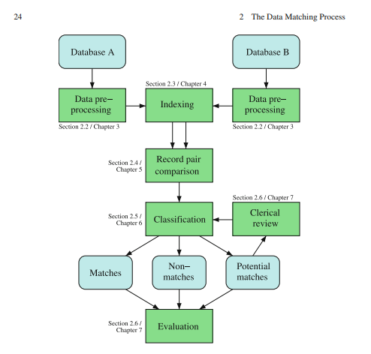
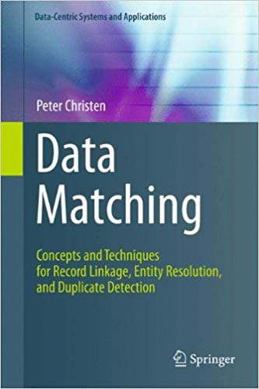
Design

Slide 10
Implementation
Pre-processing
Indexing
Record pair comparison
Classification
Evaluation

Slide 11
Implementation
Pre-Processing
Remove
Unwanted characters
Trim
All unnecessary whitespace
Standardize
Common address abbreviations
Ex.
Combine
Related fields into a single field
Ex.
Punctuation, tabs, new lines
Address
Address_1 & Address_2
123 N State St
123 North State Street
TO
TO

Slide 12

ImplementatiOn
Indexing
Initial complexity
O(n*m)
Master data set– 21,450 records
634,598,250 comparisons!
Time
Over 25 minutes!
Match data set– 29,585 records

Slide 13
Implementation
Indexing
Indexing approach
Group similar records together by phonetic encoding
Time
~1 second
Reduced # of comparisons by 99.9%
841,138 comparisons!

Slide 14
Implementation
Record pair comparison
Similarity Metric
Levenshtein Distance
Ratio between 0 – 100
Weights per field
Sum of weights equal to 1
Confidence
Sum of each field's similarity *weight
A score of 100 is a perfect match
Weights

Slide 15
Implementation
Score Classification
Non-match
Potential Match
Match
[ 0, 70)
[70, 90)
[ 90, 100]

Slide 16
Implementation
Evaluation
Count known matches
Unique identifier match between records
Count how known matches we identified
If a known match is in our top list
Accuracy score
Identified matches / Total known matches
Manual review
To ensure matches make sense

Slide 17
Core Dependencies
Unit Testing
Xdrop's FuzzyWuzzy Library
Levenshtein Distance Ratio
Junit's JUnit Library
Apache's Commons-CSV Library
Phonetic Encoding
Apache's Commons-Codec Library
Json Parsing
Org.json's JSON library
CSV Parsing

Slide 18
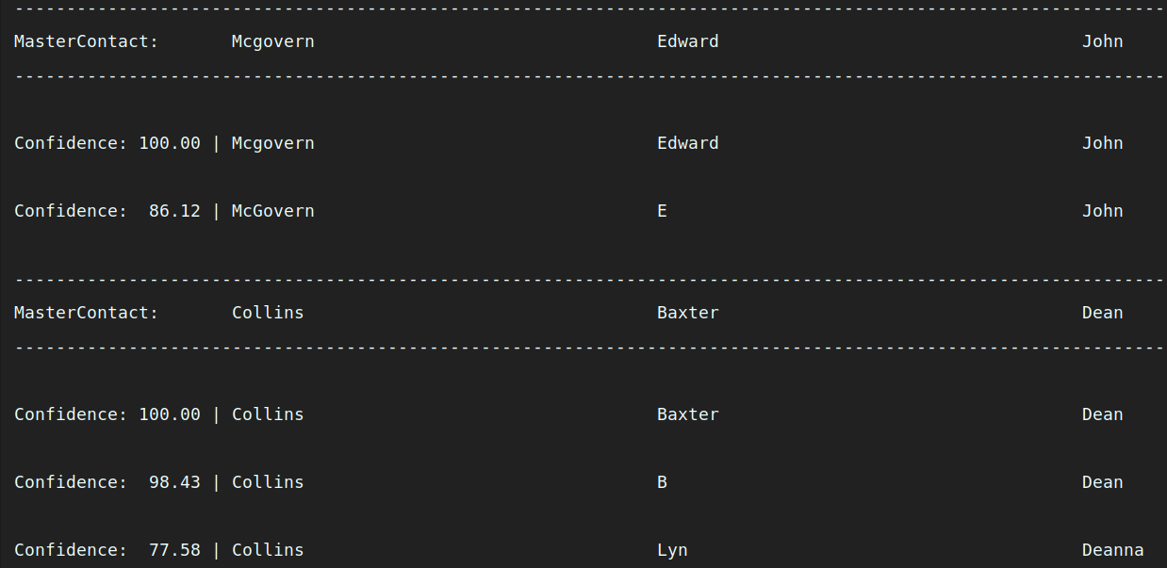
Demo

Slide 19
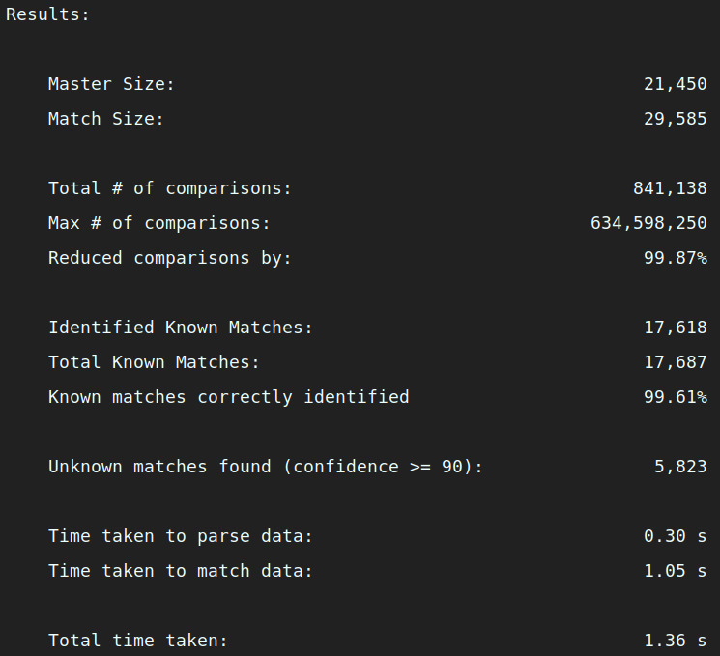
Demo

Slide 20
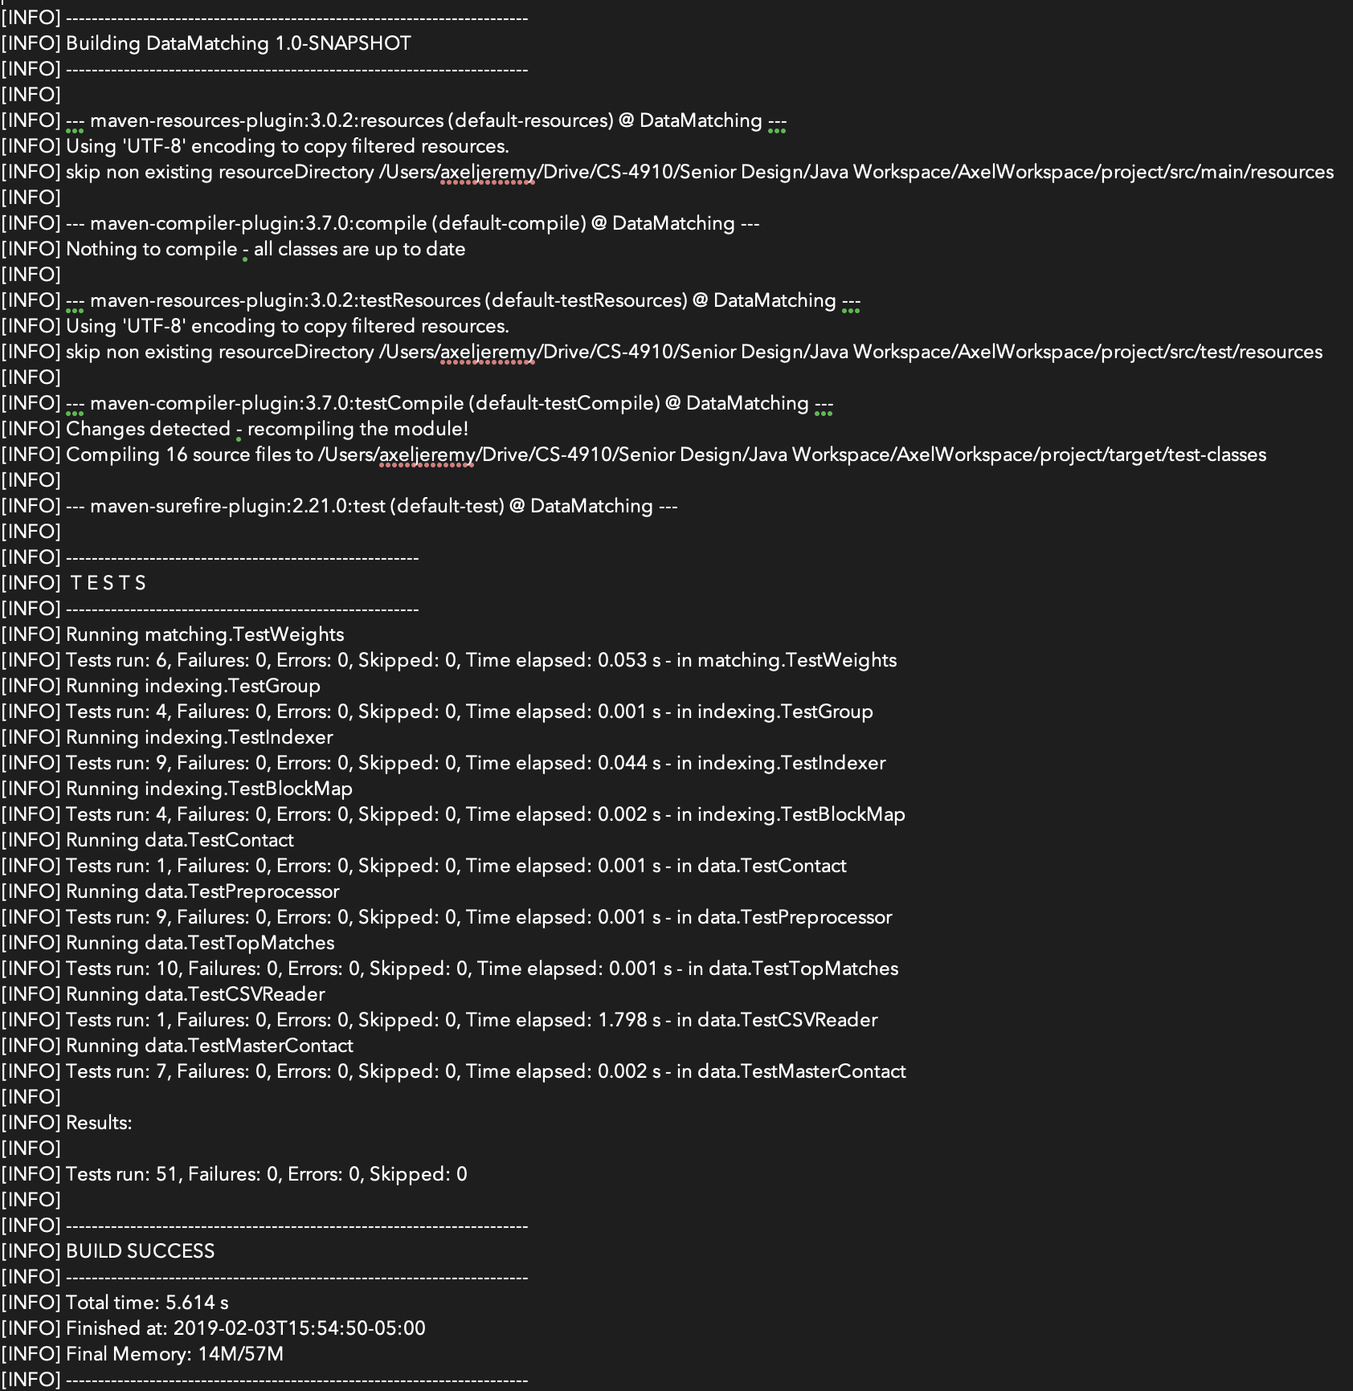
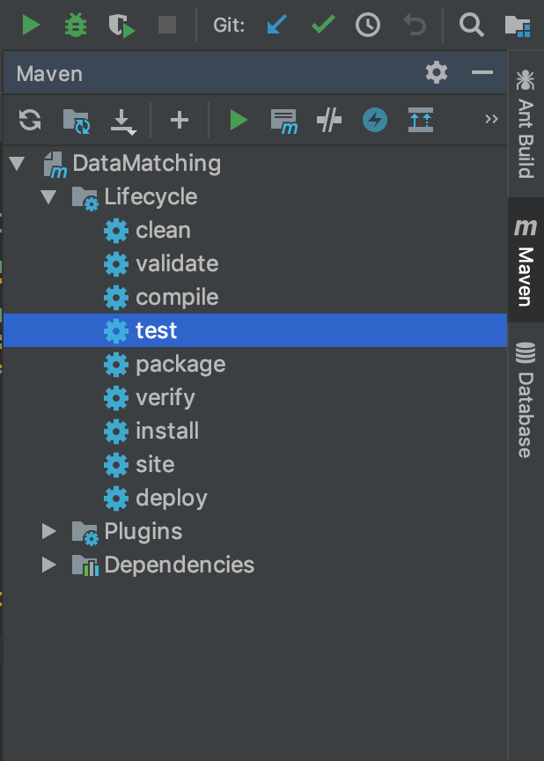
Testing

Slide 21
Maintainability
Readability
Comprehensive Documentation
Object Oriented Design

Slide 22
Achieved Goals
Simplicity
Readability
Maintainability

Slide 23
Conclusion
Met client's requirements
Created an efficient and scalable solution

