Slide 1
Fuzzy Record Linkage
By Gregory Smith & Axel Solano

Slide 2
Introduction
The Problem
Requirements
Design
Implementation
Demo
Testing
Maintainability
Conclusion
Achieved Goals
Dependencies
Client Info

Slide 3

Client info
Local company based in Kalamazoo, MI
Master data management platform
https://www.salespage.com/

Slide 4
The problem
Given two sets of contact data, find duplicate contacts between the two by measuring contact’s similarity.

Slide 5
The problem
Data Set A
Last Name | First Name | City | Phone | Unique ID
Doe | John | Grand Rapids | (616) 123-4567 | 11111
Johnson | William | Kalamazoo | (269) 456-7890 | 22222
Miller | Mike | Detroit | (313) 987-6543 | 33333
Data Set B
Last Name | First Name | City | Phone | Unique ID
Doe | John | - | (616) 123-4567 | -
Johnson | Will | Kalamazoo | (269) 456-7890 | -
Miller | Mike | Chicago | (313) 987-6543 | -

Slide 6
Requirements
Java is used as the language to create the functionality.
1
Only freely distributed, open-source dependencies are used.
2

Slide 7
Design Decisions
Intellij IDEA IDE
1
Github used for version control
2
Maven for building and testing tool
3

Slide 8
What is Maven?
Build automation tool
Dependency manager
Notes:
Maven is a build automation tool used primarily for Java projects. Maven addresses two aspects of building software: first, it describes how software is built, and second, it describes its dependencies.
Maven Phases
Although hardly a comprehensive list, these are the most common default lifecycle phases executed.
validate: validate the project is correct and all necessary information is available
compile: compile the source code of the project
test: test the compiled source code using a suitable unit testing framework. These tests should not require the code be packaged or deployed
package: take the compiled code and package it in its distributable format, such as a JAR.
integration-test: process and deploy the package if necessary into an environment where integration tests can be run
verify: run any checks to verify the package is valid and meets quality criteria
install: install the package into the local repository, for use as a dependency in other projects locally
deploy: done in an integration or release environment, copies the final package to the remote repository for sharing with other developers and projects.
There are two other Maven lifecycles of note beyond the default list above. They are
clean: cleans up artifacts created by prior builds
site: generates site documentation for this project

Slide 9
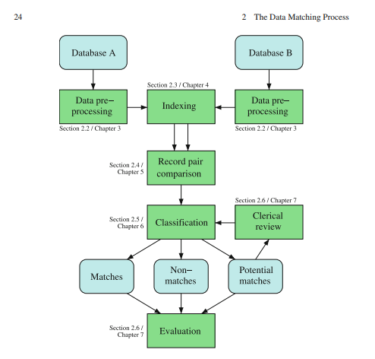

Our Design

Slide 10
Implementation
Pre-processing
Indexing
Record pair comparison
Classification
Evaluation

Slide 11
Implementation
Pre-Processing
Remove
Unwanted characters
Trim
All unnecessary whitespace
Standardize
Common address abbreviations
Ex.
Combine
Related fields into a single field
Ex.
Punctuation, tabs, new lines
Address
Address_1 & Address_2
123 N State St
123 NORTH STATE STREET
TO
TO

Slide 12

ImplementatiOn
Indexing
Initial complexity
N*M comparisons
Master data set– 21,450 records
634,598,250 comparisons!
Time
Over 25 minutes!
Match data set– 29,585 records

Slide 13
Implementation
Indexing
First Name | Last Name | Last Name Encoding
Mike | Day | T
Sarah | Doe | T
Hannah | Hilkens | HLKNS
Syndey | Hilkins | HLKNS
Drake | Niven | NFN
Josh | Nieveen | NFN
Megan | Grand | KRNT
James | Grent | KRNT
First Name | Last Name | Last Name Encoding
John | Doe | T
Hannah | Hilkens | HLKNS
Bill | Niven | NFN
Kyle | Grant | KRNT
1st approach: 4 x 8 = 32
2nd approach: 2*4 = 8
32/8 =
4 times faster

Slide 14
Implementation
Indexing
Indexing approach
Group similar records together by phonetic encoding
Time
~1 second!
Reduced # of comparisons by 99.9%
841,138 comparisons!
Parallel processing

Slide 15
Implementation
Record pair comparison
Similarity Metric
Levenshtein Distance
Ex. Axel ~ Axe = 75
Ratio between 0 – 100
Weights per field
Sum of weights equal to 1
Confidence
Sum of each field's similarity * weight
A score of 100 is a perfect match
Weights

Slide 16
Implementation
Score Classification
Non-match
Potential Match
Match
[ 0, 70)
[70, 90)
[ 90, 100]

Slide 17
Implementation
Evaluation
Count known matches
Unique identifier match between records
Count how many matches we identified
If a known match is in our top list
Accuracy score
Identified matches / Total known matches
Manual review
To ensure matches make sense

Slide 18
Core Dependencies
Unit Testing
Xdrop's FuzzyWuzzy Library
Levenshtein Distance Ratio
Junit's JUnit Library
Apache's Commons-CSV Library
Phonetic Encoding
Apache's Commons-Codec Library
Json Parsing
Org.json's JSON library
CSV Parsing

Slide 19
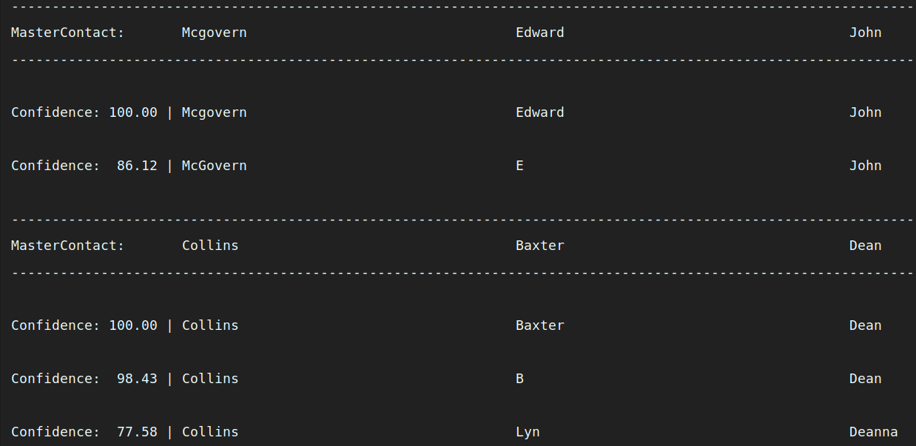
Demo

Slide 20
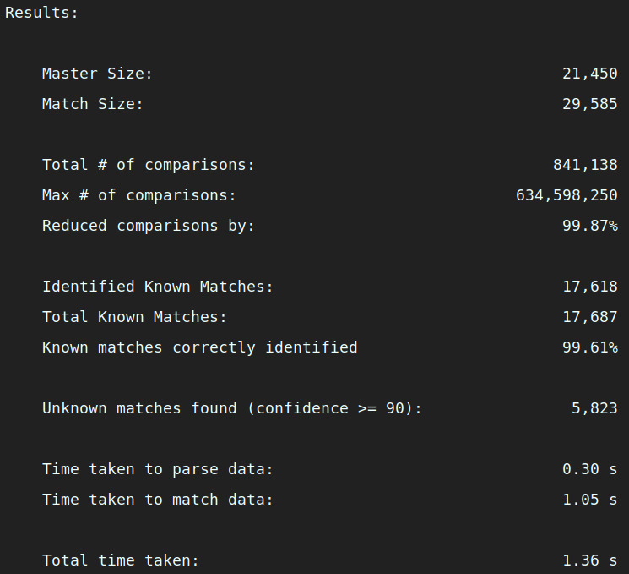
Demo

Slide 23
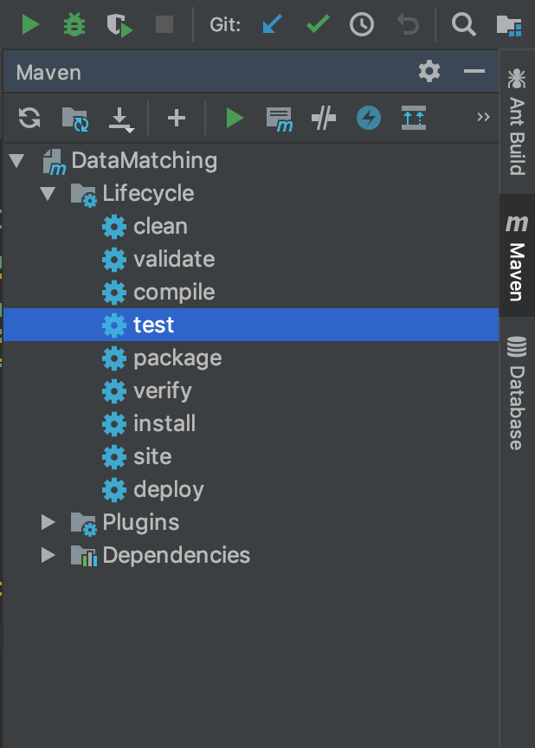
Testing
Fast & Easy access to testing

Slide 24
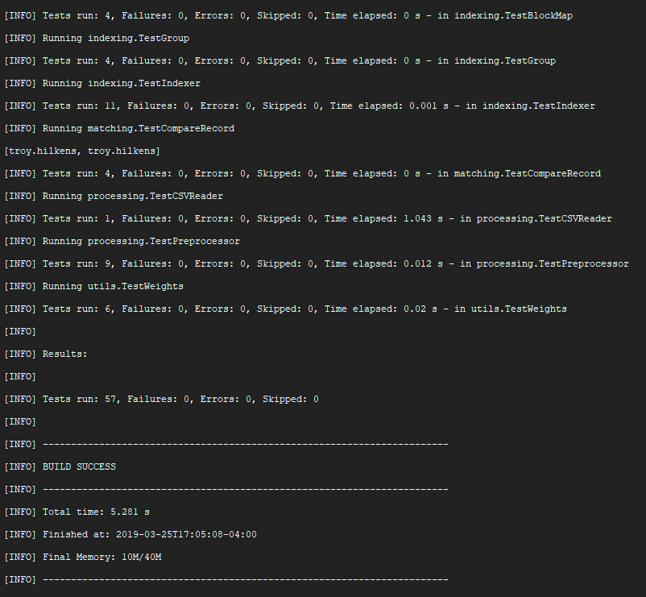
Testing
57 Tests
5.2 seconds
10Mb memory used

Slide 25
Maintainability & Achieved goals
Readability
Comprehensive Documentation
Simplicity
Flexibility

Slide 26
Conclusion
Met client's requirements
Created an efficient and scalable solution to the problem
SalesPage is very impressed and happy with the results

