Slide 1
Fuzzy Record Linkage
By Gregory Smith & Axel Solano

Slide 2
Introduction
Objective
Requirements
Prerequisite Knowledge
Design Decisions
Design
Implementation
Demo
Testing
Maintainability
Conclusion

Slide 3
Objective
Given a master dataset and matching datasets, generate functionality to evaluate various datapoints and return a level of confidence of a match to the master dataset.

Slide 4
Requirements
Java is used as the language to create the functionality.
1
Only freely distributed, open-source dependencies are used.
2

Slide 5
Prerequisite Knowledge
Knowledge of Java
Knowledge of Github

Slide 6
Design Decisions
Intellij IDEA IDE
1
Github used for version control
2
Maven for building and testing tool
3

Slide 7
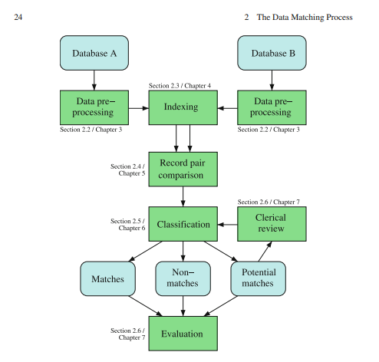
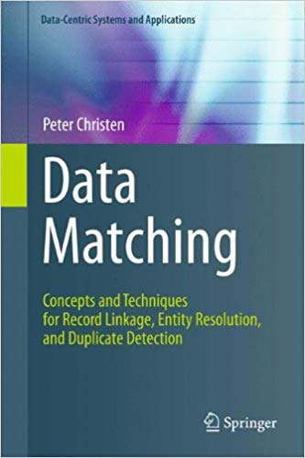
Design

Slide 8
Implementation
Pre-processing
Indexing
Record pair comparison
Classification
Evaluation

Slide 9
Implementation
Pre-Processing
Remove
Unwanted characters
Trim
All unnecessary whitespace
Transform
Common address abbreviations
Ex.
Combine
Related fields into a single field
Ex.
Punctuation, tabs, new lines
Address
Address_1 & Address_2
123 N State St
123 North State Street

Slide 10

ImplementatiOn
Indexing
Initial complexity
O(n*m)
Master dataset – 21,450 records
634,598,250 comparisons!
Time
Over 25 minutes!
Match dataset – 29,585 records

Slide 11
Implementation
Indexing
Indexing approach
Group similar records together by phonetic encoding
1,261,453 comparisons!
Time
~2 seconds
Reduced # of comparisons by 99%
Apache Commons Codec package used

Slide 12
Implementation
Record pair comparison
Compare contacts in each group
Utilized Java's parallel stream
Similarity Metric
Levenshtein Distance
Ratio between 0 – 100
Weights
Weights per field
Sum of weights equal to 1
Calculation
Sum of each field's similarity * each field's weight
Score of Confidence
Calculation between 0 – 100
A score of 100 is a perfect match
FuzzyWuzzy package used

Slide 13
Implementation
Score Classification
Non-match
Potential Match
Match
[ 0, 70)
[70, 90)
[ 90, 100]

Slide 14
Implementation
Evaluation
Count known matches
Unique identifier match between records
Count how known matches we identified
If a known match is in our top list
Accuracy score
Identified matches / Total known matches
Manual review
To ensure matches make sense

Slide 15
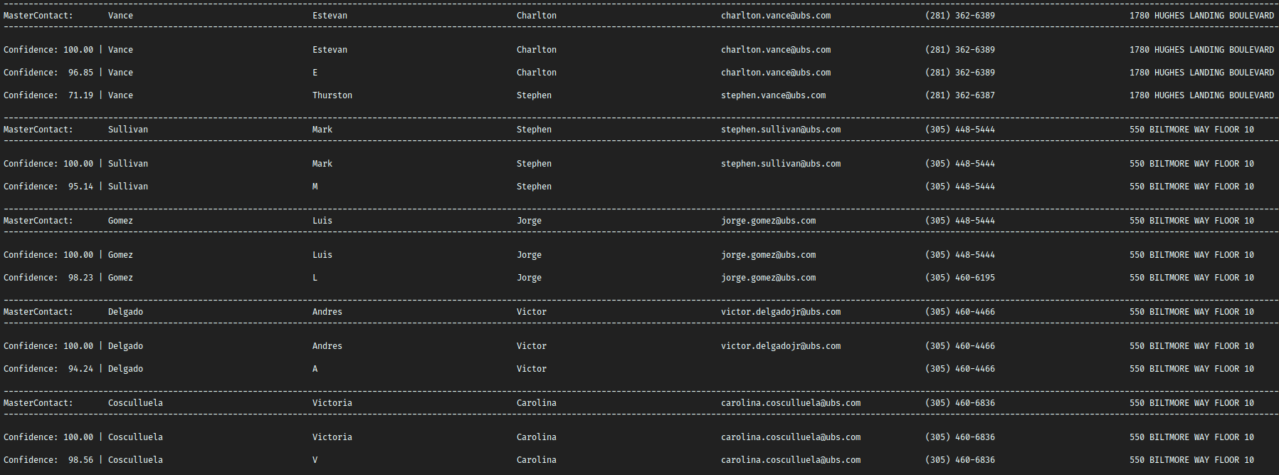
Demo

Slide 16
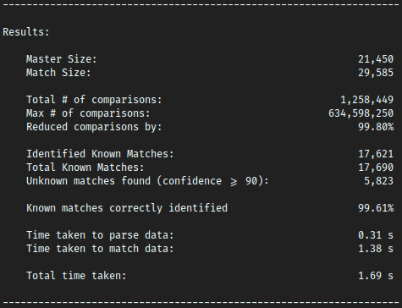
Demo

Slide 17
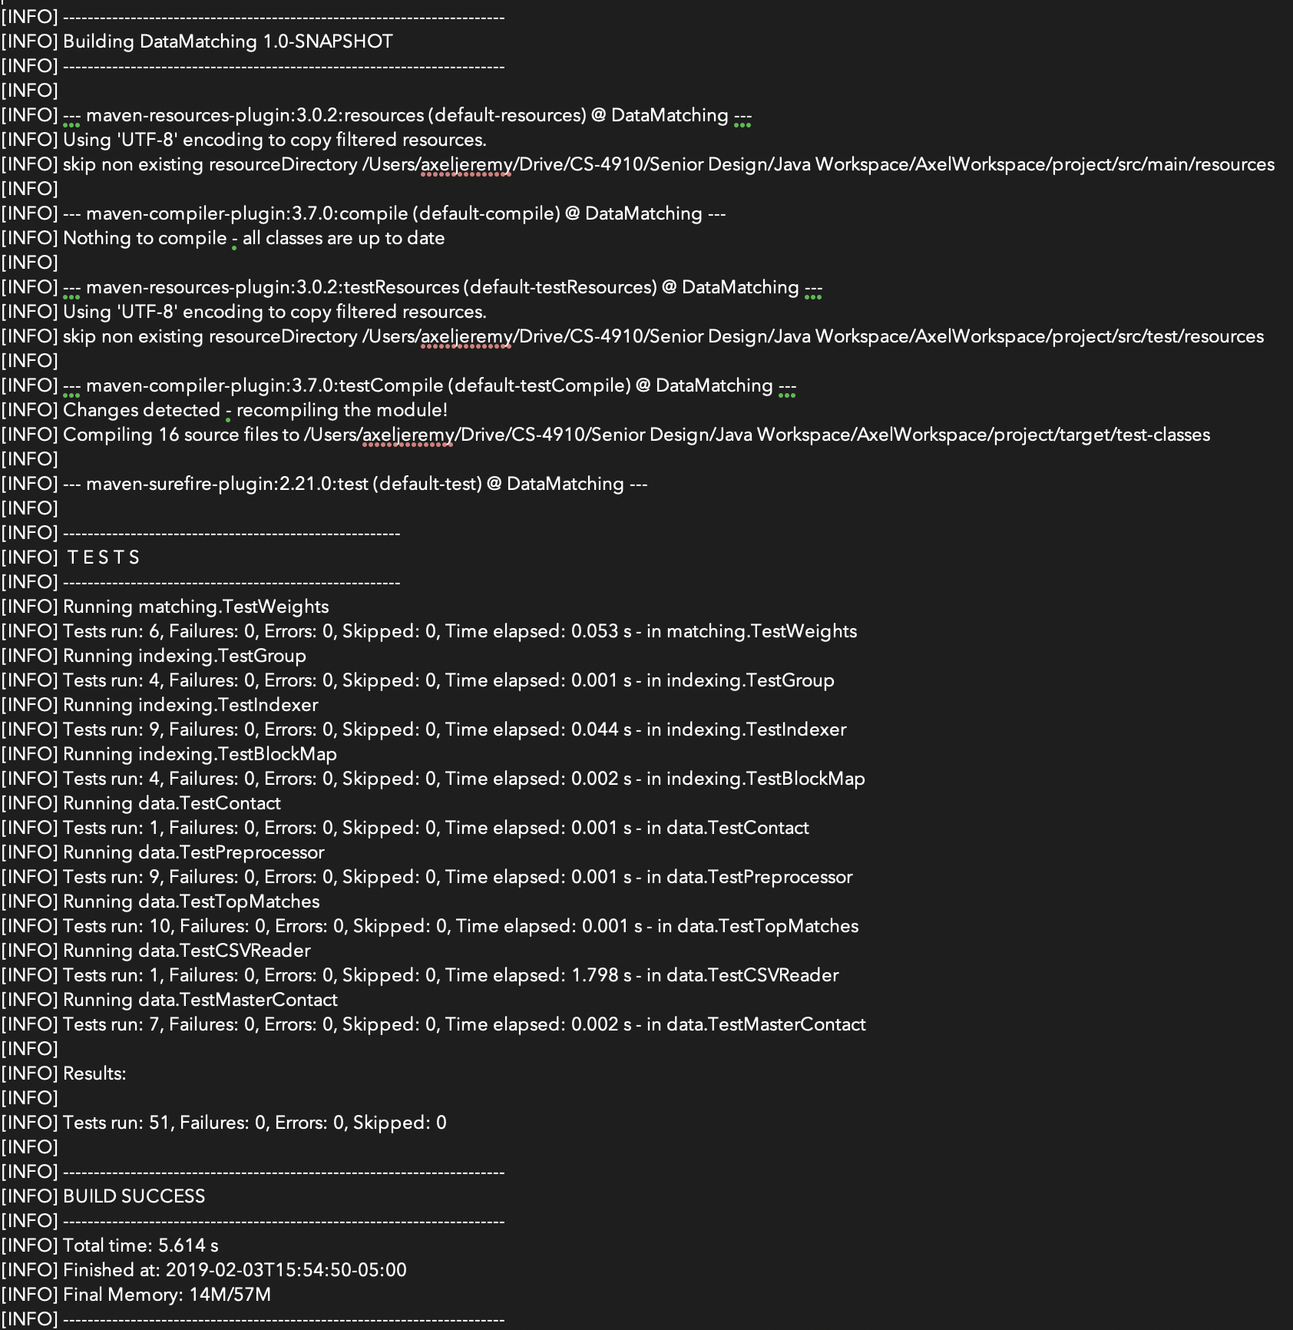
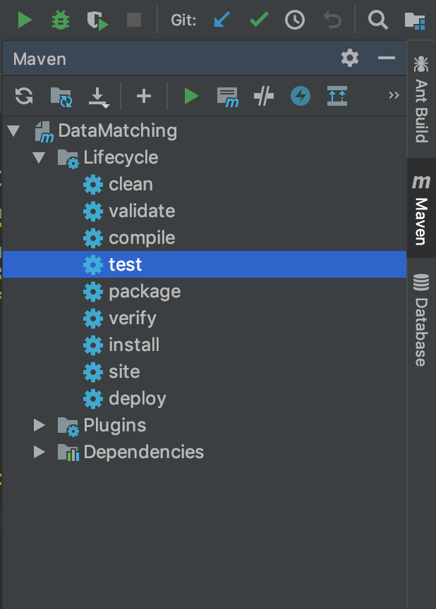
Testing

Slide 18
What is Maven?
Project management tool
Build automation tool primarily for Java projects
Small core expandable with plugins
Project Object Model (POM)
Dependency management

Slide 19
Achieved Goals
Visibility
Reusability
Maintainability
Comprehensibility

Slide 20
Maintainability
The engineering team of SalesPage will be in charge.

Slide 21
Client info
SalesPage
https://www.salespage.com
The engineering team will use out design and algorithm to implement a real time feature for the data matching problem in its proprietary software.

Slide 22
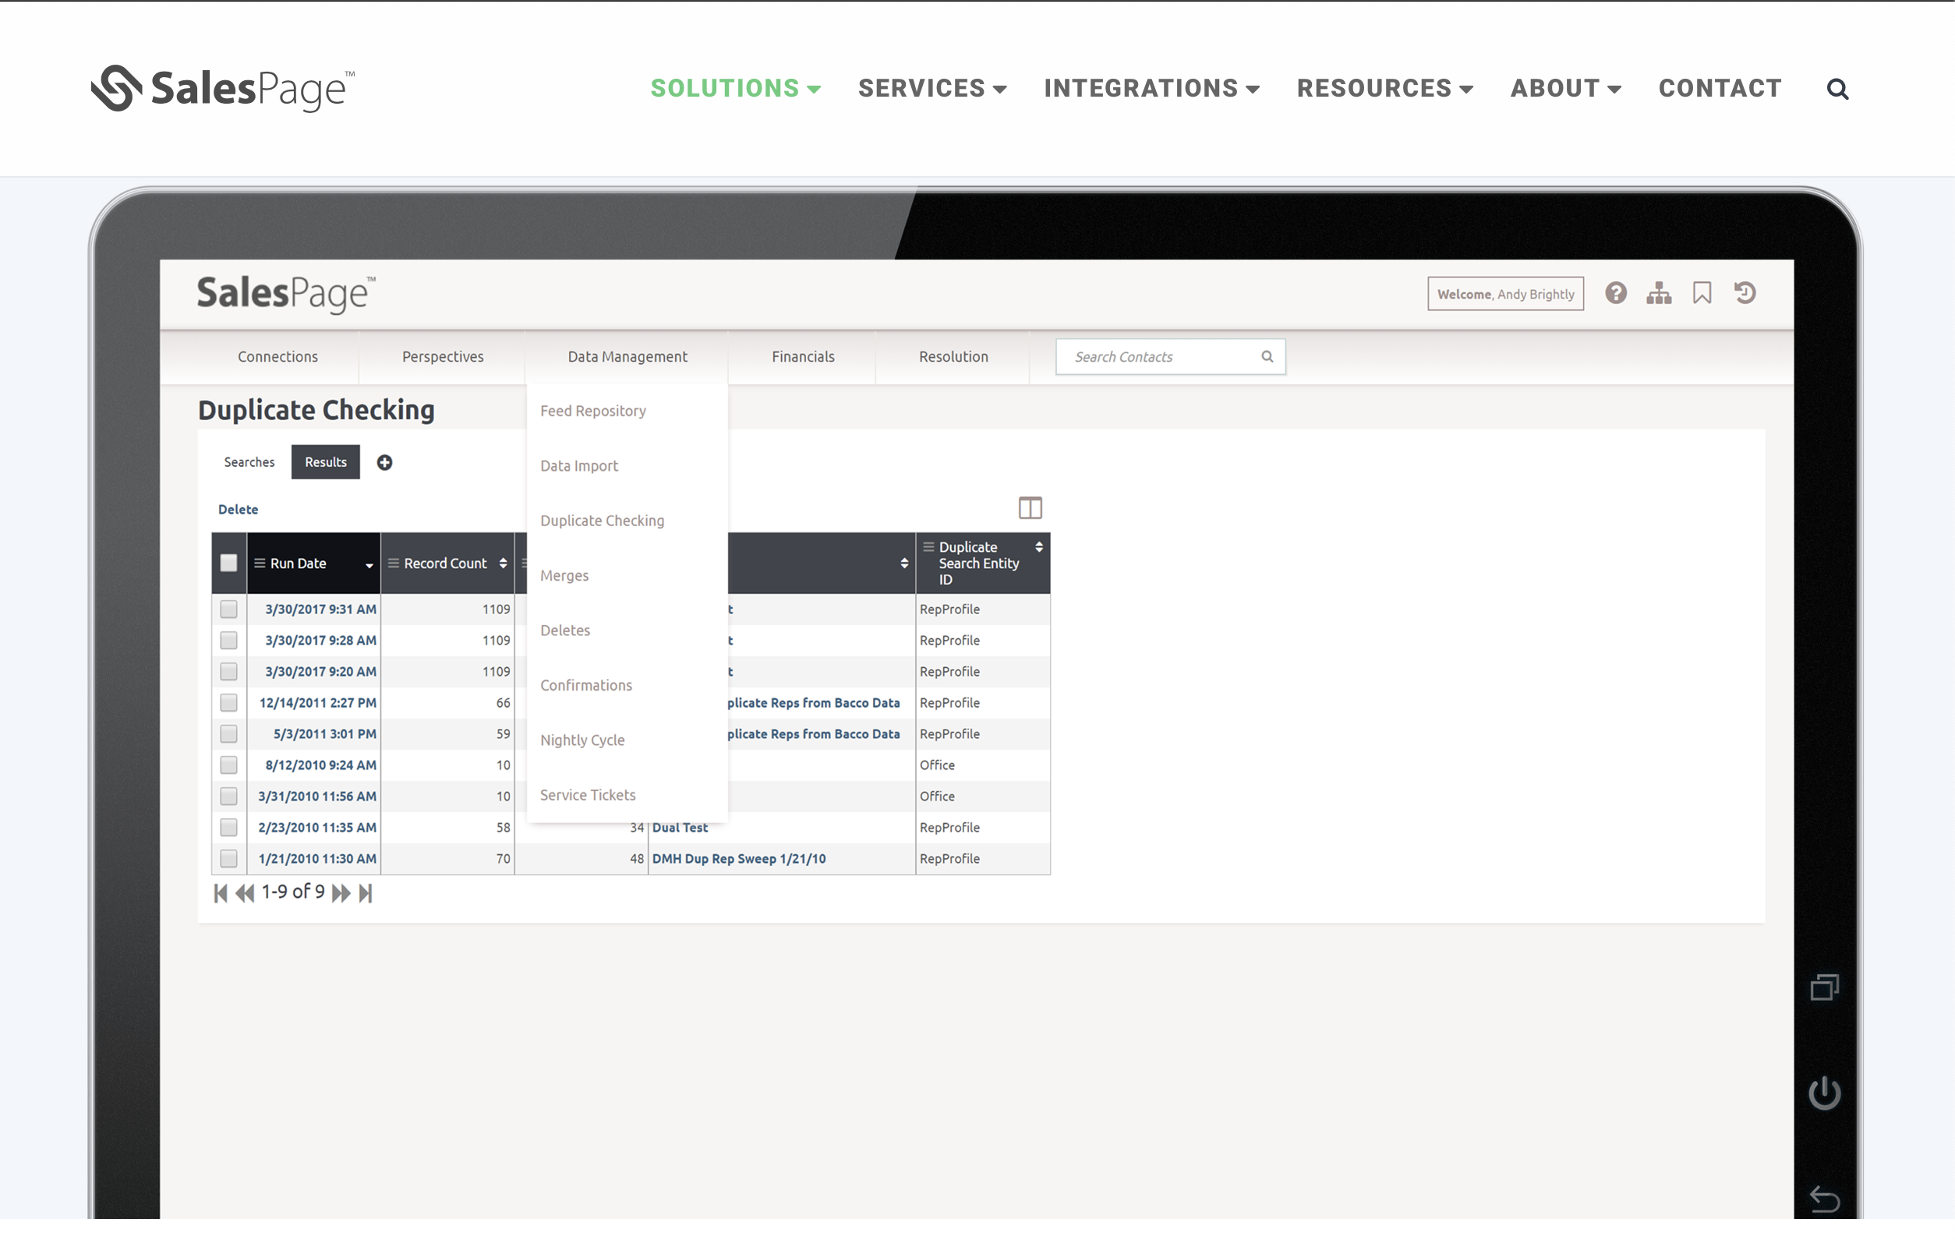

Slide 23
Conclusion
We believe we conclude a decent and complex version 1 of the project but we are looking to meet with the client to make some modifications if necessary.
We also will work in another version to compare other complex models to test performance and behavior.
We learn a about the different string similarity algorithms used in the industry.

