Slide 1
Bug Catcher 1
UPDATE tblStaff
SET Salary = 100000
WHERE Stf_ID is '001'
Answer: Should specify = operator.
UPDATE tblStaff
SET Salary = 100000
WHERE Stf_ID = '001'

Slide 2
Bug Catcher 2
SELECT *
FROM Employee E
INNER JOIN Location L
ON E.LocationID = L.LocationID
ORDER HINT State, FirstName
Answer: Use the ORDER BY clause.
SELECT *
FROM Employee E
INNER JOIN Location L
ON E.LocationID = L.LocationID
ORDER BY State, FirstName

Slide 3
SELECT *
FROM Employee E
INNER JOIN Location L
ON E.LocationID = L.LocationID
ORDER BY FirstName DEC
Bug Catcher 3
Answer: Descending keyword is incorrect.
SELECT *
FROM Employee E
INNER JOIN Location L
ON E.LocationID = L.LocationID
ORDER BY FirstName DESC

Slide 4
SELECT *
FROM SalesInvoice si
INNER JOIN SalesInvoiceDetail sd
ON si.InvoiceID = sd.InvoiceID
SalesInvoiceDetail sd INNER JOIN CurrentProducts cp
ON sd.ProductID = cp.ProductID
Bug Catcher 4
Answer: Between each JOIN a table can be listed only once.
SELECT *
FROM SalesInvoice si
INNER JOIN SalesInvoiceDetail sd
ON si.InvoiceID = sd.InvoiceID
INNER JOIN CurrentProducts cp
ON sd.ProductID = cp.ProductID

Slide 5
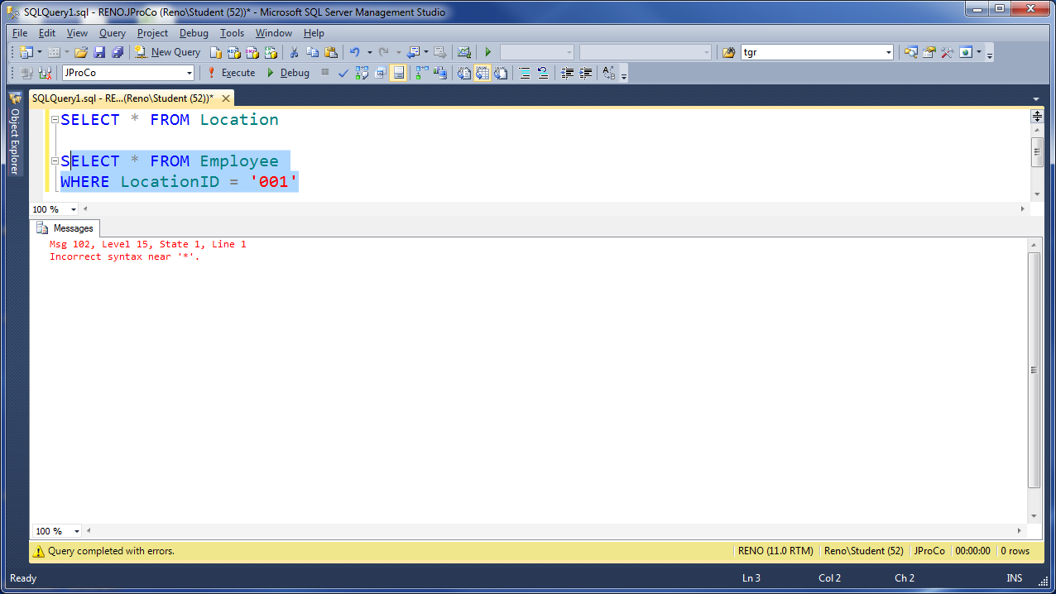
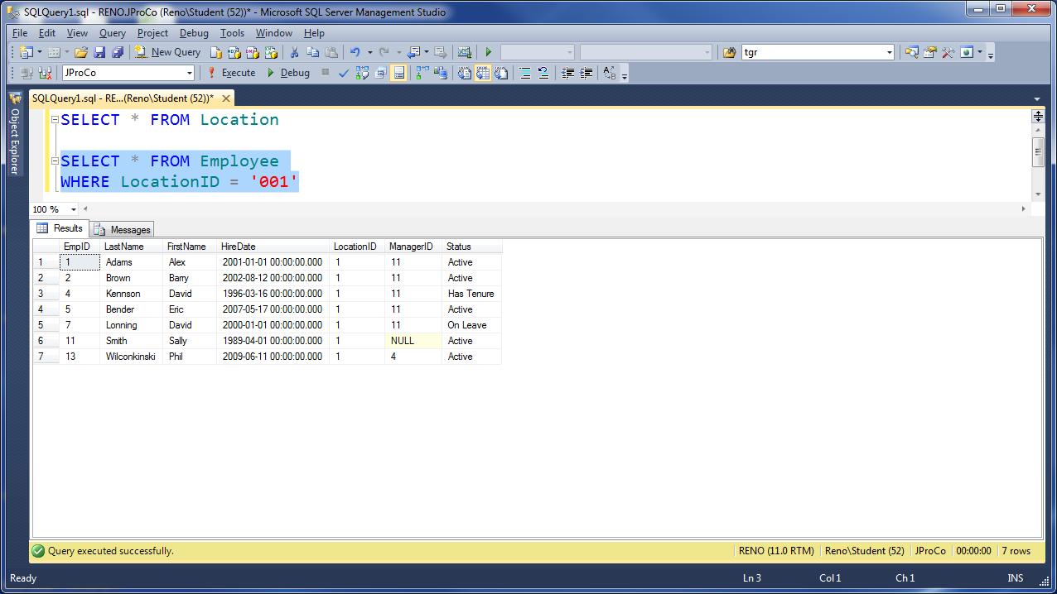
Bug Catcher 5
Answer: Fix Selection to cover the code.

Slide 6
Bug Catcher 6
SELECT cu.FirstName, cu.LastName, cu.InvoiceID
FROM Customer cu
INNER JOIN SalesInvoice si
ON cu.CustomerID = sd.CustomerID
WHERE InvoiceID >= 500
ORDER BY LastName
Answer: SalesInvoice table is incorrectly aliased.
SELECT cu.FirstName, cu.LastName, cu.InvoiceID
FROM Customer cu
INNER JOIN SalesInvoice si
ON cu.CustomerID = si.CustomerID
WHERE InvoiceID >= 500
ORDER BY LastName

Slide 7
Bug Catcher 7
SELECT TransactionID, Date, Item, Category Warehouse, CustomerID, Quantity, UnitPrice
FROM dbo.PurchaseActivity
WHERE TransactionID = 30543
Answer: Missing comma in the select list.
SELECT TransactionID, Date, Item, Category, Warehouse,CustomerID, Quantity, UnitPrice
FROM dbo.PurchaseActivity
WHERE TransactionID = 30543

Slide 8
Bug Catcher 8
(2 bugs)
SELECT e.EmpID, e.FirstName, e.LastName, l.city, l.state, p.HourlyRate, p.MonthlySalary, p.YearlySalary
FROM Employee e
INNER JOIN Location l ON e.LocationID = l.LocationID
INNER JOIN PayRates ON p.EmpID
Answer: 1.) PayRates table is not aliased
2.) Second ON clause is missing join criteria
SELECT e.EmpID, e.FirstName, e.LastName, l.city, l.state, p.HourlyRate, p.MonthlySalary, p.YearlySalary
FROM Employee e
INNER JOIN Location l ON e.LocationID = l.LocationID
INNER JOIN PayRates p ON p.EmpID = e.EmpID

