Slide 1
Bug Catcher 1
SELECT *,
NTILE() OVER (20) as StateGroup
FROM StateList
Answer: NTILE needs a number.
SELECT *,
NTILE(20) OVER (ORDER BY LandMass DESC) as StateGroup
FROM StateList

Slide 2
Bug Catcher 2
SELECT ROW_NUMBER() OVER(ORDER BY HireDate ) AS SeniorRow, *
FROM Employee
WHERE SeniorRow % 2 = 0
Answer: Need a derived table to predicate on the expression field.
SELECT * FROM
(SELECT ROW_NUMBER() OVER(ORDER BY HireDate ) AS SeniorRow, *
FROM Employee) DrvTbl
WHERE SeniorRow % 2 = 0

Slide 3
Bug Catcher 3
SELECT *
FROM Customer
WHERE CustomerID % 2 % 0
Answer: After mod you need a comparison operator.
SELECT *
FROM Customer
WHERE CustomerID % 2 = 0

Slide 4
Bug Catcher 4
SELECT ROW_NUMBER(ORDER BY RetailPrice DESC) AS RowID, *
FROM CurrentProducts
Answer: Ranking function needs the OVER clause.
SELECT ROW_NUMBER() OVER(ORDER BY RetailPrice DESC) AS RowID, *
FROM CurrentProducts

Slide 5
SELECT *
FROM
(SELECT ROW_NUMBER() OVER(ORDER BY RetailPrice DESC) AS RowID, *
FROM CurrentProducts) AS DrvTbl
WHERE RowID % 5 = 6
Bug Catcher 5
Answer: Mod can never be greater than divisor.
SELECT *
FROM
(SELECT ROW_NUMBER() OVER(ORDER BY RetailPrice DESC) AS RowID, *
FROM CurrentProducts) AS DrvTbl
WHERE RowID % 5 = 1

Slide 6
Bug Catcher 6
SELECT BuyerID,
OrderType, OrderDate,
MAX(OrderDate) OVER(PARTITION BY) AS MostRecentBuyerDate
FROM Buyers
Answer: Need to choose a field to Partition.
SELECT BuyerID,
OrderType, OrderDate,
MAX(OrderDate) OVER(PARTITION BY BuyerID) AS MostRecentBuyerDate
FROM Buyers

Slide 7
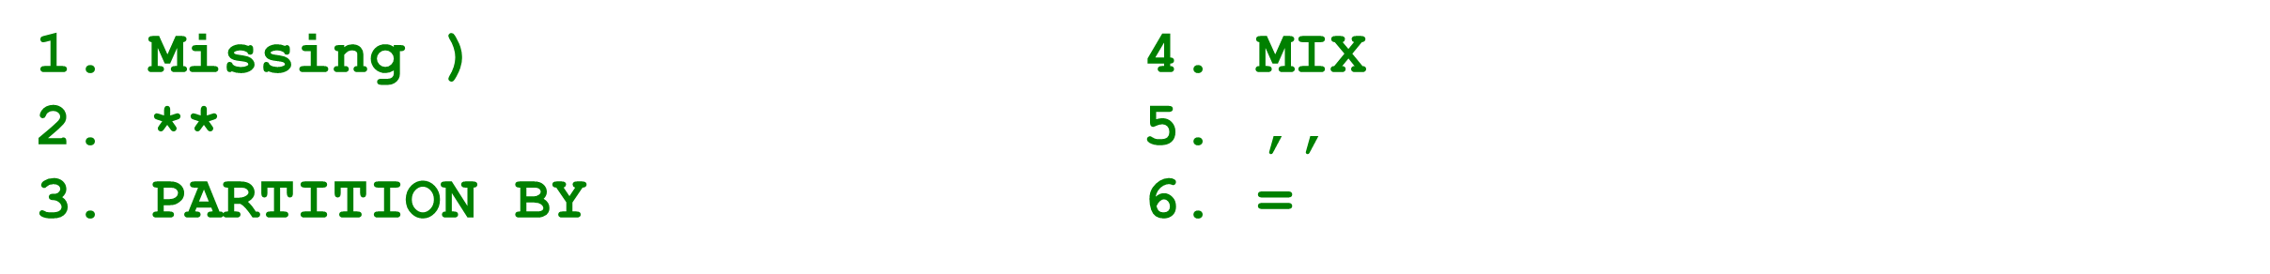
Bug Catcher 7
(6 bugs)
SELECT ** FROM
(SELECT BuyerID, OrderType, OrderDate,, MIX(OrderDate) OVER(PARTITION ORDER BuyerID) AS MostRecentBuyerDate
FROM Buyers DrvTbl
WHERE OrderDate + MostRecentBuyerDate

