Slide 1
Bug Catcher 1
CREATE TABLE tblCars
(
c_id int primary key,
c_make varchar(25) not null,
c_model varchar(25) not null,
c_year int(25) null
)
Answer: Int’s do not need a size specifier.
CREATE TABLE tblCars
(
c_id int primary key,
c_make varchar(25) not null,
c_model varchar(25) not null,
c_year int null
)

Slide 2
USE dbPublish
GO
CREATE TYPE dbo.EmailAddress
FROM nvarchar
NULL
Bug Catcher 2
Answer: Need to specify a size for your field.
USE dbPublish
GO
CREATE TYPE dbo.EmailAddress
FROM nvarchar(50)
NULL

Slide 3
Bug Catcher 3
ALTER tblTitles
ADD t_Country [CountryCode]
GO
Answer: Need the TABLE keyword
ALTER TABLE tblTitles
ADD t_Country [CountryCode]
GO

Slide 4
Bug Catcher 4
ALTER TABLE tblTitles
ADD t_Country (CountryCode)
GO
Answer: Use Square Brackets around your data-type.
ALTER TABLE tblTitles
ADD t_Country [CountryCode]
GO

Slide 5
Bug Catcher 5
ALTER TABLE
ADD stf_Email [emailAddress] NULL
Answer: Need to include the table name.
ALTER TABLE tblStaff
ADD stf_Email [emailAddress] NULL

Slide 6
USE dbPublish
GO
CREATE TYPE dbo.EmailAddress
FROM nvarchar(50)
NOT NALL
Bug Catcher 6
Answer: Null keyword is misspelled
USE dbPublish
GO
CREATE TYPE dbo.EmailAddress
FROM nvarchar(50)
NOT NULL

Slide 7
CREATE table tblTitles
(
t_id char(4) primary key,
t_title varchar(25) not null,
t_price money(8) not null,
t_cat_id char(2)
)
GO
Bug Catcher 7
Answer: You only need to specify sizes with character fields, all other determine their own size.
CREATE table tblTitles
(
t_id char(4) primary key,
t_title varchar(25) not null,
t_price money not null,
t_cat_id char(2)
)
GO

Slide 8
Bug Catcher 8
USE dbPublish
GO
ALTER TYPE dbo.EmailAddress
FROM nvarchar(50) TO nvarchar(75)
NOT NULL
Answer: You can not alter a Type, you must drop and recreate.
USE dbPublish
DROP TYPE dbo.EmailAddress
GO
CREATE TYPE dbo.EmailAddress
FROM nvarchar(75)
NOT NULL
GO

Slide 9
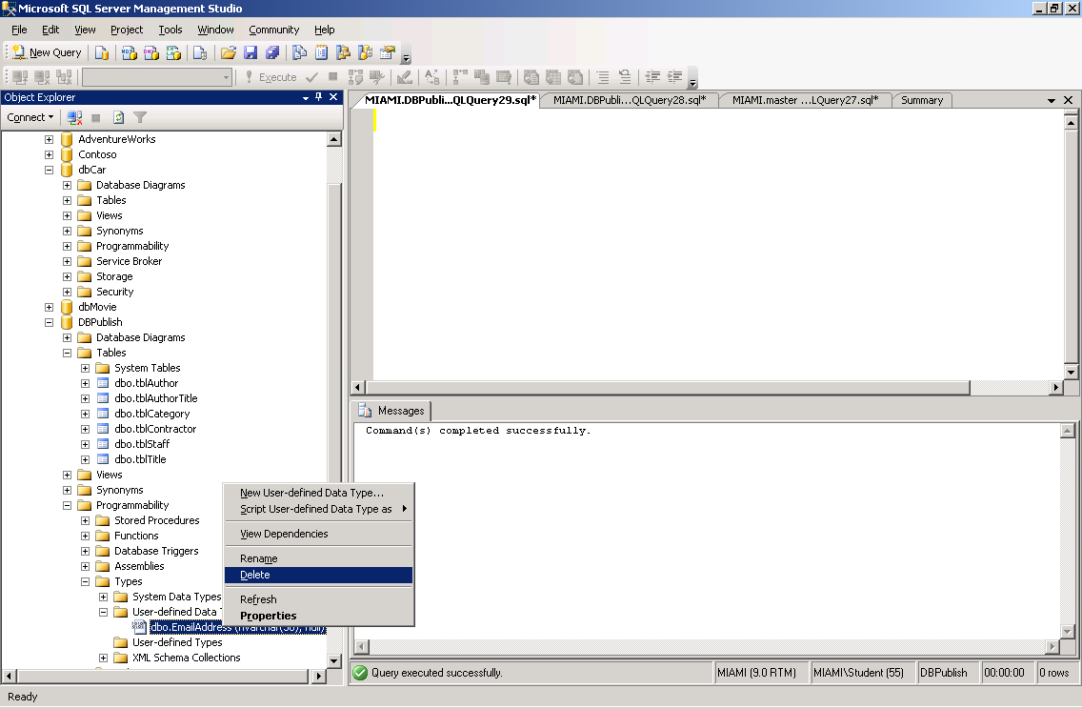
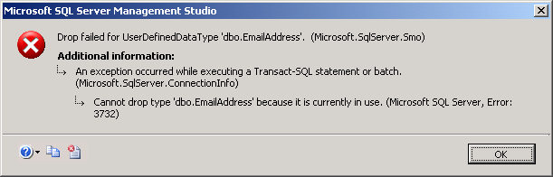
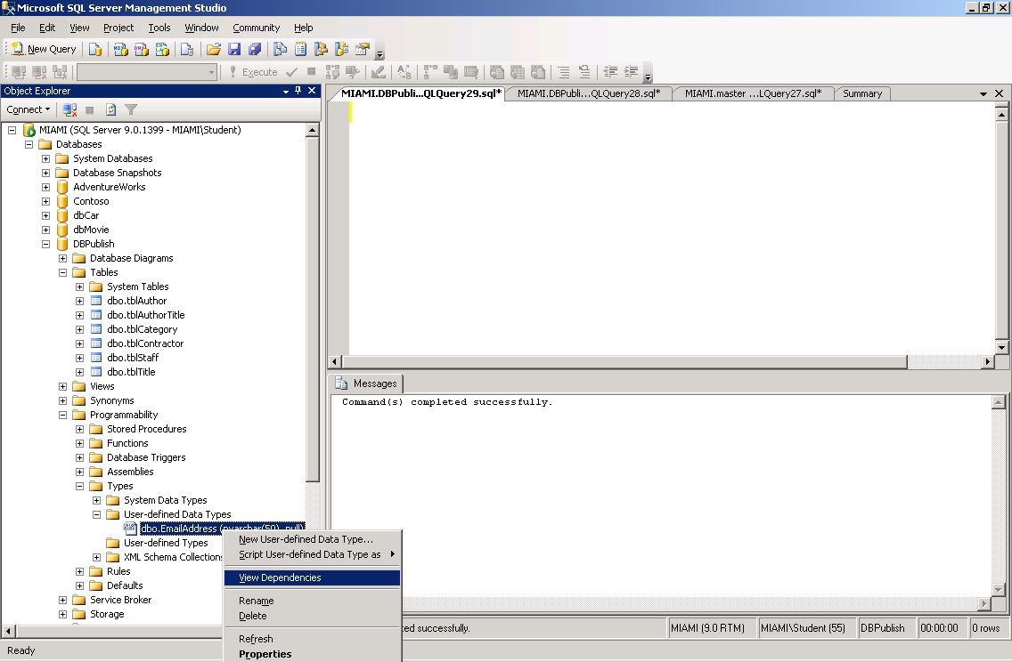
Bug Catcher 9
Answer: You can only delete a type after all dependencies are gone.

Slide 10
Bug Catcher 10
(5 bugs)
USE dbPublish
ADD TYPE dbo.EmailAddress
FROM nvarchar(50)
NOT NULL
CREATE TABLE tblEmp
(Empid char(4) primary key,
EmpName varchar(25) not nulls,
EmpPay money not null,
EmpMail EmailAddress(50) null)
GO
Need GO after USE dbPublish.
If use of datatype is NULL then type should be Nullable.
CREATE TYPE (not ADD).
Email type size is already specified.
Use NOT NULL (NULLS is not correct).

