Slide 1
Multifunctional Fireguard Bot
Supervised By
Khadiza Sultana Sayma
Lecturer
University of Asia Pacific
Presented By
Md. Osman Goni-23101012
Aeysha Tabassum-23101014
Arannamoy Mondal-23101024
Fabia Akter Borsha-23101025
1

Slide 2
INTRODUCTION/PROBLEM STATEMENT
Fire accidents lead to huge loss of life and property due to delayed detection and human dependency.
Most existing robots are limited to single functions. Multifunctional Fireguard Bot is designed as an affordable, smart solution that combines Line Following, Fire Detection, Wireless Control, and AI Obstacle Avoidance into one platform for enhanced safety.
2

Slide 3
OBJECTIVES
Design and implement an ESP32-based multifunctional robot capable of:
  Line following for accurate movement along predefined paths
  Obstacle avoidance for smooth navigation without collisions
  Fire detection and control (buzzer alarm)
  Wi-Fi control for wireless smartphone-based operation
3

Slide 4
PROPOSED SOLUTION / SYSTEM OVERVIEW
To design and implement the ESP-32 based multifunctional robot (Obstacle Avoidance, Line following, Fire Detect , WIFI- Control), the following steps will be followed:
Problem Identification – Need for a robot to detect obstacles,and fire.
2. Hardware Setup – ESP32 with sensors, motors, driver, buzzer, and power system.
3. Software Design – Programming ESP32 for obstacle avoidance,alarm.
4. Integration & Testing – Connect all modules and test step by step.
5. Performance Evaluation – Check accuracy, speed, and response of the robot.
6. Documentation & Presentation – Prepare report, diagrams, and demo.
4

Slide 5
REQUIRED COMPONENTS
  ESP32 Camera Module – Primary microcontroller that hosts the Wi-Fi web server, streams real-time video for YOLOv11 AI obstacle avoidance, and handles high-level motor control.
  Arduino UNO R3 -Secondary microcontroller responsible for processing real-time, low-level data from the IR and flame sensors, and triggering the emergency alarm system.
  L298N Motor Driver Shield – Drives the DC motors to control wheel movement and direction.
  Robotic Chassis 4 Wheel – Provides the physical frame and mobility platform for all components.
  Flame Sensor Module for Fire Detection – Senses infrared light from flames to detect fire presence.
  Li-ion Battery – Rechargeable power source for portable robot operation.
  18650 Battery Holder – Securely holds Li-ion batteries and provides electrical connections.
  Jumper Wires, Switch – Connects components on the circuit and turns the robot on/off.
  IR sensor - used for line following by detecting black or white surfaces.
  Buzzer – Emits audible alarm sound when gas leakage or fire is detected.
5

Slide 6
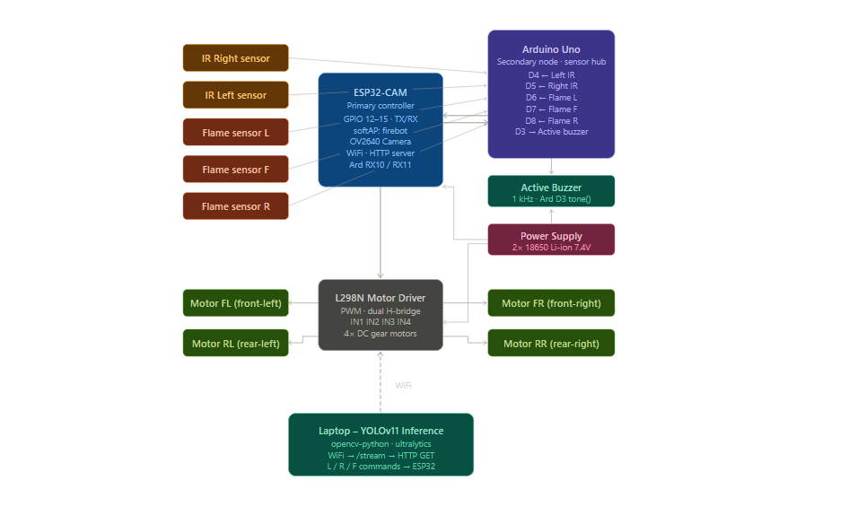
BLOCK DIAGRAM
6

Slide 7
WORKING METHOD
  Power ON – System initializes all sensors and modules.
  Mode Selection – Autonomous mode (line following + obstacle avoidance + Fire detection) or Manual mode (Wi-Fi control).
  Continuous Sensing –flame, and obstacle sensors(ESP32 CAM) constantly monitor the environment.
  Decision Making –
    If obstacle detected → change path
    If fire detected → activate buzzer
  Navigation – Line following IR sensors guide movement
  User Control – smartphone app override autonomous mode.
7

Slide 8
EXPECTED OUTPUT / APPLICATIONS
Expected Output:
  Early detection of fire with audible alerts
  Autonomous navigation with obstacle avoidance and line following
  Remote controlled operation
Applications:
  Assisting firefighters by providing initial fire control
  Smart city and IoT-based safety systems
  Surveillance and assistive robotics
8

Slide 9
CONCLUSION
  The ESP-32 based Multifunctional fireguard Bot integrates multiple features in one system: obstacle avoidance, line following, fire detection, and WiFi control.
  WIFI control enable flexible and convenient human-robot interaction.
  Environmental sensing (fire) enhances monitoring and safety.
  The system has practical applications in home automation, industrial monitoring, surveillance, and assistive robotics.
  Demonstrates the potential and adaptability of ESP-32 powered robotics for real-world tasks.
9

Slide 10
THANK YOU
10

