Slide 1

INTEGRANTES
GONZALEZ BECERRA SERGIO - 15211300
GUTIERREZ CRUZ JORMAN ELIUD - 15211303
MIRANDA ESPINOZA OSCAR ROBERTO - 15211904
PINO ALVAREZ OSCAR BRANDON - 17210622
TRONCO MOLINA EDGAR - 17212191

Slide 2
STREETS
IN TURMOIL

Slide 3


Slide 4
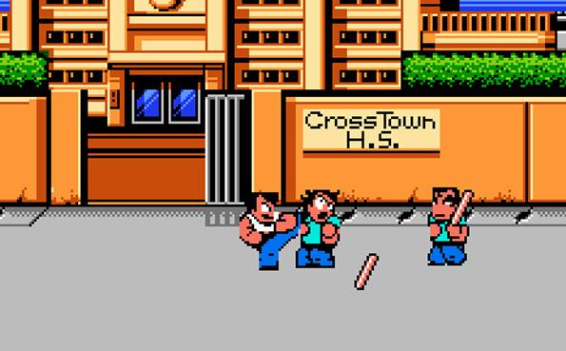
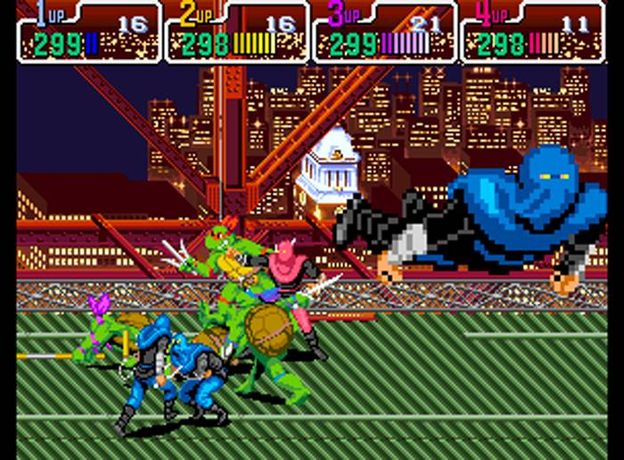

Slide 5
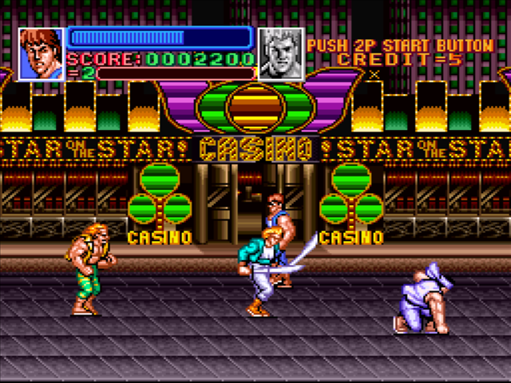
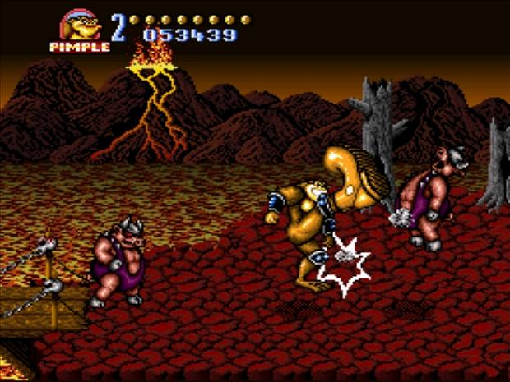

Slide 6
